Slide 1


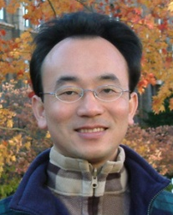
COVID-19後疫情時代 遠距行銷 (Social Distancing Marketing Beyond COVID-19 Pandemic)
Min-Yuh Day
戴敏育
Associate Professor
副教授
Institute of Information Management, National Taipei University
國立臺北大學 資訊管理研究所
https://web.ntpu.edu.tw/~myday
2020-08-14

Slide 2



戴敏育 博士 (Min-Yuh Day, Ph.D.)
國立台北大學 資訊管理研究所 副教授
中央研究院 資訊科學研究所 訪問學人
國立台灣大學 資訊管理 博士
Publications Co-Chairs, IEEE/ACM International Conference on Advances in Social Networks Analysis and Mining (ASONAM 2013- )
Program Co-Chair, IEEE International Workshop on Empirical Methods for Recognizing Inference in TExt (IEEE EM-RITE 2012- )
Publications Chair, The IEEE International Conference on Information Reuse and Integration (IEEE IRI)

Slide 3
Outline
Case Study on Marketing Beyond COVID-19 Pandemic
Marketing Management
IT Enabled Digital Transformation
Business Model and Marketing Strategy

Slide 4
Case Study on Marketing Beyond COVID-19 Pandemic
Background Introduction
SWOT
Strengths, Weaknesses, Opportunities, Threats
PESTLE, Five Forces, Value Chain Analysis
TOWS
STP
Segmentation, Targeting, Positioning
4P
Product, Price, Place, Promotion
Business Model

Slide 5
Marketing Management
1
Understanding Marketing Management
2
Capturing Marketing Insights
3
Connecting with Customers
4
Building Strong Brands
5
Creating Value
6
Delivering Value
7
Communicating Value
8
Conducting Marketing Responsibly for Long-term Success

Slide 6
Part 1. Understanding Marketing Management 1. Defining Marketing for the New Realities 2. Developing Marketing Strategies and Plans
1
Understanding Marketing Management

Slide 7
Part 2. Capturing Marketing Insights 3. Collecting Information and Forecasting Demand 4. Conducting Marketing Research
2
Capturing Marketing Insights

Slide 8
Part 3. Connecting with Customers 5. Creating Long-term Loyalty Relationships 6. Analyzing Consumer Markets 7. Analyzing Business Markets 8. Tapping into Global Markets
3
Connecting with Customers

Slide 9
Part 4. Building Strong Brands 9. Identifying Market Segments and Targets 10. Crafting the Brand Positioning 11. Creating Brand Equity 12. Addressing Competition and Driving Growth
4
Building Strong Brands

Slide 10
Part 5. Shaping the Market Offerings 13. Setting Product Strategy 14. Designing and Managing Services 15. Introducing New Market Offerings 16. Developing Pricing Strategies and Programs
5
Creating Value

Slide 11
Part 6. Delivering Value 17. Designing and Managing Integrated Marketing Channels 18. Managing Retailing, Wholesaling, and Logistics
6
Delivering Value

Slide 12
Part 7. Communicating Value 19. Designing and Managing Integrated Marketing Communications 20. Managing Mass Communications: Advertising, Sales Promotions, Events and Experiences, and Public Relations 21. Managing Digital Communications: Online, Social Media, and Mobile 22. Managing Personal Communications: Direct and Database Marketing and Personal Selling
7
Communicating Value

Slide 13
Part 8. Conducting Marketing Responsibly for Long-term Success 23. Managing a Holistic Marketing Organization for the Long Run
8
Conducting Marketing Responsibly for Long-term Success

Slide 14
IT Enabled Digital Transformation

Slide 15
Marketing Management and Information Systems

Slide 16
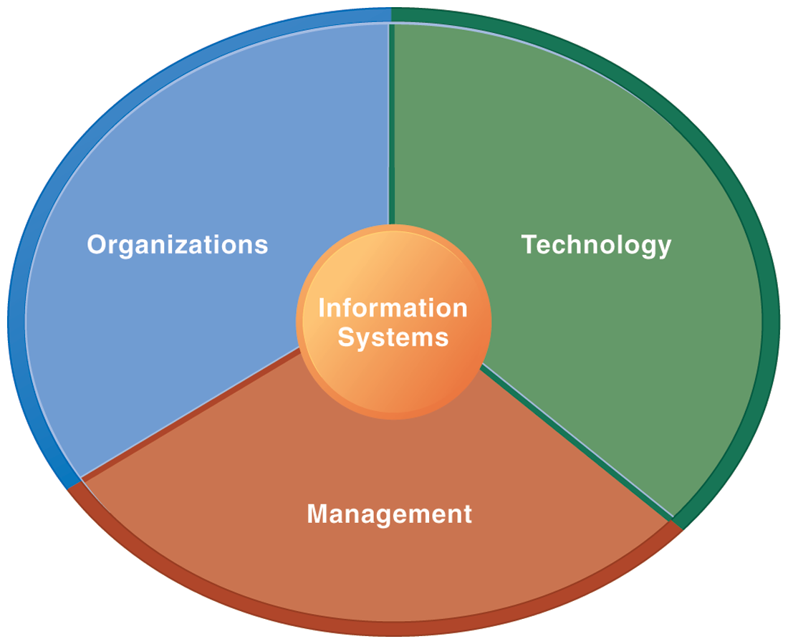
Information Management (MIS) Information Systems

Slide 17
Fundamental MIS Concepts
Business Challenges
Management
Organization
Information System
Business Solutions
Technology

Slide 18
Marketing

Slide 19
Marketing
“Meeting needs profitably”

Slide 20
Marketing
“Marketing is an organizational function and a set of processes for creating, communicating, and delivering value to customers and for managing customer relationships in ways that benefit the organization and its stakeholders.”

Slide 21
Marketing Management

Slide 22
Marketing Management
“Marketing management is the art and science of choosing target markets and getting, keeping, and growing customers through creating, delivering, and communicating superior customer value.”

Slide 23
Marketing Management Tasks
Developing market strategies and plans
Capturing marketing insights
Connecting with customers
Building strong brands
Creating value
Delivering value
Communicating value
Creating successful long-term growth

Slide 24
The Essence of Strategic Marketing (STP)
Segmentation
Targeting
Positioning

Slide 25
Customer Value

Slide 26
Value
the sum of the tangible and intangible benefits and costs

Slide 27
Value
Total customer benefit
Customer perceived value
Total customer cost

Slide 28
Customer Perceived Value
Product benefit
Total customer benefit
Customer perceived value
Services benefit
Personnel benefit
Image benefit
Monetary cost
Total customer cost
Time cost
Energy cost
Psychological cost

Slide 29
Customer Value Triad
Quality, Service, and Price (qsp)
Quality
Service
Price

Slide 30
Value and Satisfaction
Marketing
identification, creation, communication, delivery, and monitoring of customer value.
Satisfaction
a person’s judgment of a product’s perceived performance in relationship to expectations

Slide 31
Building Customer Value, Satisfaction, and Loyalty

Slide 32
Satisfaction
“a person’s feelings of pleasure or disappointment that result from comparing a product’s perceived performance (or outcome) to expectations”

Slide 33
Loyalty
“a deeply held commitment to rebuy or repatronize a preferred product or service in the future despite situational influences and marketing efforts having the potential to cause switching behavior.”

Slide 34
Customer Perceived Value, Customer Satisfaction, and Loyalty
Customer Perceived Performance
Customer
Perceived Value
Customer
Satisfaction
Customer
Loyalty
Customer
Expectations

Slide 35
CEO CIO CFO
CEO
Strategy and Sales
(Leading)
CIO
Enterprise Technology Integration
CFO-COO
Finance and Operations
(Lagging)
Source: http://www.r3now.com/what-is-the-proper-relationship-for-the-cio-ceo-and-cfo/

Slide 36
CEO CIO CMO
CEO
Strategy and Sales
(Leading)
CIO
Enterprise Technology Integration
CMO
Marketing
Communication
Adapted from: http://www.r3now.com/what-is-the-proper-relationship-for-the-cio-ceo-and-cfo/

Slide 37
Business Model and Strategy

Slide 38
Business Model

Slide 39
Business Model
8
7
2
4
1
Key Partners
Key Activities
Value Proposition
Customer Relationships
Customer Segments
6
3
Key Resources
Channels
9
5
Cost Structure
Revenue Streams
Source: Alexander Osterwalder & Yves Pigneur, Business Model Generation: A Handbook for Visionaries, Game Changers, and Challengers, Wiley, 2010.

Slide 40
Definition of Business Model
A business model describes the rationale of how an organization creates, delivers, and captures value.
Source: Alexander Osterwalder & Yves Pigneur, Business Model Generation: A Handbook for Visionaries, Game Changers, and Challengers, Wiley, 2010.

Slide 41
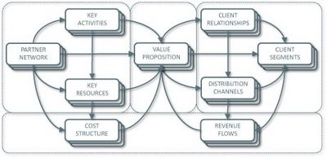
Business Model Canvas
Key Activities
Customer Relationships
Key Partners
Value Preposition
Customer Segments
Key Resources
Channels
Cost Structure
Revenue Streams
Source: http://nonlinearthinking.typepad.com/nonlinear_thinking/2008/07/the-business-model-canvas.html
https://www.youtube.com/watch?v=QoAOzMTLP5s

Slide 42
Business Model Canvas
Infrastructure Management
Product
Customer Interface
Key Activities
Customer Relationships
Key Partners
Value Preposition
Customer Segments
Key Resources
Channels
Financial Aspects
Cost Structure
Revenue Streams
Source: http://nonlinearthinking.typepad.com/nonlinear_thinking/2008/07/the-business-model-canvas.html
https://www.youtube.com/watch?v=QoAOzMTLP5s

Slide 43
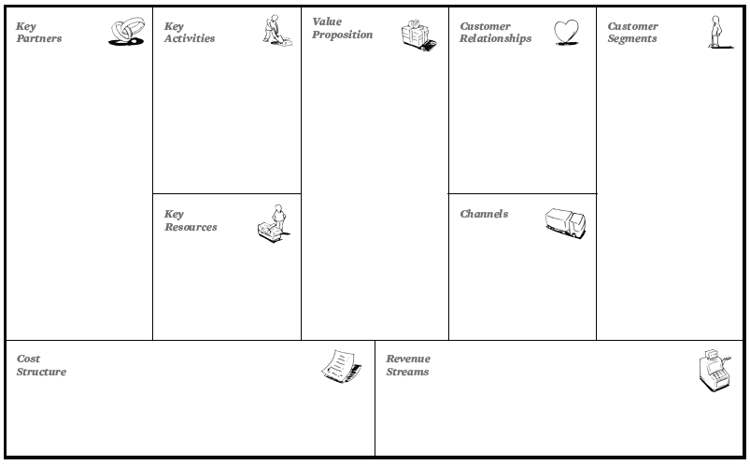
The 9 Building Blocks of Business Model
8
7
2
4
1
6
3
9
5
Source: Alexander Osterwalder & Yves Pigneur, Business Model Generation: A Handbook for Visionaries, Game Changers, and Challengers, Wiley, 2010.

Slide 44
The 9 Building Blocks of Business Model
8
7
2
4
1
How?
What?
Who?
6
3
Why?
9
5
Source: Alexander Osterwalder & Yves Pigneur, Business Model Generation: A Handbook for Visionaries, Game Changers, and Challengers, Wiley, 2010.

Slide 45
Marketing Strategy

Slide 46
Marketing Plan

Slide 47
Strategy vs. Tactics

Slide 48
Strategy vs. Tactics
Policy
Strategic
Procedure
Tactical
Execution
Operational
Source: http://joyante.wordpress.com/2011/02/21/business-strategy-versus-tactics/

Slide 49
Strategy vs. Tactics
Strategy
Tactics
Planning
Doing
Large Scale
Smaller Scale
Why
How
Difficult to Copy
Easy to Copy
Long Time Frame
Short Time Frame

Slide 50
Strategy
Plans
Tactics

Slide 51
Strategy > Plans > Tactics
Strategy involves a blueprint for gaining a competitive advantage.
Plans are the second-level goals in the hierarchy.
A complex strategy may contain many plans.
Tactics are the step-by-step methods you use to accomplish a plan.

Slide 52
Marketing Planning Process
Analyzing marketing opportunities
Selecting target markets
Designing marketing strategies
Developing marketing programs
Managing the marketing effort

Slide 53
The Strategic Planning, Implementation, and Control Processes
Planning
Implementing
Controlling
Corporate Planning
Organizing
Measuring Results
Division Planning
Diagnosing Results
Implementing
Business Planning
Taking corrective action
Product Planning

Slide 54
Marketing Plan
The strategic marketing plan lays out the target markets and the firm’s value proposition, based on an analysis of the best market opportunities.

Slide 55
Marketing Plan
The tactical marketing plan specifies the marketing tactics, including product features, promotion, merchandising, pricing, sales channels, and service.

Slide 56
Business Unit Strategic-Planning Process
External environment (Opportunity & Threat analysis)
Business Mission
Goal formulation
Strategy formulation
Program formulation
Implementation
Feedback and Control
SWOT analysis
Internal environment (Strengths & weakness analysis)

Slide 57
Business Unit Strategic-Planning Process
External environment (Opportunity & Threat analysis)
Business Mission
Goal formulation
Strategy formulation
Program formulation
Implementation
Feedback and Control
SWOT analysis
Internal environment (Strengths & weakness analysis)
1
Business Mission

Slide 58
Business Unit Strategic-Planning Process
External environment (Opportunity & Threat analysis)
Business Mission
Goal formulation
Strategy formulation
Program formulation
Implementation
Feedback and Control
SWOT analysis
Internal environment (Strengths & weakness analysis)
2
External environment (Opportunity & Threat analysis)
SWOT analysis
Internal environment (Strengths & weakness analysis)

Slide 59
Business Unit Strategic-Planning Process
External environment (Opportunity & Threat analysis)
Business Mission
Goal formulation
Strategy formulation
Program formulation
Implementation
Feedback and Control
SWOT analysis
Internal environment (Strengths & weakness analysis)
3
Goal formulation

Slide 60
Business Unit Strategic-Planning Process
External environment (Opportunity & Threat analysis)
Business Mission
Goal formulation
Strategy formulation
Program formulation
Implementation
Feedback and Control
SWOT analysis
Internal environment (Strengths & weakness analysis)
4
Strategy formulation

Slide 61
Business Unit Strategic-Planning Process
External environment (Opportunity & Threat analysis)
Business Mission
Goal formulation
Strategy formulation
Program formulation
Implementation
Feedback and Control
SWOT analysis
Internal environment (Strengths & weakness analysis)
5
Program formulation

Slide 62
Business Unit Strategic-Planning Process
External environment (Opportunity & Threat analysis)
Business Mission
Goal formulation
Strategy formulation
Program formulation
Implementation
Feedback and Control
SWOT analysis
Internal environment (Strengths & weakness analysis)
6
Implementation

Slide 63
Business Unit Strategic-Planning Process
External environment (Opportunity & Threat analysis)
Business Mission
Goal formulation
Strategy formulation
Program formulation
Implementation
Feedback and Control
SWOT analysis
Internal environment (Strengths & weakness analysis)
7
Feedback and Control

Slide 64
Marketing Plan Contents
Executive summary (1.0)
Table of contents
Situation analysis (2.0) (Ch1)
Marketing strategy (3.0) (Ch2)
Marketing tactics (4.0) (Ch3)
Financial projections (5.0) (Ch4)
Implementation controls (6.0) (Ch5)

Slide 65
Sample Marketing Plan
1.0
Executive Summary
1.0 Executive Summary
2.0 Situation Analysis
3.0 Marketing Strategy
4.0 Marketing Tactics
5.0 Financials
6.0 Controls
2.0
Situation Analysis
3.0
Marketing Strategy
4.0
Marketing Tactics
5.0
Financials
6.0
Controls

Slide 66
2.0 Situation Analysis
Sample Marketing Plan
1.0
Executive Summary
2.1 Market Summary
2.2 SWOT Analysis
2.3 Competition
2.4 Product Offering
2.5 Keys to Success
2.6 Critical Issues
2.0
Situation Analysis
3.0
Marketing Strategy
4.0
Marketing Tactics
5.0
Financials
6.0
Controls

Slide 67
2.1 Market Summary
Sample Marketing Plan
1.0
Executive Summary
2.1.1 Market Demographics
Geographics
Demographics
Behavior Factors
2.1.2 Market Needs
2.1.3 Market Trends
2.1.4 Market Growth
2.0
Situation Analysis
3.0
Marketing Strategy
4.0
Marketing Tactics
5.0
Financials
6.0
Controls

Slide 68
3.0 Marketing Strategy
Sample Marketing Plan
1.0
Executive Summary
3.1 Mission
3.2 Marketing Objectives
3.3 Financial Objectives
3.4 Target Markets
3.5 Positioning
2.0
Situation Analysis
3.0
Marketing Strategy
4.0
Marketing Tactics
5.0
Financials
6.0
Controls

Slide 69
4.0 Marketing Tactics
Sample Marketing Plan
1.0
Executive Summary
4.1 Product
4.2 Pricing
4.3 Distribution (Place)
4.4 Communications (Promotion)
4.5 Marketing Research
2.0
Situation Analysis
3.0
Marketing Strategy
4.0
Marketing Tactics
5.0
Financials
6.0
Controls

Slide 70
5.0 Financials
Sample Marketing Plan
1.0
Executive Summary
5.1 Break-Even Analysis
5.2 Sales Forecast
5.3 Expense Forecast
2.0
Situation Analysis
3.0
Marketing Strategy
4.0
Marketing Tactics
5.0
Financials
6.0
Controls

Slide 71
6.0 Controls
Sample Marketing Plan
1.0
Executive Summary
6.1 Implementation
6.2 Marketing Organization
6.3 Contingency Planning
2.0
Situation Analysis
3.0
Marketing Strategy
4.0
Marketing Tactics
5.0
Financials
6.0
Controls

Slide 72
Evaluating a Marketing Plan
Is the plan simple/succinct?
Is the plan complete?
Is the plan specific?
Is the plan realistic?

Slide 73
Summary
Case Study on Marketing Beyond COVID-19 Pandemic
Marketing Management
IT Enabled Digital Transformation
Business Model and Marketing Strategy

Slide 74
Q & A
COVID-19後疫情時代 遠距行銷 (Social Distancing Marketing Beyond COVID-19 Pandemic)
Min-Yuh Day
戴敏育
Associate Professor
副教授
Institute of Information Management, National Taipei University
國立臺北大學 資訊管理研究所
https://web.ntpu.edu.tw/~myday
2020-08-14

