Slide 1
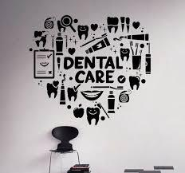
Dental and Mouth Disease Chatbot Assistant
Group members:
NAME | MATRIC NUM
MOHD HARIZ BIN ABDUL MALEK | B031810296
MEOR AMIRUL ASHRAF BIN JAMALULAIL | B031810468
MUHAMMAD HARRAZ BIN HARUN | B031810426
MUHAMMAD FIKRUN AMIN | B031810404
Lecturer name : PROF. Ts. Dr. Goh ong sing

Slide 2
A. DEFINING THE PROJECT

Slide 3
INTRODUCTION
The product of this proposed project is a web-based medical companion system which is designed exclusively for dental and oral health. The main purpose of this dental companion system is to provide a free dental consultation service that can be accessed online at all time through an AI powered chatbot. Why? Because as of today, the problem with covid-19 pandemic is, it has caused many dental clinics, especially government medical facilities in Malaysia, to limit the admission of its patients. Furthermore, dental consultation is also not encouraged during this pandemic, as the government stated, the citizens need to stay at home if there are no important matters outside especially in red zone areas. Thus, through this project, we intended to create an online web platform as way to conduct consultation or short self-diagnosis based on the patient's symptoms. In addition, people with iatrophobia, who are afraid of disclosing their dental problem with doctors, can also use the chatbot feature for self-diagnosis. People who want to know more about their dental condition before or
After they went to their dentist also may be able to find this feature helpful.

Slide 4

OBJECTIVE
1) To develop a free dental consultation service than can be accessed online at all time via an AI powered chatbot.
2) To design a chatbot system that enable user to communicate with machine like real-life conversation.
3) To develop a web-based medical assistant system especially for oral and dental health.

Slide 5
B. PLANNING THE PROJECT

Slide 6
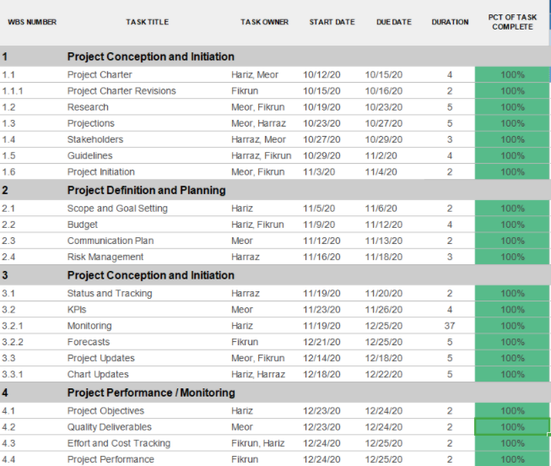
WORK BREAKDOWN STRUCTURE

Slide 7
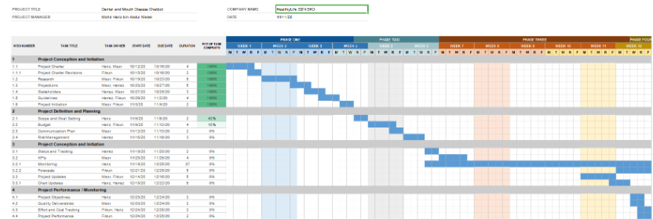
GANTT CHART

Slide 8
RISK IDENTIFICATION CHART
Control Element | What is likely to go wrong | How and when will I know ? | What will I do about it ?
Quality | Inaccurate predicting the disease | When we do the maintenance | We will train our chatbot again and add a new dataset to the oldest dataset
Cost | High demand hardware to make our chatbot more accurate | When the cost more than our prediction | Get the sponsor
Time | Time to train the chatbot model took much time | When we will go to train the chatbot | Train the chatbot earlier before the time to used it

Slide 9
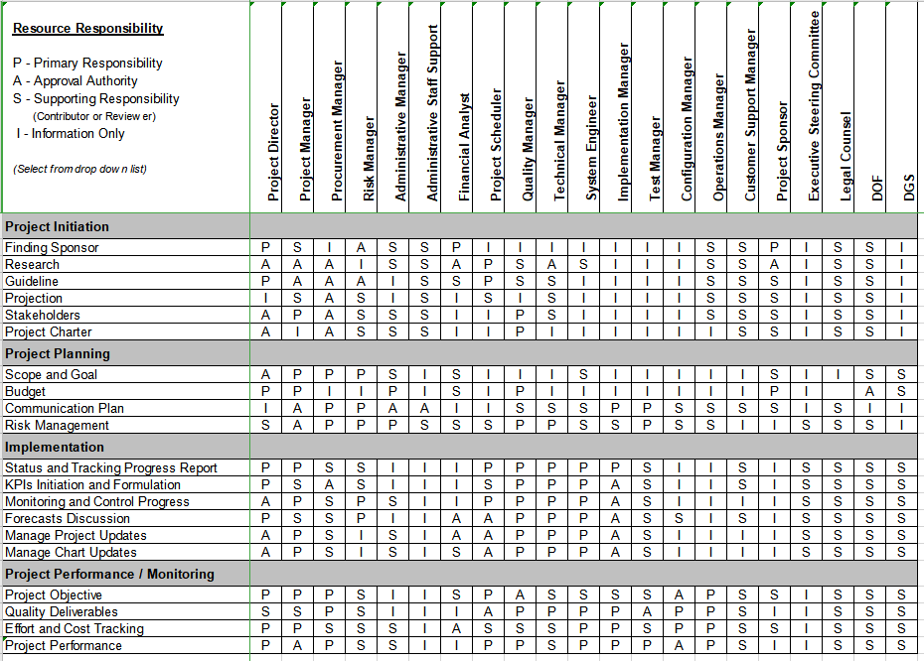
RESPONSIBILITY ASSIGNMENT MATRICES (RAM)

Slide 10
Name | Role
Mohd Hariz Bin Abdul Malek | Project Manager
Muhammad Harraz Bin Harun | Financial Admin
Meor Amirul Ashraf Bin Jamalulail | Data Analyst
Muhammad Fikrun Amin | Software Engineer

Slide 11
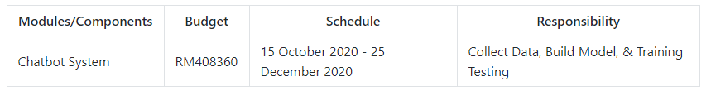
PROJECT PLANNING SUMMARY

Slide 12
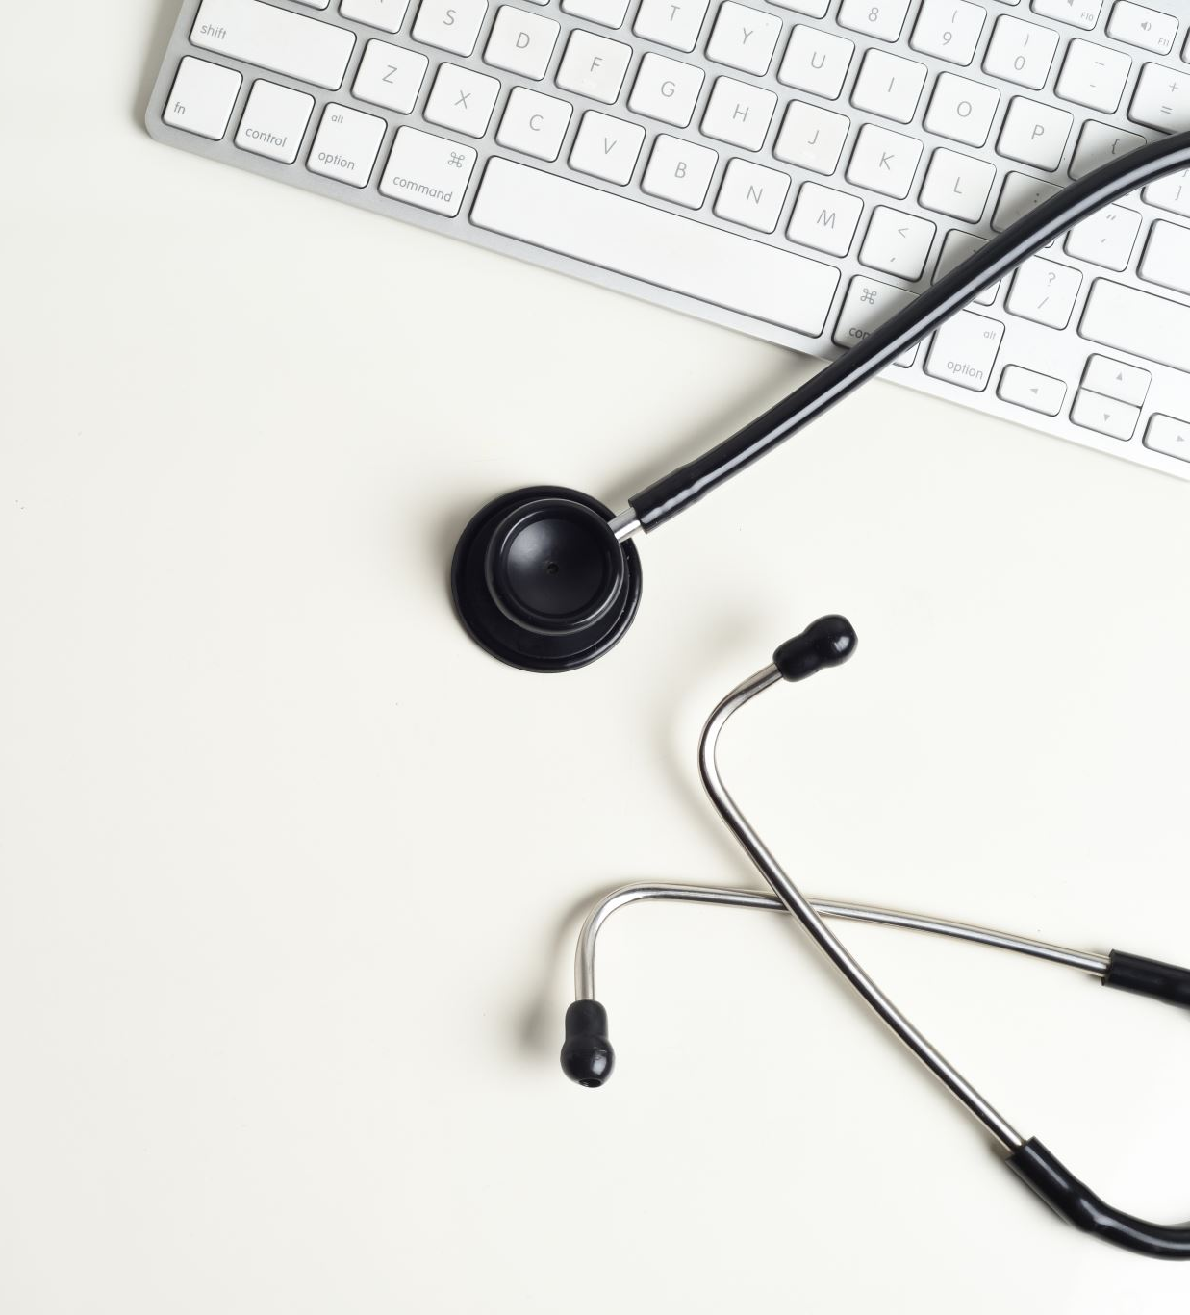
C. IMPLEMENTING THE PROJECT PLAN
Deliverables:
1) Successfully detect disease
2) Web Dashboard Design
3) Disease Model

Slide 13
TASK & ESTIMATED COST
Task | Estimated Costs | Notes
Acquisition | RM 250, 600.00 | Hardware, software
Design | RM 4, 260.00 | Dataset, License
Restoration | RM 153,500.00 | Administrator, Insurance
TOTAL | RM408,360.00 | estimated

Slide 14
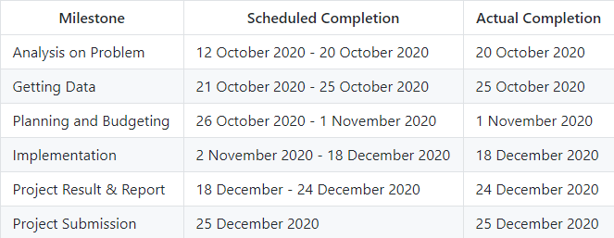
MILESTONE CHART

Slide 15
D. EXECUTING THE PROJECT

Slide 16
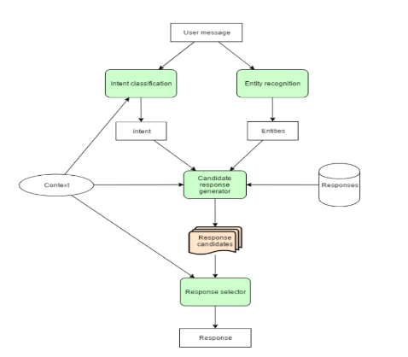
Chatbot Diagram

Slide 17
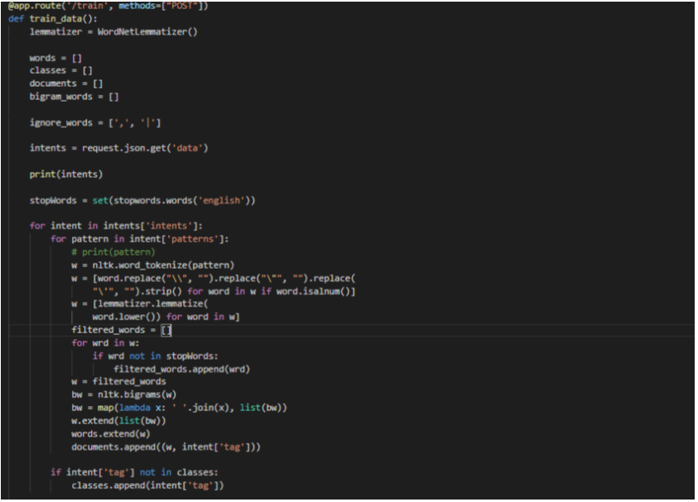
Cleaning Text

Slide 18
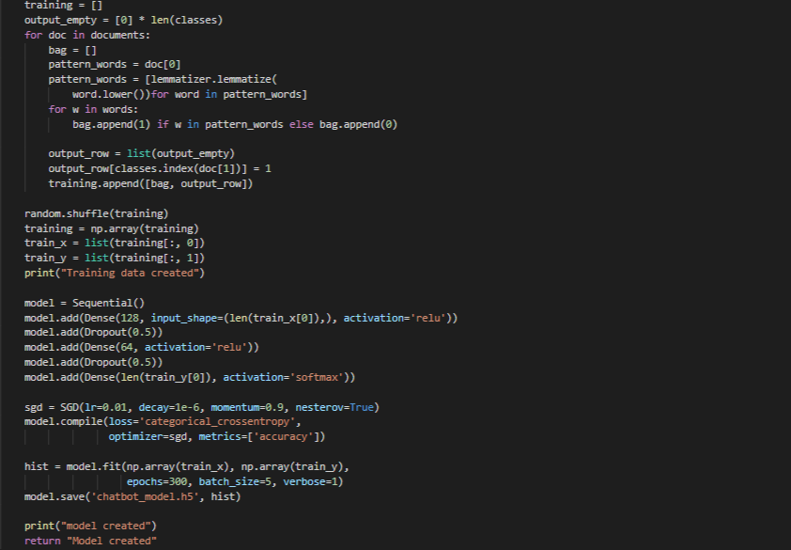
Training Text

Slide 19
COMPLETING THE PTOJECT
Sign off form | https://github.com/fikrunamin/Dental-and-Mouth-Medical-Chatbot/blob/main/images/SignOff.PNG
Lesson Learned Report | https://github.com/fikrunamin/Dental-and-Mouth-Medical-Chatbot/blob/main/Lab%20Work/Project%20Closing.pdf
Final Project Report | https://github.com/fikrunamin/Dental-and-Mouth-Medical-Chatbot/edit/main/README.md
Close Contract | https://github.com/fikrunamin/Dental-and-Mouth-Medical-Chatbot/blob/main/Lab%20Work/Procurement%20Management.pdf

Slide 20
CONCLUSION
The system has the potential to bring benefits to the public and also reduce workloads of dentists. By having this system, people can always have their dental health consultation in just one click away. Those who think that dental health is a very personal topic and embarrassed to consult with a dentist can also use this system as they will not need to meet the dentist in person. Not only that, who have difficulties in their finances will not want to waste their money on unnecessary needs. Hence, if they are not sure whether they are suffering from any dental disease, they can get their suggestions by consulting with this chatbot for free before they decide to visit the dentist. In conclusion, this artificial intelligence powered dental health chatbot has brought many benefits to the public.

