Slide 1

100 Years!
May 18, 2002
Ruth Marie Hambley

Slide 2
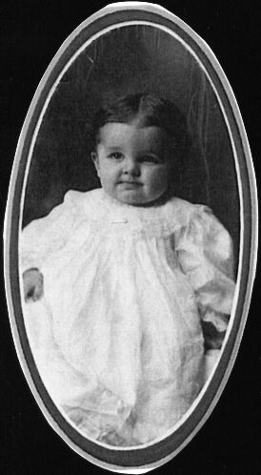

Ruth Marie Pringle
Born: may 18, 1902

Slide 3
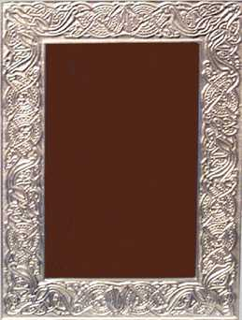
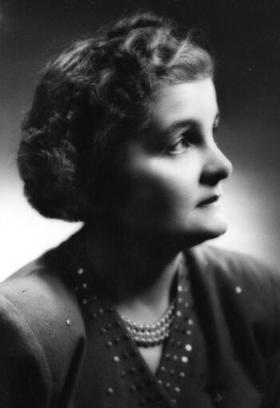
Ruth 1920

Slide 4
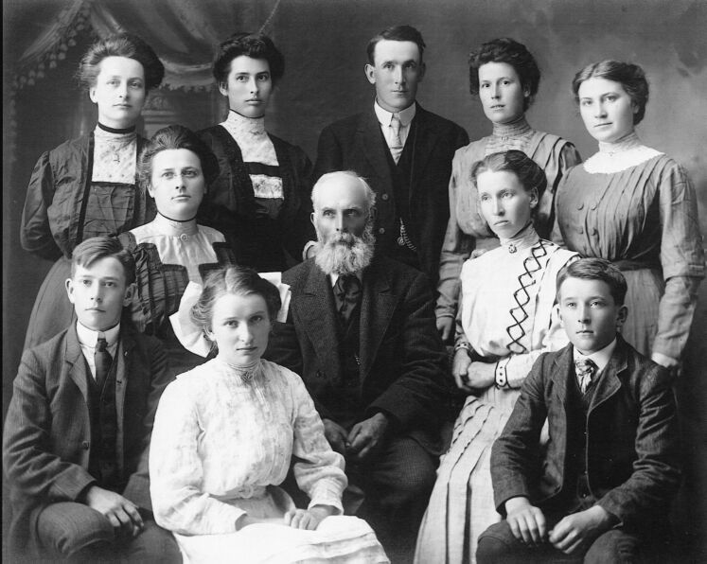
John Joseph Hambley Family
(J. J. Hambley 1898-1964 lower right)

Slide 5
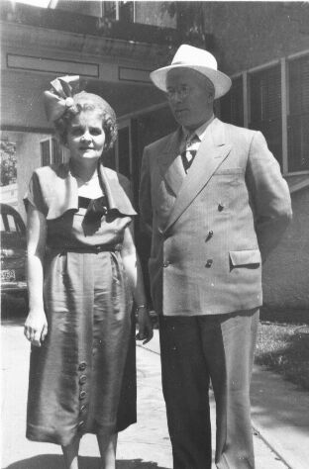
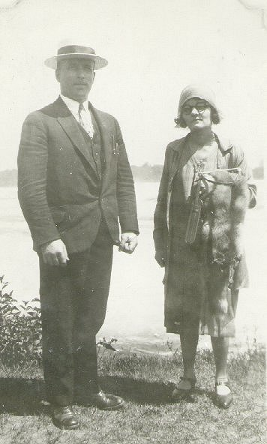
Ruth & John
Married January 12, 1924-Selkirk, Manitoba
June 24, 1951

Slide 6
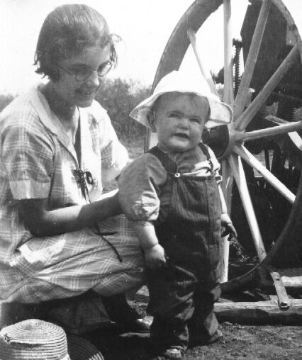
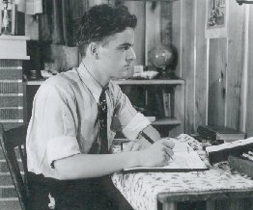
Ruth’s children-Bruce
1944
1925

Slide 7
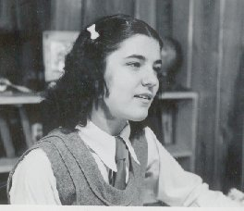
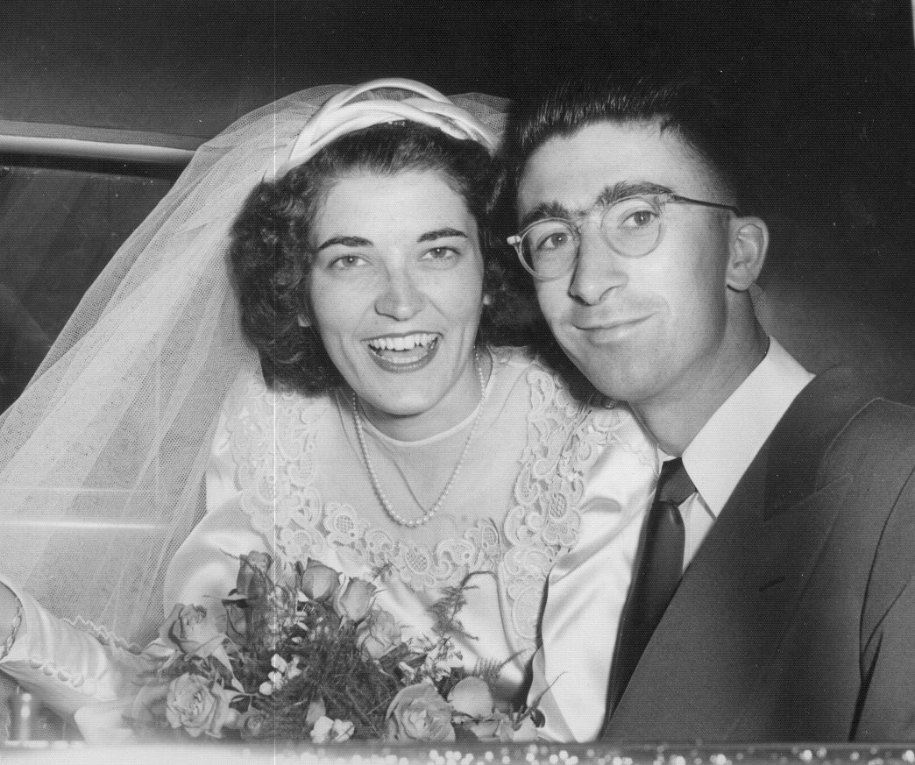
Ruth’s children-Marion
July 1, 1950
1942

Slide 8
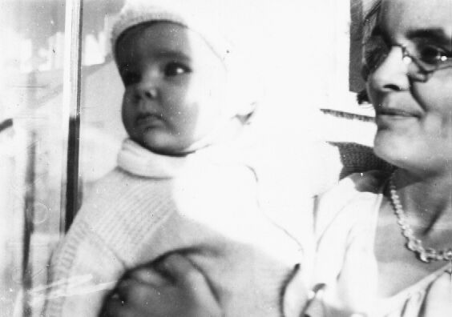
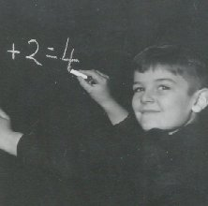
Ruth’s Children-Bryan
January 5, 1934
(10 months)
1940-7 years old

Slide 9
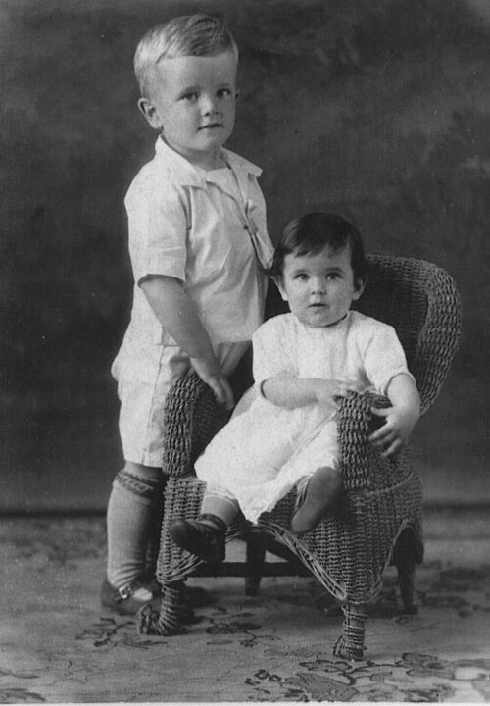
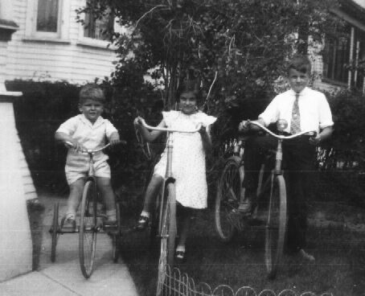
Ruth’s Children
Bryan, Marion, Bruce (1937)
Bruce & Marion
(July 1928)

Slide 10
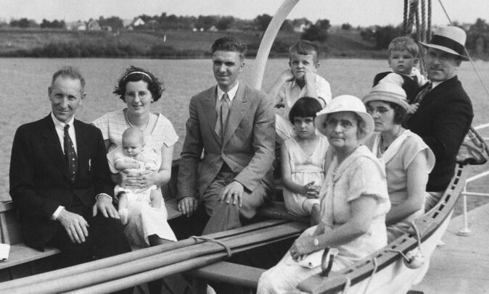
The Hambley & Pringle Families (1938)
Ruth’s father, Mary, Joyce, Walter, Bruce, Marion, Bryan, John, Ruth, Ruth’s mother

Slide 11
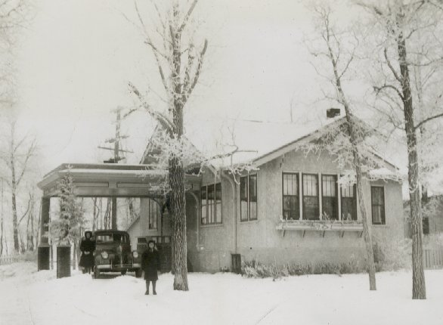
1469 WELLINGTON Crescent
1939

Slide 12
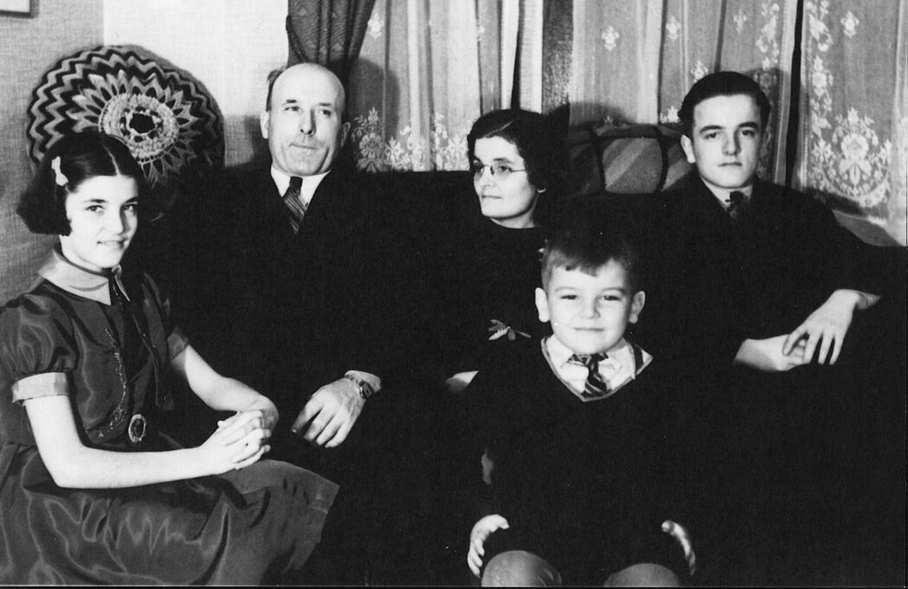
The Hambley Family
1938

Slide 13
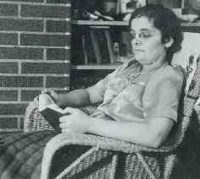
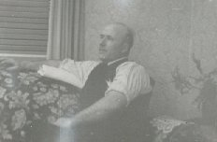
Ruth & John
AT HOME
AT HOME 1944

Slide 14
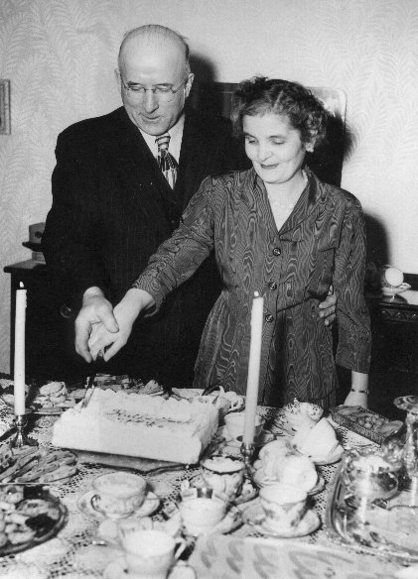
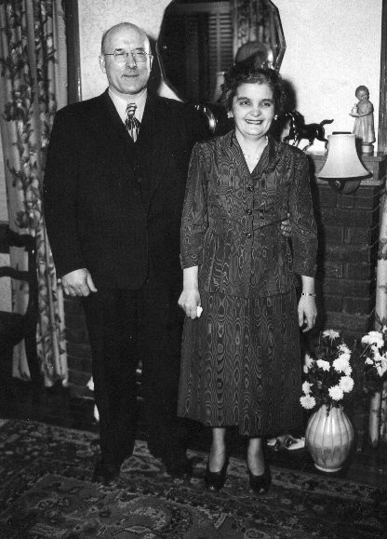
Ruth & John- 1949
25th Wedding
Anniversary

Slide 15
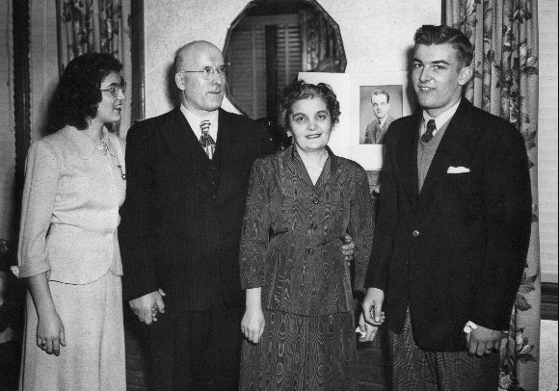
25th Wedding Anniversary- Family Photo

Slide 16
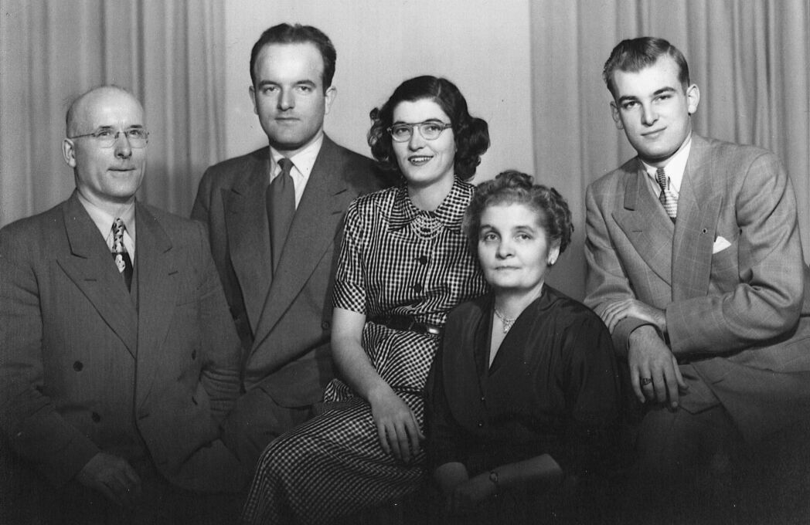
The Hambley Family
1951

Slide 17
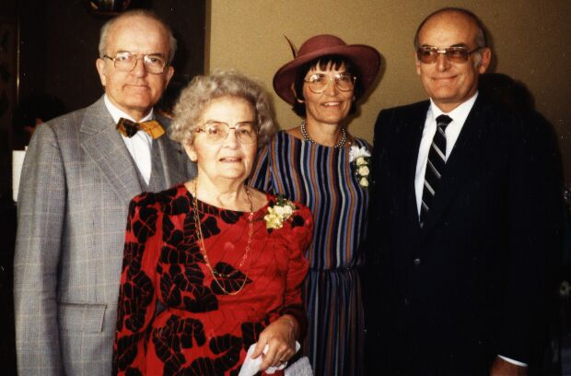
Ruth, Bruce, Marion, Bryan
(1984)

Slide 18
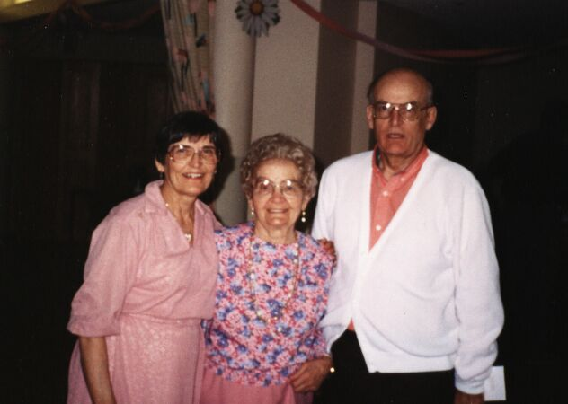
Ruth &
Marion, Bryan
(May 1994) White Rock, B.C.

Slide 19
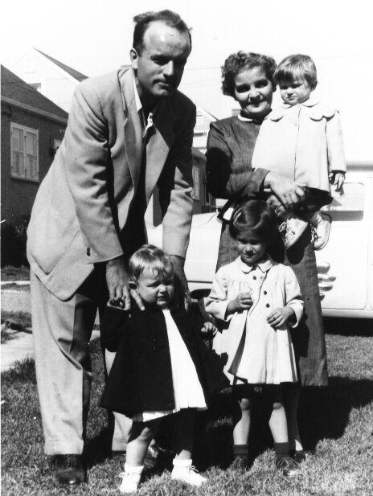
Ruth & Grandchildren
1955- Bruce, Judy, Janet, Gail

Slide 20
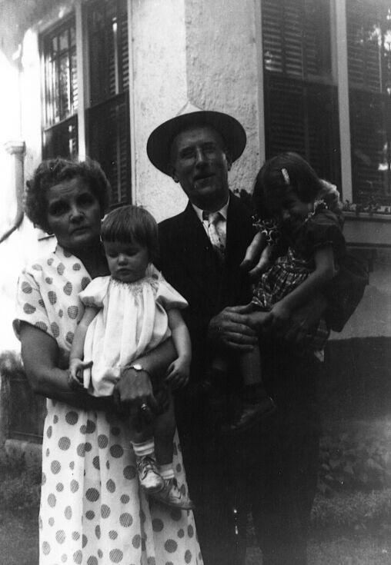
Ruth & Grandchildren
Gail & Janet (1955)

Slide 21
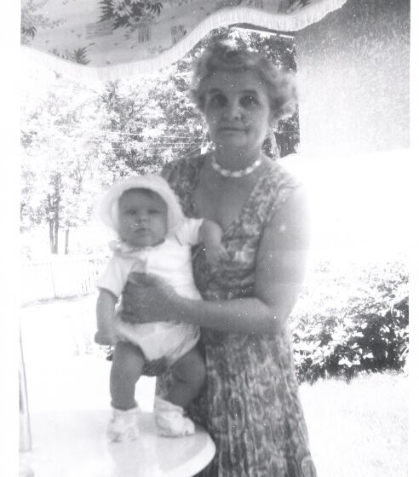
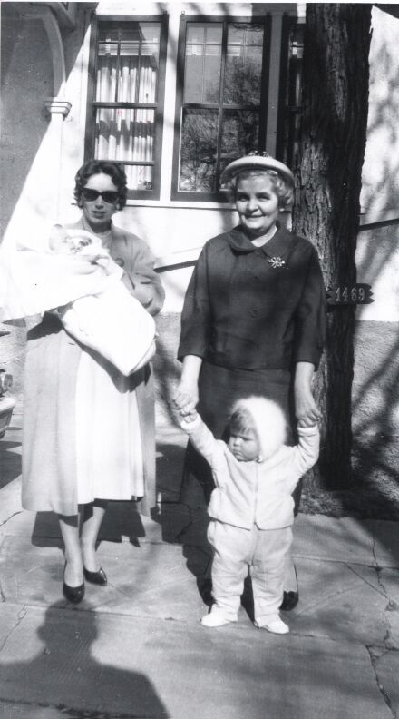
Ruth & Grandchildren
Nancy (1959)
Winnipeg
Nancy & John (1960)

Slide 22
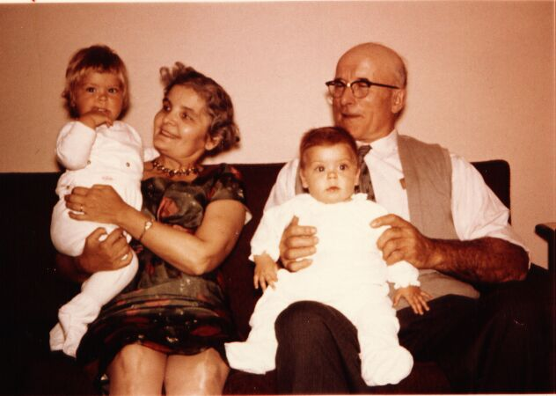
Ruth & Grandchildren Nancy & John (1960)

Slide 23
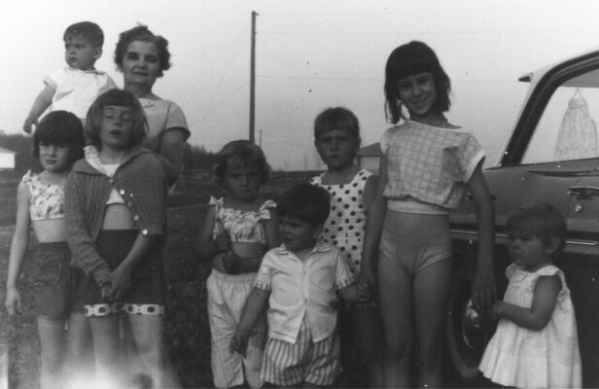
Ruth & Grandchildren
1961- John, Gail, Judy, Jayne, Ian, Patti, Janet, Nancy

Slide 24
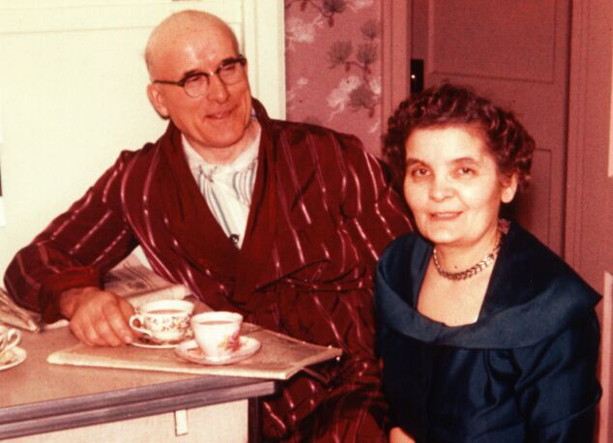
Ruth & John- 1962

Slide 25
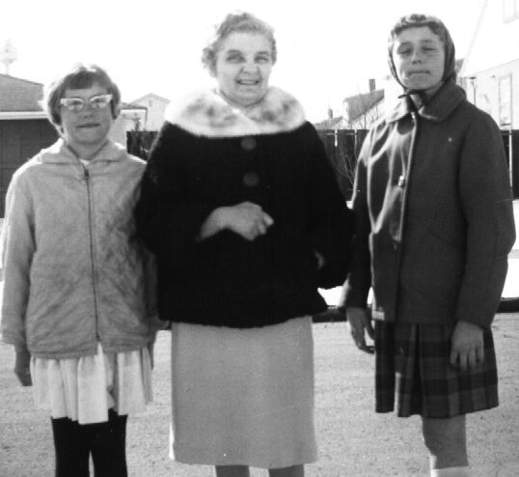
Ruth & Grandchildren
Patti & Judy-1963

Slide 26
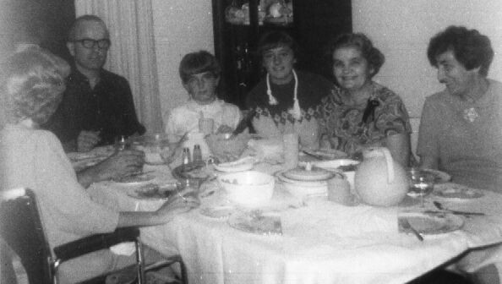
Ruth & Grandchildren
Bruce, Jayne, Judy, Lil (1969)

Slide 27
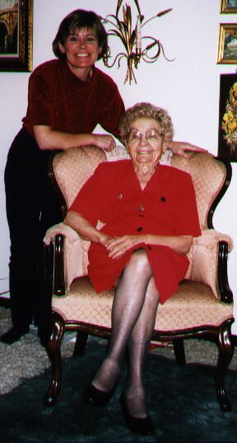
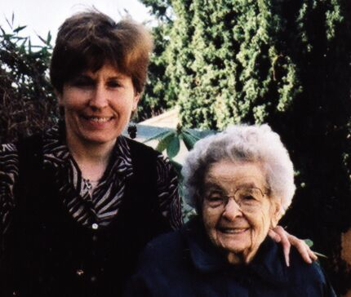
Ruth & Grandchildren
Patti, 2001-Victoria
Nancy, 1999-Winnipeg

Slide 28
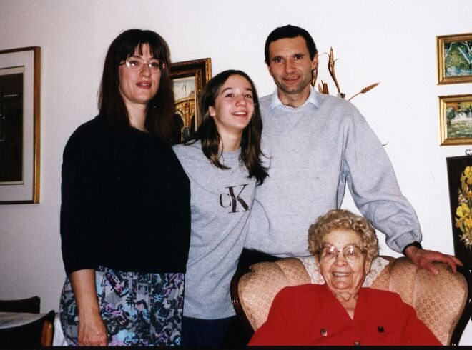
Ruth & Great/Grandchildren
Janet, Jillian, Darrell
October (1999) Winnipeg

Slide 29
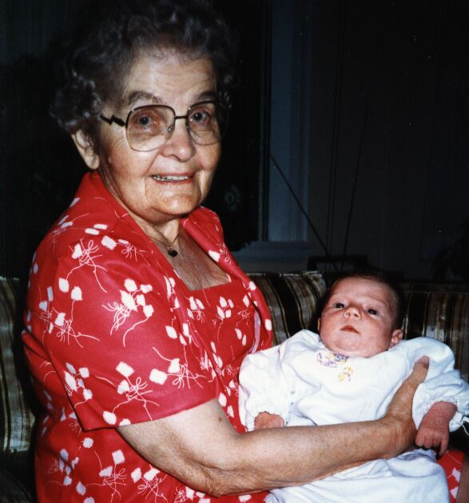
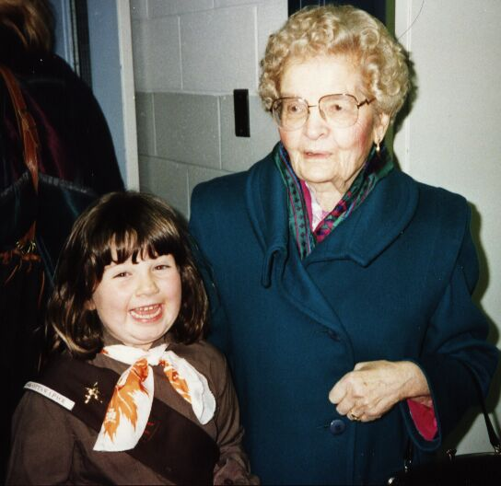
Ruth & Great-Grandchildren
Samantha (1982)
Samantha (1992)

Slide 30
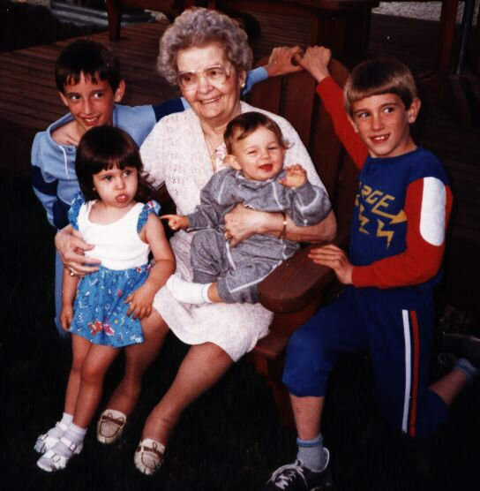
Ruth & Great-Grandchildren
Jonathan, Jessica, Samantha, Curtis- 1987

Slide 31
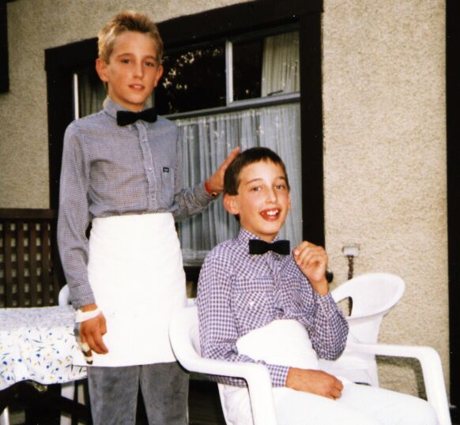
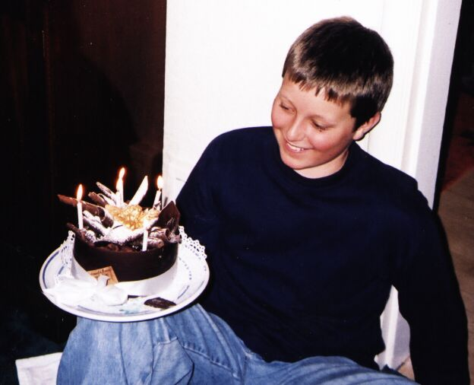
Ruth’s Great Grandchildren
Benjie- 13th birthday (2000)
Curtis & Jonathon (1989)

Slide 32
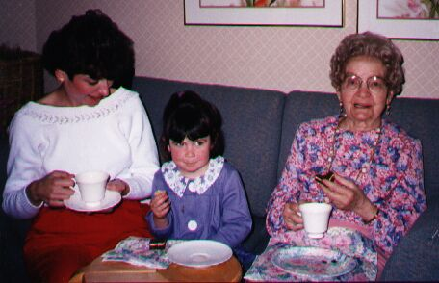
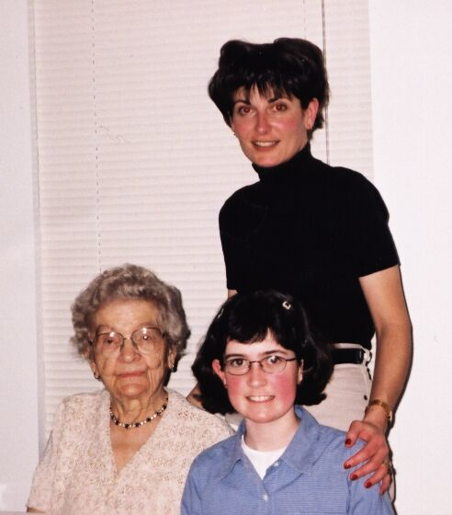
Ruth & Great Grandchildren
March 2001
1994-Lindsey

Slide 33
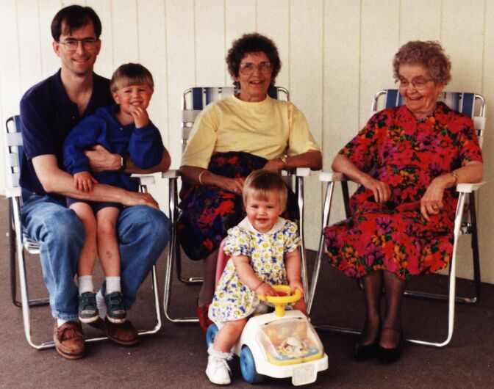
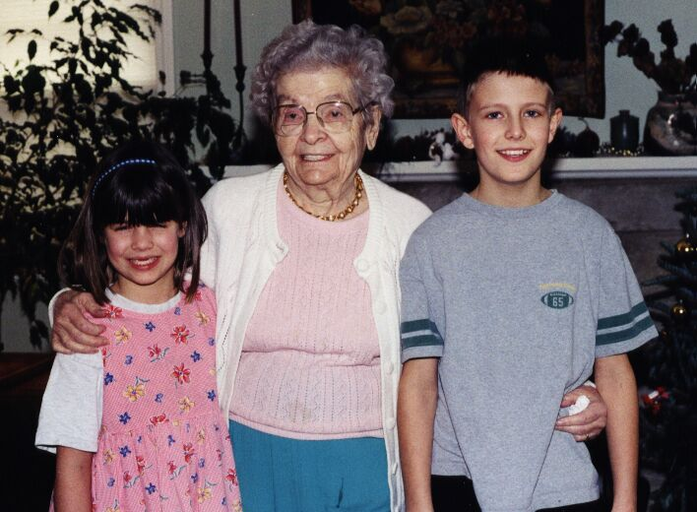
Ruth & Great-Grandchildren
Scott & Melanie, 2000
Scott & Melanie, 1990

Slide 34
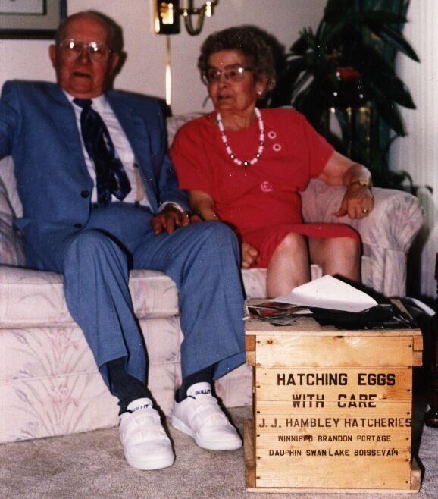
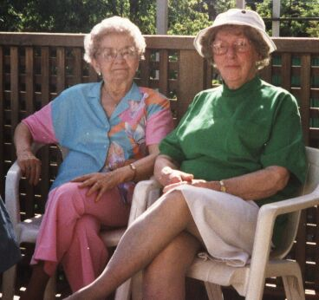
Ruth & Family/Friends
Gowan Hay (1992)
Bill Moffat (1992)

Slide 35
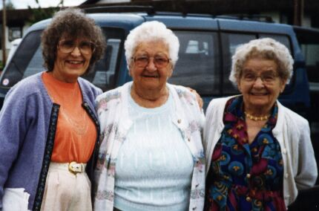
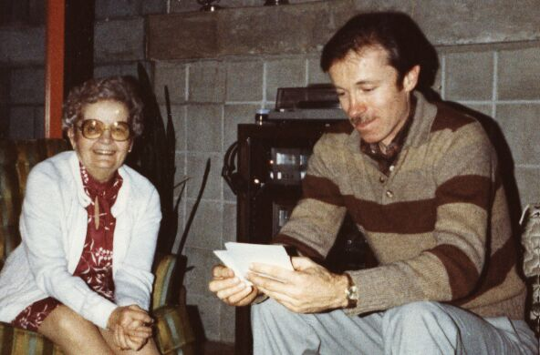
Ruth & Family/Friends
Syd Lee (1982)
Lizzie Peters (1997)

Slide 36


Birthdays, Birthdays, Birthdays!!!
90th 1992-Vancouver
85th 1987-Winnipeg

Slide 37


Birthdays, Birthdays, Birthdays!!!
95th (1997)
Nancy, Lindsey, Samantha
Vancouver

Slide 38

Member- River heights united Church
November (1999) Winnipeg

Slide 39

1999-Winnipeg

Slide 40

2001

Slide 41

Ruth’s
Descendants
1992

Slide 42

Ruth’s Descendants
1992

Slide 43







Happy 100th
Birthday Ruth!
And many more!

