Slide 1
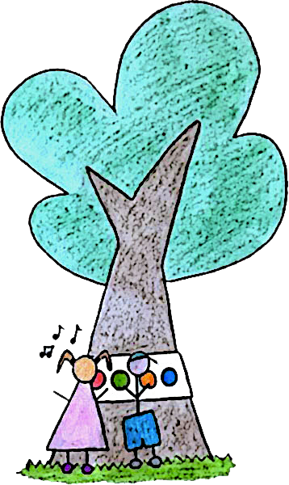
GEKI (GEt-out Kids and Interact)
A Smart Game Motivating Children To Become Outdoor Explorer
Giovanni Filaferro
Michele Gennaioli
Giuseppe Manzi
Valentina Menabue

Slide 2
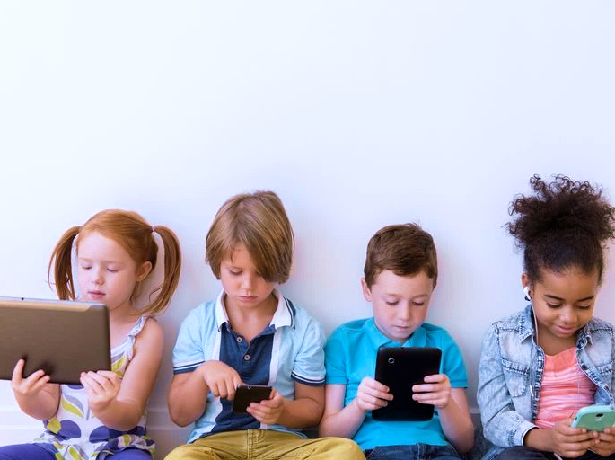
Nowadays children are sometimes
too exposed to displays and technology...

Slide 3
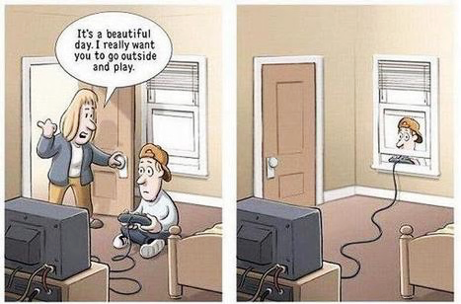
PURPOSE

Slide 4
PURPOSE

Slide 5
GOALS
SMART DEVICE:
To motivate children to interact with the nature while enjoying
GAME:
To be attractive and instructive and make children explore the nature

Slide 6
SMART DEVICE
A band with a microcontroller plus 4 bright buttons, 2 speakers for 5-8 years-old children (also inclusive)
INTERACTION
Lights
Sound
Touch

Slide 7
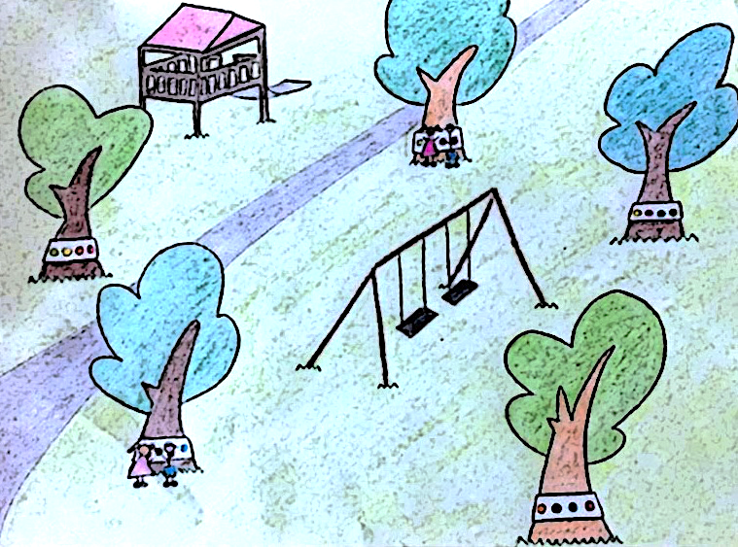
GAME
Through the interaction with the band, the children are driven in a “treasure hunt”:
Each tree tells a chapter of a story.
Based on some clues the children find the next tree in order
to know the next part of the story.
When the children reach the end, they learn the educative moral of the story

Slide 8
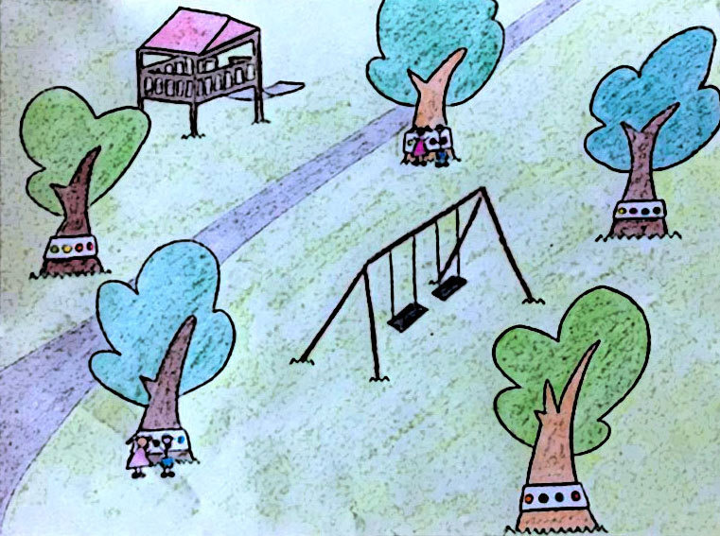
GAME
Through the interaction with the band, the children are driven in a “treasure hunt”:
Each tree tells a chapter of a story.
Based on some clues the children find the next tree in order to know the next part of the story.
When the children reach the end, they learn the educative moral of the story

Slide 9
The effect resulting from a touch or from the completion of a previous action can be configured using JSON files, so that it’s possible to define whichever interaction flow/game you want.

Slide 10
USER STUDY (PHASE 1)
MEETING WITH THE TEACHERS
Goals
Verify if the teachers approve the device
Review the subject of the stories
Identify new ideas to improve the learning experience

Slide 11
USER STUDY (PHASE 2)
OBSERVING THE CHILDREN
Goals
Verify if the children approve the device
Verify if the game is instructive
Check if the age range is the right one
Identify new ideas to make the game and/or the device more attractive

Slide 12
FUTURE IMPLEMENTATIONS
RFID Cards representing characters, settings or other elements of the story, in order to adapt it to the user
Possibility to implement many other new games
Interacting with other smart objects in the park (ex. ABBOT)
Capacitive fabric instead of buttons

