Slide 1
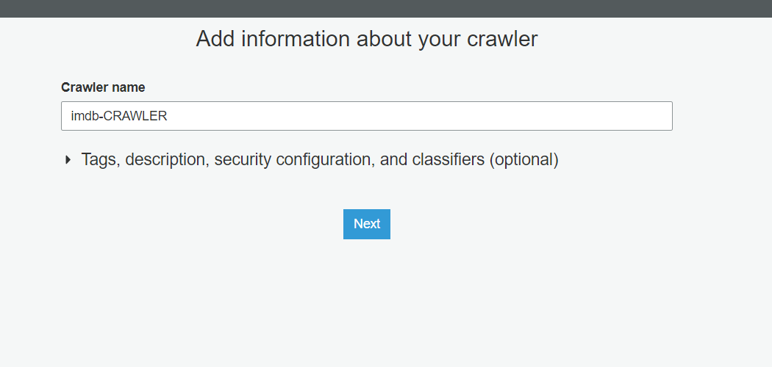

Slide 2
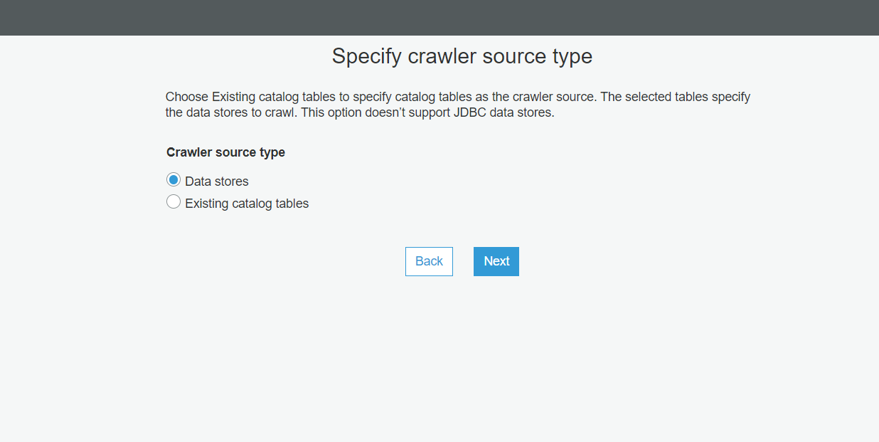

Slide 3
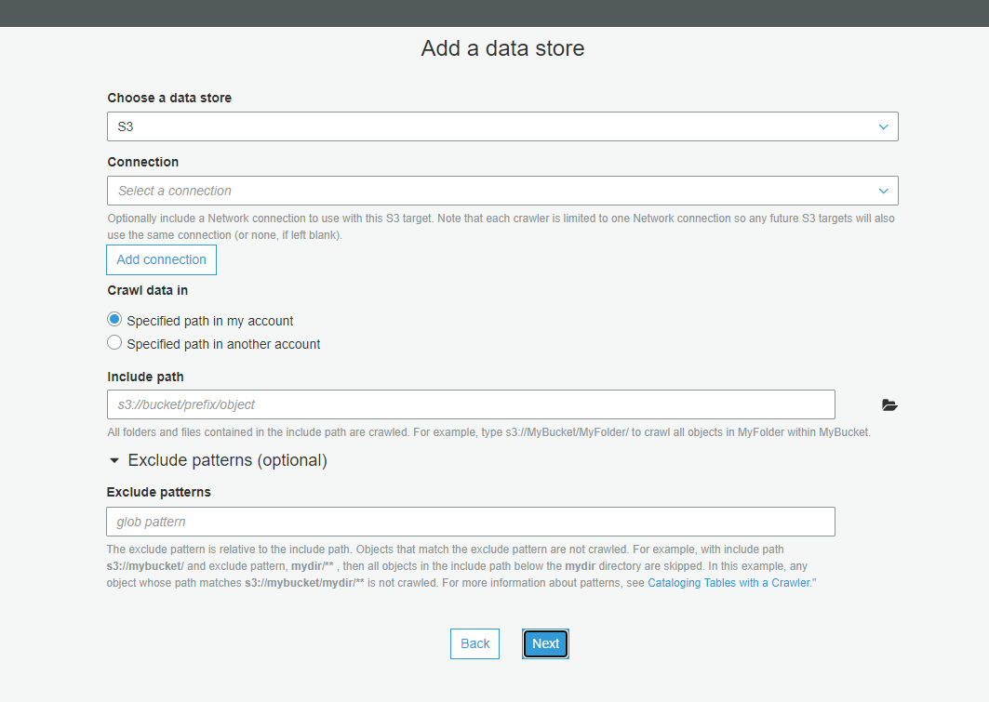

Slide 4
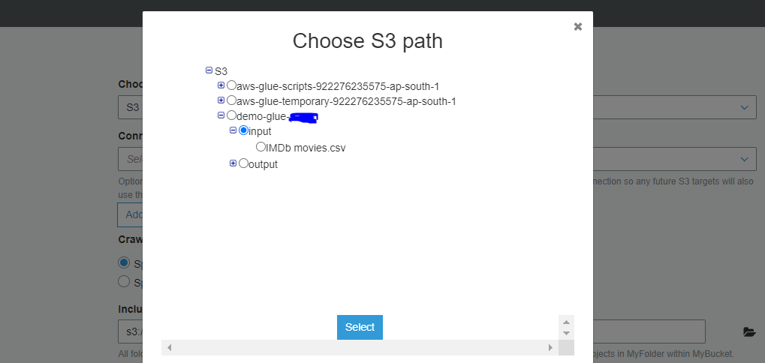

Slide 5
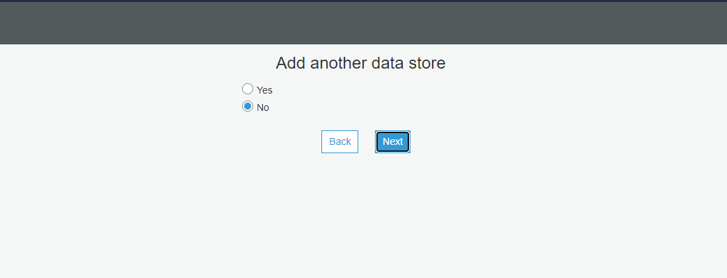

Slide 6
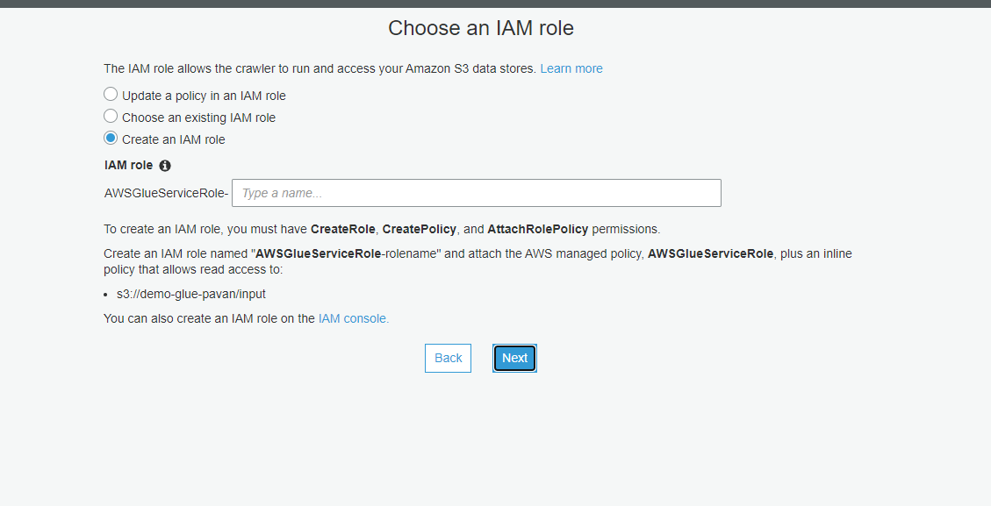

Slide 7
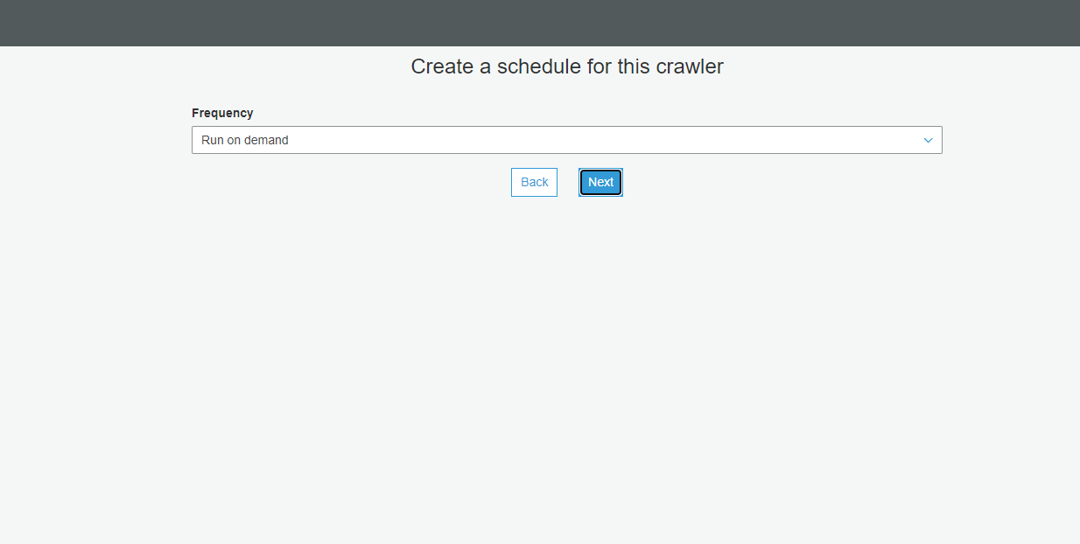

Slide 8
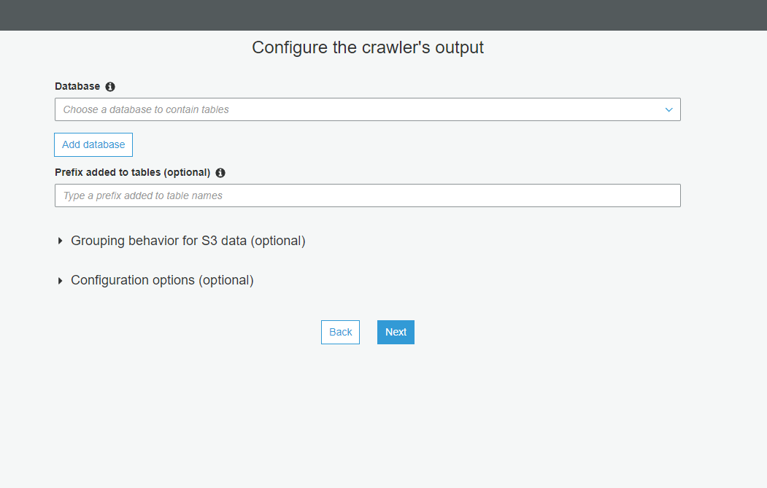

Slide 9
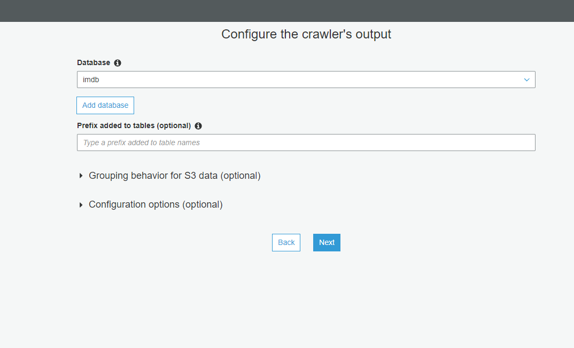

Slide 10
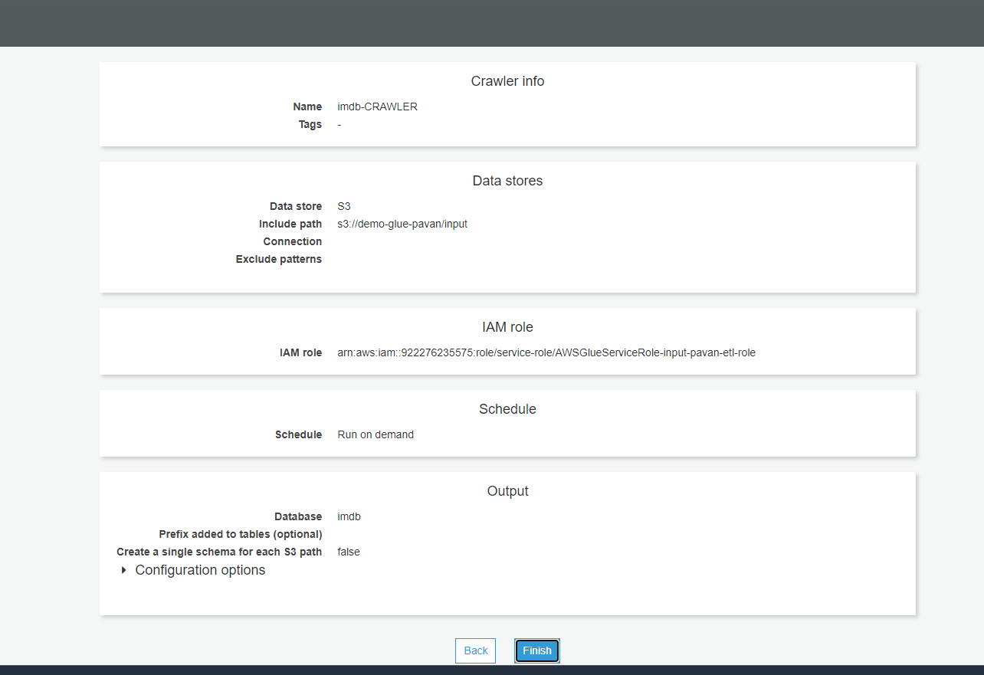

Slide 11
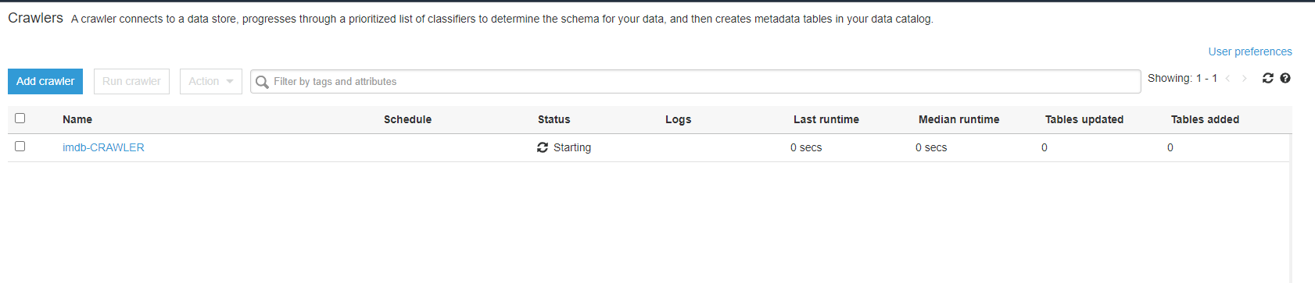
RUN THE CROWLER

Slide 12
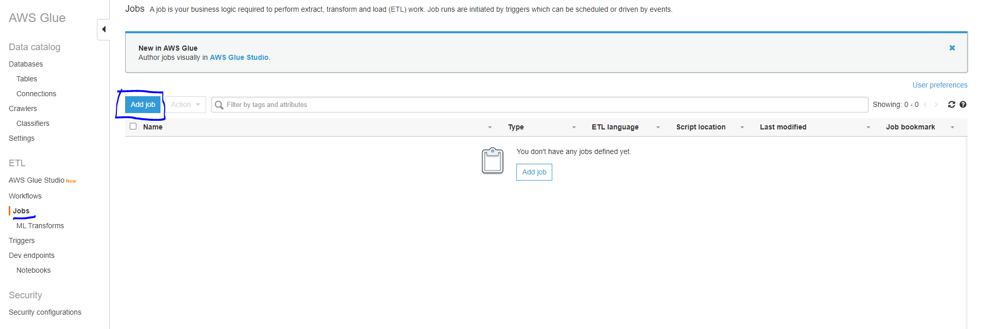

Slide 13
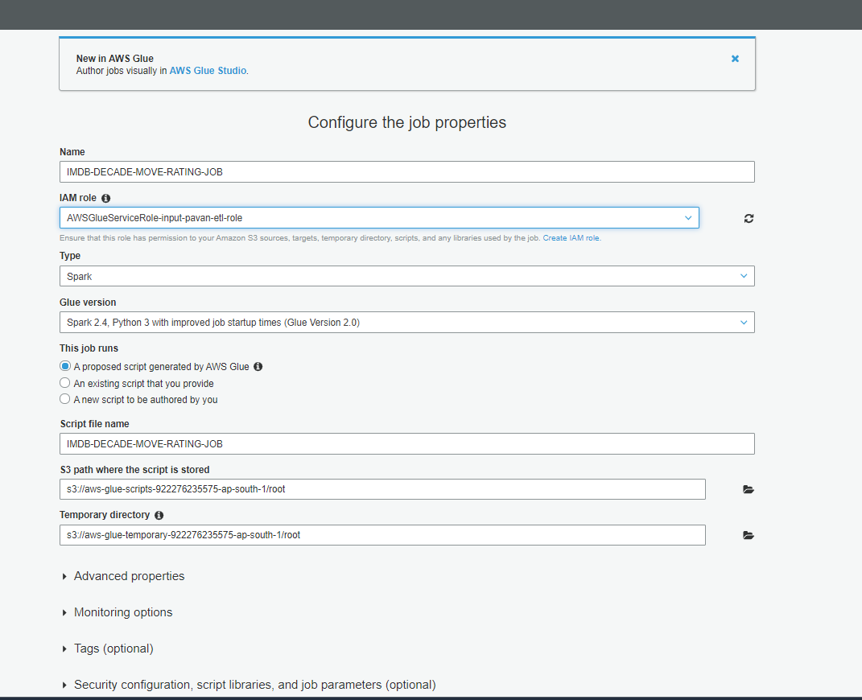

Slide 14
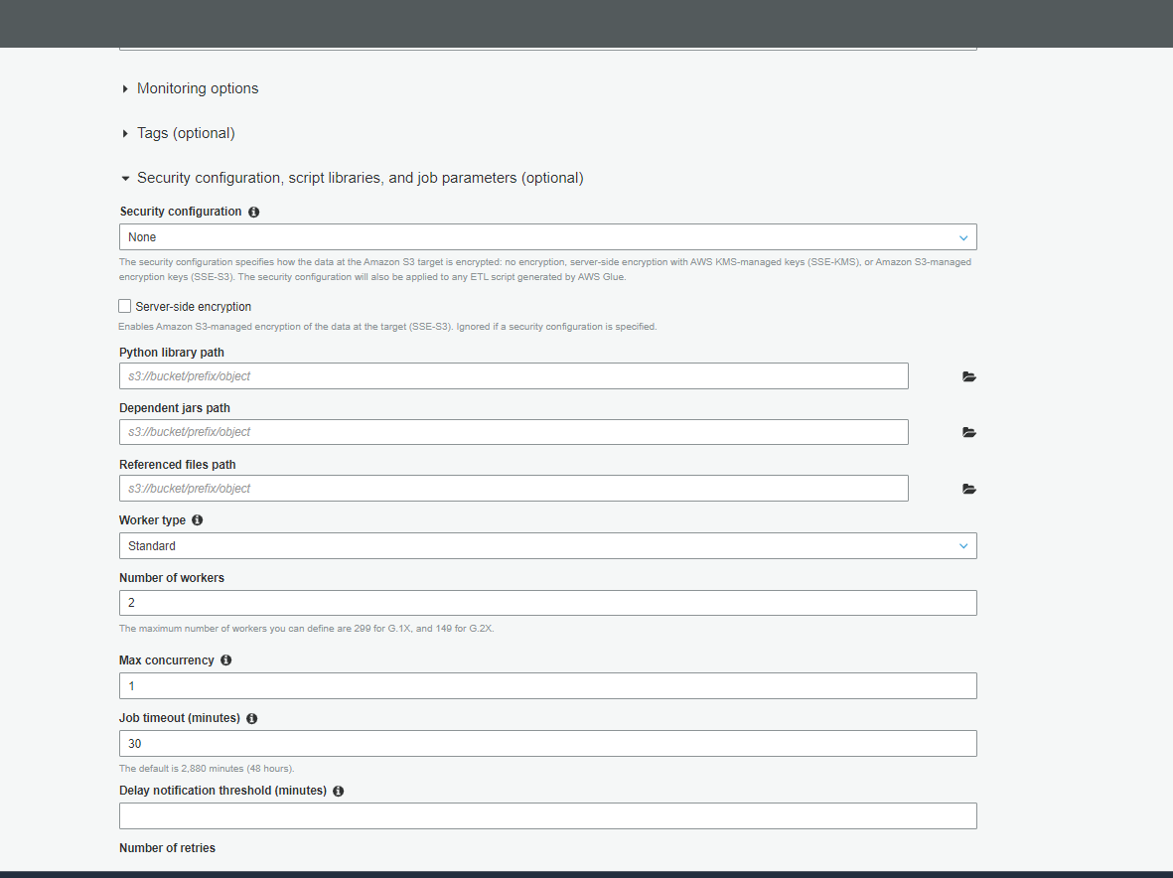

Slide 15
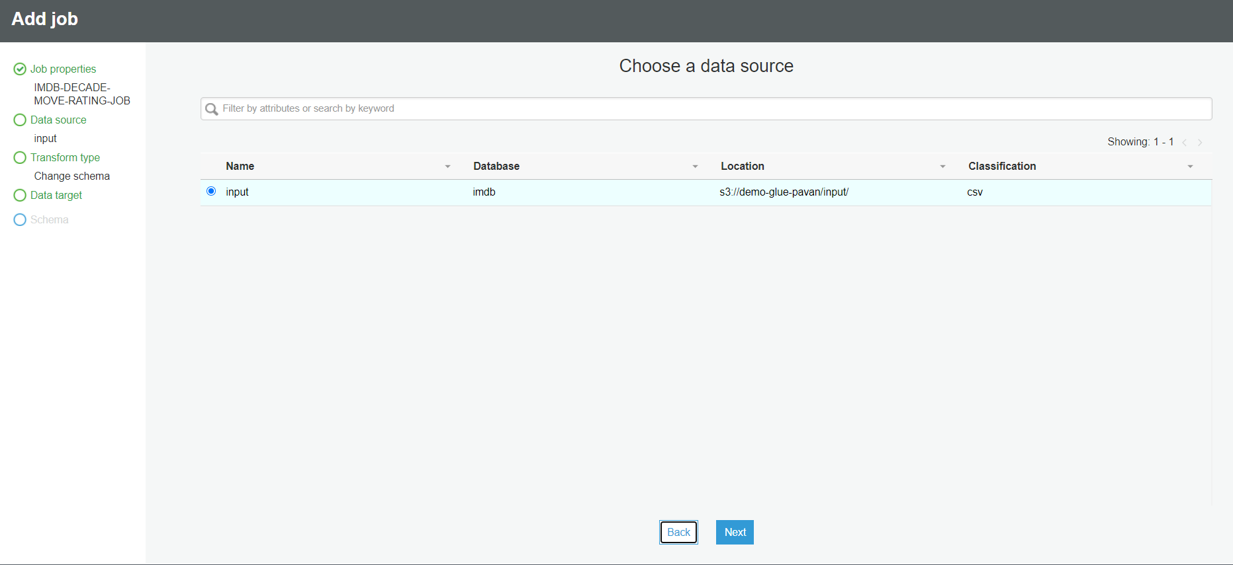

Slide 16
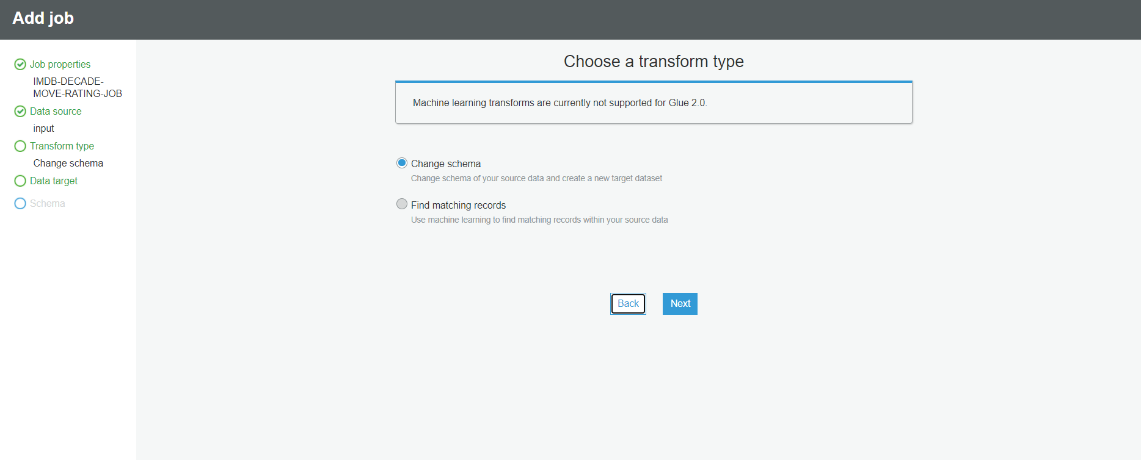

Slide 17
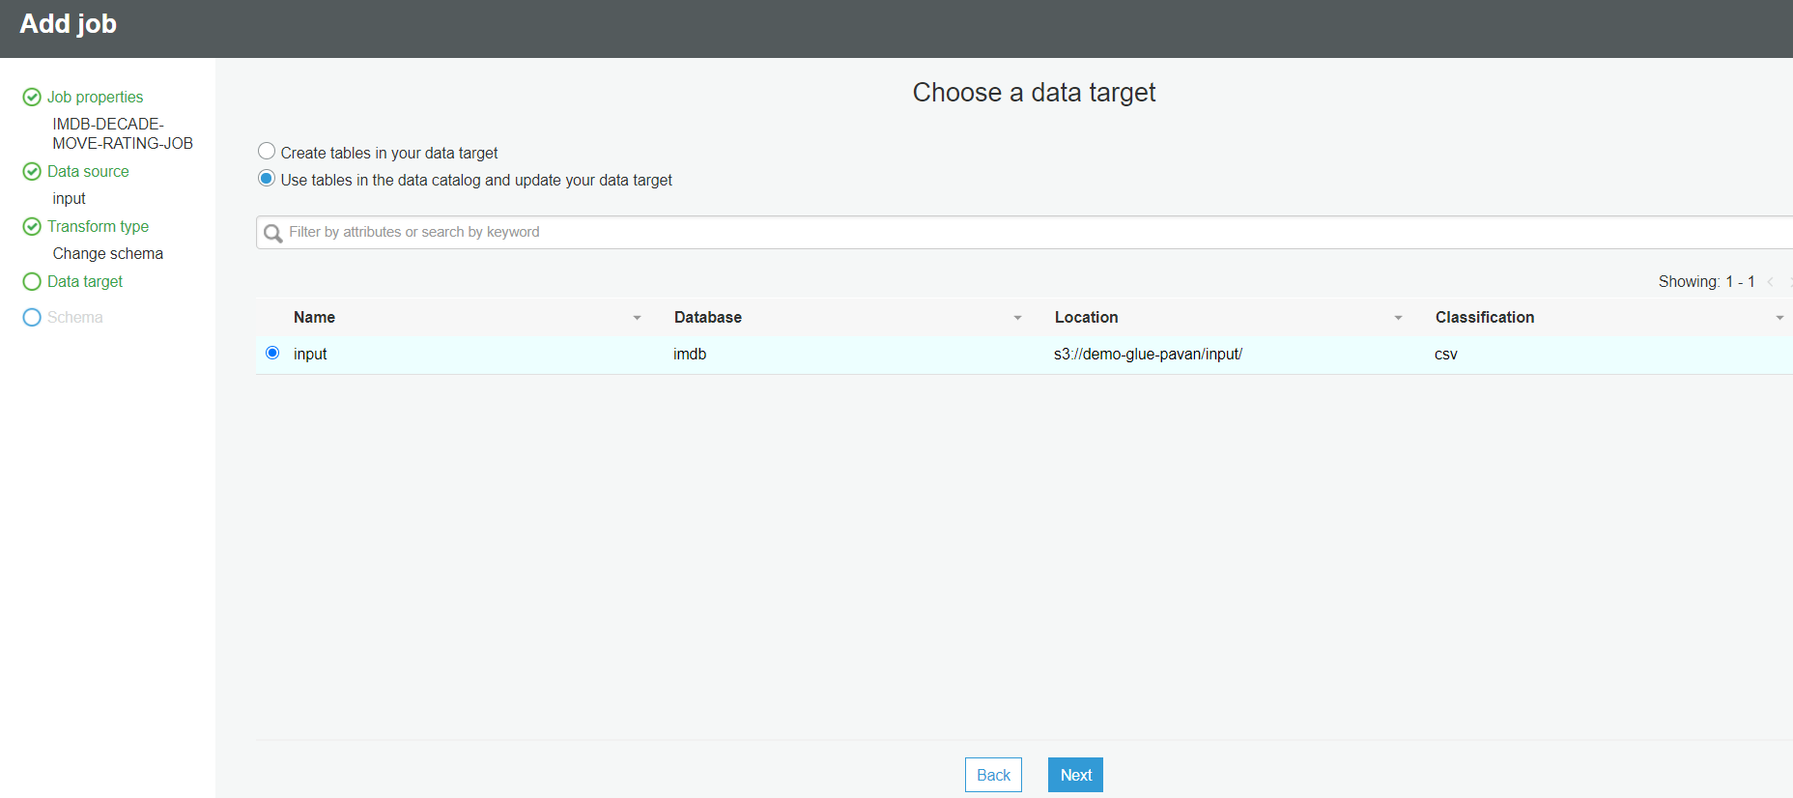

Slide 18
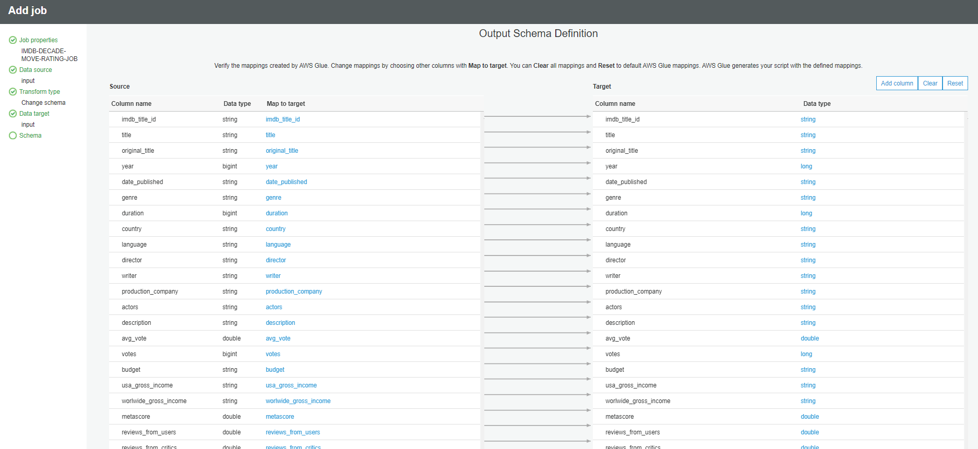

Slide 19
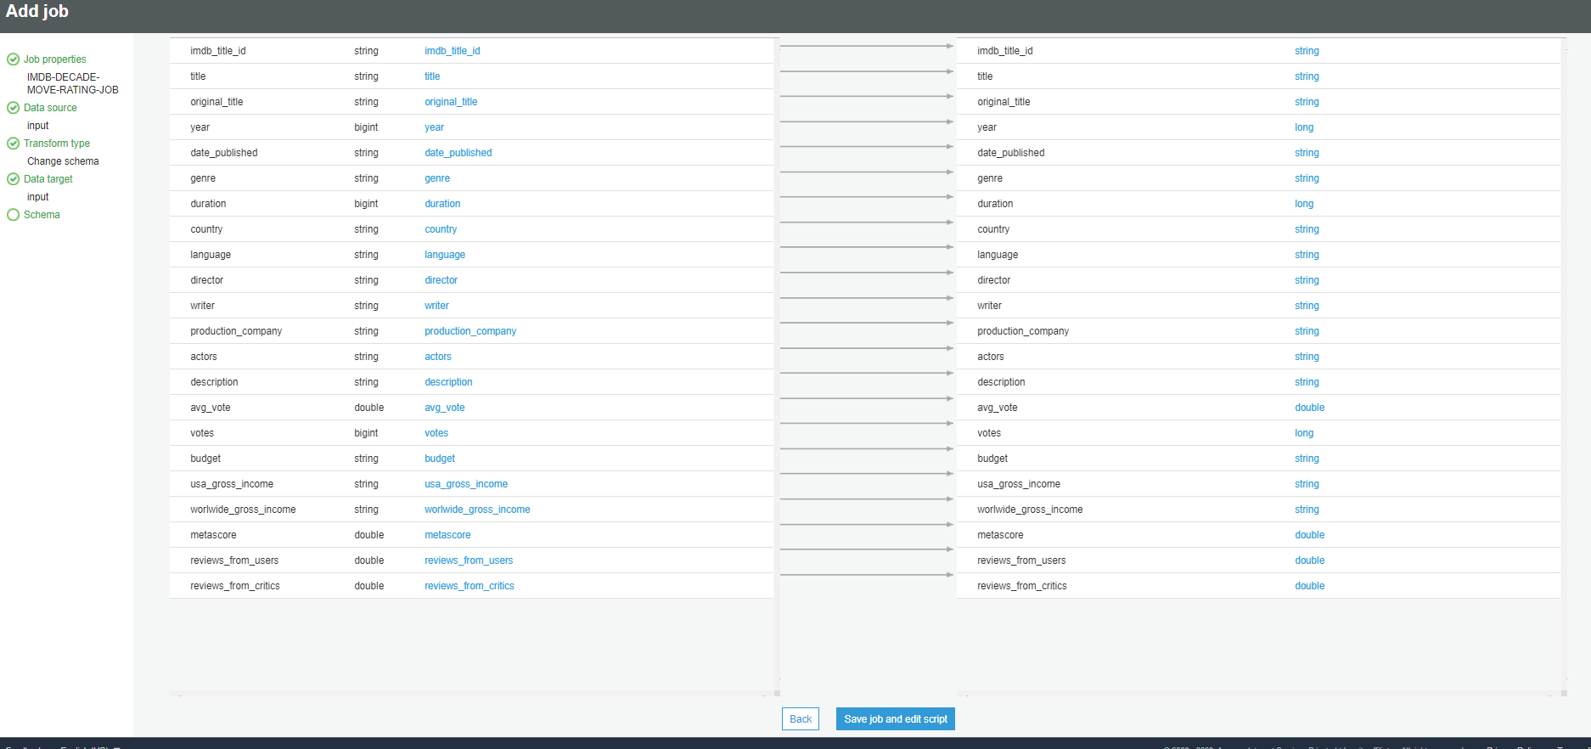

Slide 20
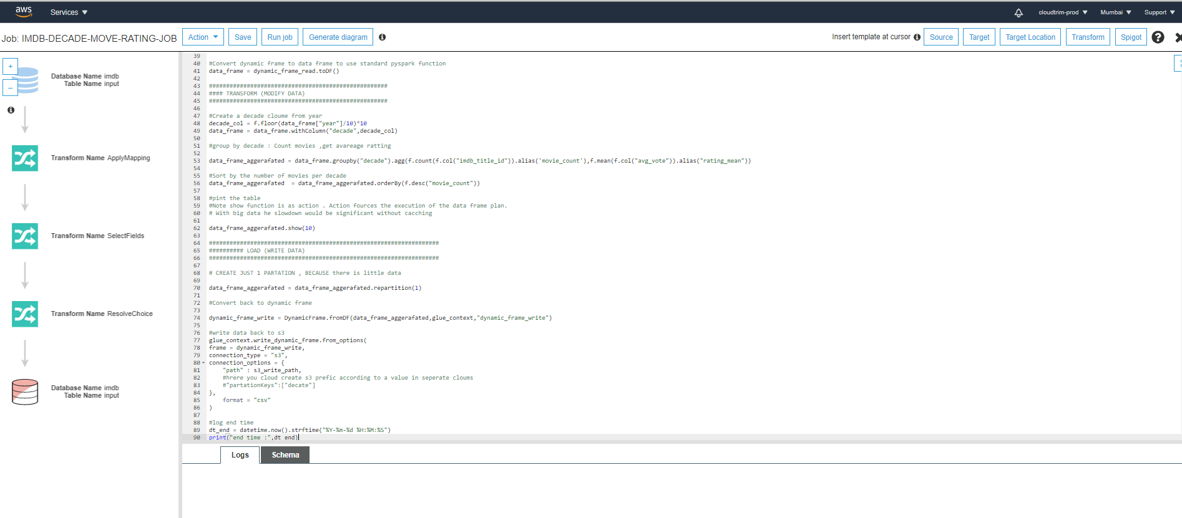

Slide 21
Oct 12, 2020, 6:15:43 PM Pending execution
start time : 2020-10-12 12:46:28
+-------+-----------+------------------+
| decade|movie_count| rating_mean|
+-------+-----------+------------------+
|[2017,]| 3329| 5.696785821568039|
|[2018,]| 3257| 5.688609149524094|
|[2016,]| 3138| 5.658062460165704|
|[2015,]| 2977| 5.616560295599591|
|[2014,]| 2942|5.6712780421481925|
|[2019,]| 2841| 5.791270679338264|
|[2013,]| 2783| 5.619762845849813|
|[2012,]| 2560|5.6283984375000085|
|[2011,]| 2429| 5.62087278715522|
|[2009,]| 2298|5.6398607484769565|
+-------+-----------+------------------+
only showing top 10 rows
end time : 2020-10-12 12:46:52

