Slide 1
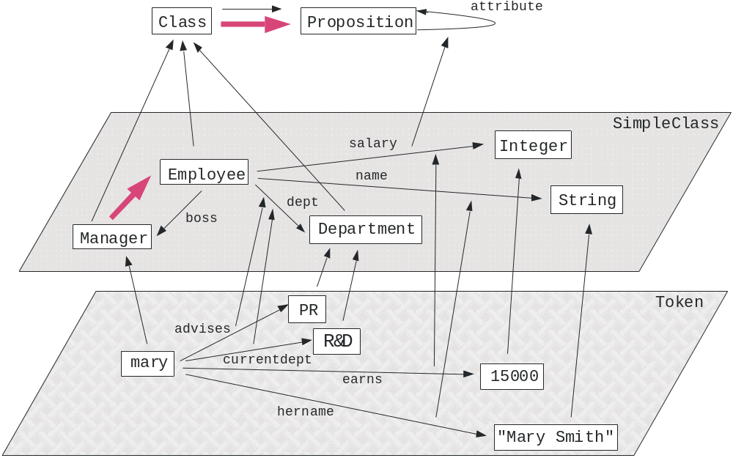
Notes:
NeuEmpl

Slide 2
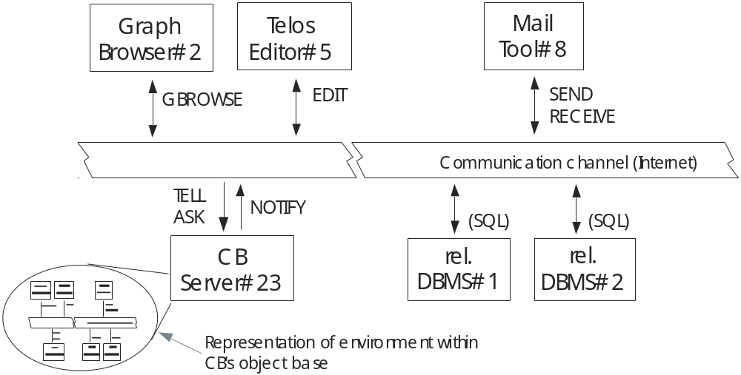
Notes:
cb_fig1

Slide 3
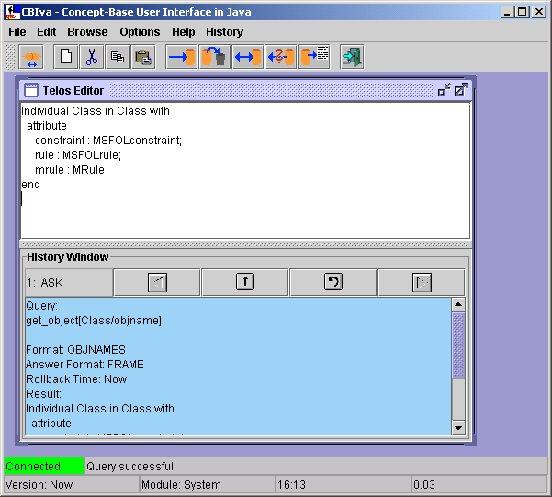
Clear
Cut
Copy
Paste
Tell
Untell
Retell
Ask
Load Object
Exit
Connect
Main Telos
Editor
History Window
Status Bar
Notes:
cbivamain

Slide 4
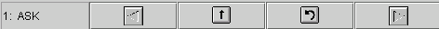
Number and type of operation
Go to previous
operation
Copy Text to
Telos Editor
Redo
operation
Go to next
operation
Notes:
historybuttons

Slide 5
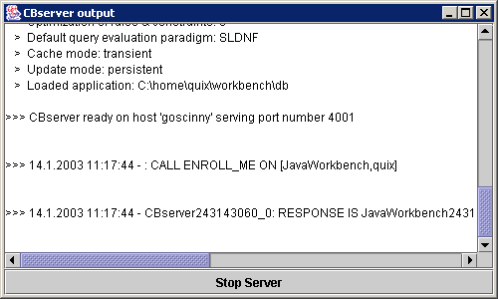
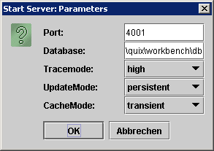
Notes:
startserver

Slide 6
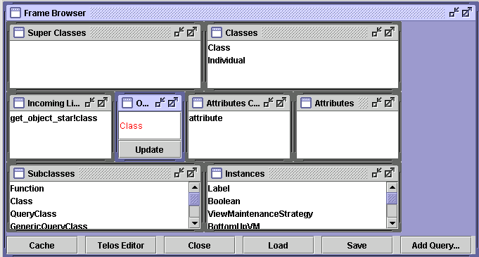
Notes:
framebrowser

Slide 7
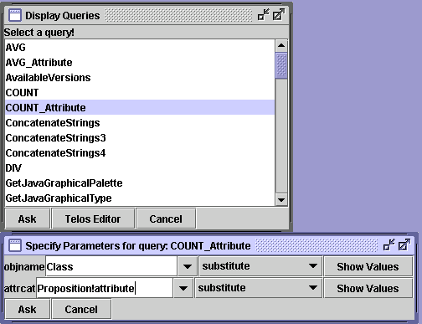
Notes:
displayqueries

Slide 8
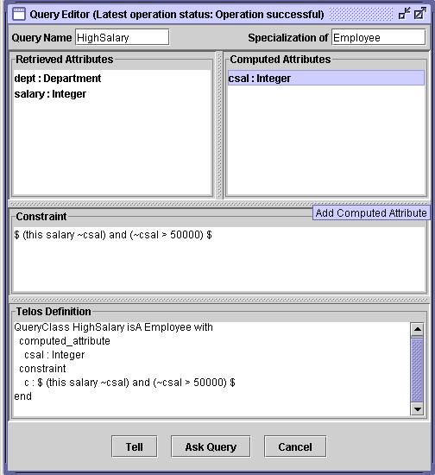
Notes:
queryeditor

Slide 9
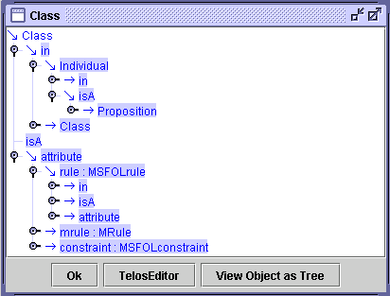
Notes:
frametree

Slide 10
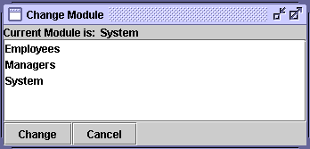
Notes:
choose_modcontext

Slide 11
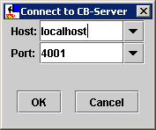
Notes:
connectserver

Slide 12
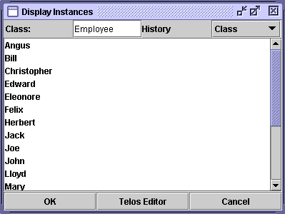
Notes:
session_display

Slide 13
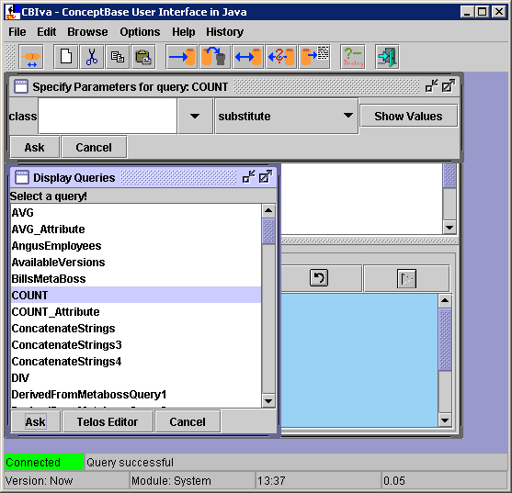
Notes:
displayqueries

Slide 14
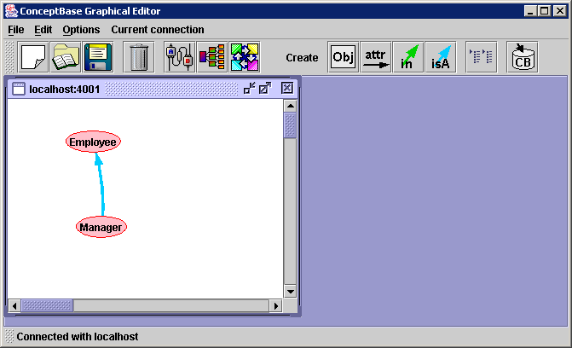
Notes:
graph_empl

Slide 15
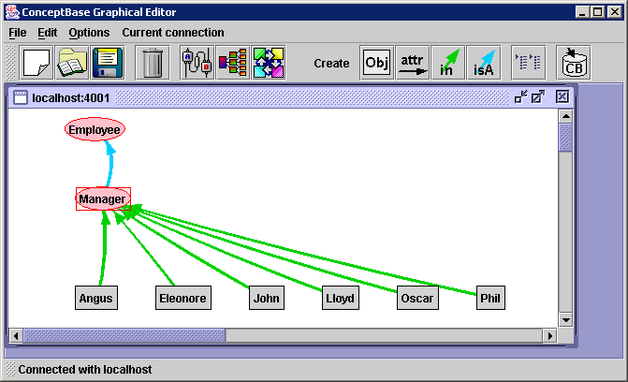
Notes:
graph_man

Slide 16
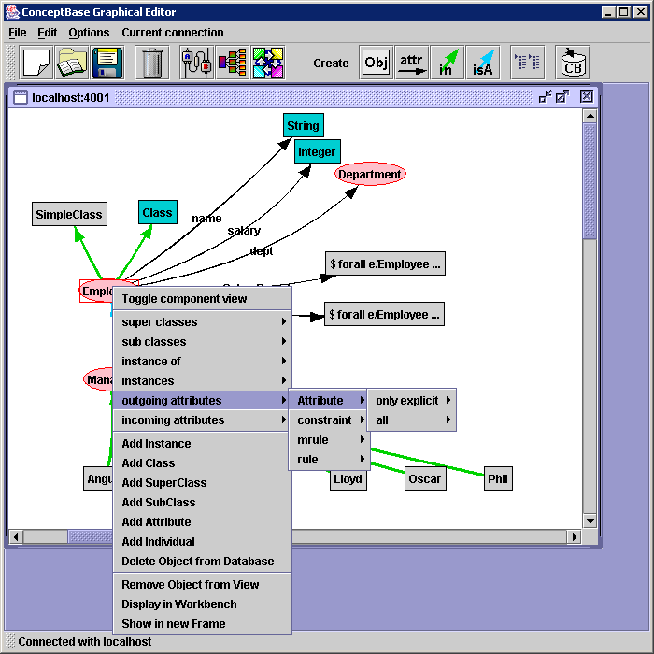
Notes:
graph_super

Slide 17
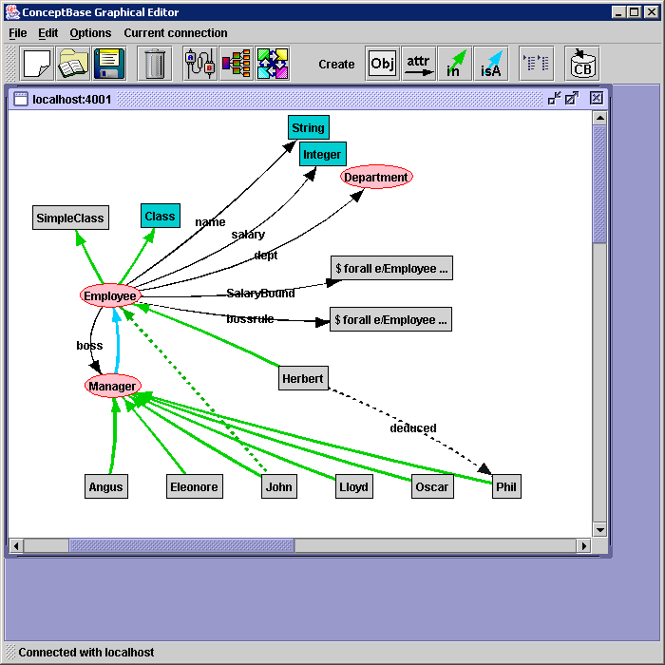
Notes:
graph_impl

Slide 18
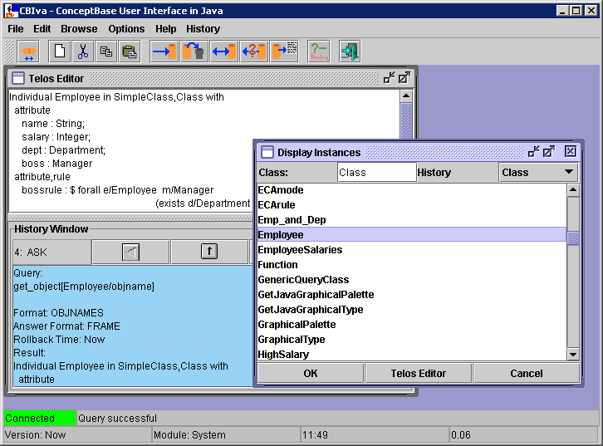
Notes:
telos_ed

Slide 19
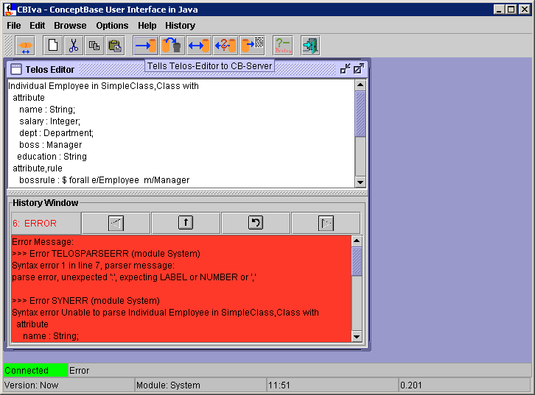
Notes:
telos_ed_error

Slide 20
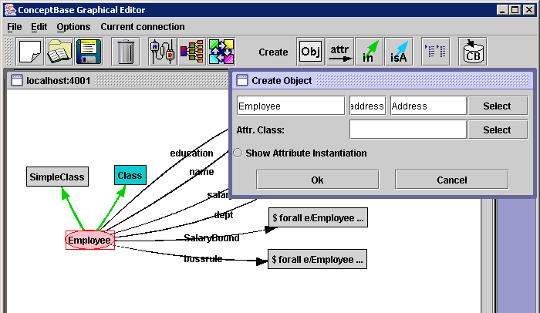
Notes:
graph_add_attr

Slide 21
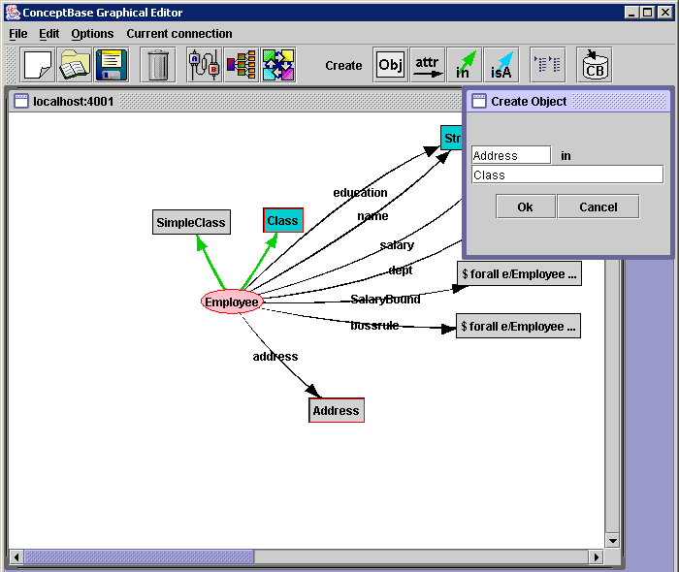
Notes:
graph_add_inst

Slide 22
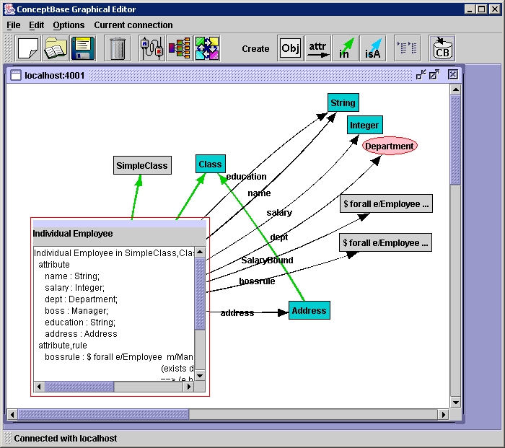
Notes:
graph_commit

Slide 23
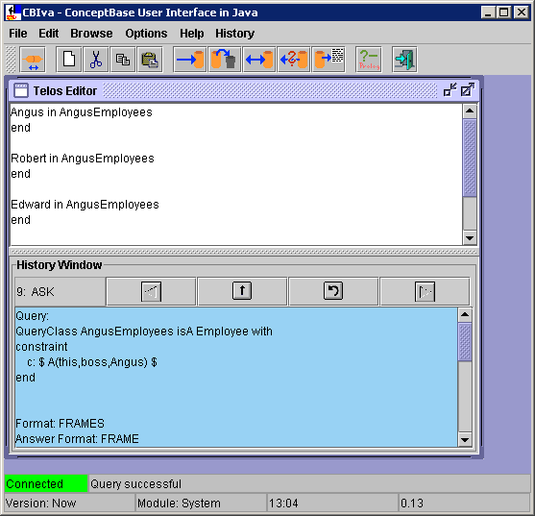
Notes:
query_answer

Slide 24
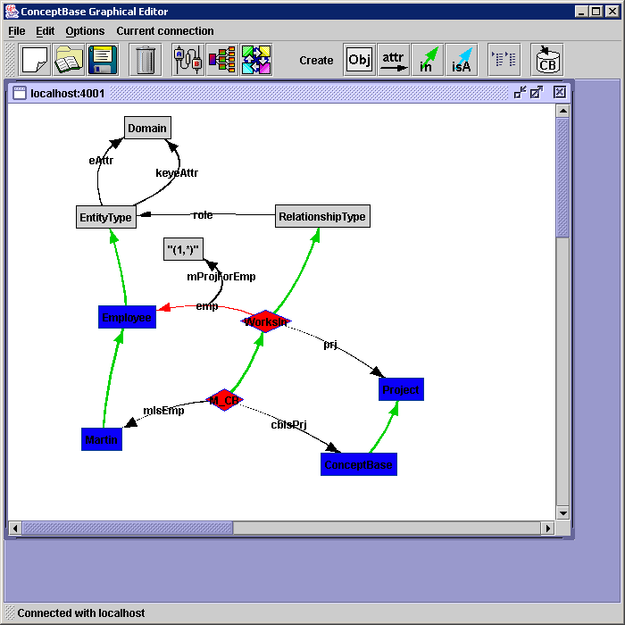
Notes:
er_incons

Slide 25
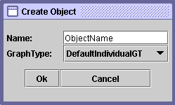
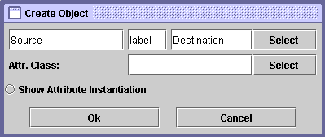
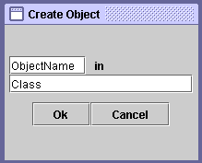

Notes:
createobject

Slide 26
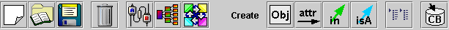
Open a new frame
(without connection)
Remove selected
objects
Show object
Create objects
Commit
Load & Save layout
Open
connection
Show links between marked objects
Show added/
removed objects
Notes:
graphed_toolbar

Slide 27
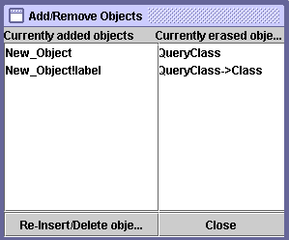
Notes:
graphed_addremove

Slide 28
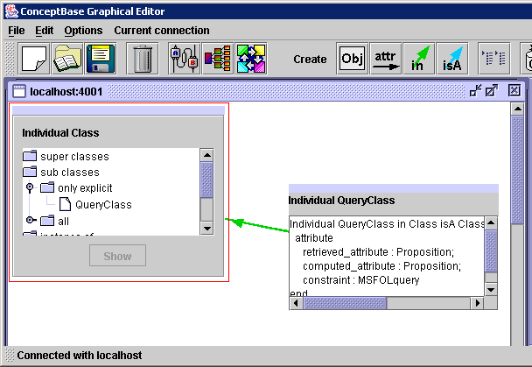
Notes:
componentview

Slide 29
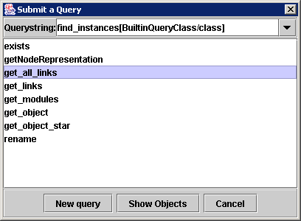
Notes:
querytoserver

Slide 30
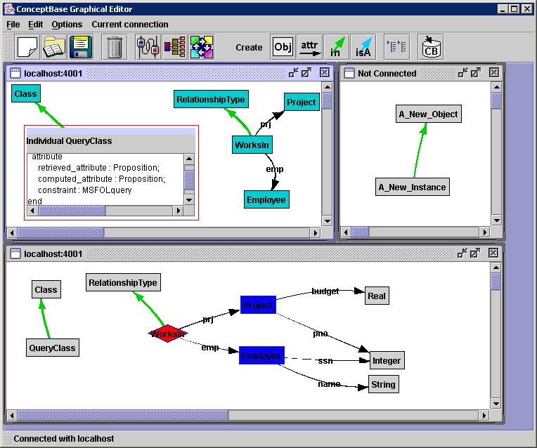
Notes:
overview

