Slide 1
PRODUCTION
Analysis of IMDB Dataset
DIRECTOR
Michelle, Uthara, Filbert, Jun Jie, Jit Woon
CAMERA
Group 3
DATE
SCENE
TAKE
2nd Nov 2021
1
#1

Slide 2


Known also as the Internet Movie DataBase
contains over 8 million titles but has been divided into subsets to allow ease of usage.
Stays relevant by being refreshed daily
Subsets used:
IMDb movies.csv - movies with attributes such as movie description, average rating, number of votes, genre, etc.
IMDb names.csv - cast members with personal attributes such as birth details, death details, height, spouses, children, etc.
IMDb ratings.csv - rating details from demographic perspective.
IMDb title_principals.csv - cast members roles in movies with attributes such as IMDb title id, IMDb name id, order of importance in the movie, role, and characters played.
We aim to help production houses in their decision making when trying to decide whether or not to support a proposal

Slide 3
Data Preparation
Variable Name | Description
Title | Title of the Movie
Genre | The first genre listed
Duration | Duration in minutes
Country | Country where movie was produced
Continent | Continent where movie was produced
Director | Movie director
Avg vote | Average rating out of 10
Budget | Budget of the movie
Worldwide gross | Worldwide box office proceeds
Profit | (Worldwide gross – budget)
Metascore | Average score out of 100, given by critics
Allgenders_age_avg vote | Average rating from each age group
Males_age_avg vote | Average rating from each male age group
Females_age_avg vote | Average rating from each female age group
Further Data Cleaning was conducted:
Filtered only movies produced from 2000-2020
Filtered out movies with less than 100 votes
Filtered out movies with no available information on budget and worldwide gross income
Took only the first listed genre and ignored the other 2 genres (if any)
Filtered out movies with budget < $100K
Filtered out movies with worldwide gross income < 1000

Slide 4
Dataset Limitations
Missing Data from columns (Budget, Worldwide Gross Income)
Some movies had multiple movie genres (up to three) and we only took the first one
Data is unbalanced as most movies are produced in North America and Europe, and very few movies are produced in Africa and South America

Slide 5
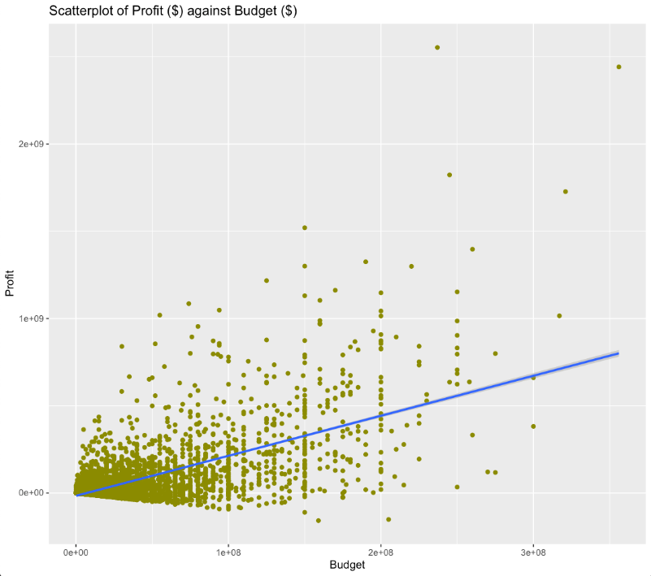
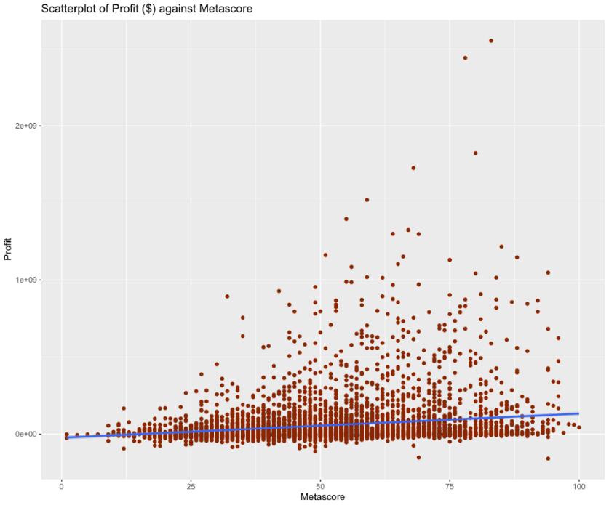
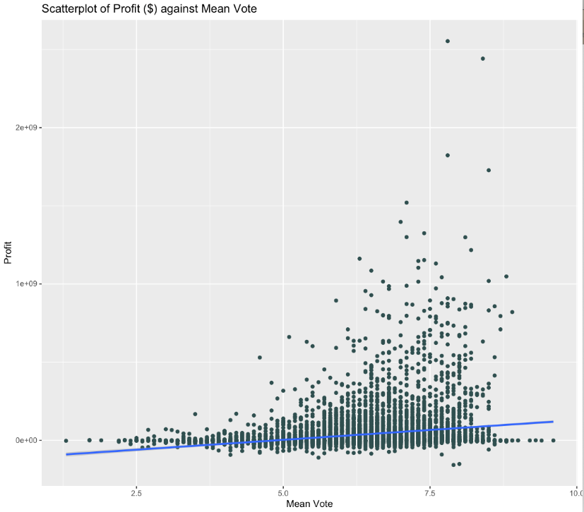
Statistical Analysis –
Scatterplot to analyze correlation of independent variables with Profit
Profit ($) vs Budget ($)
Profit ($) vs Metascore
Profit ($) vs Mean Vote
r = 0.663
r = ~0
r = 0.202
Notes:
shiny

Slide 6
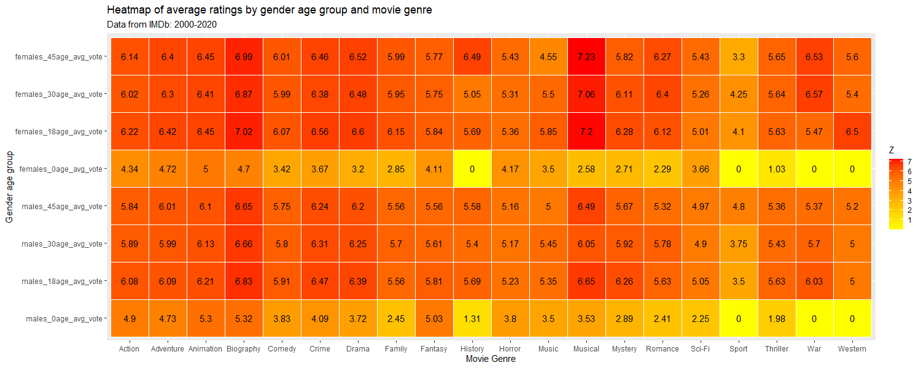
Statistical Analysis –
Average Ratings by Gender, Age Group and Movie Genre

Slide 7
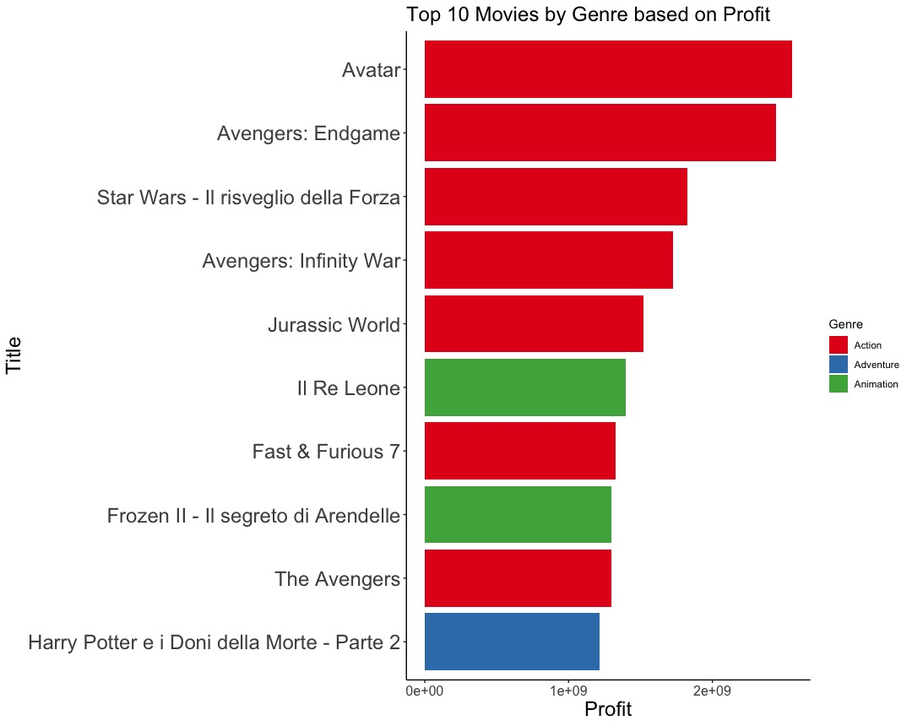
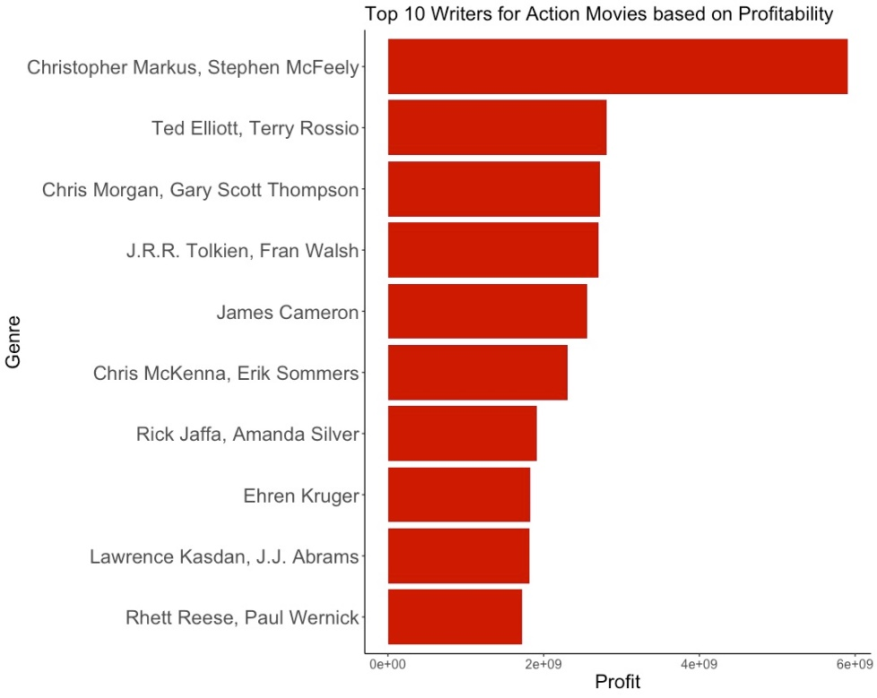
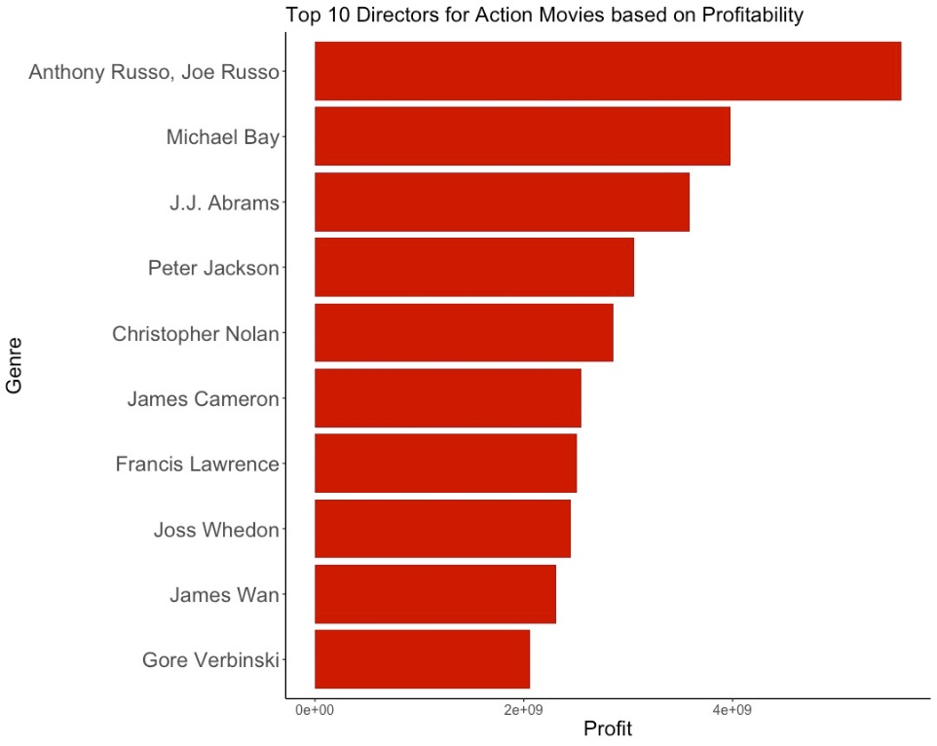
Statistical Analysis –
Ranking of top Genres, Directors and Writers based on Profitability
Top 10 movies by Genre
Top 10 Directors for Action movies
Top 10 Writers for Action movies
Notes:
shint

Slide 8
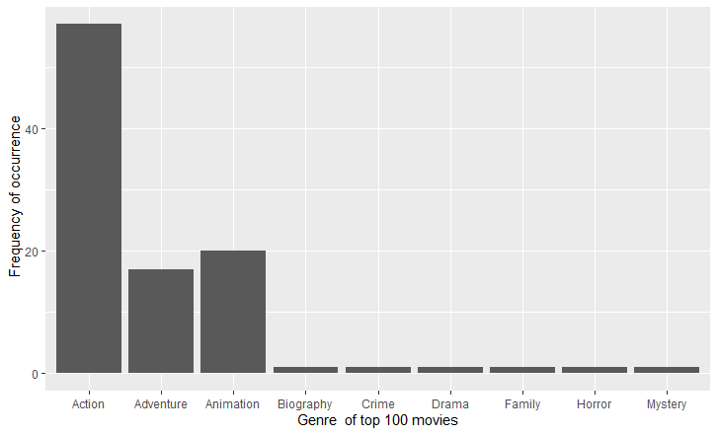
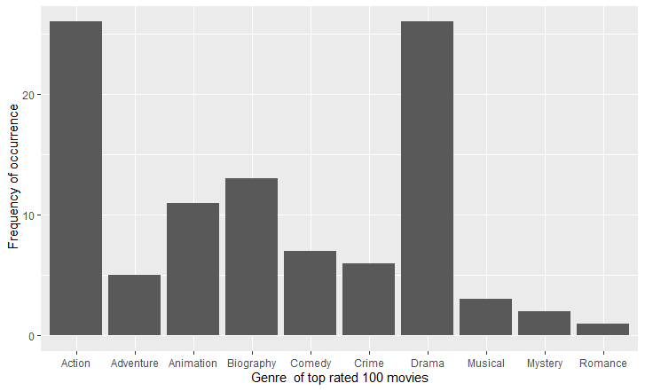
Statistical Analysis –
Ranking of top 100 genres in terms of profitability/ratings
Genres of top 100 most profitable movies
Genres of top 100 highly rated movies

Slide 9
Demo of Shiny App

