Slide 1
AI4I 2026 CHALLENGE — TRACK 4 (DEPLOYMENT)
Lango — AI Data Guard
■ Security and governance gateway for enterprise AI use
■ AI4I 2026 Challenge — Track 4 (Deployment)
■ Team Lango: Phakamile Mlala & Vanessa Moyo, NUST Bulawayo
● LANGO — AI DATA GUARD

Slide 2
02 — PROBLEM
Staff are pasting real institutional data into AI tools — with zero oversight
■ National IDs, bank details, and patient records routinely enter AI chat prompts
■ No logging, no control, no way to prove what left the institution
■ A live compliance and data-protection exposure today, not a hypothetical one
● LANGO — AI DATA GUARD

Slide 3
03 — WHO IT'S FOR
Built for the people accountable when this goes wrong
■ Primary user: frontline staff whose prompts pass through the gateway
■ Beneficiary and payer: compliance, risk, and IT security teams
■ Target sectors: banks, hospitals, government ministries
● LANGO — AI DATA GUARD

Slide 4
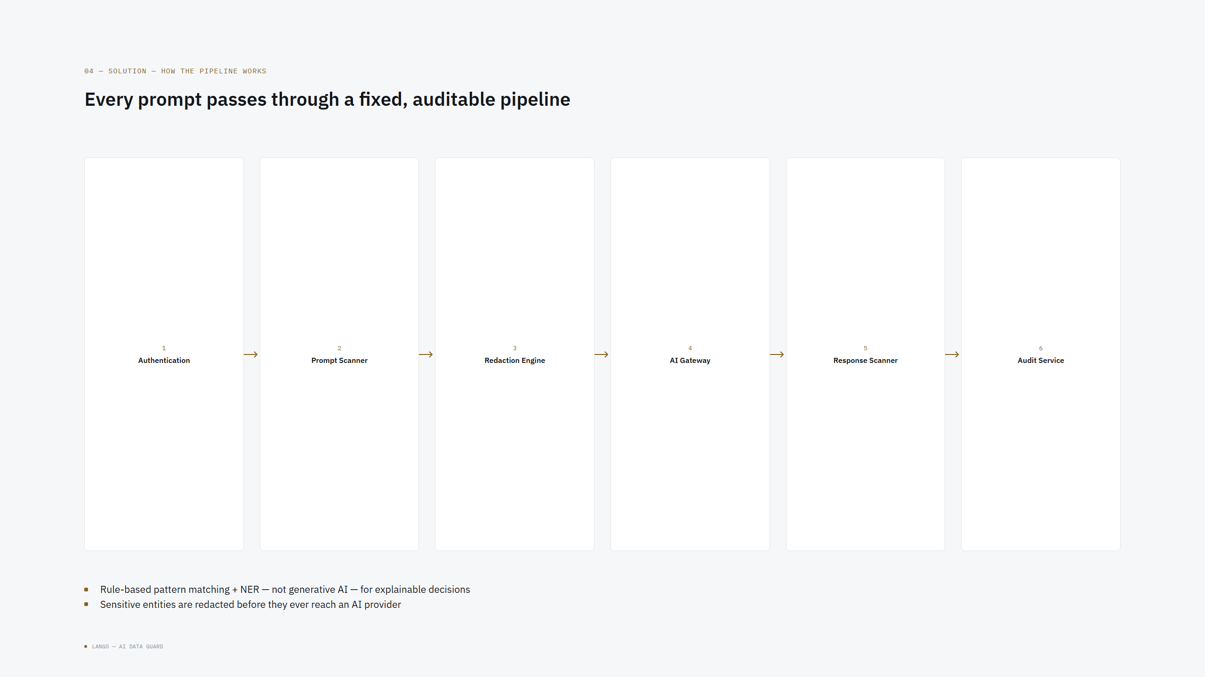

Slide 5
05 — LIVE DEMO
Switch to live demo here
lango-app-dusky.vercel.app
Walk through: Command Center → Audit Log → Fairness Audit → Drift & Security → Pilot & Sandbox
Live at lango-app-dusky.vercel.app — real Rust/Axum backend on Render, real PostgreSQL, not a frontend-only mockup. Presenter drives the actual app for this section, not slides.
● LANGO — AI DATA GUARD

Slide 6
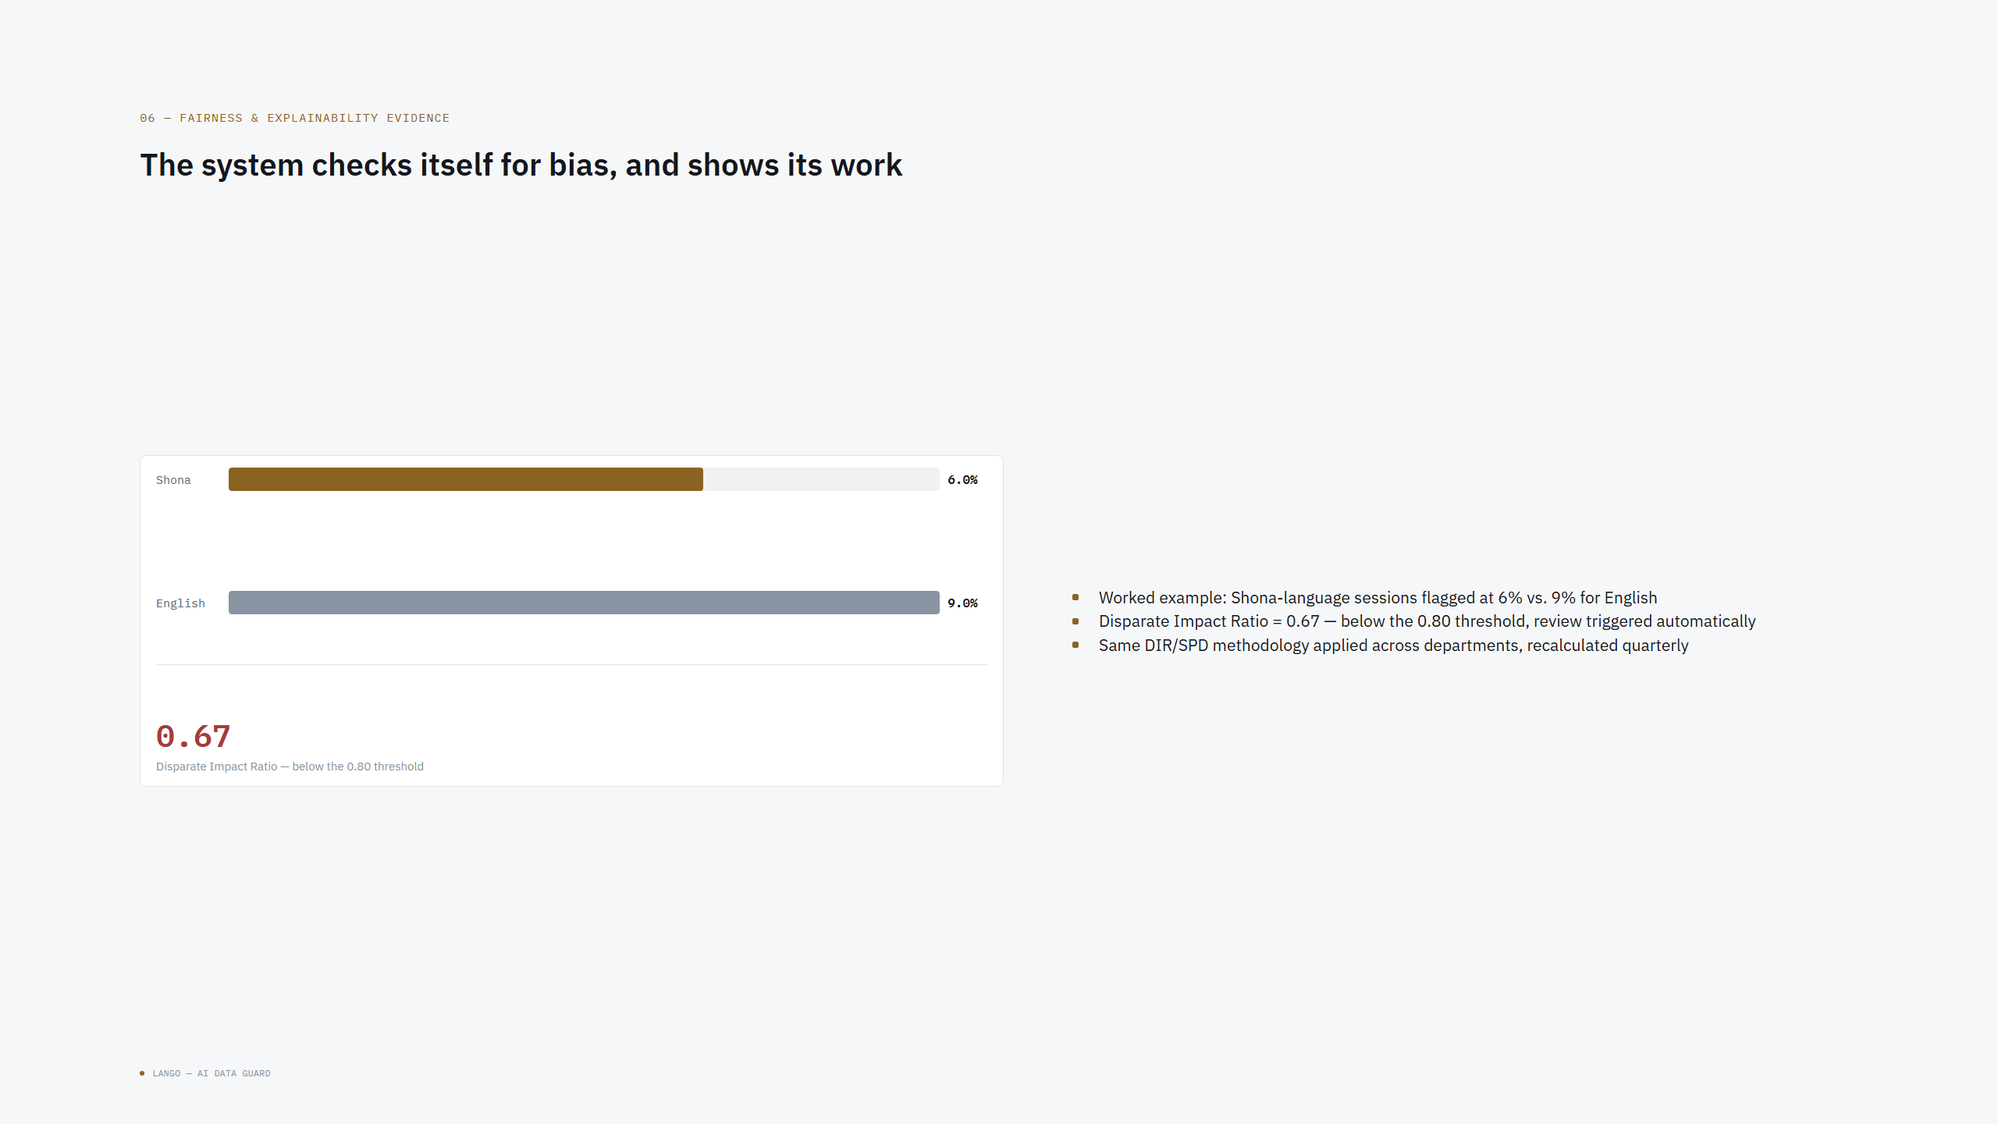

Slide 7
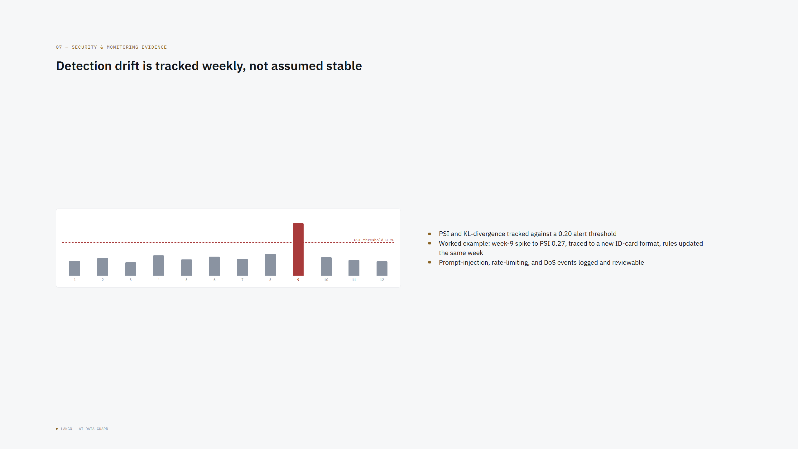

Slide 8
08 — BUSINESS MODEL
Institution pays, staff use, compliance benefits
■ Customer: the institution (bank/hospital/ministry), bought at CISO/Head of Compliance level
■ Pilot phase: no revenue yet — proving the concept at one institution, one department
■ Post-pilot: per-seat/per-institution licensing, priced against the cost of a compliance incident avoided
● LANGO — AI DATA GUARD

Slide 9
09 — ROADMAP
30 / 60 / 90-day path from a real, deployed, hardened v0.1 to a validated pilot
■ Day 30: pilot institution and department confirmed, consent signed off, institution onboarded onto the platform (multi-tenant isolation, rate limiting, and a basic internal security pass are already built and tested — this is about onboarding a real institution onto existing infrastructure, not building that infrastructure)
■ Day 60: midpoint review — redaction accuracy and fairness measured on real pilot traffic
■ Day 90: full pilot cohort onboarded, go/no-go decision on scale-out
● LANGO — AI DATA GUARD

Slide 10
10 — TEAM + ASK
Team Lango — and what we need next
■ Phakamile Mlala (Team Leader, Electronic Engineering, NUST Bulawayo) & Vanessa Moyo (Researcher, Product Design)
■ Built with Claude and Claude Code for drafting and implementation — reviewed by the team throughout
■ Ask: a real pilot institution partner — multi-tenant isolation, rate limiting, and a basic internal security pass are already built and tested, not the ask anymore
■ Also need: input from a real institutional security/compliance reviewer on the shared-vs-dedicated-instance tenancy tradeoff (see docs/DEPLOYMENT_PLAN.md) — a decision worth making with an actual institutional stakeholder, not in isolation — plus support standing up a live AI provider connection and a formal penetration test ahead of real institutional traffic
● LANGO — AI DATA GUARD

