Slide 1
Fruit Data
Fruit | Quantity | Price per Unit
Apples | 5 | $0.50
Mangoes | 3 | $1.00
Oranges | 4 | $0.75
Melons | 2 | $1.50
Bananas | 6 | $0.30

Slide 2
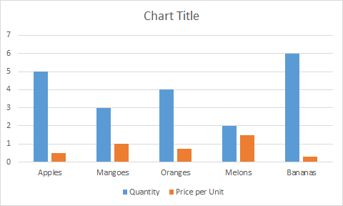
Fruit Chart

