Slide 1

Assay of β- Glucosidase
Laxman Manjhi 2019BB10034
Ratnesh Kumar Sharma 2019BB10047

Slide 2

Background
β-Glucosidase is an enzyme that catalyzes the hydrolysis of β-D-glucosides into glucose and another molecule. An assay of β-glucosidase measures the amount of enzyme activity in a sample. This is typically done by measuring the amount of glucose produced from a substrate over time and converting that measurement to units of activity. The assay can be used to determine the activity of β-glucosidase in various samples, including bacteria, yeast, plant tissues, and more. The specific conditions of the assay, such as temperature, pH, and substrate concentration, may be optimized for each sample to ensure accurate results.

Slide 3
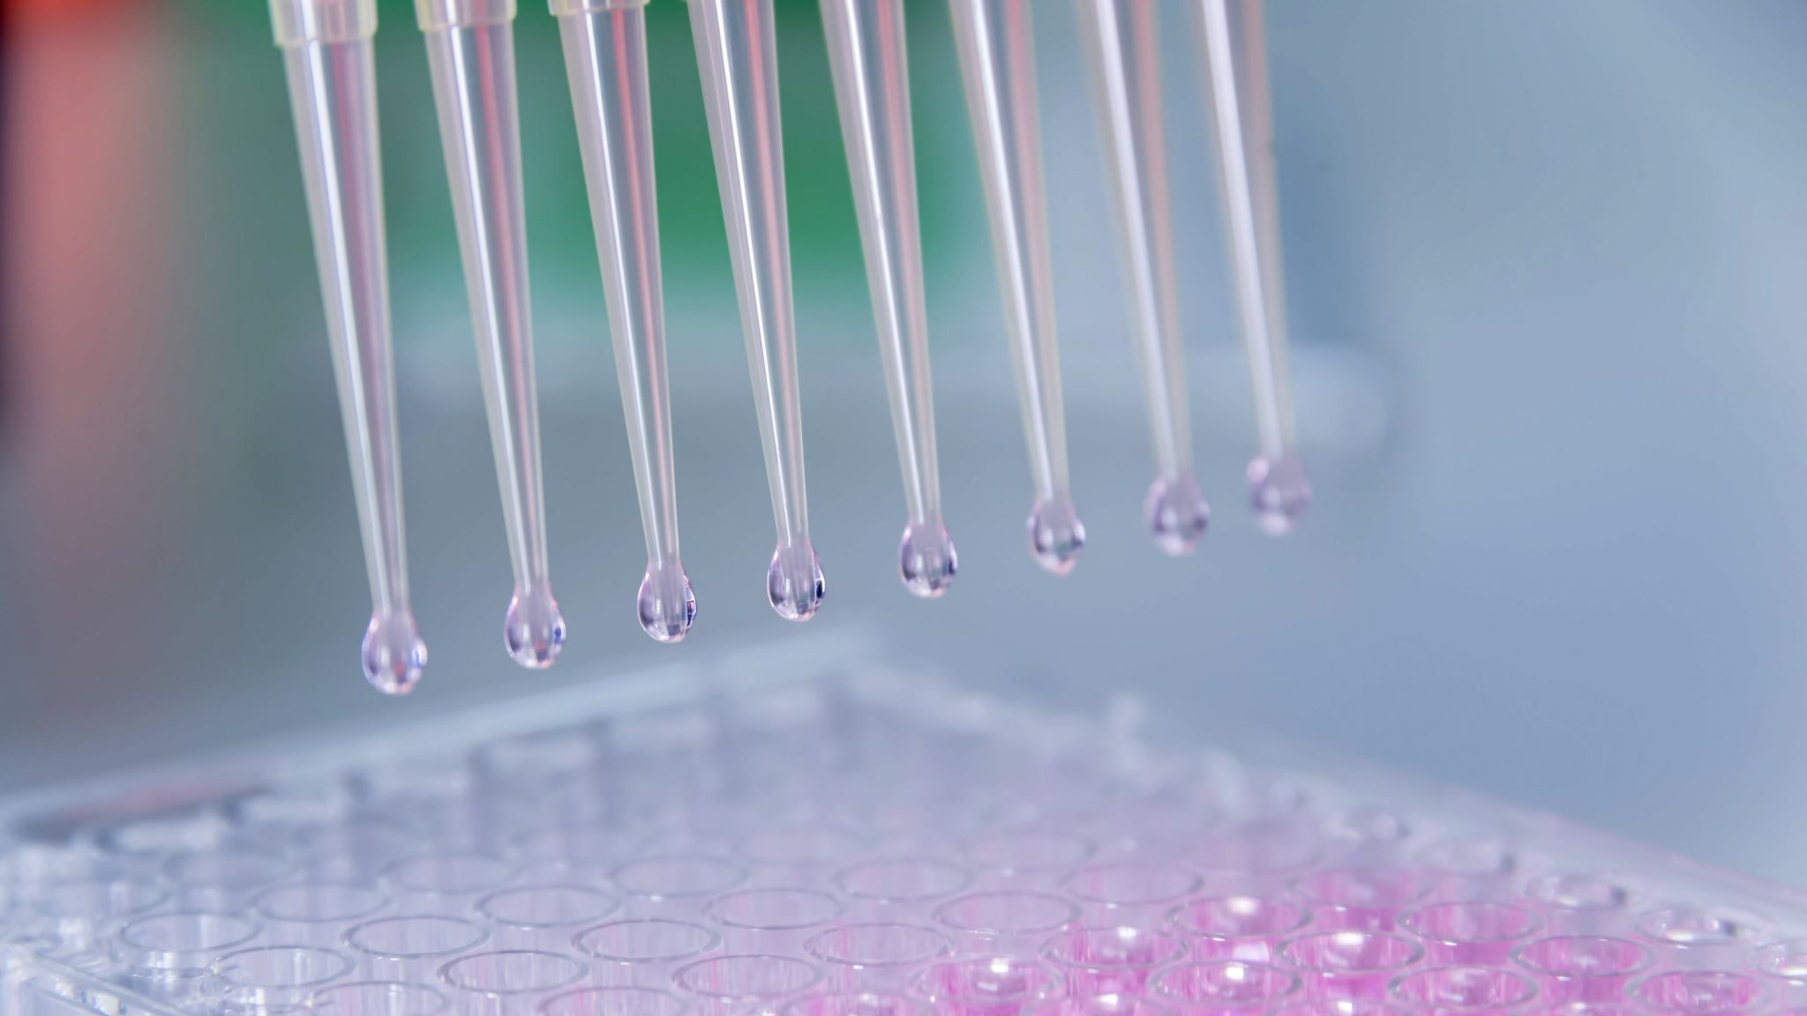
Methods
I. Standard Curve a. Dilute PNP solution from 10 µM to 100 µM with citrate buffer to a final volume of 1 mL. You can use dilutions of 20, 40, 60, 80, or 100 µM. (Note: Dilute with citrate buffer, not water) b. Add 0.5 mL of 1N Na2CO3 to each tube and measure the OD at 405 nm against a reagent blank (Blank = 1 mL citrate buffer + 0.5 mL 1N Na2CO3).
II. Enzyme Assay a. Add 0.9 mL of pre-equilibrated PNPG solution to 100 µL of enzyme. b. Incubate the solution in a water bath for 10 minutes. c. Stop the reaction by adding 0.5 mL of 1N Na2CO3 to each tube. d. Measure the absorbance at 405 nm. (Blank = 0.1 mL citrate buffer + 0.9 mL PNPG + 0.5 mL of 1N Na2CO3)

Slide 4
OBSERVATION
conc | abs
0 | 0
20 | 0.27
40 | 0.535
60 | 0.725
80 | 1.047
100 | 1.279
Unknown
50c | 1.154
RM | 0.443

Slide 5
GRAPH

Slide 6
Calculation
Equation is y= 0.0128x
Where,
Y= Abs
X=Conc.
Conc. At 50c= 90
Conc. At RT= 34.60

Slide 7
THANK YOU

