Slide 1
First Law of Thermodynamics
You will recall from Chapter 5 that energy cannot be created nor destroyed.
Therefore, the total energy of the universe is a constant.
Energy can, however, be converted from one form to another or transferred from a system to the surroundings or vice versa.

Slide 2
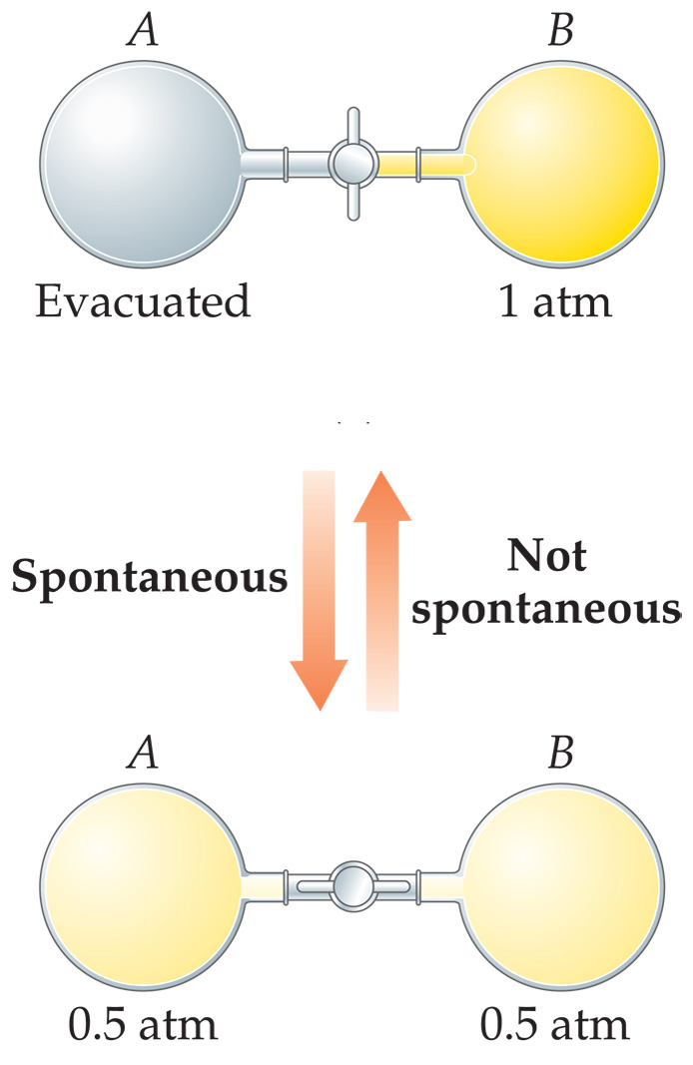
Spontaneous Processes
Spontaneous processes are those that can proceed without any outside intervention.
The gas in vessel B will spontaneously effuse into vessel A, but once the gas is in both vessels, it will not spontaneously

Slide 3
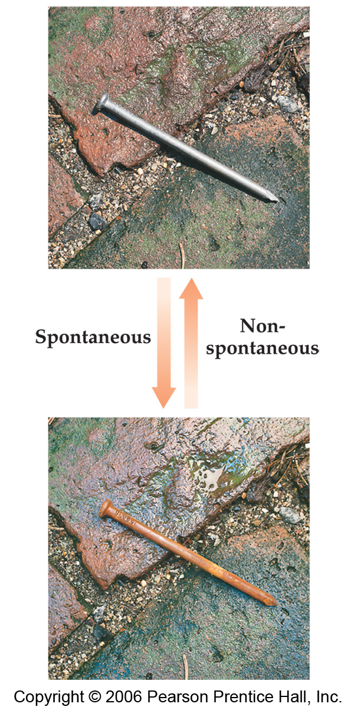
Spontaneous Processes
  Processes that are spontaneous in one direction are nonspontaneous in the reverse direction.

Slide 4
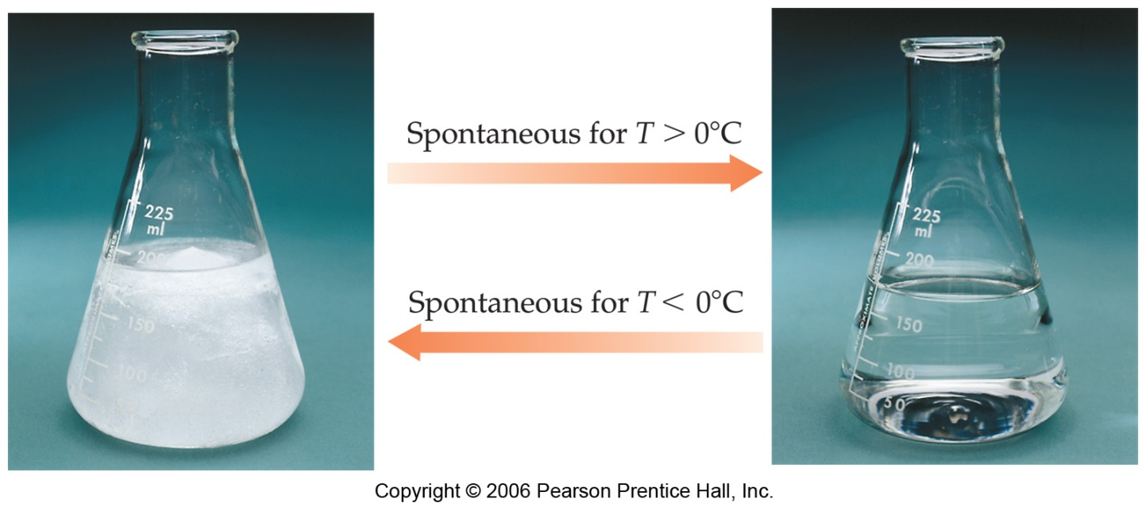
Spontaneous Processes
Processes that are spontaneous at one temperature may be nonspontaneous at other temperatures.
Above 0°C it is spontaneous for ice to melt.
Below 0°C the reverse process is spontaneous.

Slide 5
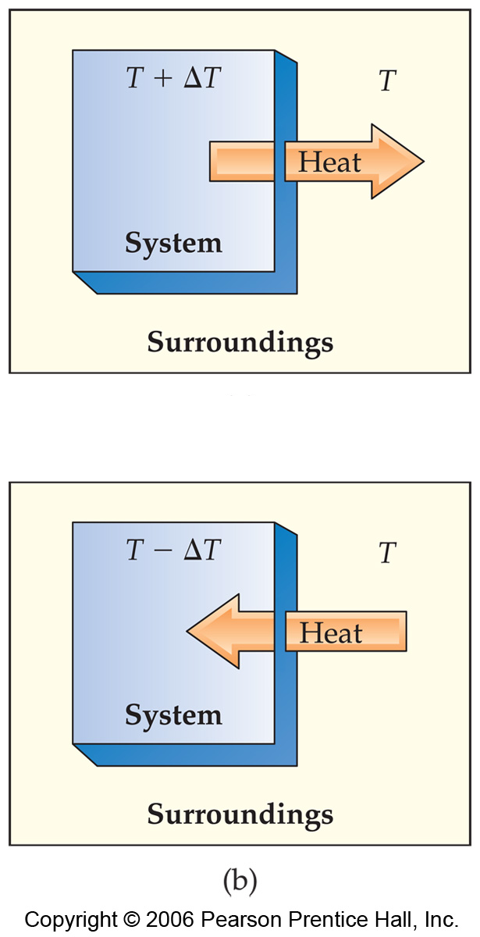
Reversible Processes
  In a reversible process the system changes in such a way that the system and surroundings can be put back in their original states by exactly reversing the process.
  Changes are infinitesimally small in a reversible process.

Slide 6
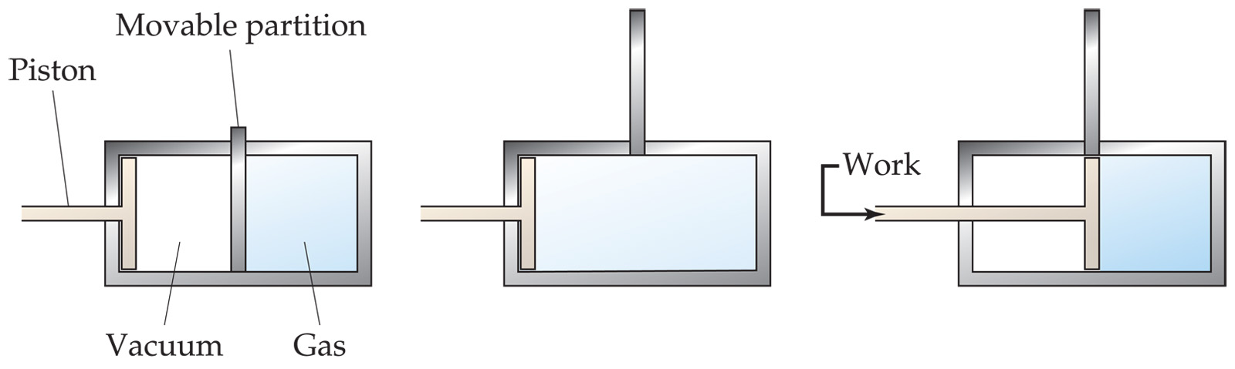
Irreversible Processes
Irreversible processes cannot be undone by exactly reversing the change to the system.
All Spontaneous processes are irreversible.
All Real processes are irreversible.

Slide 7
Entropy
Entropy (S) is a term coined by Rudolph Clausius in the 19th century.
Clausius was convinced of the significance of the ratio of heat delivered and the temperature at which it is delivered,
q
T

Slide 8
Entropy
Entropy can be thought of as a measure of the randomness of a system.
It is related to the various modes of motion in molecules.

Slide 9
Entropy
Like total energy, E, and enthalpy, H, entropy is a state function.
Therefore,
ΔS = S_{final} − S_{initial}

Slide 10

Entropy
For a process occurring at constant temperature (an isothermal process):
q_{rev} = the heat that is transferred when the process is carried out reversibly at a constant temperature.
T = temperature in Kelvin.

Slide 11
Second Law of Thermodynamics
The second law of thermodynamics: The entropy of the universe does not change for reversible processes
and
increases for spontaneous processes.
Reversible (ideal):
Irreversible (real, spontaneous):

Slide 12
Second Law of Thermodynamics
“You can’t break even”
Reversible (ideal):
Irreversible (real, spontaneous):

Slide 13
Second Law of Thermodynamics
The entropy of the universe increases (real, spontaneous processes).
But, entropy can decrease for individual systems.
Reversible (ideal):
Irreversible (real, spontaneous):

Slide 14
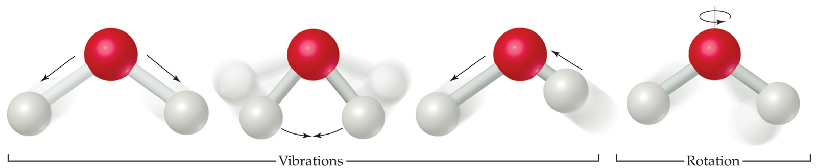
Entropy on the Molecular Scale
Ludwig Boltzmann described the concept of entropy on the molecular level.
Temperature is a measure of the average kinetic energy of the molecules in a sample.

Slide 15
Entropy on the Molecular Scale
Molecules exhibit several types of motion:
  Translational: Movement of the entire molecule from one place to another.
  Vibrational: Periodic motion of atoms within a molecule.
  Rotational: Rotation of the molecule on about an axis or rotation about σ bonds.
Notes:
€

Slide 16
Entropy on the Molecular Scale
Boltzmann envisioned the motions of a sample of molecules at a particular instant in time.
  This would be akin to taking a snapshot of all the molecules.
He referred to this sampling as a microstate of the thermodynamic system.

Slide 17
Entropy on the Molecular Scale
Each thermodynamic state has a specific number of microstates, W, associated with it.
Entropy is
S = k lnW
where k is the Boltzmann constant, 1.38 × 10⁻²³ J/K.

Slide 18
Entropy on the Molecular Scale
Implications:
• more particles
-> more states -> more entropy
• higher T
-> more energy states -> more entropy
• less structure (gas vs solid)
-> more states -> more entropy

Slide 19
Entropy on the Molecular Scale
The number of microstates and, therefore, the entropy tends to increase with increases in
  Temperature.
  Volume (gases).
  The number of independently moving molecules.

Slide 20
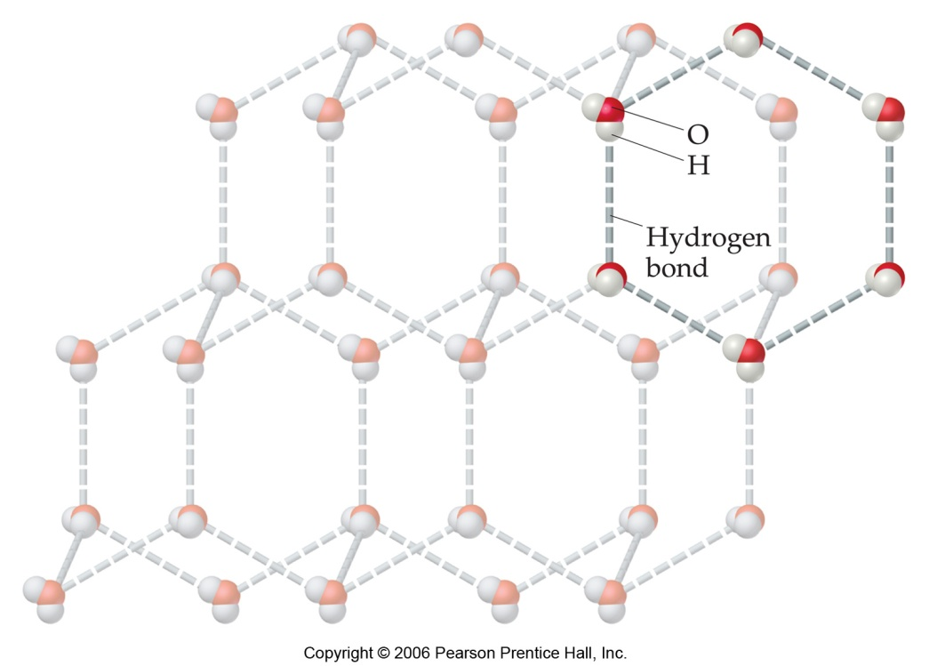
Entropy and Physical States
Entropy increases with the freedom of motion of molecules.
Therefore,
S(g) > S(l) > S(s)

Slide 21
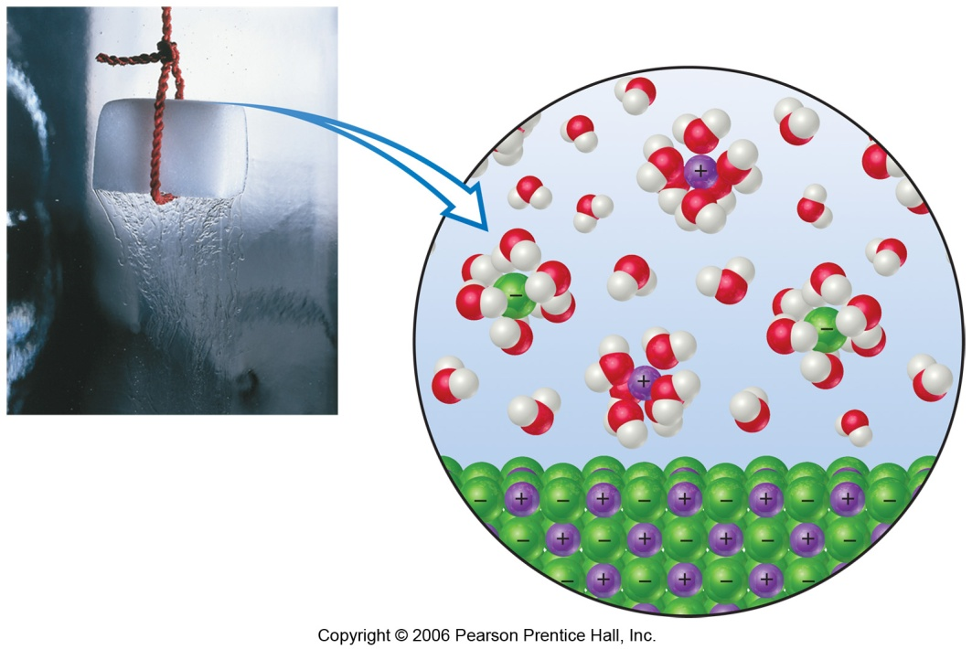
Solutions
  Dissolution of a solid:
  Ions have more entropy (more states)
  But,
  Some water molecules have less entropy (they are grouped around ions).
Usually, there is an overall increase in S.
(The exception is very highly charged ions that make a lot of water molecules align around them.)

Slide 22
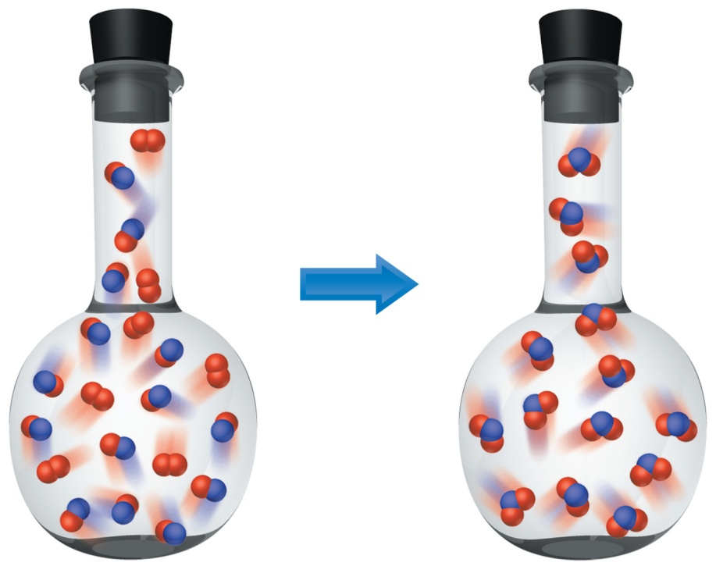
Entropy Changes
In general, entropy increases when
  Gases are formed from liquids and solids.
  Liquids or solutions are formed from solids.
  The number of gas molecules increases.
  The number of moles increases.

Slide 23
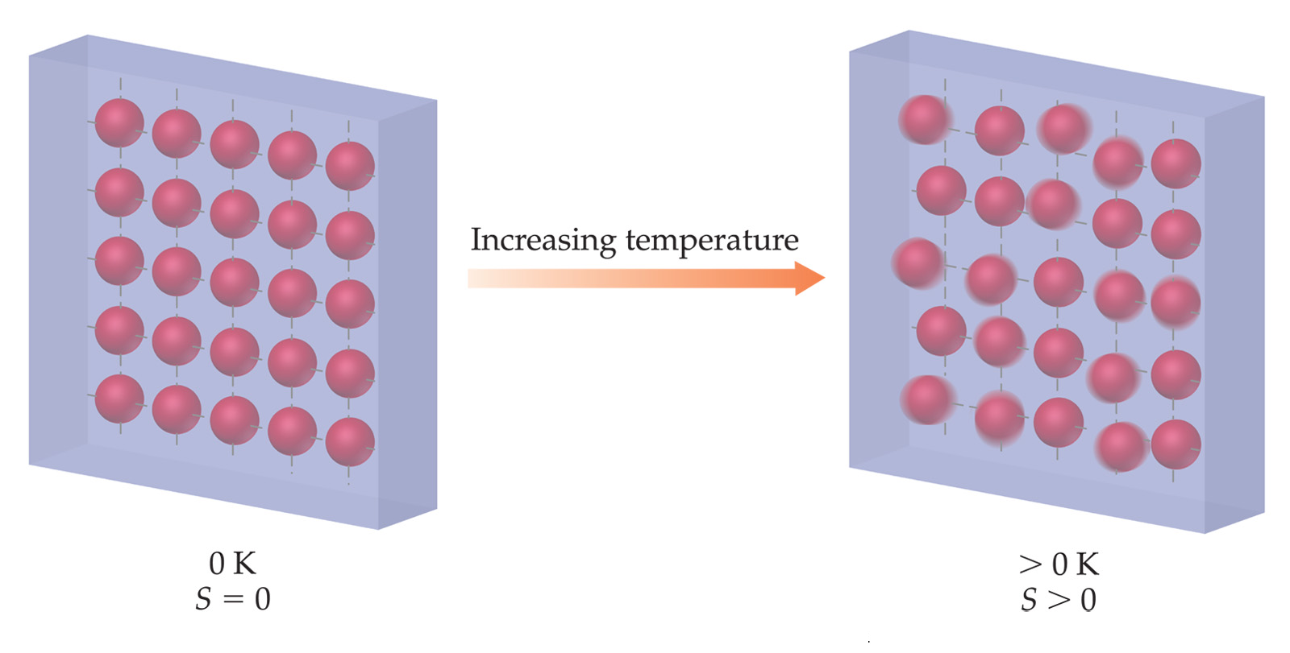
Third Law of Thermodynamics
The entropy of a pure crystalline substance at absolute zero is 0.

Slide 24

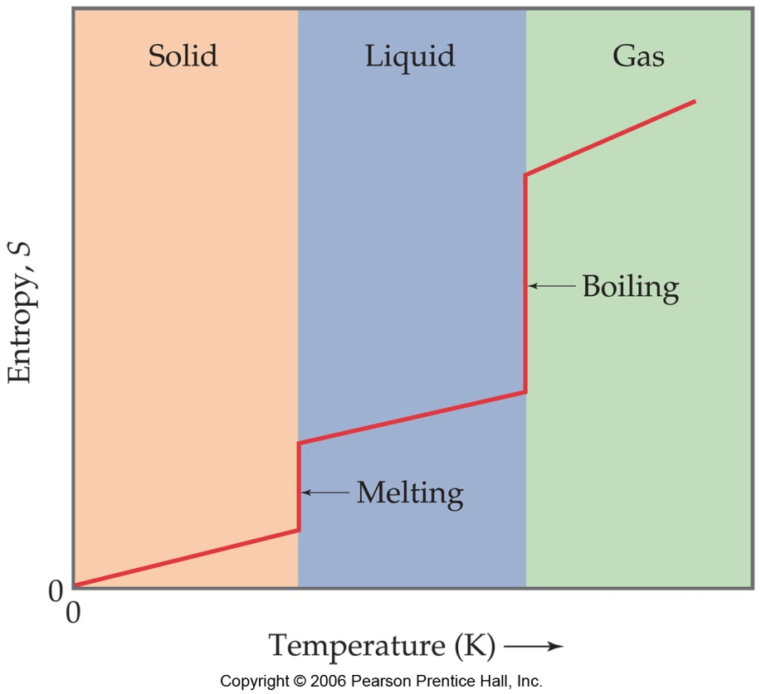
Third Law of Thermodynamics
The entropy of a pure crystalline substance at absolute zero is 0.
No stereotypes, labels, or genres can rationalize this. Fueled by the decay of the world, order and chaos unite, Entropy is born...
Music to make your head explode
Entropy:
Smiles for stab wounds
2004
http://www.garageband.com/artist/entropy_1

Slide 25
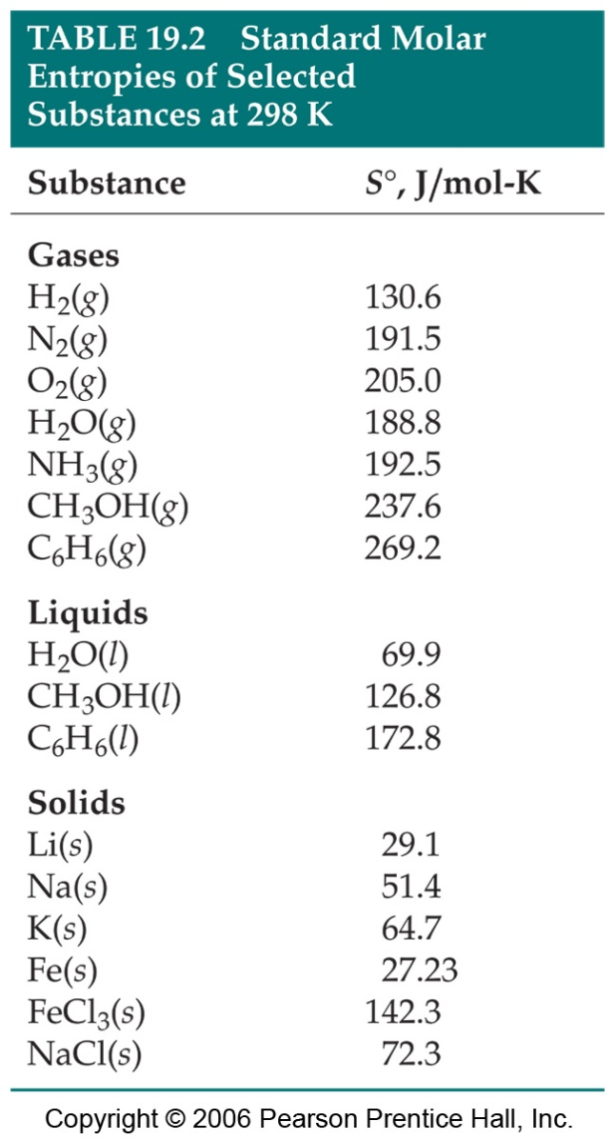
Standard Entropies
These are molar entropy values of substances in their standard states.
Standard entropies tend to increase with increasing molar mass.

Slide 26
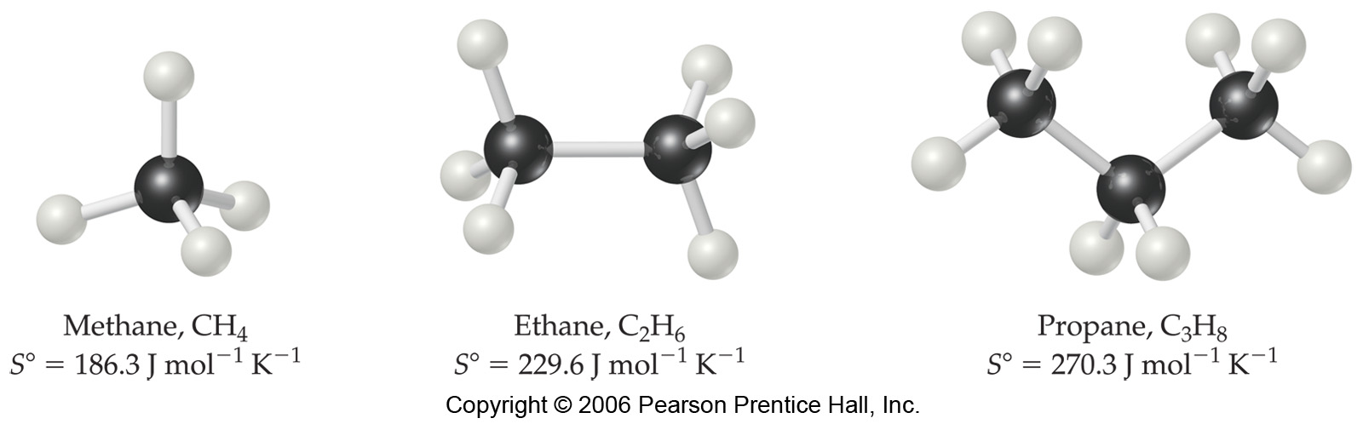
Standard Entropies
Larger and more complex molecules have greater entropies.

Slide 27

Entropy Changes
Entropy changes for a reaction can be calculated the same way we used for ΔH:
S° for each component is found in a table.
Note for pure elements:

Slide 28

Practical uses: surroundings & system
Entropy Changes in Surroundings
Heat that flows into or out of the system also changes the entropy of the surroundings.
For an isothermal process:

Slide 29

Practical uses: surroundings & system
Entropy Changes in Surroundings
Heat that flows into or out of the system also changes the entropy of the surroundings.
For an isothermal process:
At constant pressure, q_{sys} is simply ΔH° for the system.

Slide 30

Link S and ΔH: Phase changes
A phase change is isothermal (no change in T).
Entropy_{system}
For water:
ΔH_{fusion} = 6 kJ/mol
ΔH_{vap} = 41 kJ/mol
If we do this reversibly: ΔS_{surr} = –ΔS_{sys}

Slide 31
Practical uses: surroundings & system
Entropy Change in the Universe
The universe is composed of the system and the surroundings.
Therefore,
ΔS_{universe} = ΔS_{system} + ΔS_{surroundings}
For spontaneous processes
ΔS_{universe} > 0

Slide 32


Practical uses: surroundings & system
= – Gibbs Free Energy

Slide 33

Practical uses: surroundings & system
= – Gibbs Free Energy
Make this equation nicer:

Slide 34
Practical uses: surroundings & system
…Gibbs Free Energy
−TΔS_{universe} is defined as the Gibbs free energy, ΔG.
For spontaneous processes: ΔS_{universe} > 0
And therefore: ΔG < 0
ΔG is easier to determine than ΔS_{universe}.
So:
Use ΔG to decide if a process is spontaneous.

Slide 35
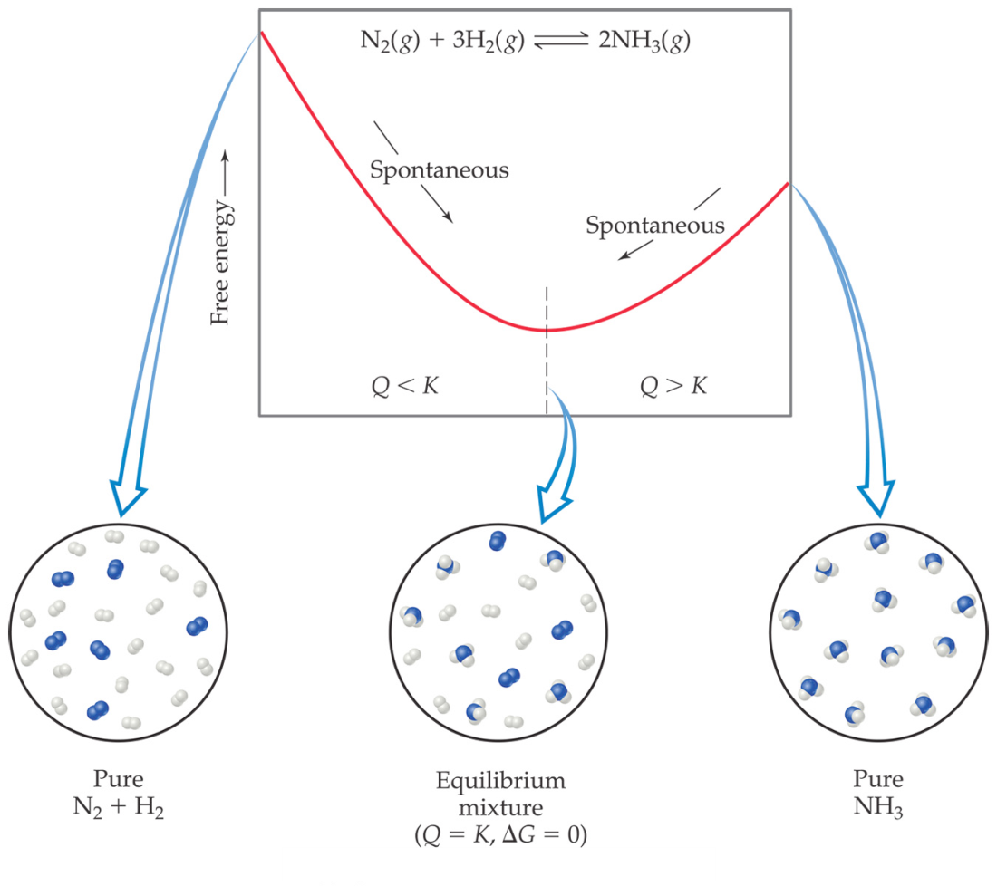
Gibbs Free Energy
If ΔG is negative, the forward reaction is spontaneous.
If ΔG is 0, the system is at equilibrium.
If ΔG is positive, the reaction is spontaneous in the reverse direction.

Slide 36
Standard Free Energy Changes
Standard free energies of formation, ΔG_{f}° are analogous to standard enthalpies of formation, ΔH_{f}°.
ΔG° can be looked up in tables,
or
calculated from S° and ΔH°.

Slide 37
Free Energy Changes
Very key equation:
This equation shows how ΔG° changes with temperature.
(We assume S° & ΔH° are independent of T.)

Slide 38
Free Energy and Temperature
There are two parts to the free energy equation:
  ΔH°— the enthalpy term
  TΔS° — the entropy term
The temperature dependence of free energy comes from the entropy term.

Slide 39
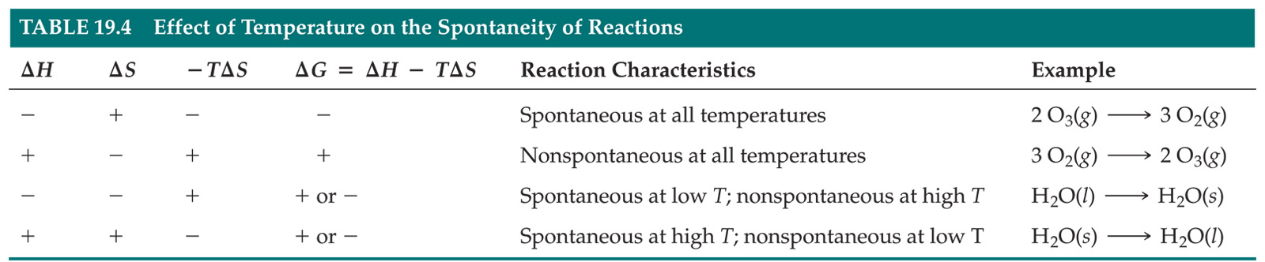
Free Energy and Temperature
By knowing the sign (+ or -) of ΔS and ΔH,
we can get the sign of ΔG and determine if a reaction is spontaneous.

Slide 40

Free Energy and Equilibrium
Remember from above:
If ΔG is 0, the system is at equilibrium.
So ΔG must be related to the equilibrium constant, K (chapter 15). The standard free energy, ΔG°, is directly linked to K_{eq} by:

Slide 41

Free Energy and Equilibrium
Under non-standard conditions, we need to use ΔG instead of ΔG°.
Q is the reaction quotiant from chapter 15.
Note: at equilibrium: ΔG = 0.
away from equil, sign of ΔG tells which way rxn goes spontaneously.

Slide 42
Gibbs Free Energy
If ΔG is negative, the forward reaction is spontaneous.
If ΔG is 0, the system is at equilibrium.
If ΔG is positive, the reaction is spontaneous in the reverse direction.

