Slide 1
FileStar Sample
Filestar AB

Slide 2
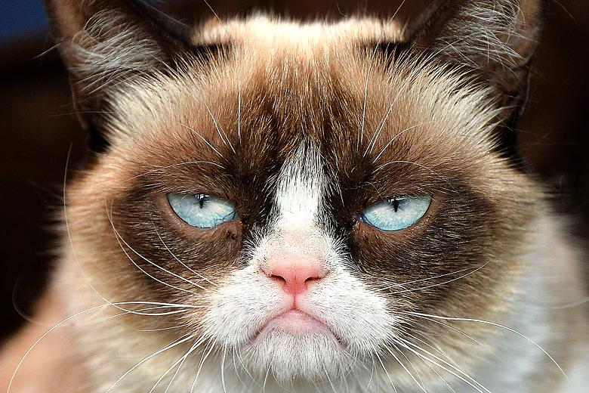
Grumpy cat

