Slide 1
Authorities

Slide 2

In Plain View

Slide 3
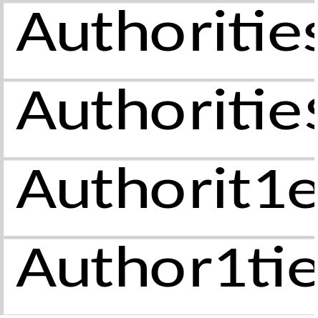
Embedded Excel and Table
Authorities
Authoritie$
Authorit1es
Author1ties

Slide 4


Authorities

