Slide 1
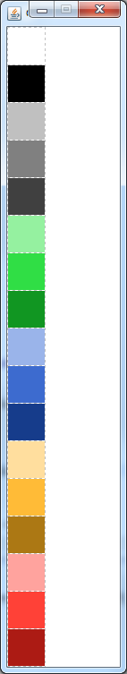
CellColor.NONE
CellColor.BLUE_LIGHT
CellColor.BLACK
CellColor.BLUE
CellColor.GREY_LIGHT
CellColor.BLUE_DARK
CellColor.GREY
CellColor.YELLOW_LIGHT
CellColor.GREY_DARK
CellColor.YELLOW
CellColor.GREEN_LIGHT
CellColor.YELLOW_DARK
CellColor.GREEN
CellColor.RED_LIGHT
CellColor.GREEN_DARK
CellColor.RED
CellColor.RED_DARK

Slide 2
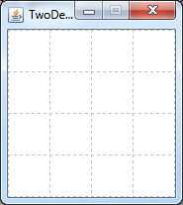
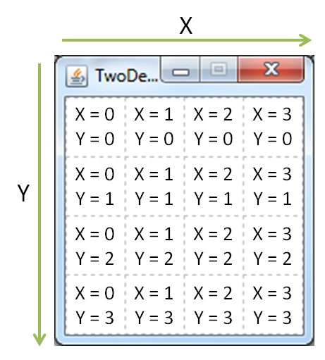
X
X = 0
Y = 0
X = 1
Y = 0
X = 2
Y = 0
X = 3
Y = 0
Y
X = 0
Y = 1
X = 1
Y = 1
X = 2
Y = 1
X = 3
Y = 1
X = 0
Y = 2
X = 1
Y = 2
X = 2
Y = 2
X = 3
Y = 2
X = 0
Y = 3
X = 1
Y = 3
X = 2
Y = 3
X = 3
Y = 3

Slide 3
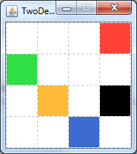

Slide 4
