Slide 1
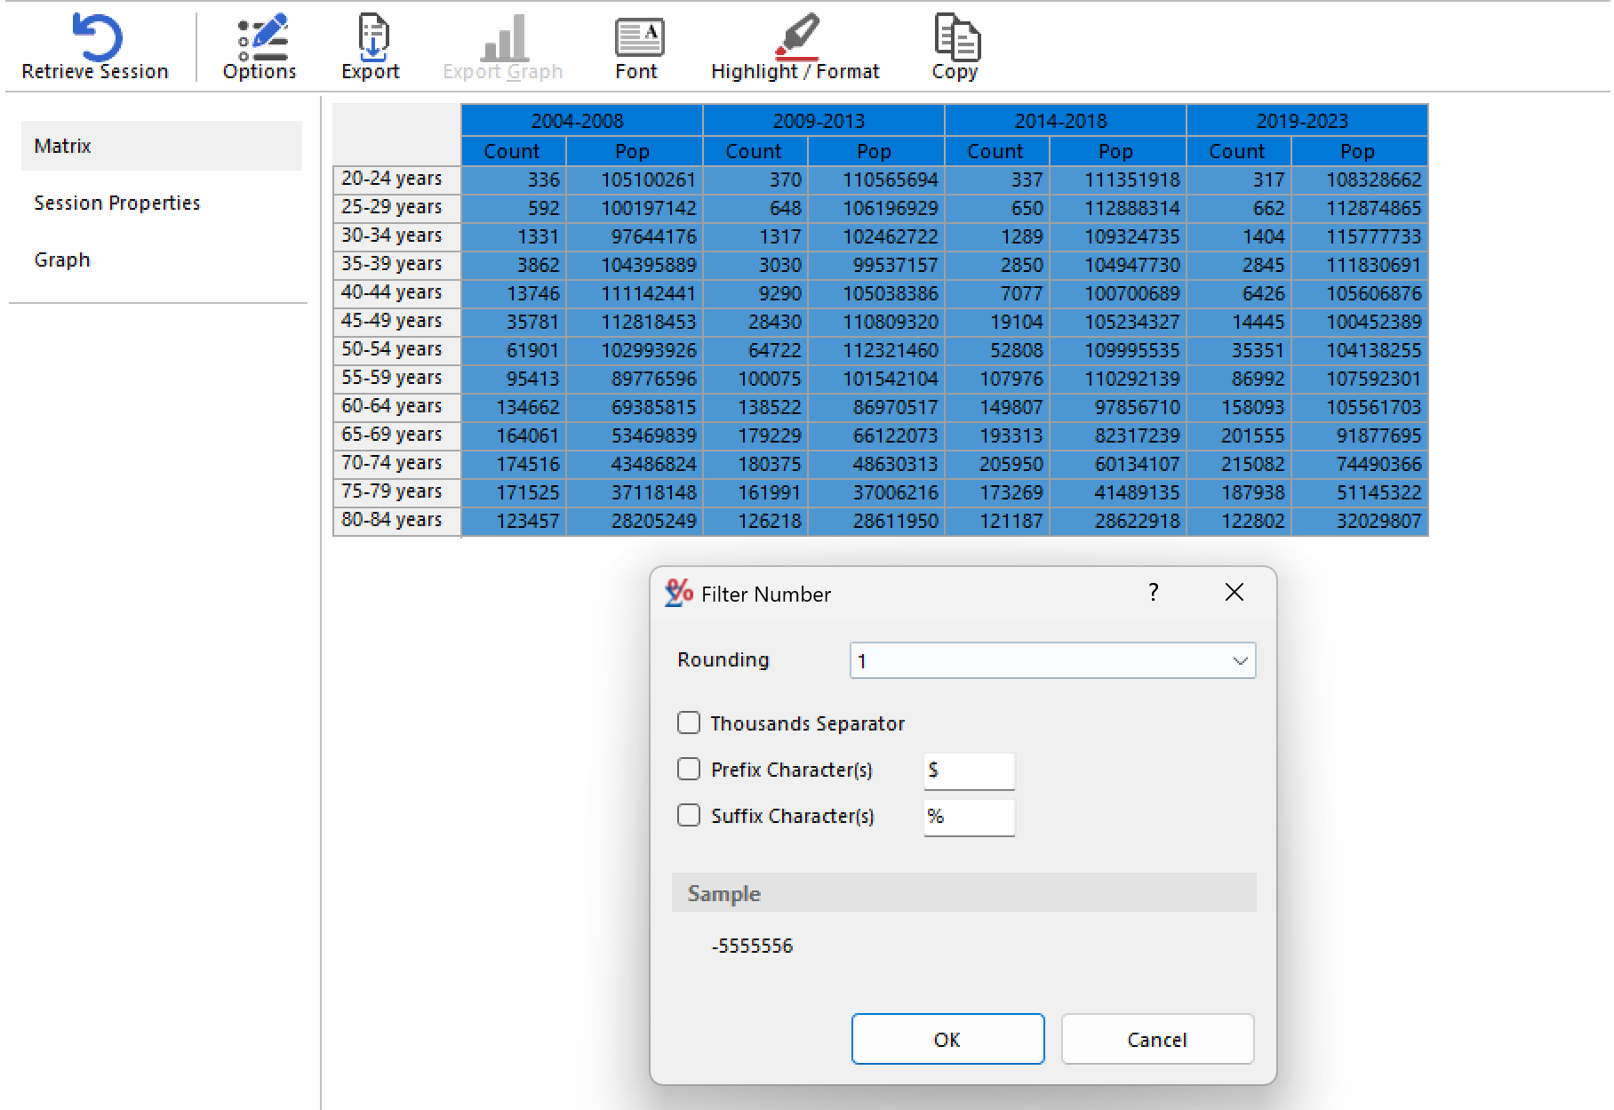
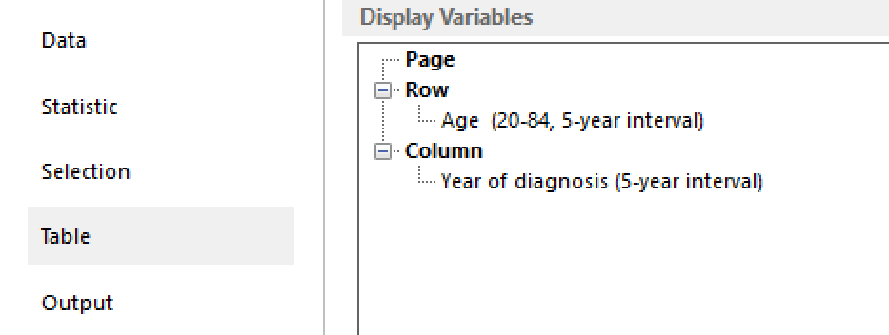
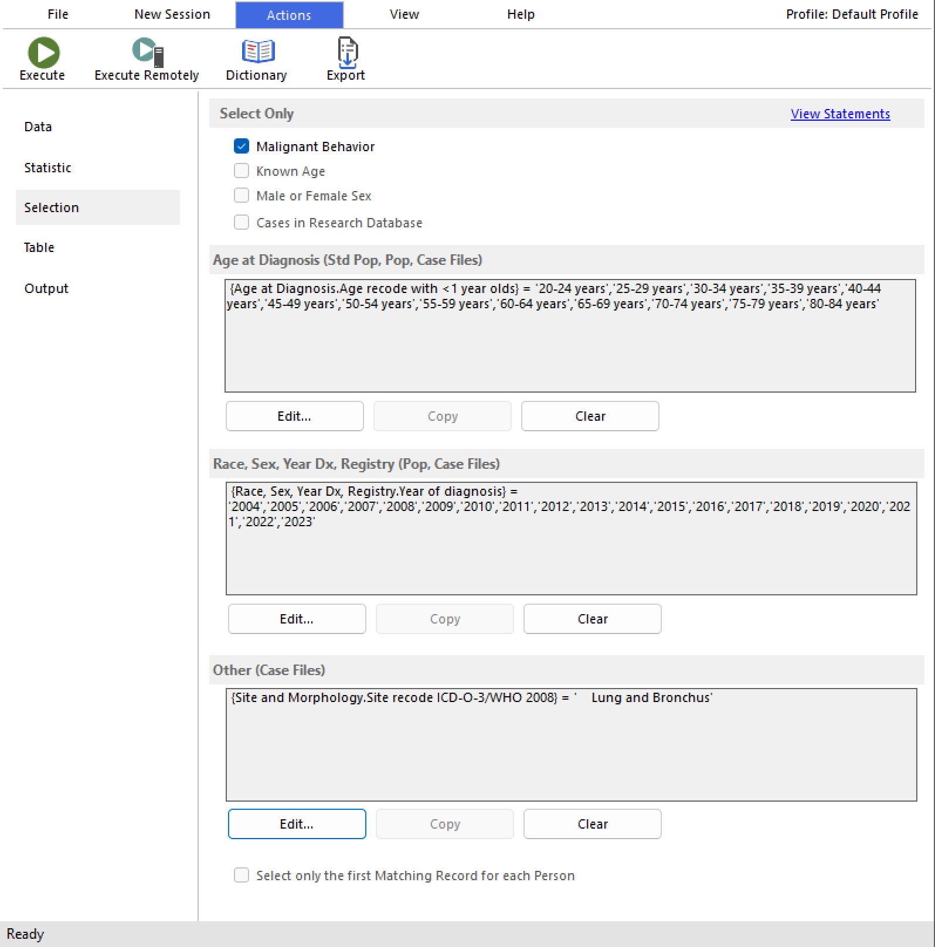
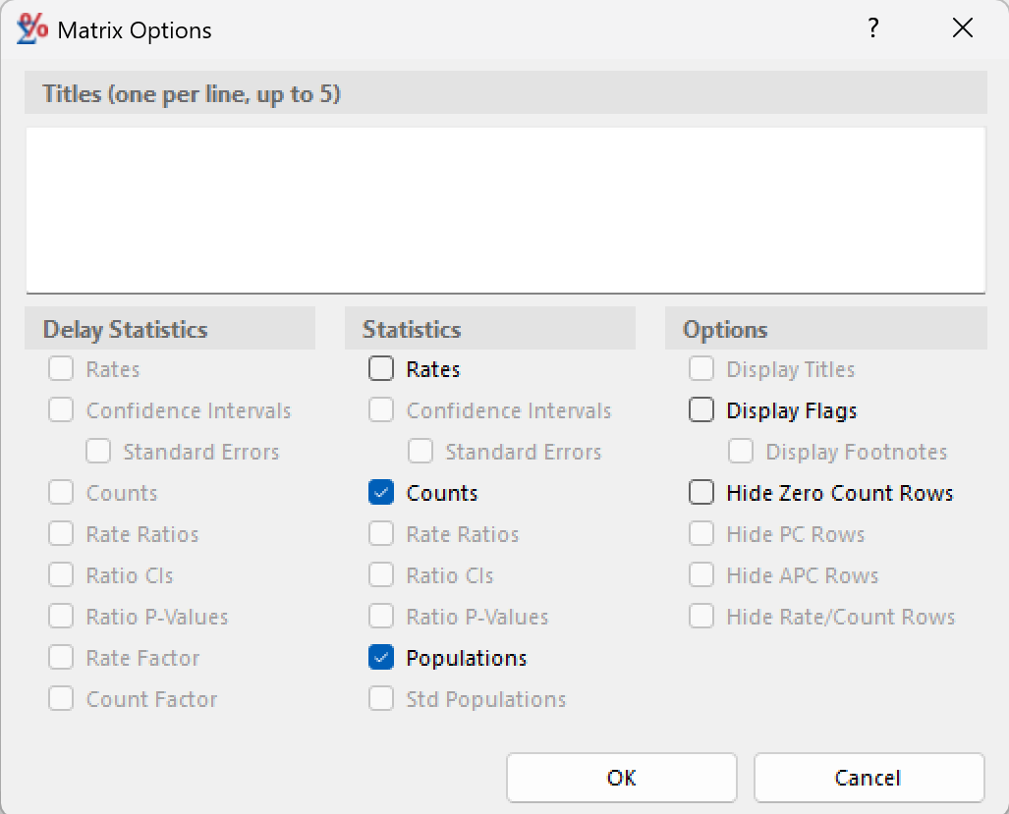
From SEER*Stat to the APC Input Matrix in Excel
1
Open a Rate session
3
Group age and calendar years
6
Highlight/Format—All columns—Filter
Select a database
Create grouped year and age variables so period width equals age width.
Click Highlight/Format, select all columns. Right-click any column title, select Filter, deselect Thousands Separator.
2
Set the case selection
4
Build the table
Set restrictions for age, year of diagnosis,
cancer types, and other variables.
Row = age in 5-year interval
Column = year of diagnosis in 5-year interval
5
Option—Keep only Counts and Populations
Click Option in the top bar and deselect others except
Counts and Populations
7
Copy—Page
Click Copy in the top bar, select Page/All Pages, then paste into Excel.
Notes:
SEER*Stat Rate sessions return Count and Population columns directly; the only reshaping needed is to interleave them by calendar period. Verify a few cells against the SEER*Stat rate output before pasting into the web tool.

Slide 2
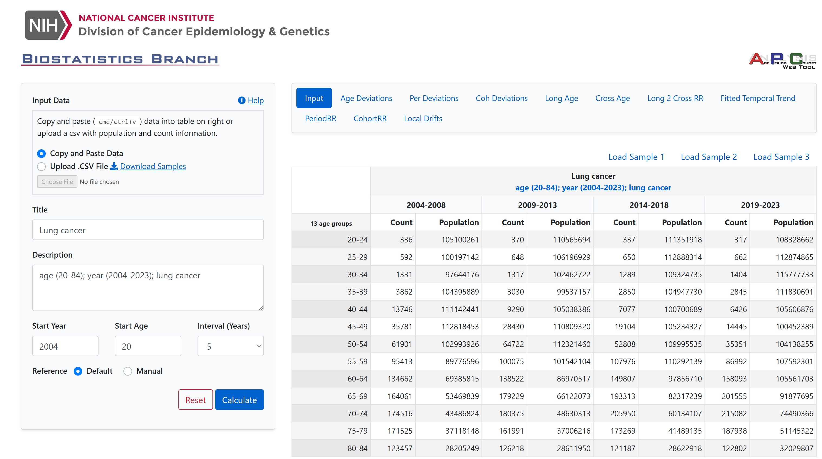
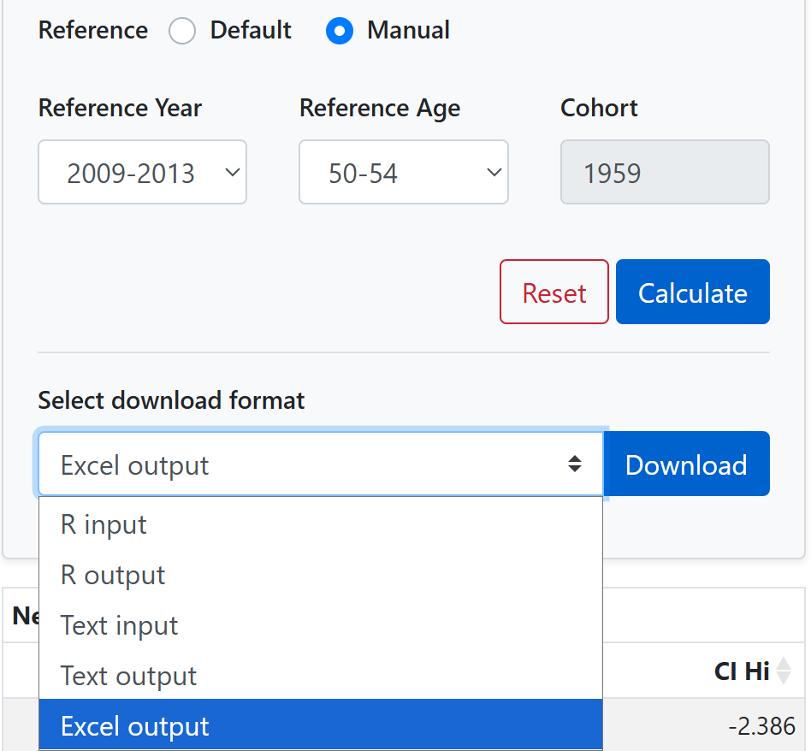
APC Web Tool (NCI)
Entry by copy-paste from Excel into the Input matrix
Rules the tool enforces
Age and period intervals must be equal in width: 5-year age groups require 5-year periods.
Count and Population cells cannot be zero
Metadata to supply: Title, Start Year, Start Age, Interval.
Default reference uses the central age group, central period, and mid-year cohort. If an alternative cohort should be the reference, select Manual and choose the reference year and age.
Click Calculate and select the output format.
Notes:
Input is a rectangular matrix of A age-group rows by 2P columns: for each calendar period, a Count column immediately followed by its Population (person-years) column. Equal age and period interval widths are what make the diagonals correspond to birth cohorts.

Slide 3
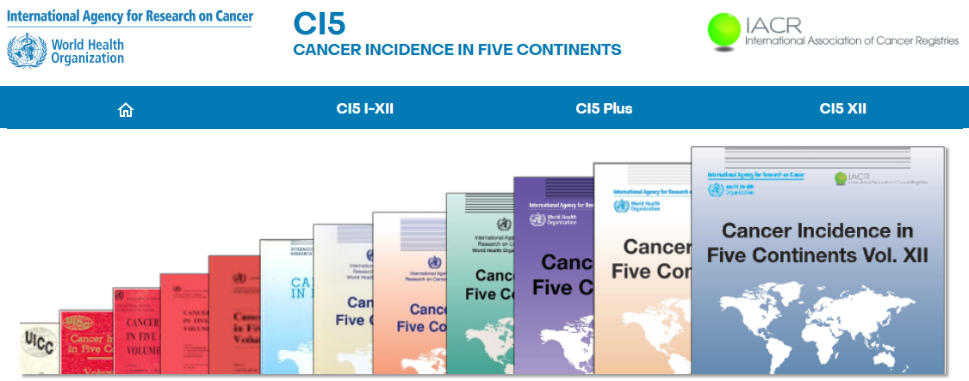

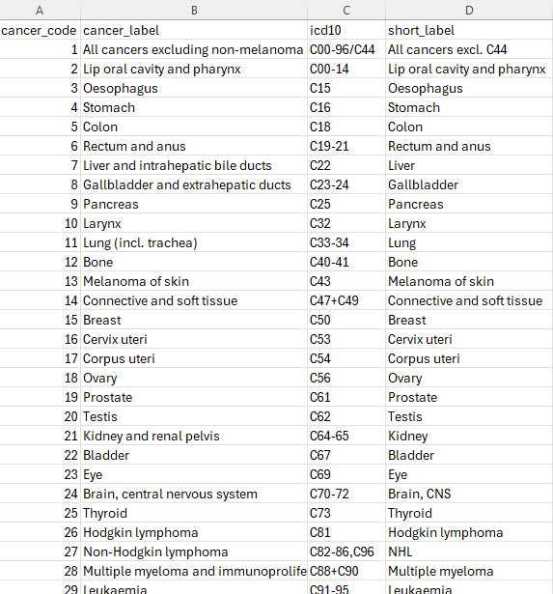
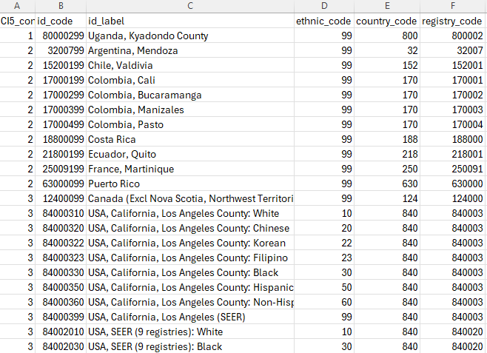
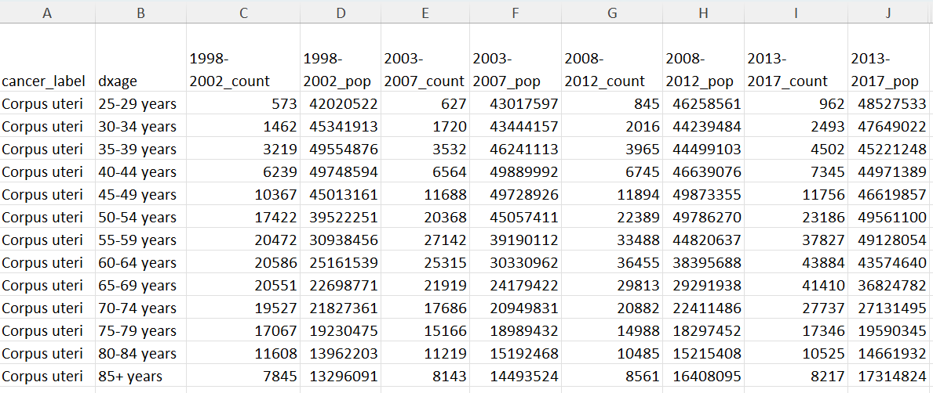
From the CI5 Plus Database to the APC Input Matrix
1
Visit CI5 website (https://ci5.iarc.fr/)
Select the CI5 Plus tab to access the database
4
Confirm country registry coverage
For countries with multiple registries, refer to the Cancer Over Time (https://gco.iarc.who.int/overtime/) for appropriate country-level summarization
5
Create equal age and period intervals
The data are provided in 5-year age groups by single calendar year, so collapse years into 5-year periods to match the age-group interval
2
Download the data
Download the Summary or Detailed dataset
6
Construct the APC input table
Arrange 5-year age groups in rows and 5-year periods in columns, with cases and population side by side for each period
3
Process and filter the data
Use the cancer and registry dictionaries to select the cancers and populations of interest
7
Copy and paste the table into the NCI Webtool
Note: Double-check the final table to ensure there are no zero-case cells

Slide 4
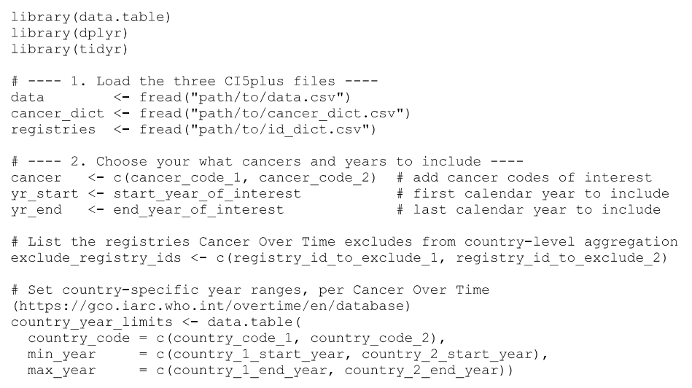
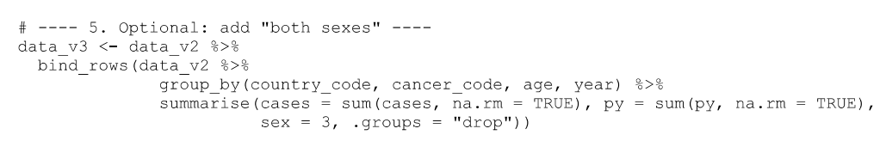
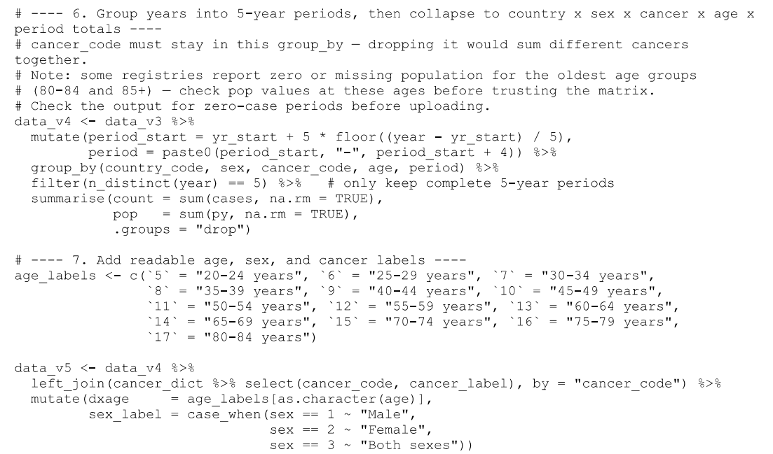
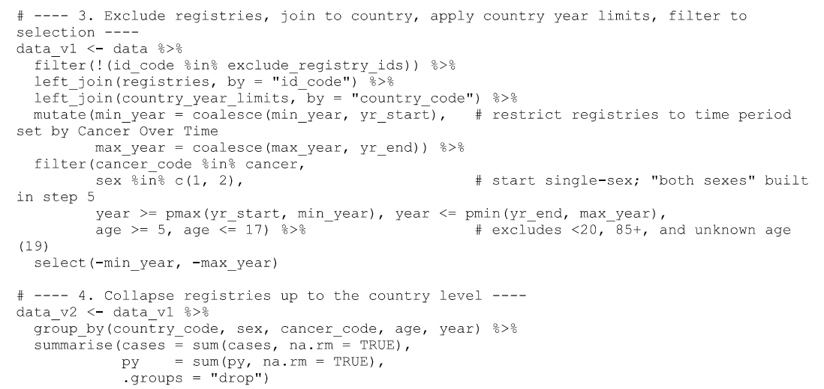
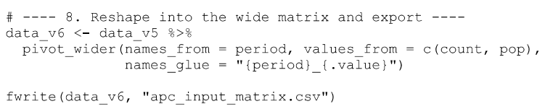
R Code for Generating the APC Input Matrix
1
Import the CI5plus dataset, select cancer codes, registry IDs, and diagnosis years
3
Optional: Generate “both sexes” observations
4
Group diagnosis years into 5-year periods and sum cases and pops
2
Exclude unused registries and summarize local registries into country-level observations
5
Pivot table to wide form and export

