Slide 1
Statistical Methods in Cancer Surveillance Research
An Age-Period-Cohort Perspective
Philip S Rosenberg, PhD
SHORT COURSE
Version 2026

Slide 2
About me
Born in 1960 in southwest Washington DC
PhD in Biostatistics from Yale University in 1988
TR Holford, MB Bracken
Married, 3 children
Lifer at the NCI (1988 – 2025)
MH Gail, BP Alter, WF Anderson
Currently affiliated with QIMR, ACS, IARC
Interests and hobbies include fitness, dogs and music

Slide 3
Why this course?
Unusual career trajectory
Strongest methodologic work during the last 10 years of my NCI career (most math people do their best work early)
By then: my skills as a programmer had matured
Capstone goal: Put new methods and software in the hands of the next generation

Slide 4
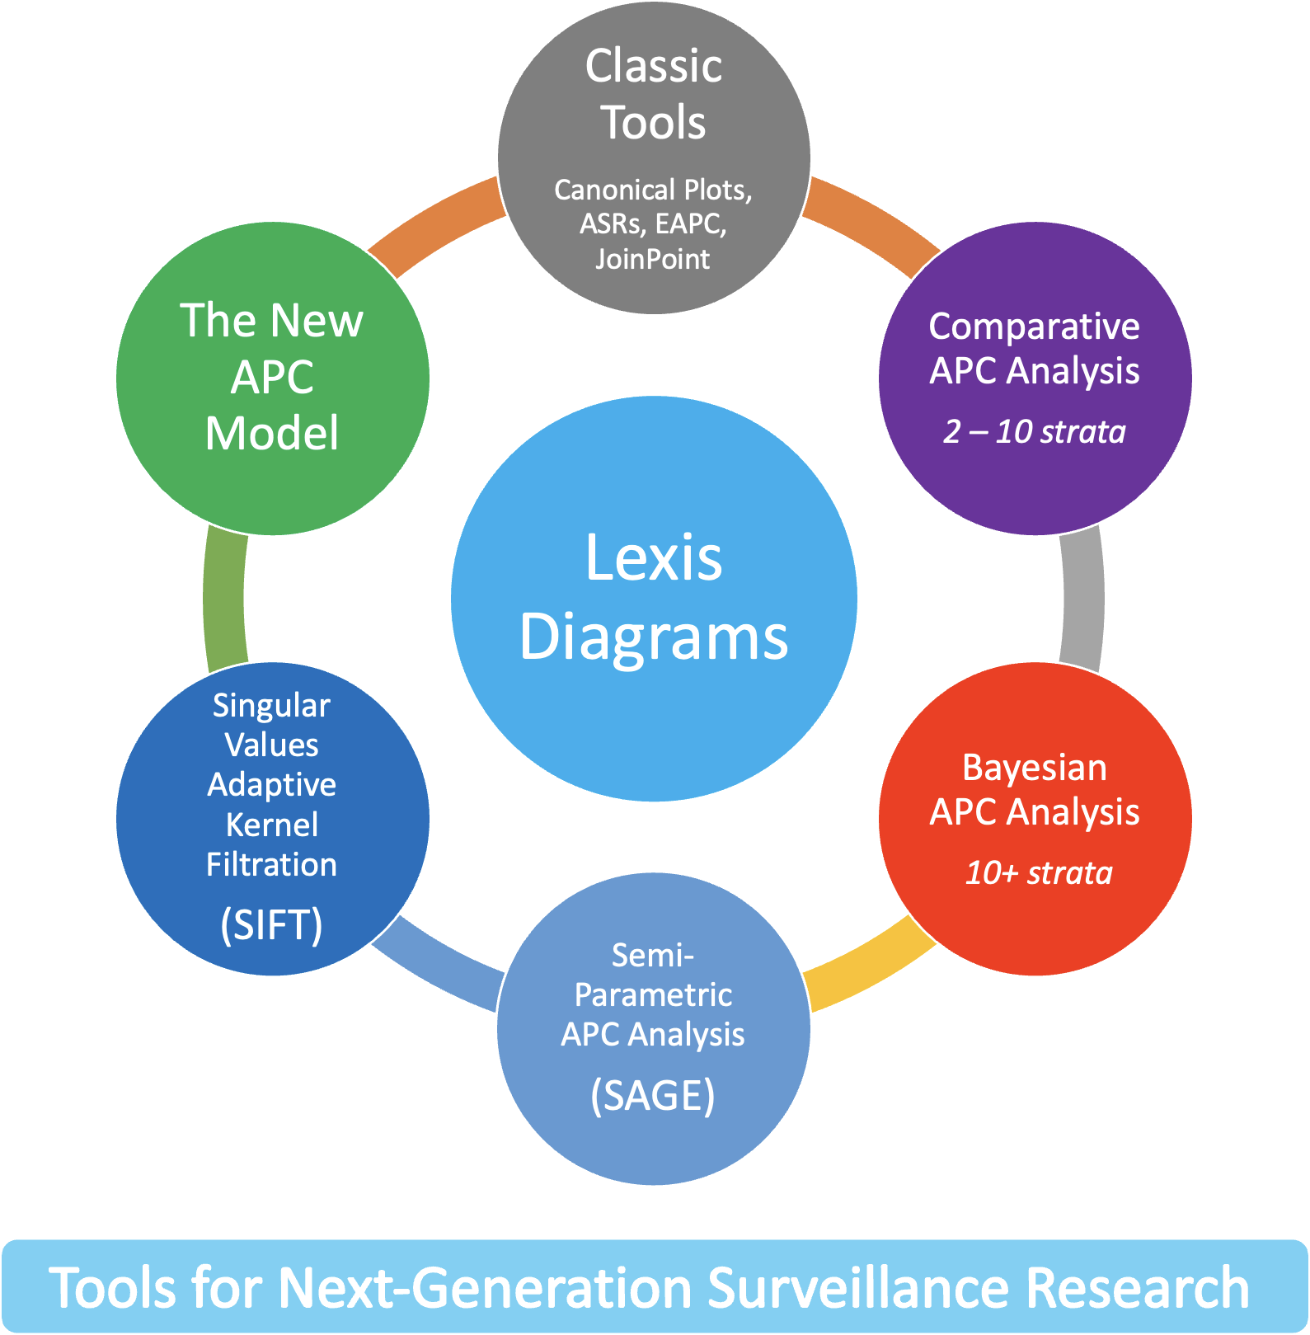
Advances in statistical methods for cancer surveillance research: an age-period-cohort perspective
Rosenberg PS, Miranda-Filho A
Frontiers in Oncology (2024)
DOI: 10.3389/fonc.2023.1332429
APC = Age-Period-Cohort
Cancer
Forecasts
Figure 1

Slide 5
Our methods and software do what they do because we have amazing collaborators!
Adalberto Miranda-Filho
William F Anderson
Aryana Arsham
Sonya Bhala
Anil K Chaturvedi
David P Check
Michael B Cook
Lynn BC Davis
Julia Elrod
Gretchen L Gierach
Scott P Kelly
Catherine M Olsen
Nirmala Pandeya
Hyuna Sung
Ana F Best
Pavel Chernyavskiy
Mark P Little
David C Whiteman
Victoria Kennerly
Jonine Figueroa
Hormuzd A Katki
Chenxi Jiang
Khushali Shah
Quiera Booker

Slide 6
We need these methods!
Many types of cancer are increasing in members of Generation X and Millennials
  Cancer Incidence Trends in Successive Social Generations in the US
  Differences in cancer rates among adults born between 1920 and 1990 in the USA: an analysis of population-based cancer registry data

Slide 7
What is Cancer (Vital Rates) Surveillance Research?
Observational science of event rates and risks (probabilities) ascertained in population-based cohorts, notably, cancer registries.
    Track cancer incidence, burden, prevalence, survivorship
    Quantify differences and disparities
    Test hypotheses
    Uncover etiologic clues
    Gauge effectiveness of screening and therapy
    Characterize natural history and its evolution over time
    Forecasting

Slide 8
Outline: Short Course 2026
Overview
The Lexis diagram
Descriptive epidemiology – standard plots and cancer statistics
Summary curves
The New Age-Period-Cohort Model
Smoothing Lexis diagrams
Semiparametric Age-Period-Cohort Analysis (SAGE)
Comparative Age-Period-Cohort Analysis
Wrap Up

Slide 9
What’s Not Covered
Statistical theory
Bayesian methods
Forecasting
Advanced programming

Slide 10
R Software
The Age-Period-Cohort Analysis Web Tool and R code
  https://analysistools.cancer.gov/apc/
Forecasting Cancer Incidence and Prevalence
  R code by Ana F Best

Slide 11
MATLAB Software
  MATISSE
  MAtlab Toolbox for vItal rateS SurveillancE
  Built-in example data
  Custom graphics
  Free accounts at MATLAB Online
  If you see it in the course, you can do it using MATISSE

Slide 13
Objective
People (including scientists) are story tellers Yuval Noah Harari
Not only will these methods help you tell a story
I believe they will help you tell the right story and with less work

