Slide 1
(2) The Lexis Diagram

Slide 2
The Lexis diagram is a fundamental construct in epidemiology, demography, and sociology.

Slide 3
The Basic Idea
A Lexis diagram is a rectangular grid of square cells with age along one axis and calendar period along the other. Individuals from a surveilled population contribute person-years and events (births, deaths, cancers, etc.) to each cell.

Slide 4
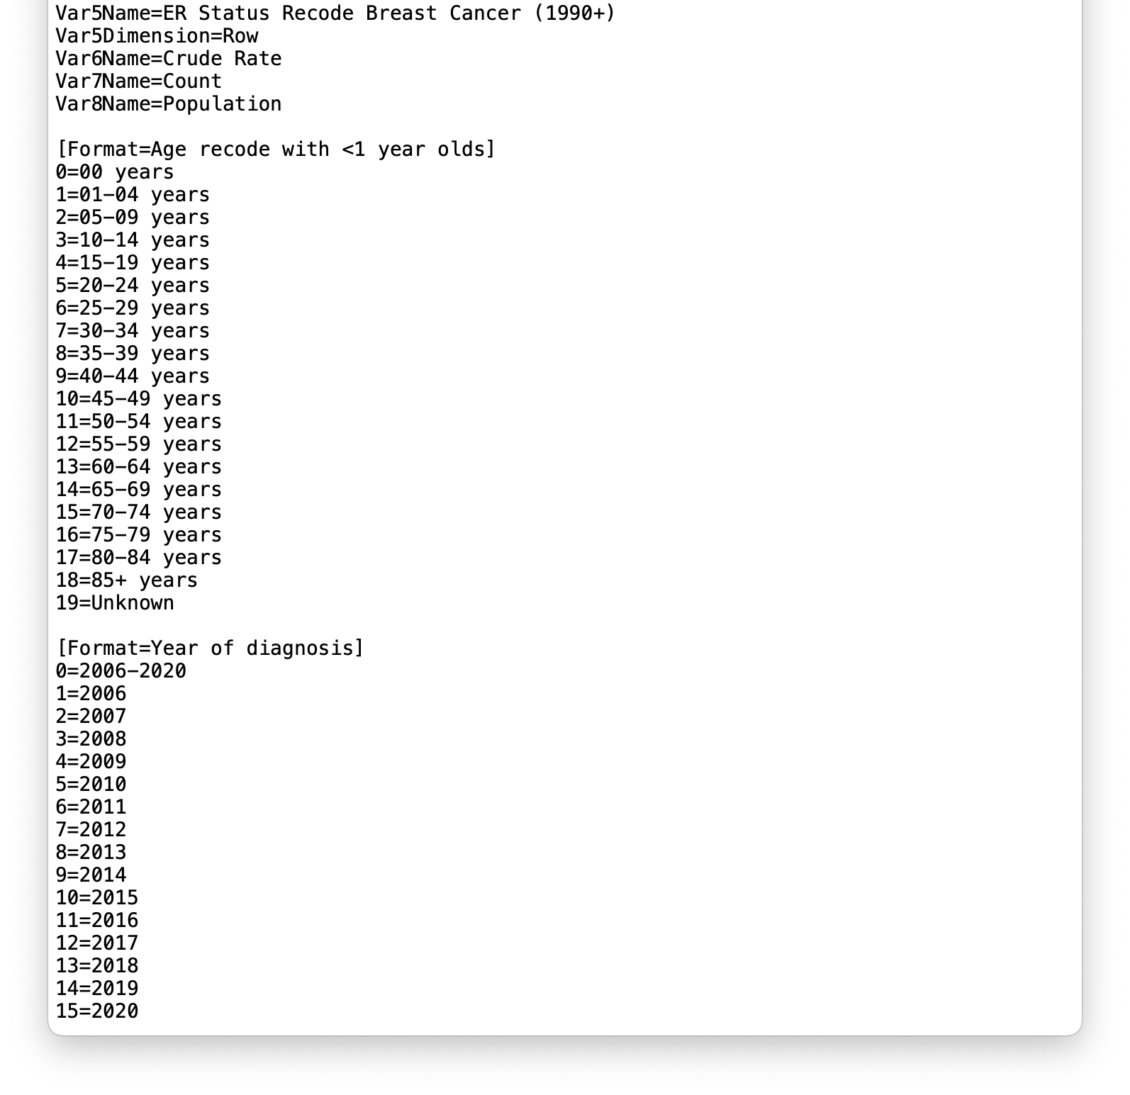
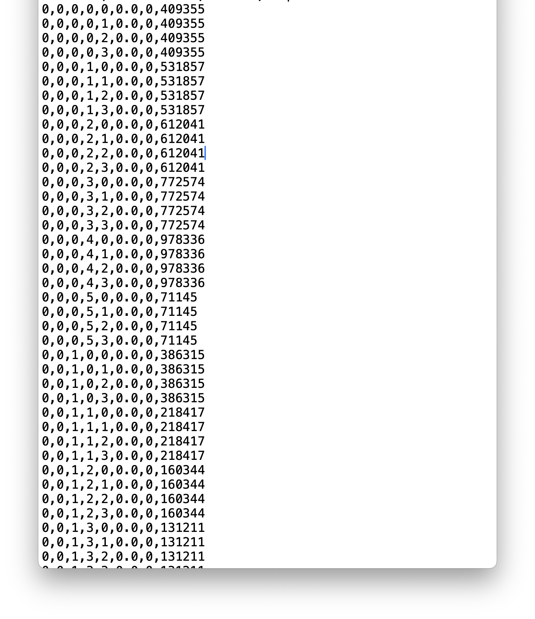
Lexis Diagrams from SEERStat
Dictionary File
Rates Session
(Thanks to Quiera Booker
and Khushali Shah)
Align by age group and year within stratum . . .

Slide 5
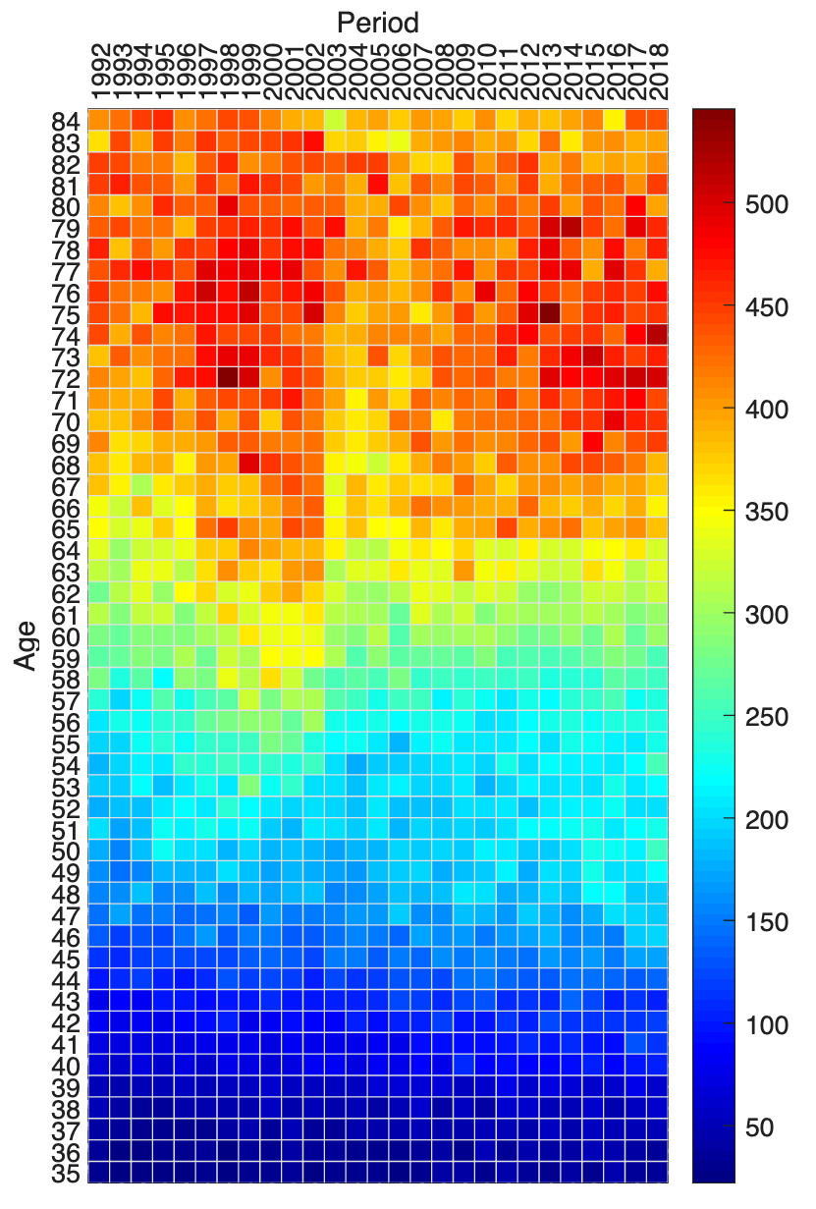
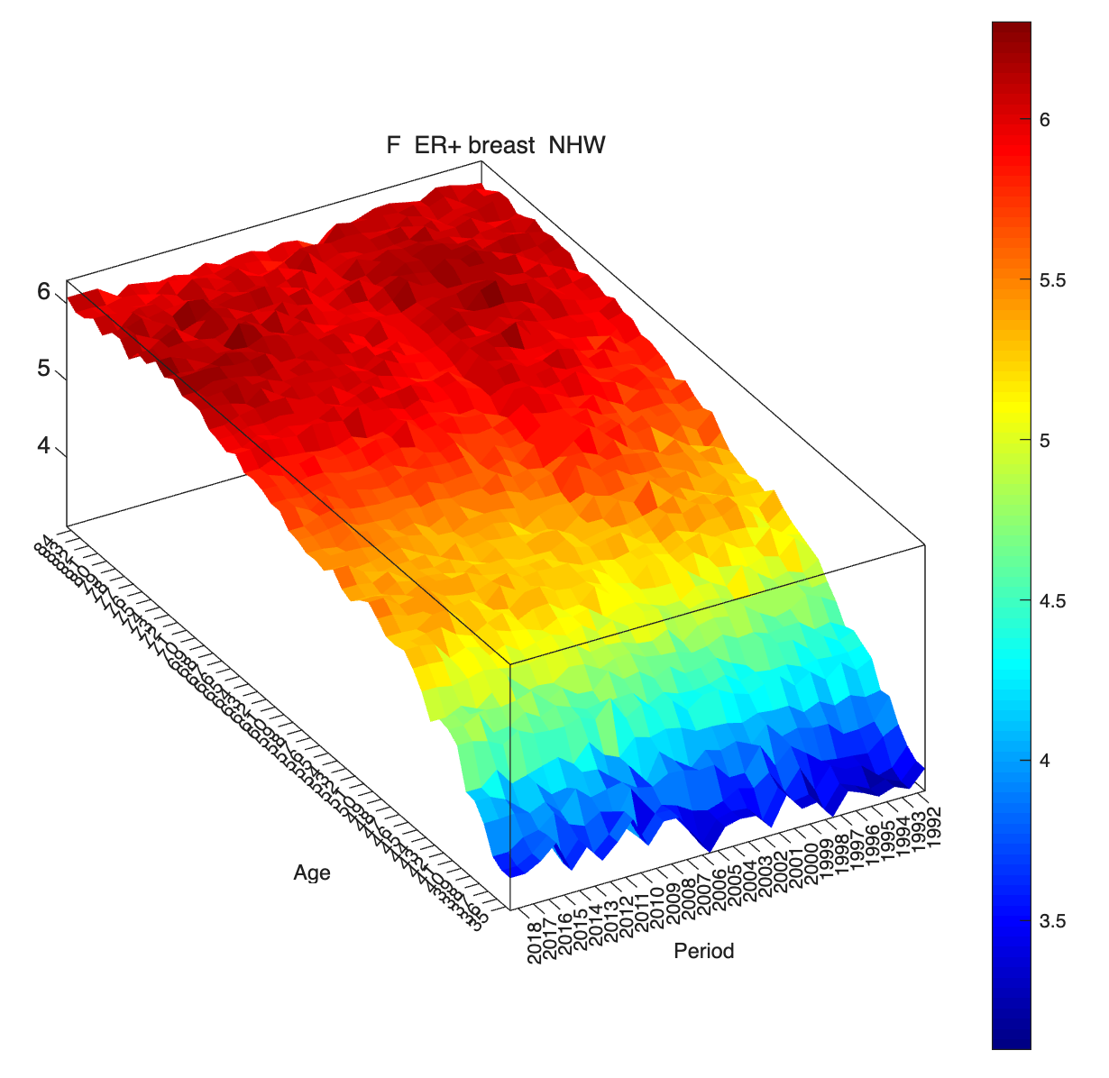
Invasive Female Estrogen Receptor Positive (ER+) Breast Cancer
Heat Map
(absolute rates)
Surface Plot
(log rates)
Age 63 in 1994
330 Cases
96,932 WY
340 per 10⁵

Slide 6

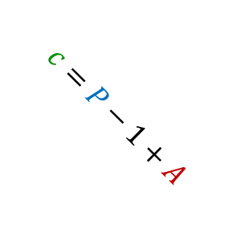


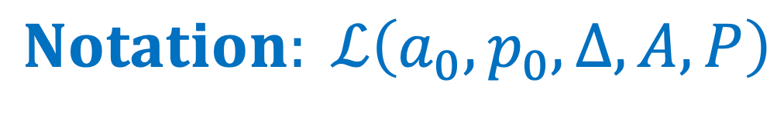

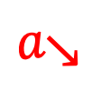
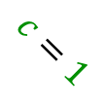





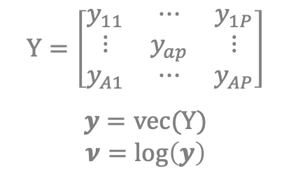









$$Notation: ℒ\left(a_{0},p_{0},∆,A,P\right)$$
$$Y=\left[\begin{matrix}y_{11} & ⋯ & y_{1P} \\ ⋮ & y_{ap} & ⋮ \\ y_{A1} & ⋯ & y_{AP}\end{matrix}\right]$$
$$y=vec(Y)$$
$$ν=log⁡\left(y\right)$$
$$period→$$
Rate Matrix:
$$p$$
$$\left(a_{0},p_{0}\right)$$
$$p=1$$
$$p=P$$
$$cohort↗$$
$$a=1$$
$$\begin{matrix}y_{ap}= \\ {10}^{5}\frac{E_{ap}}{O_{ap}}\end{matrix}$$
cross-sectional $a\text{g}e↓$
$$c=P−1+A$$
$$Δ$$
$$a$$
$$Δ$$
*
Midpoint
$$a=A$$
$$a_{∗}\left(a\right)=\left(a_{0}−\frac{∆}{2}\right)+∆a$$
$$a_{↘}$$
$$c=p−a+A$$
$$p_{∗}\left(a\right)=\left(p_{0}−\frac{∆}{2}\right)+∆p$$
$$c=1$$
longitudinal $a\text{g}e ↘$
$$c_{∗}\left(c\right)=p_{∗}\left(1\right)−a_{∗}\left(A\right)+∆c$$

Slide 7

Four Directions in the Lexis Diagram standard axes $a$ and $p$ rotated axes $a_{↘}$and $c$
Cross-Sectional in Age $a$
Cross-Sectional in Age 𝑎
Cross-Sectional in Period $p$
Cross-Sectional in Period 𝑝
Cross-Sectional in Cohort $c$
Cross-Sectional in Cohort 𝑐
Longitudinal in Age $a_{↘}$
Longitudinal in Age 𝑎_↘

Slide 8
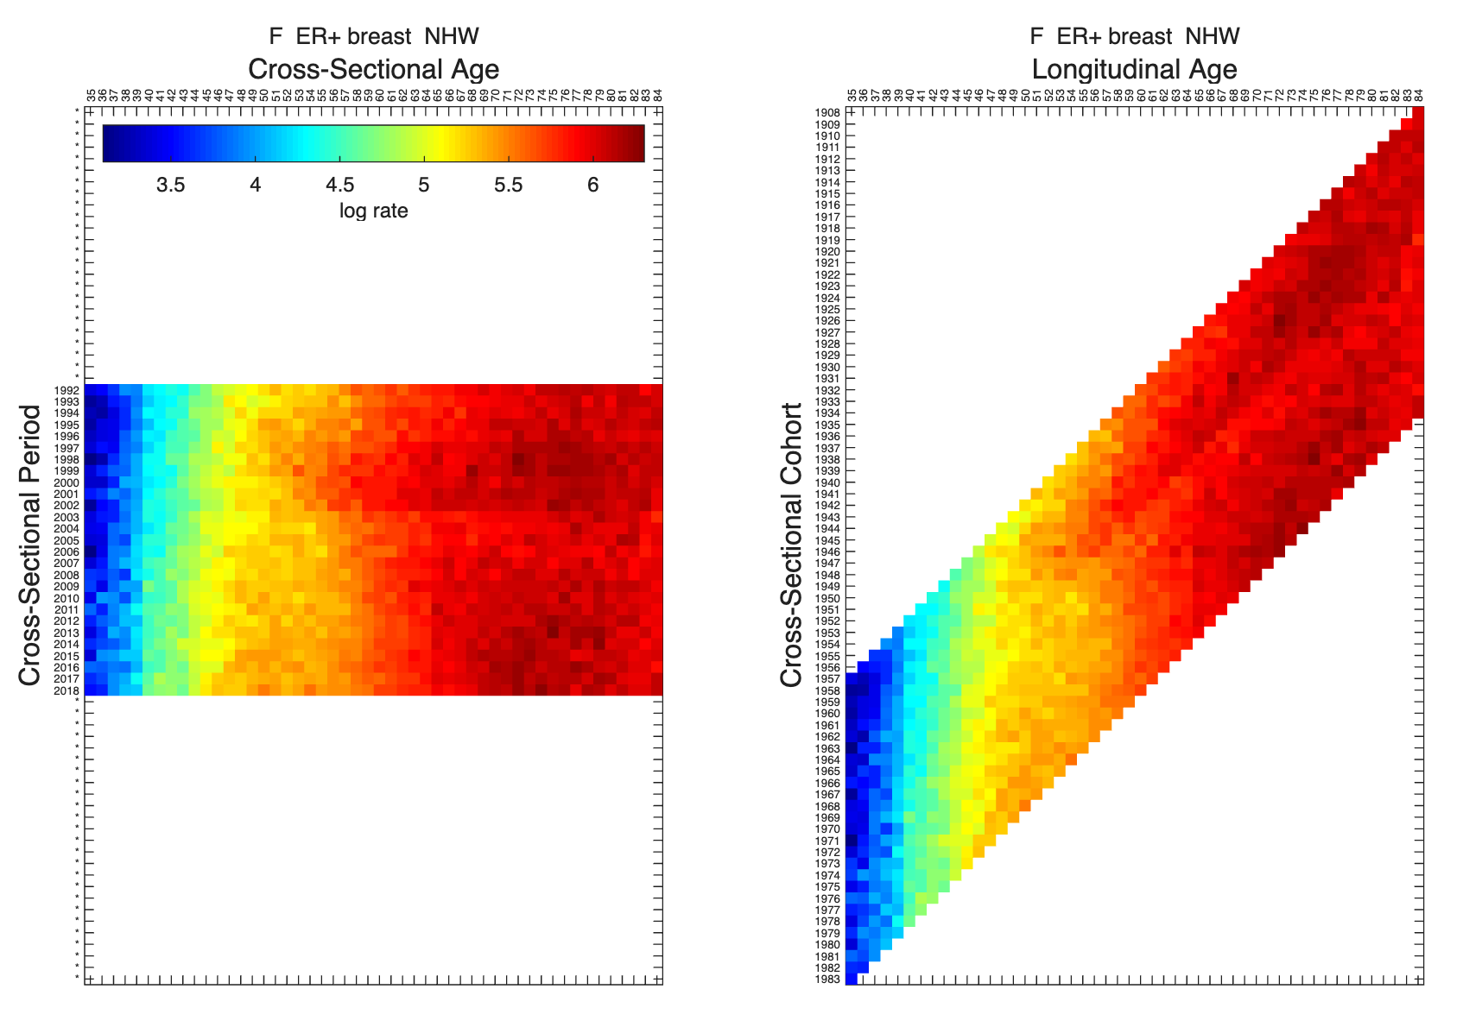
Standard Axes
Rotated Axes

Slide 9

Social Generations in the United States
1883–1900
Lost Generation
1901–1927
Greatest Generation
1928–1945
Silent Generation
1946–1964
Baby Boomers
1965–1980
Generation X
1981–1996
Millennials / Gen Y
1997–2012
Zoomers /
Gen Z
early 2010s – mid 2020s
Generation Alpha
https://en.wikipedia.org/wiki/Generation

Slide 10
Birth Cohort Effects: Impact
Each generation has characteristic lifestyle patterns
Generations are impacted by temporal disturbances at staggered ages
Drift happens
If a cancer has exogenous risk factors, it is unlikely that any two generations experience identical incidence rates.
** Consider this a central dogma **
Our analyses should untangle the separate effects of calendar period and birth cohort
  If not, our conclusions may be biased
That is why we need the methods presented in this course!

Slide 11

We seldom analyze a single Rate Matrix in isolation . . .

Slide 12
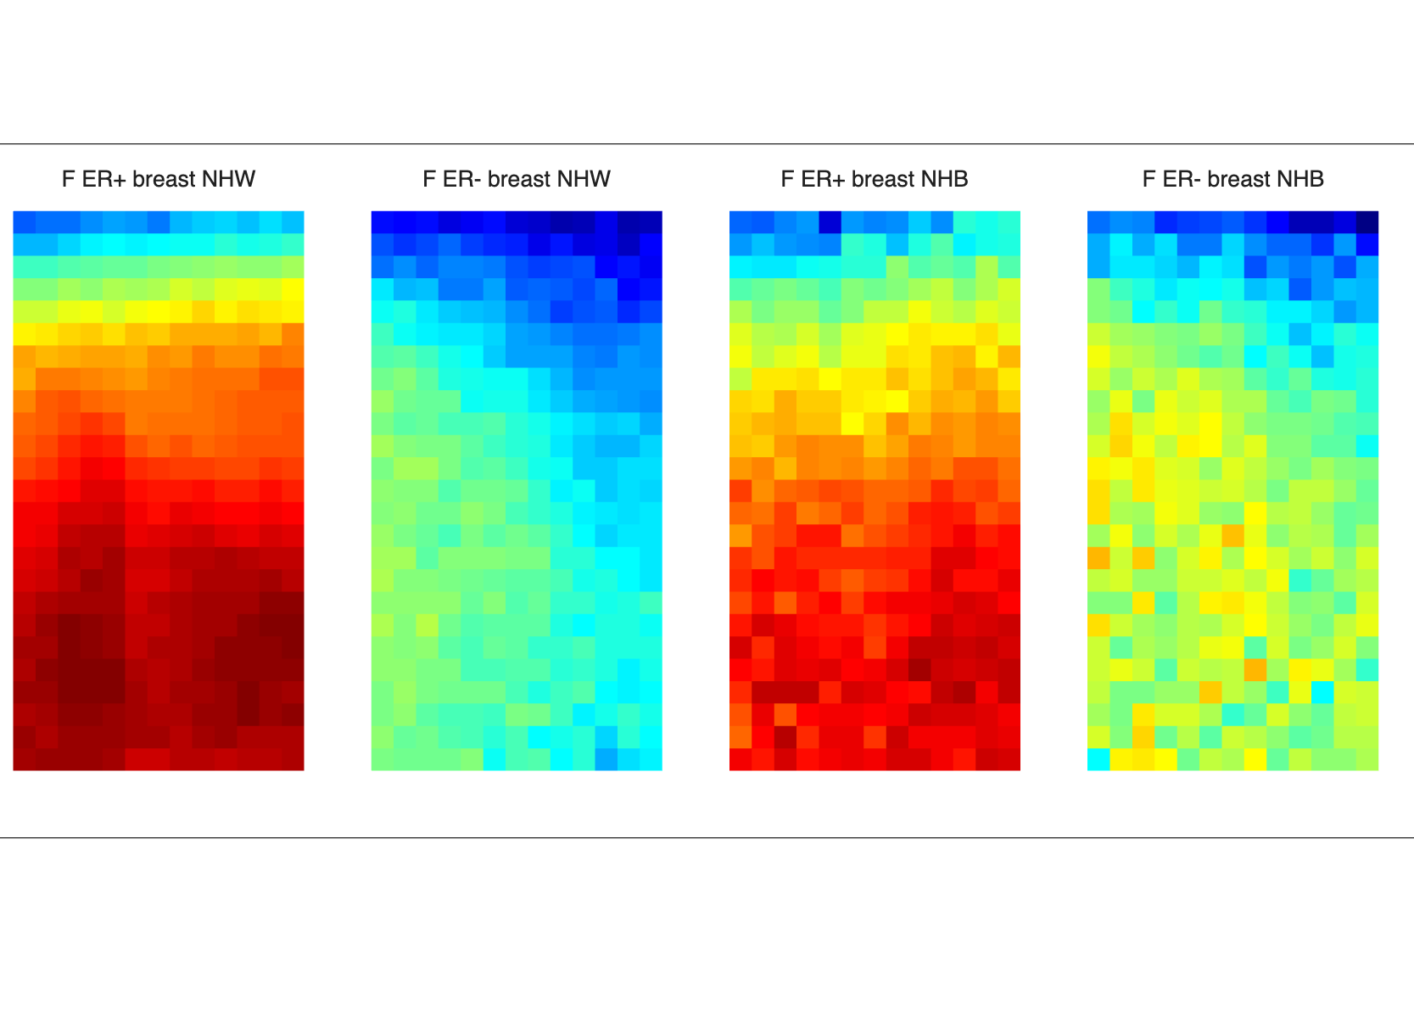
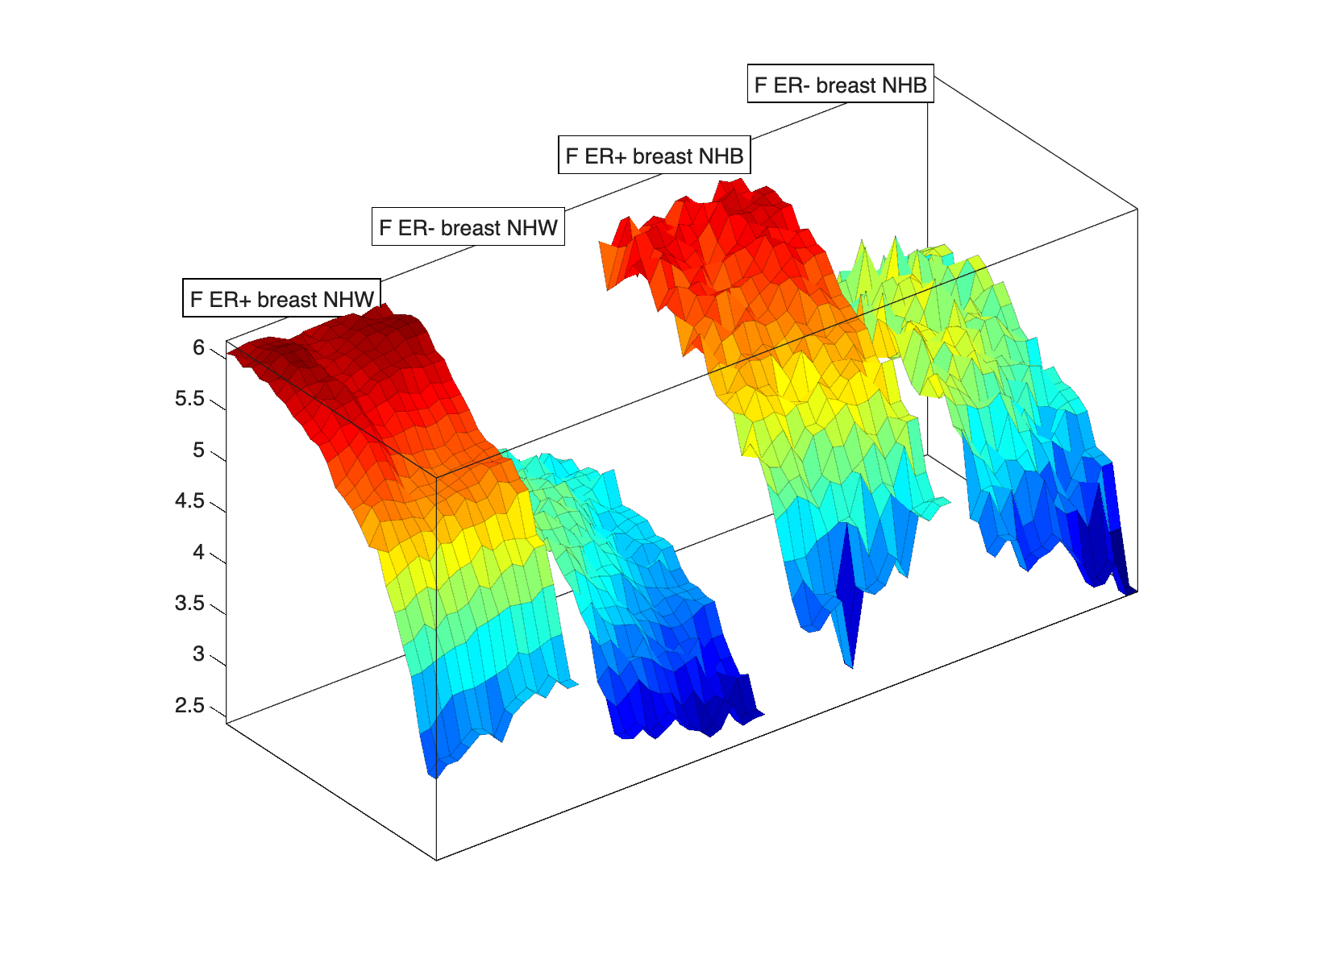
G = 4 Lexis Diagrams

Slide 13
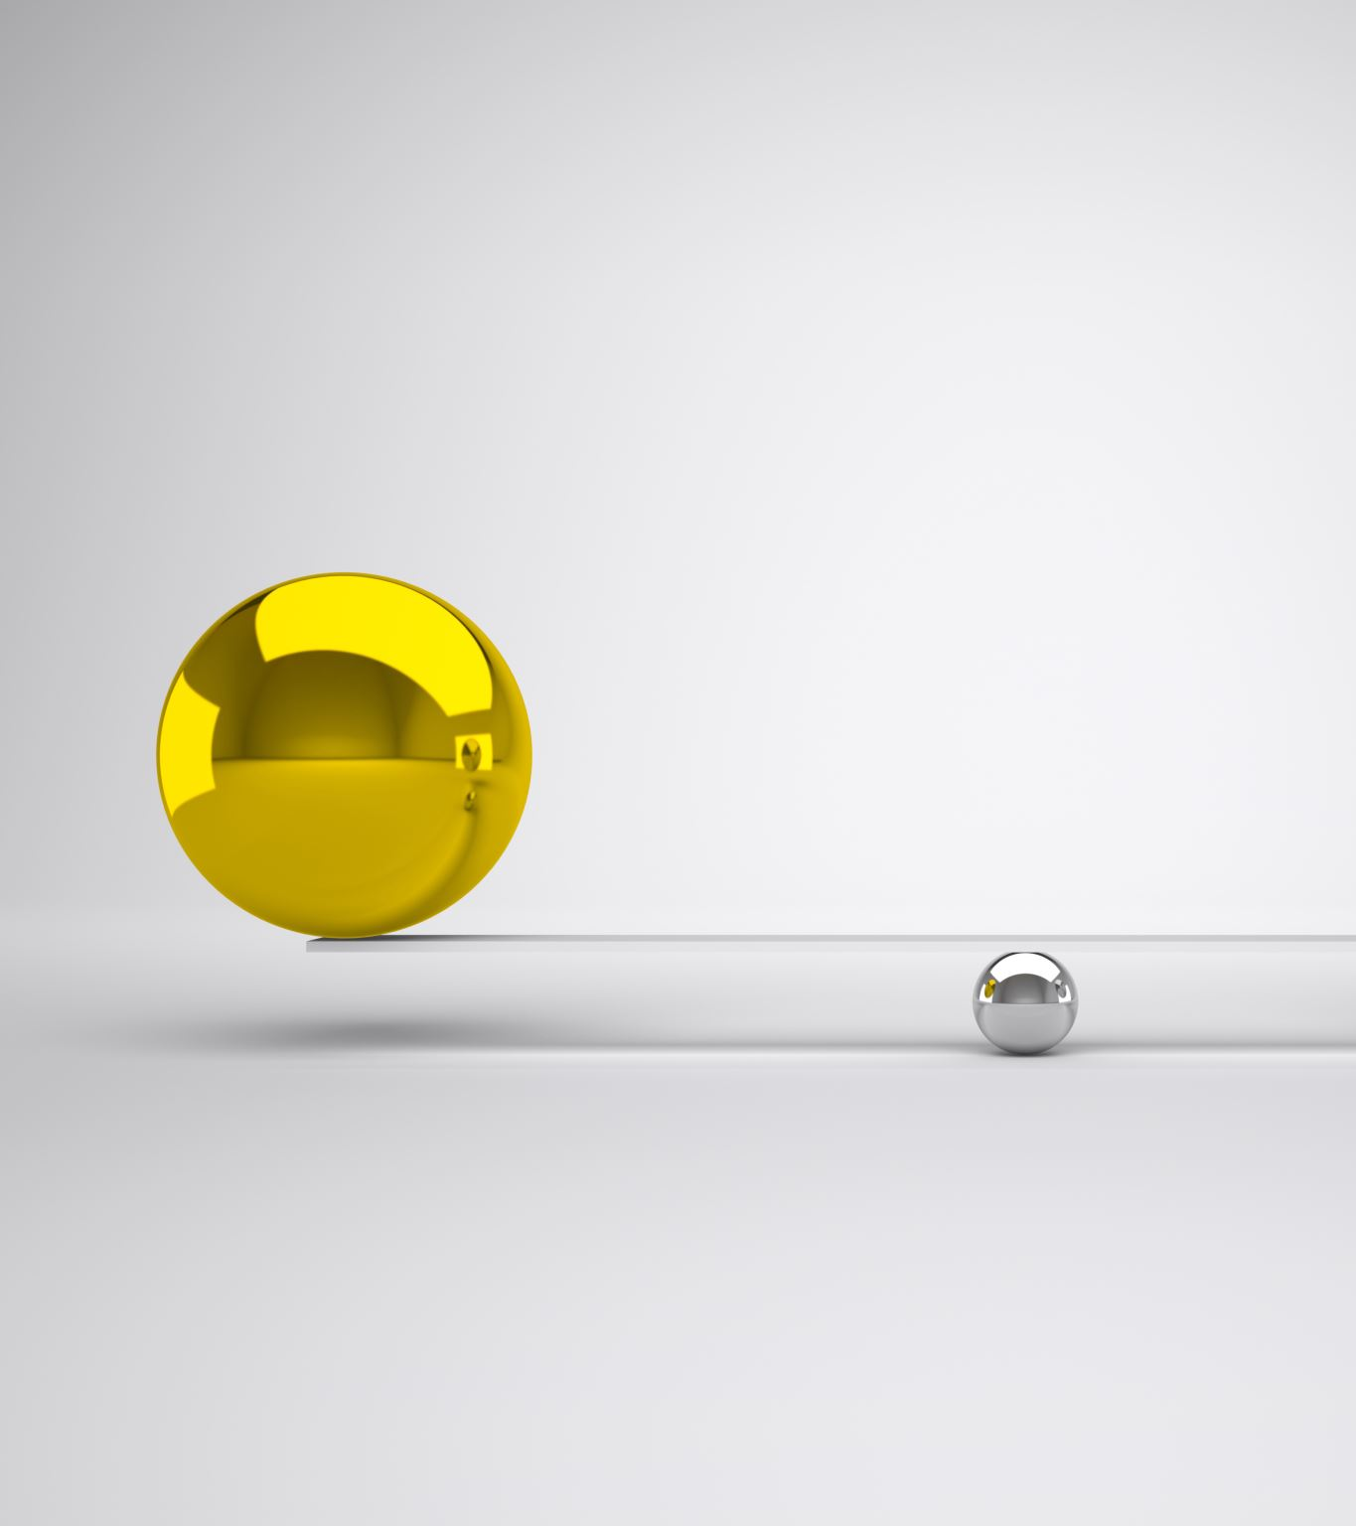
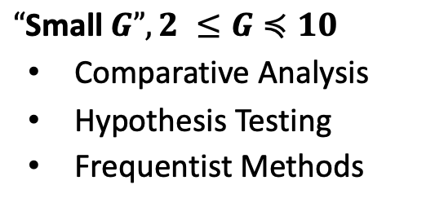
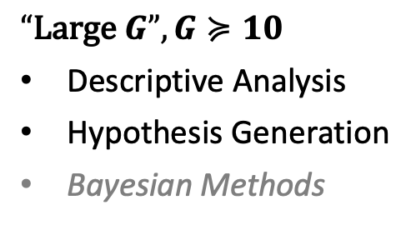
Large G versus Small G
$“\text{Large} G”, G≽10$
Descriptive Analysis
Hypothesis Generation
Bayesian Methods
$“\text{Small} G”, 2 ≤G≼10$
Comparative Analysis
Hypothesis Testing
Frequentist Methods

Slide 14
Rates Objects
Lexis diagrams are represented in MATISSE using the rates class
  Extends the schema used by the NCI Web Tool
  You can manipulate rates objects using many functions (class methods)

