Slide 1

SQL SUMMATIVE LAB · PART 2
Movie Genres:
Ratings vs. Audience Reach
An exploratory SQL analysis of IMDb movies released 2010–2019
Source: IMDb database (im.db)
Analysis with SQLite and pandas
Notes:
This presentation summarises my exploration of the IMDb movie database: what I found, the business question I formed, and the data cleaning the data needs.

Slide 2
Initial exploration findings
146,144
65,720
57%
movies in the database; releases grew from 11,849 in 2010 to 17,504 in 2017
movies have a rating, a genre and a runtime, the usable set after removing nulls
of rated movies have under 100 votes, so only films with 1,000+ votes were compared
7.27
8,642
0.31
average rating for Documentary, the highest genre; Horror is lowest at 5.28
median votes for Adventure, the biggest audience; Fantasy and Sci-Fi follow
correlation of runtime and rating: longer films are rated slightly higher
Notes:
The database is large but uneven: many movies lack genres or runtimes, and most ratings come from very few voters, so I compared genres using only movies with at least 1,000 votes. The headline pattern: the best-rated genres are not the ones with the biggest audiences.

Slide 3
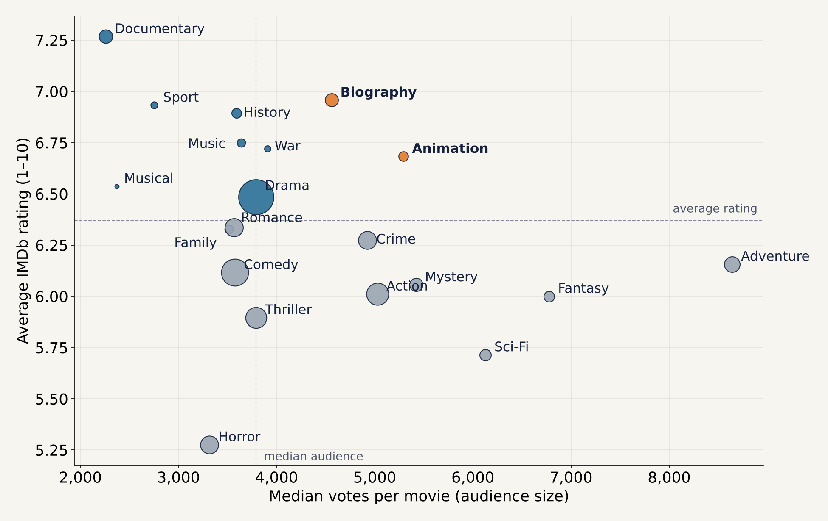
Business question: ratings vs. audience size
Do the highest-rated genres also draw the biggest audiences?
No. Documentary, Biography and History rate highest but reach smaller audiences. Adventure, Fantasy and Sci-Fi reach the most viewers but rate below average.
Biography and Animation are the only genres above average on both, the best balance of quality and reach.
Movies released 2010–2019 with 1,000+ votes; genres with 50+ movies; bubble size = number of movies
Notes:
Each bubble is a genre: further right means a bigger typical audience, higher up means a better rating. The dashed lines mark the average rating and the median audience. Only Biography and Animation sit in the top-right group, above average on both.

Slide 4
Data cleaning tasks identified
Cleaning task | What the exploration found
Remove movies after 2019 | 1,063 movies have a start_year after 2019, including impossible years like 2115
Handle null values | 5,408 movies have no genre and 31,739 no runtime; excluded, not filled in
Split multi-value genres | One text field holds up to three genres, e.g. "Action,Crime,Drama"
Fix runtime outliers | Runtimes up to 51,420 minutes; 43 movies listed as longer than 300 minutes
Filter unreliable ratings | 57% of rated movies have fewer than 100 votes; apply a minimum vote threshold
Remove duplicate rows | About 127,600 repeated movie/director pairs in the directors table
Standardize types and text | Professions and characters stored as lists inside text; names need consistent formatting
Notes:
As instructed, I only excluded nulls and did not fill anything in. The biggest risks are the duplicate director rows, which would double-count people in joins, and ratings based on very few votes.

Slide 5



CONCLUSION
Quality and reach rarely meet. Biography and Animation are the exceptions worth a closer look.
Clean the data
Track trends by year
Add people data
Apply the cleaning tasks, especially de-duplicating directors and splitting genres
Check whether Biography and Animation keep their balance across 2010–2019
Join directors and writers to find who drives ratings in the strongest genres
Notes:
The genres audiences rate best are not the ones they watch most. A studio wanting both quality and reach should look first at Biography and Animation, after the data is cleaned and the trend is confirmed over time.

