Slide 1
GPS mobility tracking
Based on Information bang for the energy buck
Filip Plata
Notes:
Introduce myself
Long-term tracking of objects in logistics, wildlife
Alogirthm adapting to changes in harvested energy
Minimize tracking error within budget
Hardware and software chosen together, energy most crucial resource
Information Bang for the Energy Buck:Towards Energy- and Mobility-Aware Tracking
Philipp Sommer1,3, Jiajun Liu1,4, Kun Zhao1, Branislav Kusy1,Raja Jurdak1, Adam McKeown2, David Westcott

Slide 2

What’s the problem?
Notes:
Tracking of flying foxes
Generally – of objects with regular motion patterns and periodic energy harvesting intervals
Just assume tracking those bats are important
Activity contrencated around camps, nocturnal animals, hang from trees during day

Slide 3

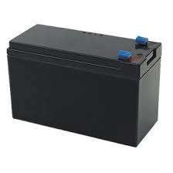
Constraints
vs
Notes:
We have a constrained power budget, and want high accuracy tracking
Adapting to changes in harvested energy
Objects have high variation in movement patterns, we need to adapt
Cannot use up budget too quickly

Slide 4
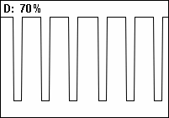
Duty cycles
Notes:
A commonly used idea is to switch off hardware when not needed
Even microcontroller can be switched
Saves up energy a lot

Slide 5
Past approaches
Detecting motion via accelerometer
Static GPS sampling
Notes:
When object is moving, periodically schedule GPS samples
Problems with changes in trajectory, with turns and so forth

Slide 6


Problems of static sampling

Slide 7
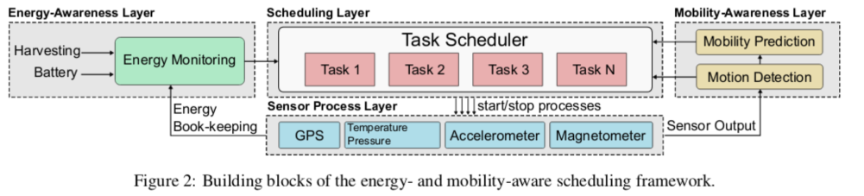
Approach in the paper
Calculating energy levels
Heuristics for detecting mobility pattern
Scheduler with GPS awaken on interrupts

Slide 8

Energy Monitoring
How much energy we have?

Slide 9
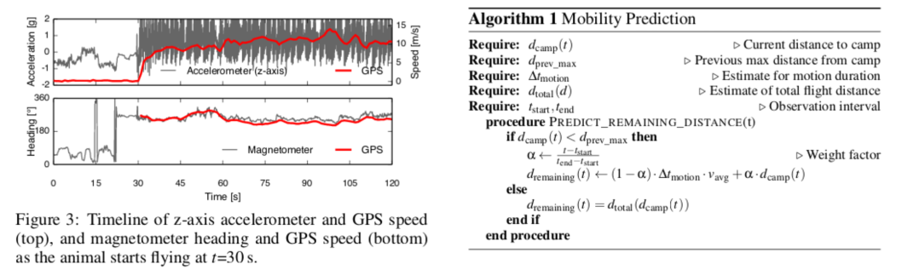
Mobility awarness block
Notes:
Scheduling tasks only when hardware detects motion
Motion: average accumulated acceleration change is above a threshold – determined by cross-validation on past data
Prediction of movement duration on the slide
This block is application dependant

Slide 10
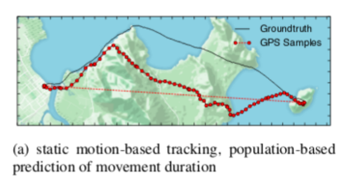
GPS sampling strategies
Static motion based

Slide 11

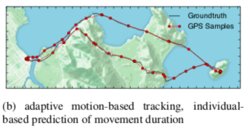
GPS sampling strategies
Adaptive motion based

Slide 12


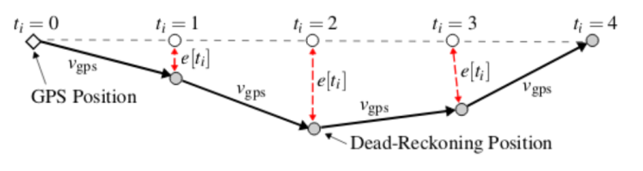
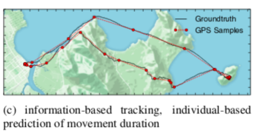
GPS sampling strategies
Information based

Slide 13
GPS sampling strategies
Optimal offline strategy

Slide 14
Hardware setup
Camazotz platform
Texas instruments CC430F5137 system-on-chip
Single cell Lithium-Ion battery, 300mAh with photovoltaic panel, typical daily charge from 10 to 50 mAh
Sensors: accelerometer, magnetometer, temperature sensor
GPS

Slide 15
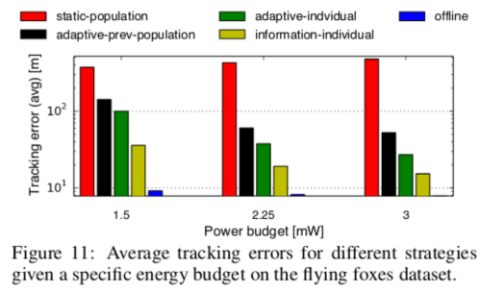
Results
Ground truth from continous GPS tracking via more powerful device

Slide 16
Q&A

