Slide 1

DSL for stock market
Filip Plata

Slide 2
What are stock markets?

Slide 3
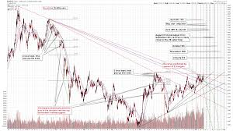
Technical analysis

Slide 4

What is wrong with market in Poland?
Around 100,000 people in Poland invest, many affluent
Data is hard to find
Tools are inflexible and expensive

Slide 5
What should we do about it?
DSL
Web service for language execution
Desktop interface
Simple mobile app for notifications
Space for people to share their ideas

Slide 6

How?
DSL executed in the cloud, sending notifications
Common technical analysis techniques baked in
Online environment for testing of code

Slide 7
Why?
Casino never loses money

