Slide 1

DSL for stock market
Filip Plata

Slide 2
Quick reminder about the project

Slide 3
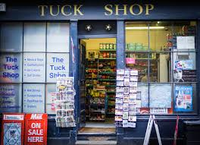
What are stock markets?
Shop for people to trade financial instruments
Most popular instrument is a small part of a company’s ownership called stocks
People can buy and sell stocks

Slide 4
Investors in Poland
100,000 people in Poland

Slide 5
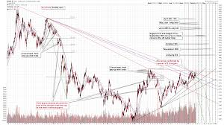
Technical analysis - speculate

Slide 6

Technical analysis
Set of tools used to predict future prices of shares, based only on the past

Slide 7
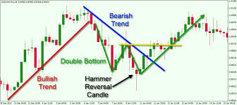
Technical analysis
Popular with investors in Poland DOI: 10.33119/KKESSiP.2015.3.3.11
Relatively easy to automate
Requires stock data
Requires tools to visualize the data

Slide 8
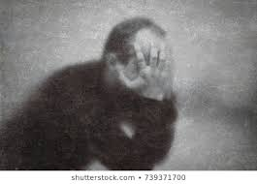
What is wrong with market in Poland?
Data is hard to obtain
Tools are inflexible, expensive and often outdated
TA in Poland is at mercy of highly overpriced tools from high street brokers

Slide 9
Problem with data in Poland
Getting it from stock exchange directly costs 24000 PLN per year, and requires agreement with exchange
Website scrappers get broken by frequent changes of html
Data available in form of files for download often has it own special format, and always it is prohibited to use it comercially
For a private person to work with this data, it requires solid programming skills

Slide 10

Problem with data in Poland
Getting it from stock exchange directly costs 24000 PLN per year, and requires agreement with exchange
Website scrappers get broken by frequent changes of html
Data available in form of files for download often has it own special format, and always it is prohibited to use it comercially
For a private person to work with this data, it requires solid programming skills
Notes:
Getting it from stock exchange directly costs 24000 PLN per year, and requires agreement with exchange
Website scrappers get broken by frequent changes of html
Data available in form of files for download often has it own special format, and always it is prohibited to use it comercially
For a private person to work with this data, it requires solid programming skills

Slide 11

Inflexibility of tools
Predefined sets of techniques
Tools receive little maintanance for years
Experimenting is very hard in such environment

Slide 12

Aim
Providing a flexible service of stock data at a fair price in Poland
5000 MAU in a year

Slide 13

Novelty of approach
Core idea is creating a DSL for stock and an execution environment for it – with data attached
This solves both data and inflexibility problem
The tool should be engine for execution of a DSL, not a premade set of buttons and charts
Providing DSL execution on cloud would also allow for easy pricing based on resources used by user
Notes:
Core idea is creating a DSL for stock and an execution environment for it – with data attached
This solves both data and inflexibility problem
The tool should be engine for execution of a DSL, not a premade set of buttons and charts
Providing DSL execution on cloud would also allow for easy pricing based on resources used by user

Slide 14

What we omit
The tool will not execute trades itself
It would pose many legal challenges

Slide 15
Challenges and quality
Will Polish stock sell us data?
Will a high street bank or fintech will not start creating their own tool
The core of the tool must be of high quality
Rest of the project needs only not to deter people from using it

Slide 16

Approaches

Slide 17
Buying technology in Poland
Outdated technology will be a hindrance, user bases are insignificant

Slide 18

Creting a product from scratch
Would require money and time
Due to quality requirement necessary for the core
Trying to partner with high street broker after having working MVP
Huge risk that we will not find partner, much smaller risk of getting kicked out of business
Notes:
Would require money and time
Due to quality requirement necessary for the core
Trying to partner with high street broker after having working MVP
Huge risk that we will not find partner, much smaller risk of getting kicked out of business

Slide 19
Partnership with high street broker
High risk of getting kicked out of business
Easier access to data and customers

Slide 20
Selected approach
Partnership with broker like BOSSA as the first necessary step

Slide 21

Overview of the solution
DSL + execution engine – core of the project
Web service for the language execution
Desktop interface
Simple mobile app for notifications
Space for people to share their ideas

Slide 22
Financial aspects
Few thousand requests per user per month ~10,000,000 requests per month
Two servers for CPU ~ 300$ per month
Two database servers ~ 150$ per month
One of the tools in basic version is priced at 5 PLN per user

Slide 23
Financial aspect
~3 PLN per user-month means we need 5000 users
User base size is crucial – and low development costs

Slide 24
Why?
Casino never loses money

