Slide 1
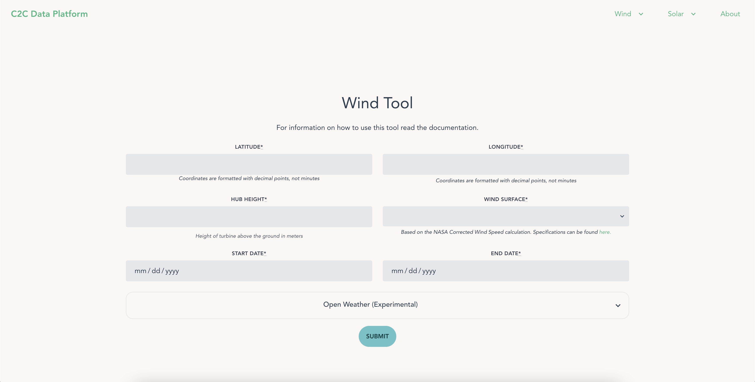
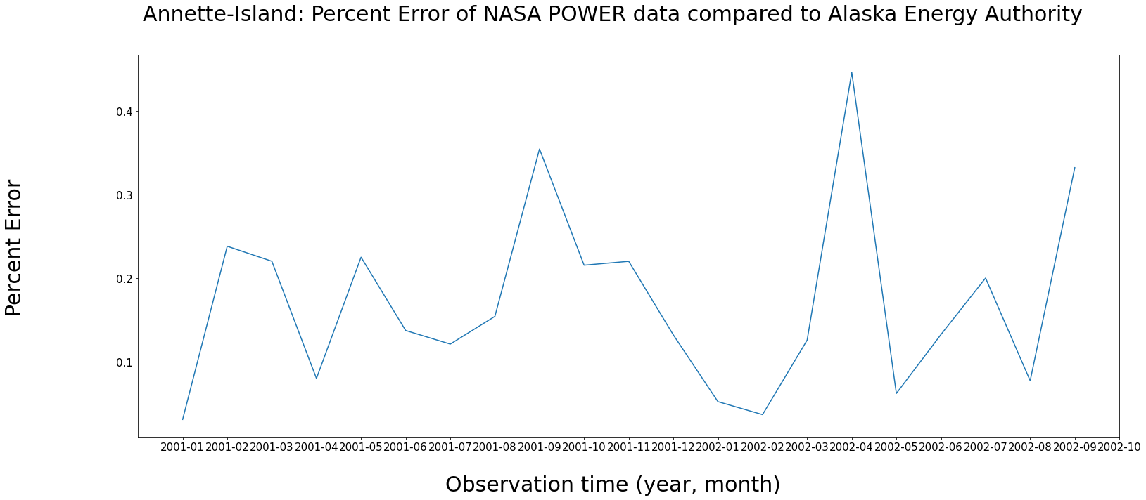
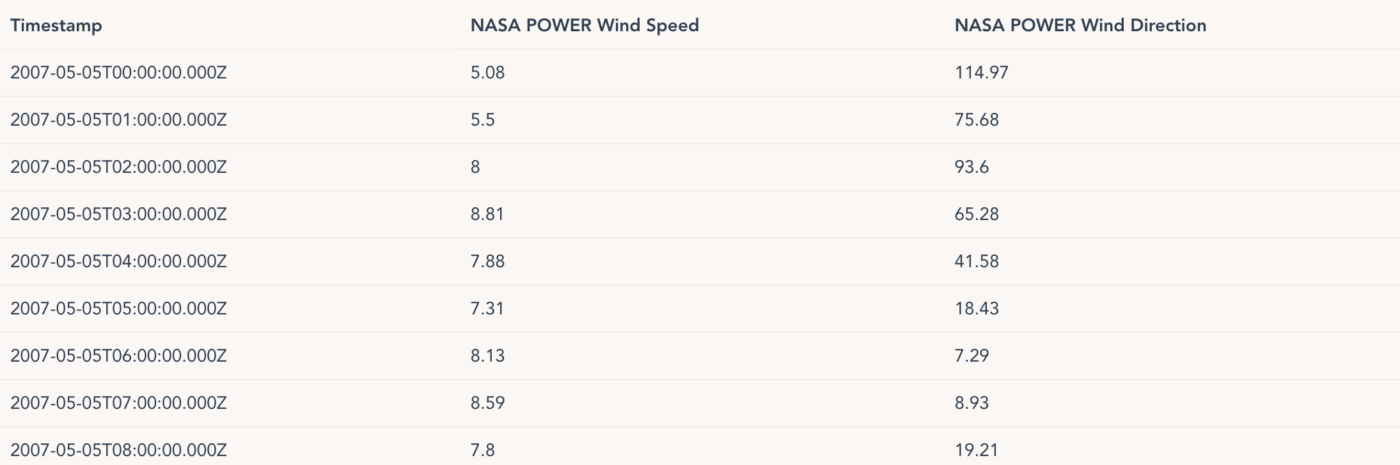



Communities to Clean Data Platform
Filip Casey, University of Colorado – Boulder
Mentor: Caitlyn Clark
Background
Siting for renewable energy projects is often extensive and costly
Although the most accurate measurements are achieved when onsite observation occurs, this acts as a significant barrier to small communities planning renewable projects
The goal of the Communities to Clean project is to provide community leaders with comprehensive, publicly available siting information
The main method for this currently is through the C2C data platform
Data
NASA POWER – Model-based renewable energy data
Wind Toolkit – Model-based wind speed/direction data
Open Weather – Model-based meteorologic data
National Weather Service – Raw meteorologic data
Alaska Energy Authority – Raw wind speed/direction data
Methods
ExpressJS backend API
Collect data from each source whenever a request is made
Format in a uniform manner for simpler data usage
Adjust for time resolution and height
Allow access through a GUI or API
Results
Platform documented and tested
Currently applying for hosting so the tool can be publicly accessible
Data source comparison done through API access as an evaluation and example for access
Future Work
Implementing solar data sources into the platform
Collaborating with developers and community leaders to receive feedback on the tool
Integration with hybrid optimization software for a fully integrated experience
Acknowledgements
I’d like to thank my mentor Caitlyn Clark, Emina Maric, and Dmitry Duplyakin for their assistance with this project
This work was supported in part by the US Department of Energy, Office of Science, Office of Workforce Development for Teachers and Scientists (WDTS) under the Science Undergraduate Laboratory Internship (SULI) program.
NREL is a national laboratory of the U.S. Department of Energy, Office of Energy Efficiency

