Slide 1

Communities to Clean
NREL July 2022
SULI: Filip Casey
Mentor: Caitlyn Clark

Slide 2
Overview
Present community members with prevalent and cost-effective siting data in one place
Develop an API for more efficient developer access
Evaluate and compare the available data sources

Slide 3


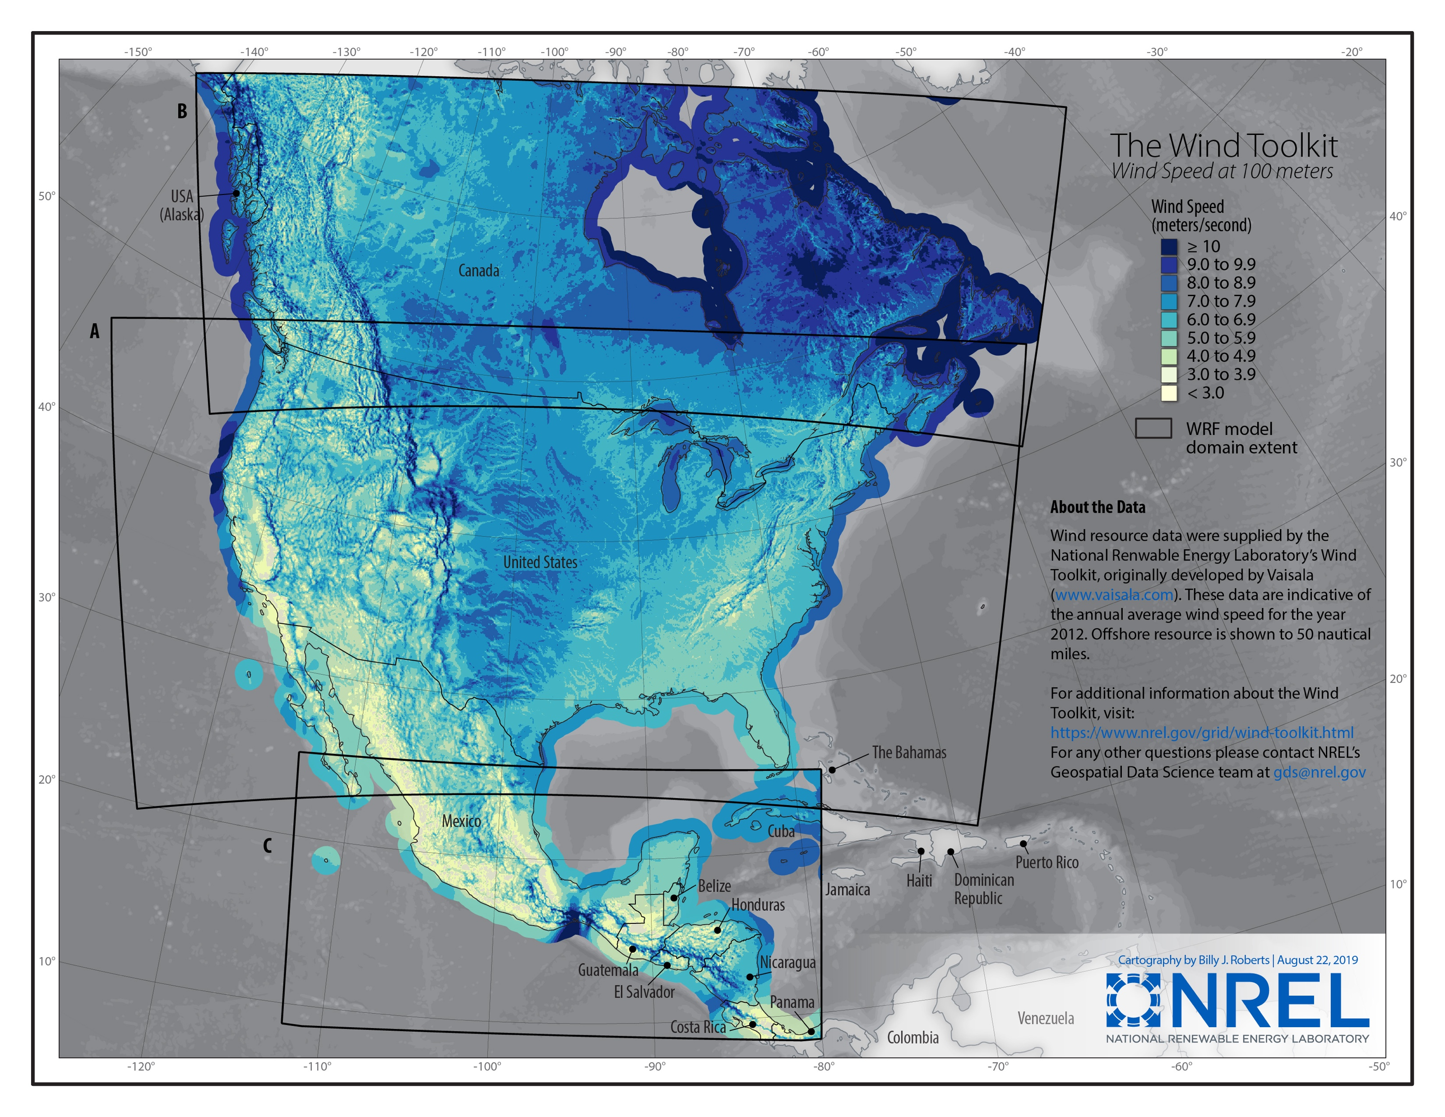


Data Sources
NASA POWER
Wind Toolkit
National Weather Service
Alaska Energy Authority
Open Weather

Slide 4
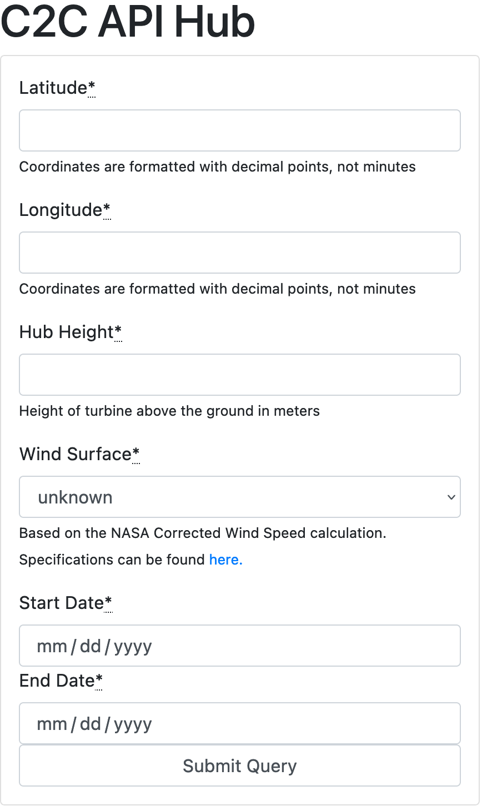
Data Access Platform
Simple to use UI for basic data access
Can specify a variety of parameters
Acts as a front-end for the API

Slide 5
API
NASA POWER
Wind Toolkit
National Weather Service
Alaska Energy Authority
Open Weather

Slide 6
Data Source Comparison Report
Written report detailing the specifications and limitations of the different data sources

Slide 7
API Demo

