Slide 1
Light source presence in images
By Filip Comsa
Notes:
The idea behind this project is to create a machine learning model based on deep learning which should be capable of classifying certain images by the follow criteria: whether an image contains, or not, a visible light source

Slide 2

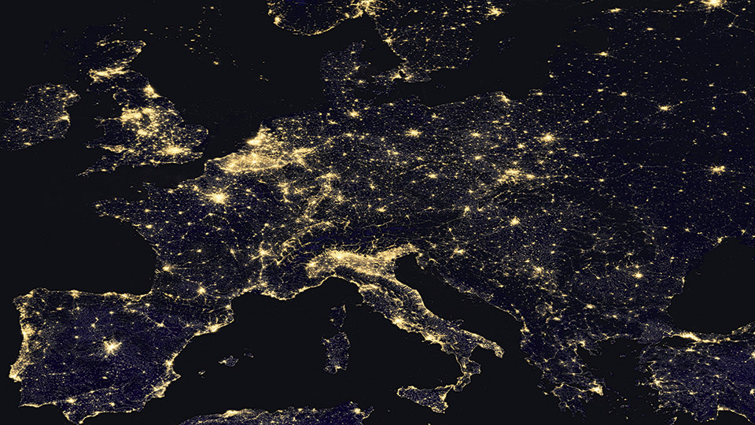
Detecting light
Real world applications
Related Work
Notes:
In the real world, such a project could have a humanitarian purpose, as a light polluting system, which has a negative effect on wild life, it contributes to the raising levels of carbon dioxide from the atmosphere, and, even more than that, it has a negative effect on human health, having sleep depravation effects in some cases. This problem, of light pollution, has become an international problem specially because the majority of the world population lives under a sky affected by this fenomenon. 80% of the world’s population is affected by this, percentages being even higher in the United States of America and in Europe, at 99%.

Slide 3
Machine Learning – Detecting Light
Image Classification
Notes:
Image classification is the task of categorizing and assigning labels to groups of pixels or vectors within an image dependent on particular rules.

Slide 4
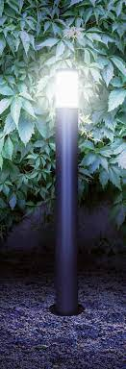
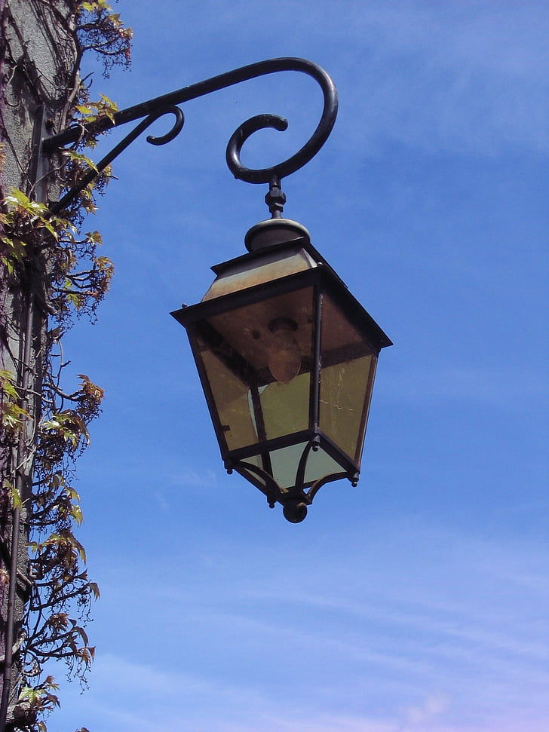
My project
Dataset
yes
no
Notes:
Even though the problem of detecting light sources has a great importance for the environment, there exists no public available datasets. Therefore, in order to find a solution for solving the issue of light pollution, a dataset containing 700 high quality images was created. The photos are splitted evenly as follows:
• 350 photos which contain turned on lights
• 350 photos which contain turned off lights

Slide 5

My project
Preprocessing
Notes:
Before using the photos from the dataset as input for the model, the photos are subjected to pre-processing. For this stage, several actions were applied, as follows:
• All pictures were resized to a standard resolution: 250x250 pixels
• The RGB interval was transformed from [0, 255] to [0, 1]
• The luminance formula using dot product is applied: P = R * 0.2126 + G * 0.7512 + B * 0.0722. The final image will look like a black and white image, but the lighting will be enhanced.
• Matrix multiplication is enforced multiple times, which cause dark spots to become darker and lighter spots to become lighter. The result is a feature enhancement, whereas the features seeking for this approach are the lightest of spots.

Slide 6
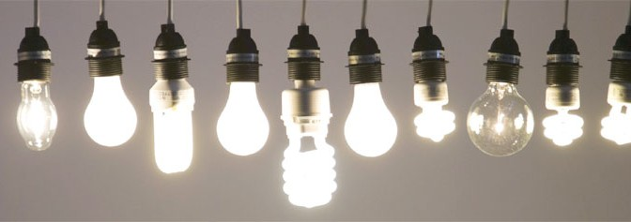
My project
Model
Notes:
EfficientNet is a Convolutional Neural Network architecture and scaling method that is optimized to scaling uniformly to all dimensions of depth, width and resolution using a compound coefficient.
AutoKeras is an open-source library for performing AutoML for deep learning models. The search is performed using so-called Keras models via the TensorFlow tf.keras API.

Slide 7
Experiments
EfficientNet
AutoKeras
Self Made Model
Notes:
The models proposed were trained and validated on the following:
• EfficientNet was trained using an M1 Pro processor having 10 core CPU, 16 core GPU and 16 core Neural Engine.
• AutoKeras was run on Intel Core i7-6700HQ processor, 4 core CPU, due to the fact that is not available for M1 architecture yet. Ergo, a lower end computer had to be used, dramatically increasing training times (from minutes to hours), while reaching inconclusive results
The dataset was split in the following way:
• 90% of the data was used for training
• and 10% for validation
Several experiments were conducted for EfficientNet model, having reached a maximum of 65% validation accuracy.

Slide 8
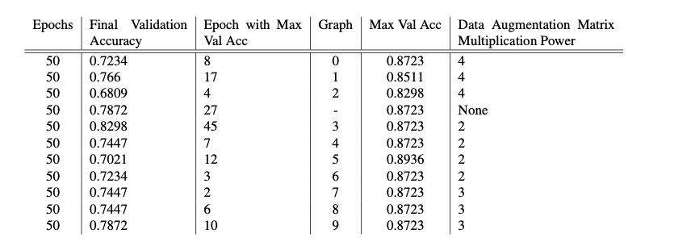
Experiments

Slide 9
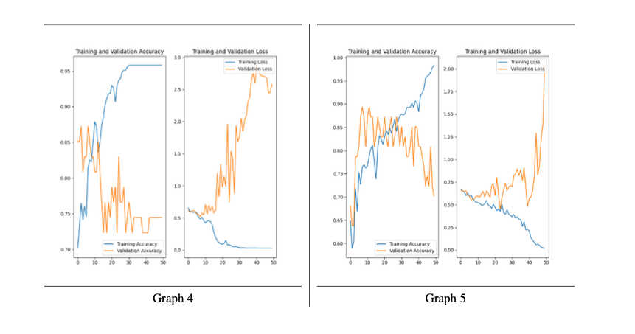
Experiments

Slide 10
Results
Validation Accuracy: up to 89%

Slide 11
Future Work
Larger dataset
Revisiting Pretrained models used with larger dataset
Using other models
Taking advantage of Image Segmentation

