Slide 1
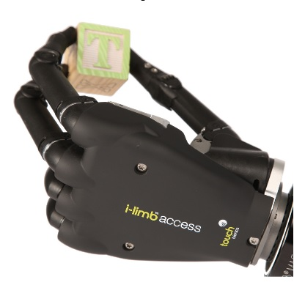
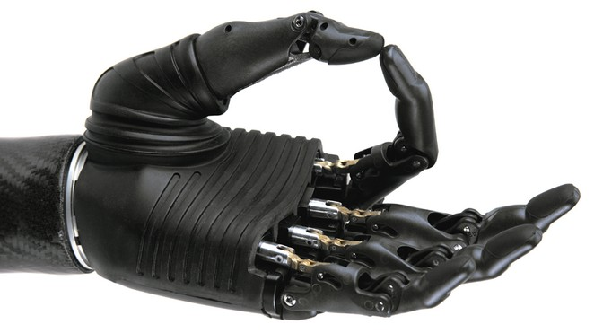
Using Deep Learning techniques on EMG data to control active prostheses
Filip Kozera Signal Processing Lab
Supervisor: Joan Lasenby

Slide 2
What is Electromyography(EMG)?
Technique for evaluating and recording electrical signals produced by skeletal muscles.
There are two kinds of EMG: surface EMG & intramuscular EMG.
Notes:
Surface EMG assesses muscle function by recording muscle activity from the surface above the muscle on the skin. Surface electrodes are able to provide only a limited assessment of the muscle activity. Intramuscular EMG can be performed using a variety of different types of recording electrodes. The simplest approach is a monopolar needle electrode. This can be a fine wire inserted into a muscle with a surface electrode as a reference; or two fine wires inserted into muscle referenced to each other.

Slide 3
What is out there at the moment?
Using EMG to control active prostheses is still expensive and not always practical. Most of the prostheses are still cosmetic or passive. There is no out of box active prostheses.
Current state-of-the-art methods enable up to 12 gestures to be recognized
Currently researchers use a wide spectrum of techniques including: Neural Networks, Hidden Markov Models and Support Vector Machines

Slide 4
Approach and aims
Moving on to recognizing more gestures. According to disabilities of the Arm, Shoulder and Hand protocol for functional movements, we need:
12 basic finger movements
8 static hand postures
9 basic wrist movements
23 grasp and functional movements
In order to mimic a human hand very well.

Slide 5
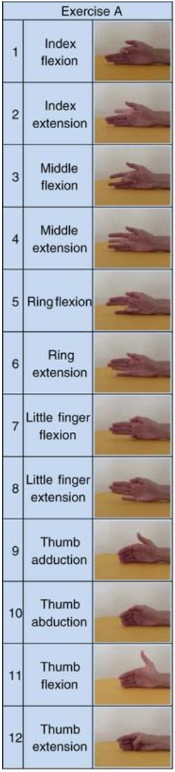
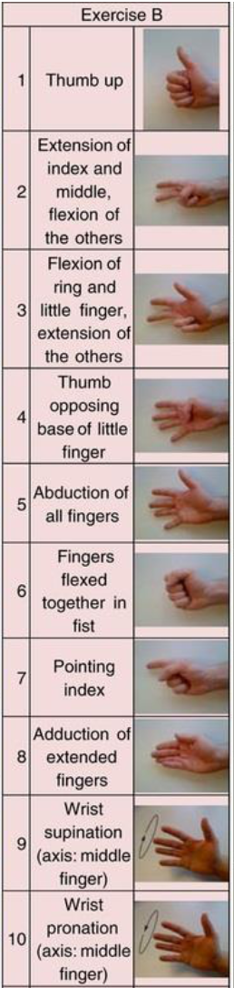
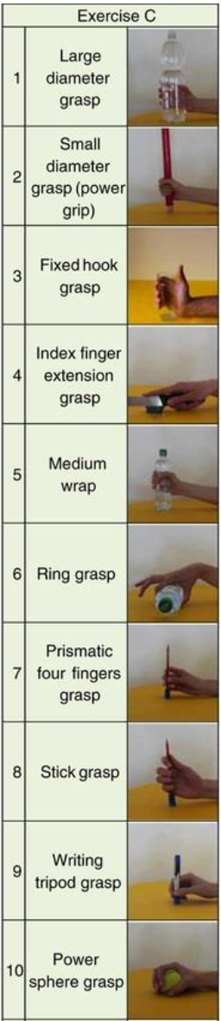

Slide 6
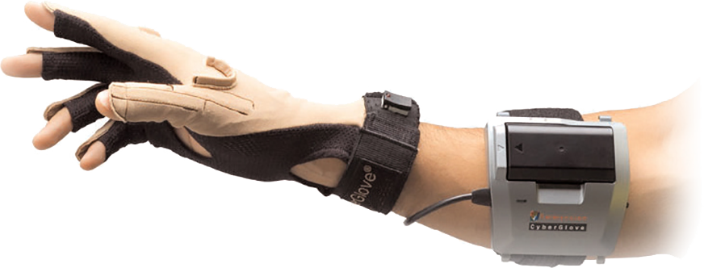
Dataset NinaPro
NinaPro is a database containing labelled data from 10 sEMG sensors about both intact and amputee subjects. The labels are corresponding to the gestures from previous slides.
There is also overlapping data from a CyberGlove II dataglove providing 22 angles of the hand’s respective joints

Slide 7
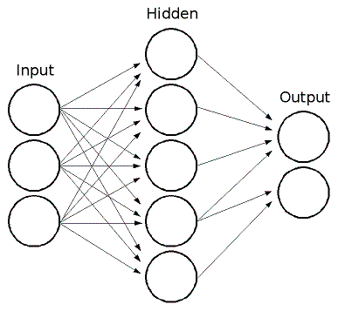
Current progress
Multi-Layer Perceptron Neural Network
Recognizing one gesture with EMG data from NinaPro Database

Slide 8
Results
Using a multi-layer perceptron NN with 32 nodes in the hidden layer and penalizing high weight values I achieved 96% accuracy in determining a fist gesture
Surprisingly I did not preprocess the data much but just fed it in to the NN after cutting out the measurements from the transition periods
Tweaking with parameters resulted in the following curve:

Slide 9
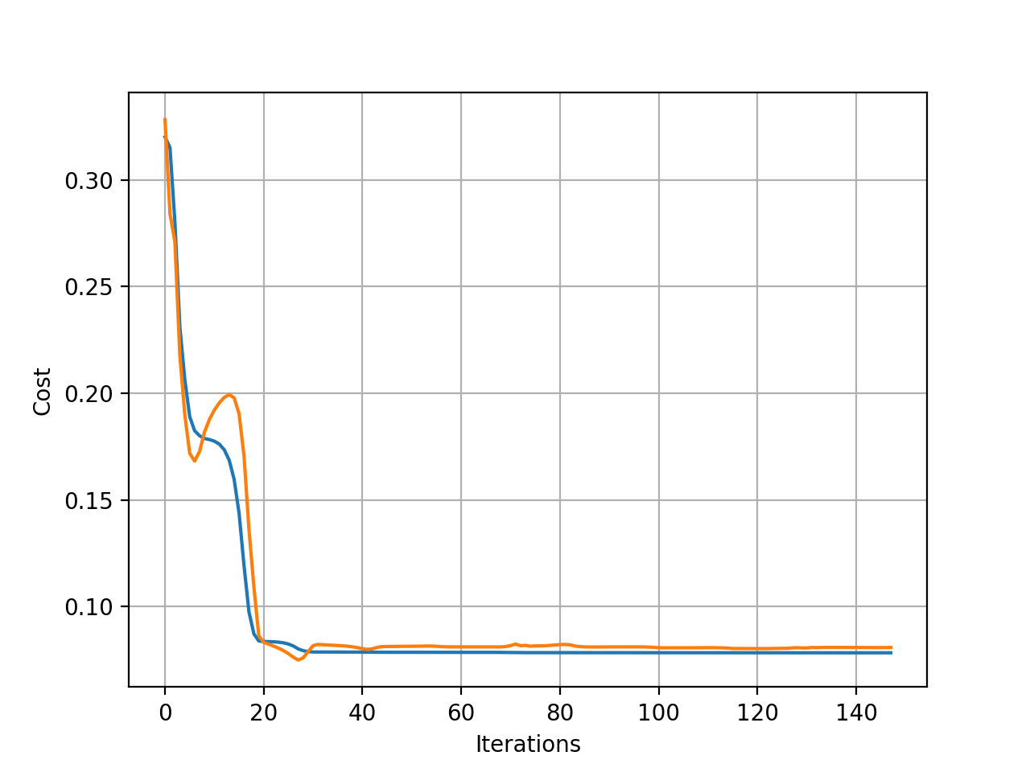

Slide 10
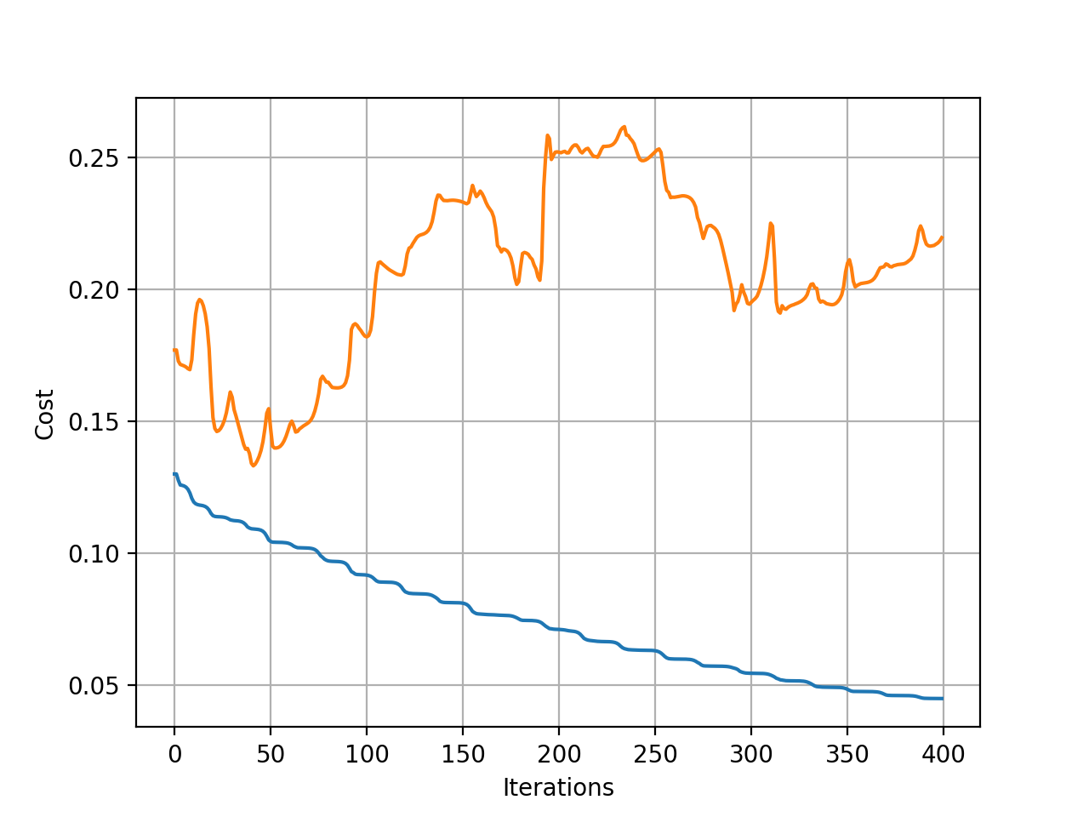

Slide 11
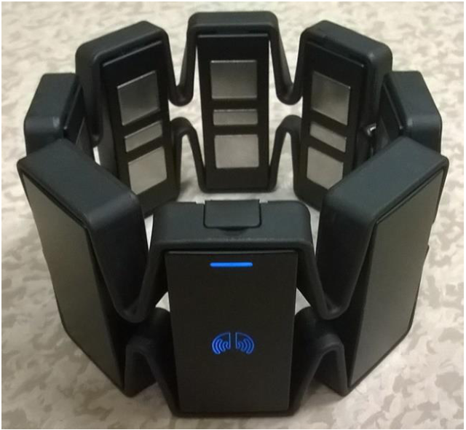
Next
Recognizing more gestures
Moving on to Tensorflow
Trying out Hidden Markov Models and Support Vector Machines
Moving to Recurrent NNs (specifically Long Short Term Memory)
Using much cheaper Myo armband to do real time gesture recognition

Slide 12
Thank you very much
Questions?

