Slide 1
LEAP AI and data consulting – Case Filip Arthur Blaafjell

Slide 2
AGENDA
Project Introduction
Pipeline Overview
Data Layers and Models
Data Governance
Summary and Questions

Slide 3
Amazon E-commerce and Macroeconomic insight in the US (2018-2023)

Slide 4
project introduction
Project goal:
Transform raw data into a unified analytical model to explore consumer spending behavior and macroeconomic performance across U.S. states.
Data:
FRED Economic Data - Monthly and state-level indicators
Open E-commerce 1.0 (MIT Media Lab) - 1.8M U.S. Amazon purchases (2018–2022) linked with user demographics.
Core Tasks:
Load data into Snowflake and design raw → staging → intermediate → marts layers.
Build robust dbt transformations with documentation and data tests.
Model aggregated state-level performance metrics (spend, CPI, unemployment).
Prepare outputs optimized for Power BI dashboards.

Slide 5
Data and pipeline overview

Slide 6
Data overview
Amazon purchases:
8 columns - transaction level data
Captures what each user bought and when
Amazon survey:
22 columns – user level demographics and behaviour
Linked to purchases by user ID
FRED macroeconomics:
13 columns – macroeconomic indicators by state
FRED Unemployment data:
3 columns – unemployment rate by state and month

Slide 7
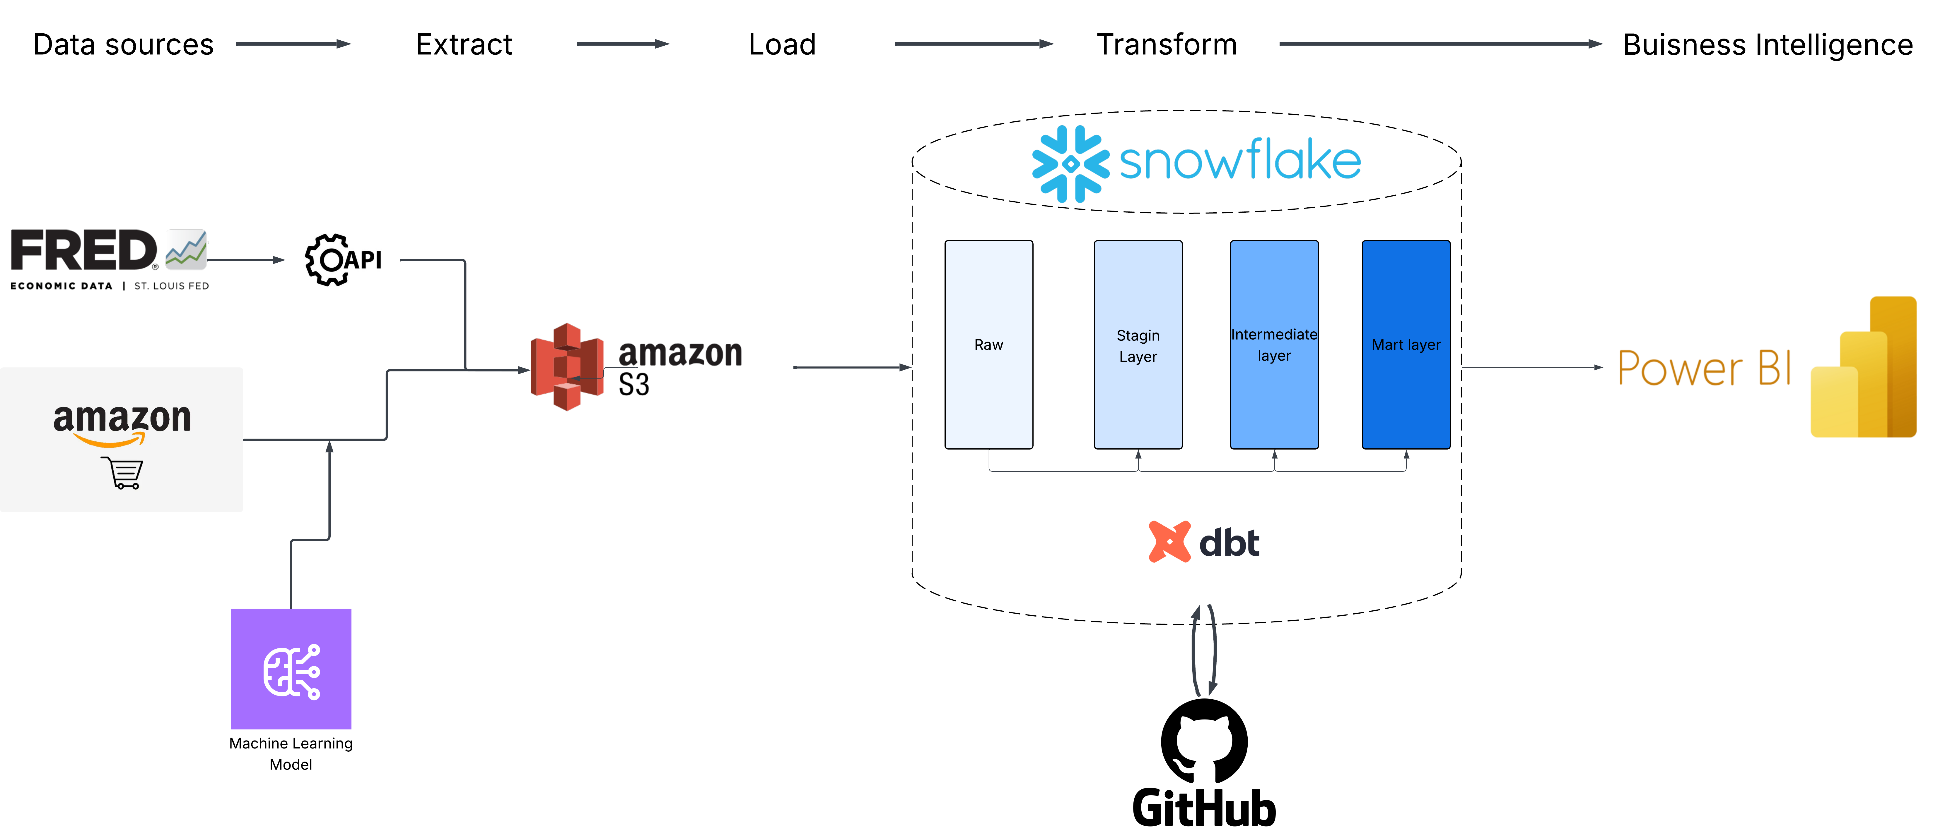
pipeline overview

Slide 8
Data layers and models

Slide 9
Data modeling framework and layer principles
Modeling Architecture and Design Principles
STAGING
Intermediate
mart
Cast and clean
Join and aggregate
Deliver business ready metrics
Built on a layered dbt transformation architecture (STG → INT → MART). The models follows principles of modularity and consistency, ensuring structured, scalable, and reliable data.
Keep grain identical to source
Enforce grain integrity
Use consistent grains
standardize Naming and values
Ensure null-safe calculations
Design for performance (no joins)

Slide 10
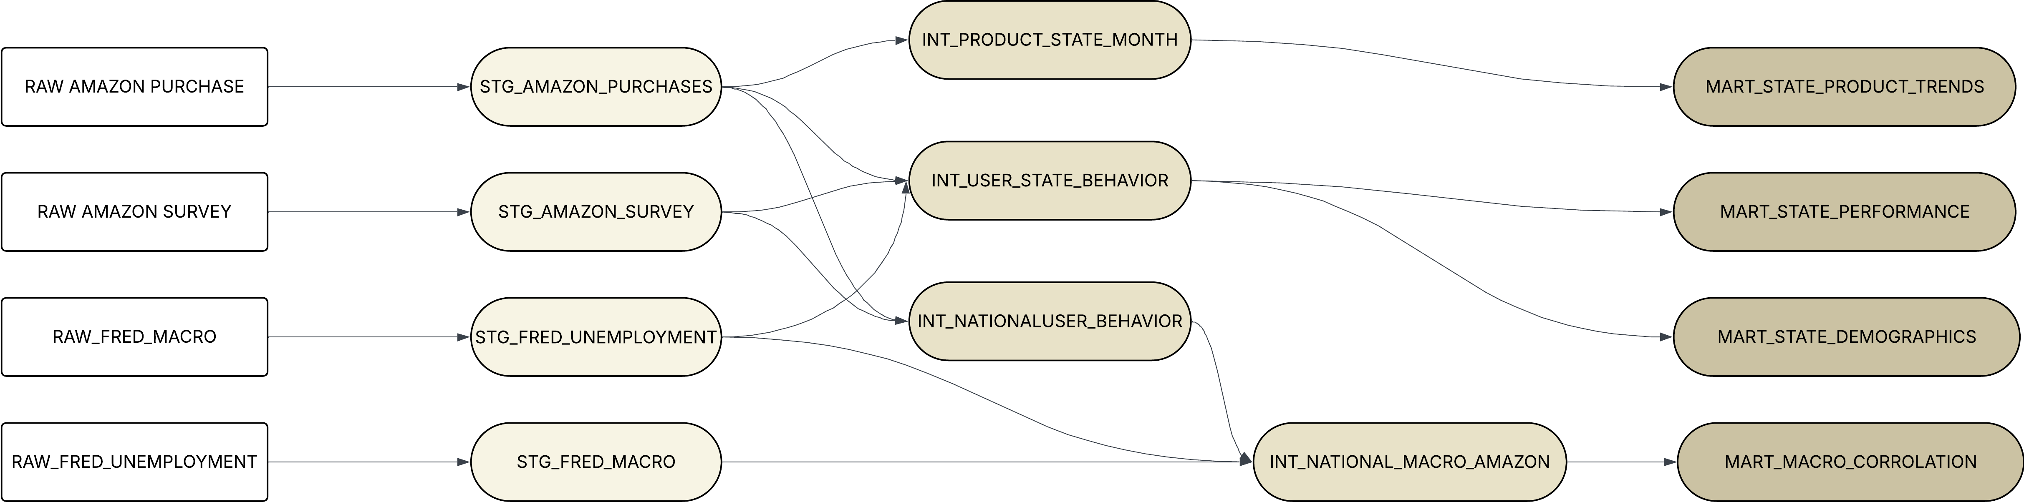
Data models
12 models: 4 Staging --> 4 Intermediates --> 4 Marts

Slide 11
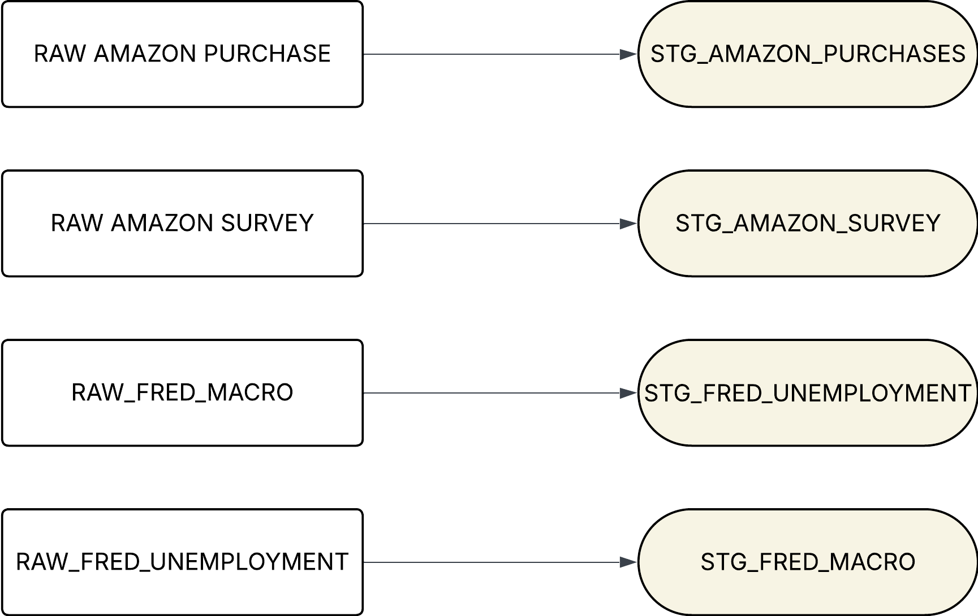
Staging layer
Modeling Architecture and Design Principles
Standardize raw feeds (types, nulls, text)
Validate core keys & domains
Remove noise early (invalid states, empty strings)
No business logic or aggregation here

Slide 12
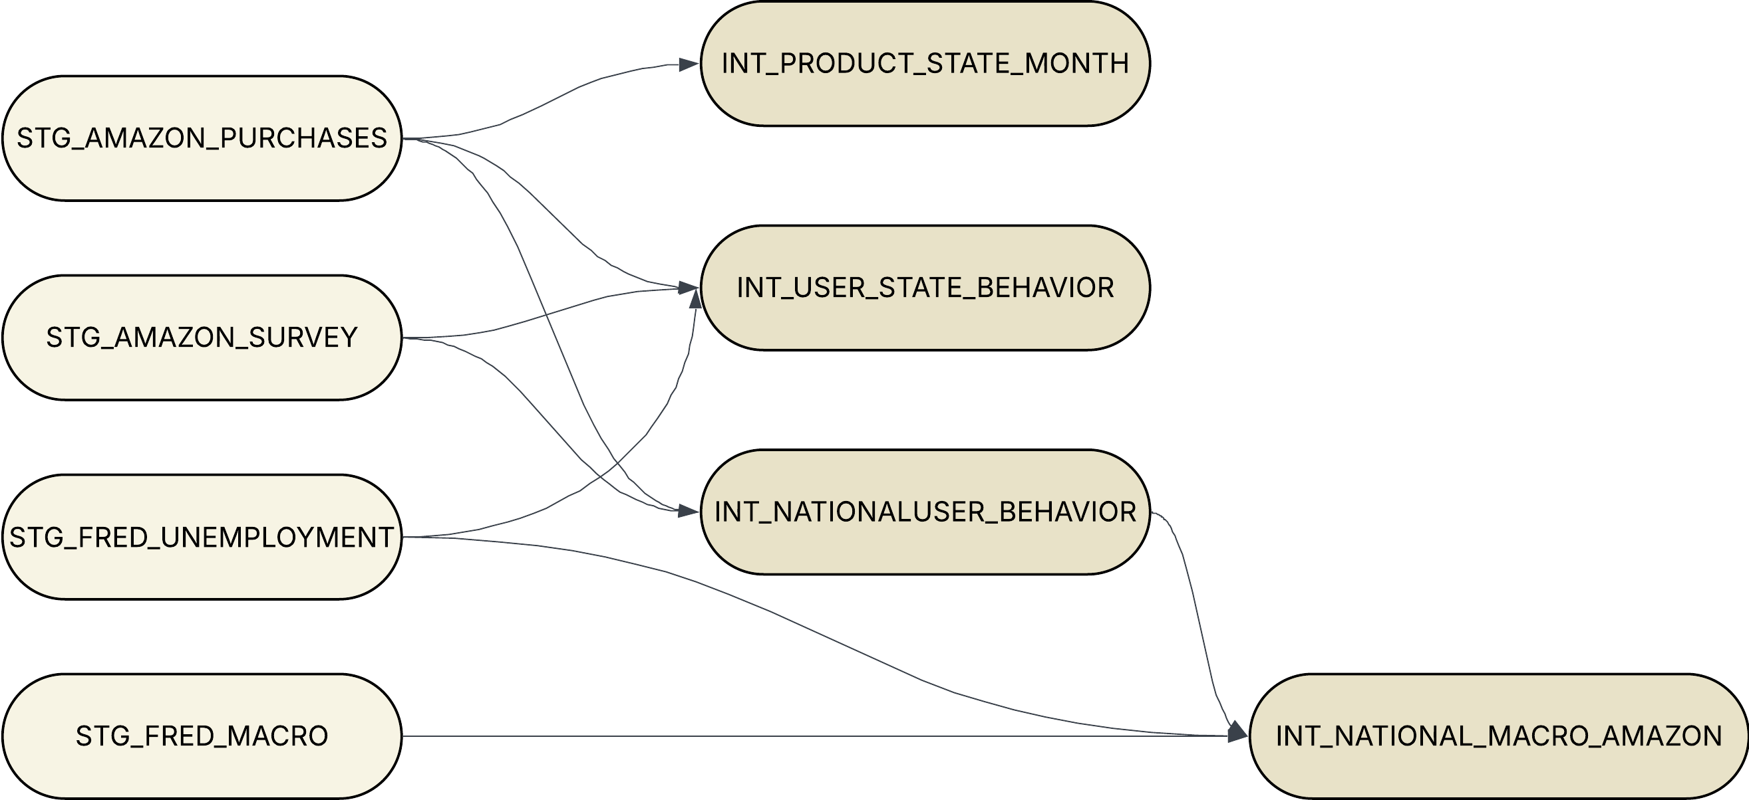
Intermediate layer
Modeling Architecture and Design Principles
Transform standardized staging data into analytics-ready aggregates based on grains.
This layer defines behavioral, product, and macro-level relationships across dimensions (user, state, month).

Slide 13
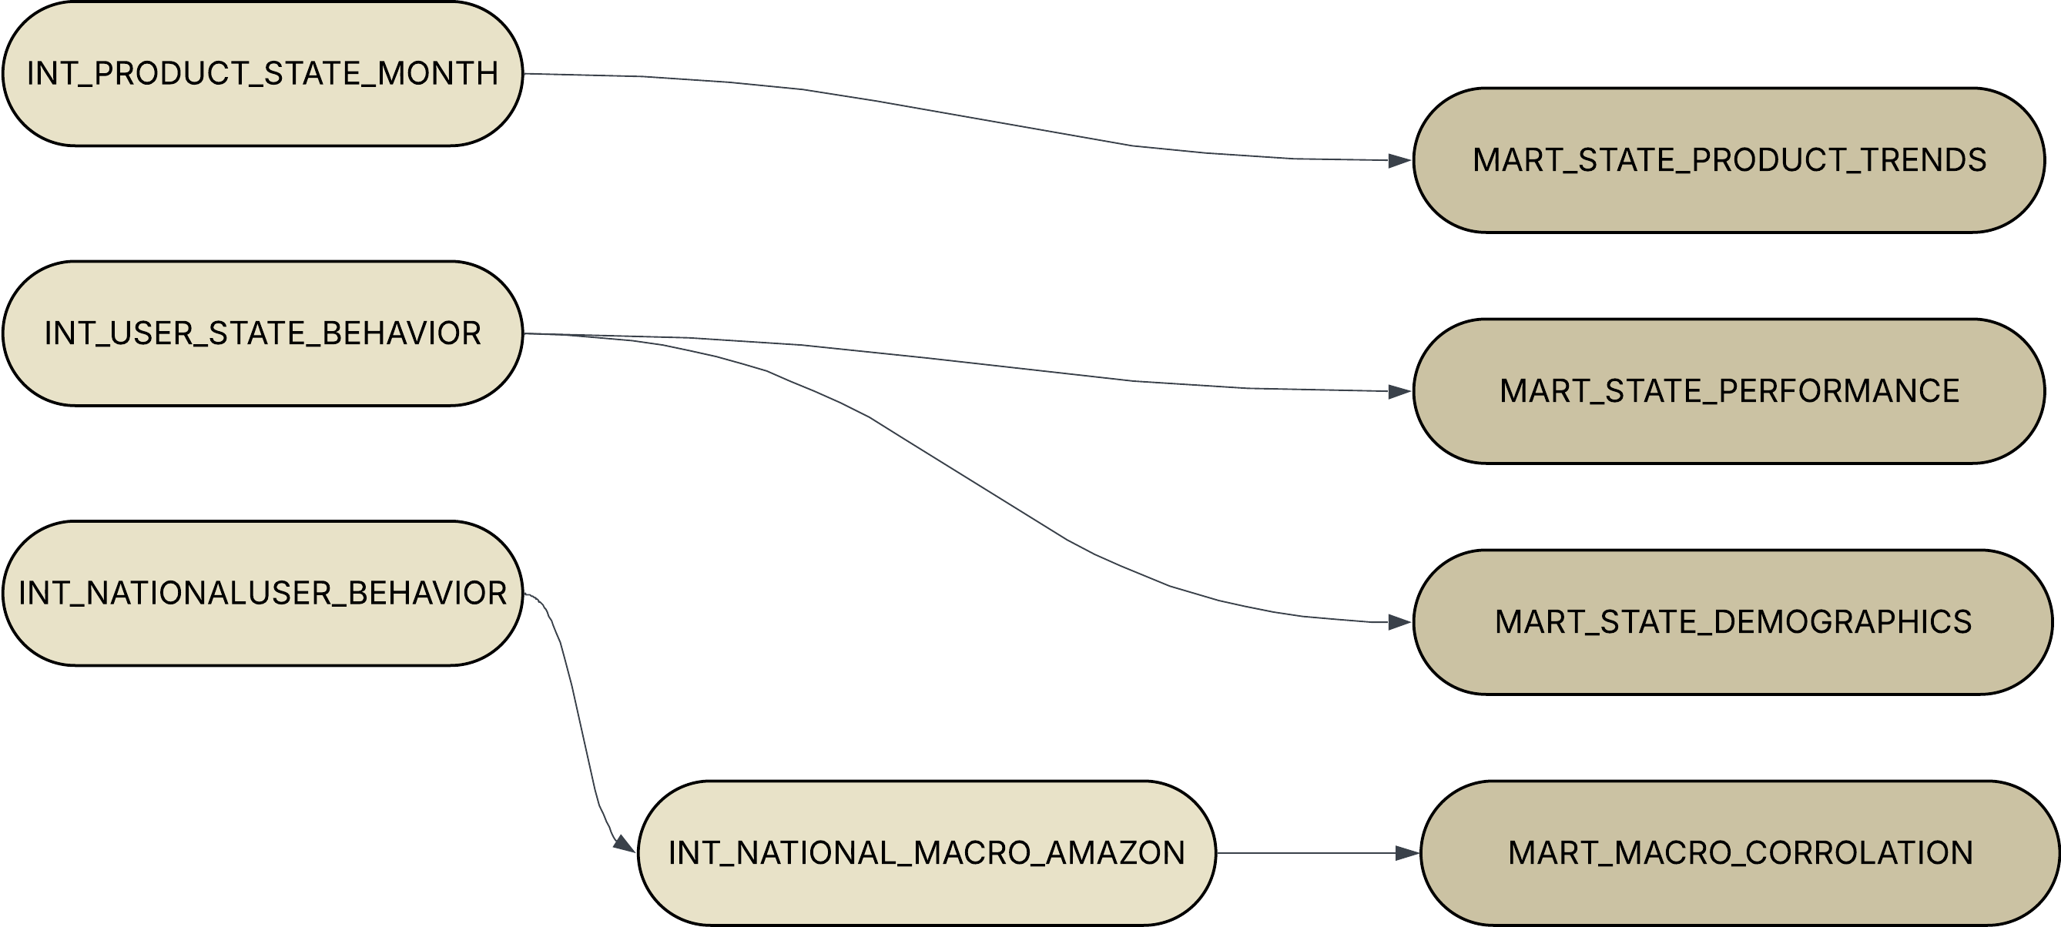
MART LAYER
Modeling Architecture and Design Principles
Deliver aggregated analytics and datasets with business logic applied.
These models expose key performance metrics, growth trends, and demographic insights for visualization and decision-making.

Slide 14


Slide 15
Current Data Governance and Scalability

Slide 16
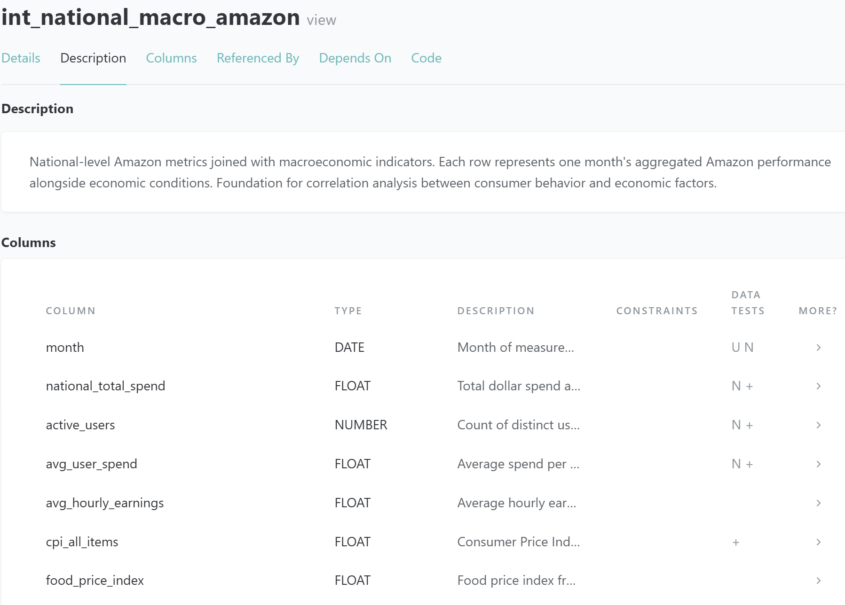
Robust testing and documentation
Modeling Architecture and Design Principles
Testing ensures that every layer meets integrity, consistency, and realism standards before data reaches analytics consumers.
All models have separate YAML test files with clear a model description, column descriptions and data quality testing.
Testing methods is separated by layers Hygiene (STG) → Aggregation (INT) → Metrics (MART)

Slide 17
Future work, thoughts and summary

Slide 18
FUTURE WORK – CI/CD → PRODUCTION READY
Modeling Architecture and Design Principles
Raw schemas continuously updated by Snowpipe.
Dedicated databases and warehouses for dev, stg, and prod, with strict role-based access.
Git CI/CD workflow:
PR triggers CI: automated dbt build and testing → Approval triggers CD: deploys to Snowflake production → Data models and metrics updated.
Add metadata logging and data freshness dashboards + Snowflake query history.

Slide 19
What would I have done differently next time?
Modeling Architecture and Design Principles
Allocate more time to mapping data lineage and defining model grains to ensure structural clarity and consistency across all layers
Prioritize scalability and governance from scratch by gaining a deeper understanding of Snowflake architecture, including warehouse, database, schema, and role configuration
Prototype a complete end-to-end data flow from raw to mart early on to validate the overall design and ensure a robust, scalable process before developing individual layers.
Establish stronger data testing and validation routines early in the process to catch anomalies and ensure trust in model outputs before building the downstream layers.
Document assumptions and data definitions continuously and more frequently to make models easier to maintain

Slide 20
THANK YOU

