Slide 1
LEAP AI and data consulting – Case

Slide 2
AGENDA
Project Introduction
Data and Pipeline Overview
DBT Snowflake Setup
Data modelling layers
BI and Insights
Summary and Questions

Slide 3
Amazon E-commerce and Macroeconomic insight in the US (2018-2022)

Slide 4
project introduction
Project goal:
Transform raw data into a unified analytical model to explore consumer spending behavior and macroeconomic performance across U.S. states.
Data:
FRED Economic Data - Monthly and state-level indicators (CPI, income, unemployment, consumer sentiment, etc.).
Open E-commerce 1.0 (MIT Media Lab) - 1.8M U.S. Amazon purchases (2018–2022) linked with user demographics.
Core Tasks:
Load data into Snowflake and design raw → staging → intermediate → marts layers.
Build robust dbt transformations with documentation and data tests.
Model aggregated state-level performance metrics (spend, CPI, unemployment).
Prepare outputs optimized for Power BI dashboards.

Slide 5
pipeline overview

Slide 6
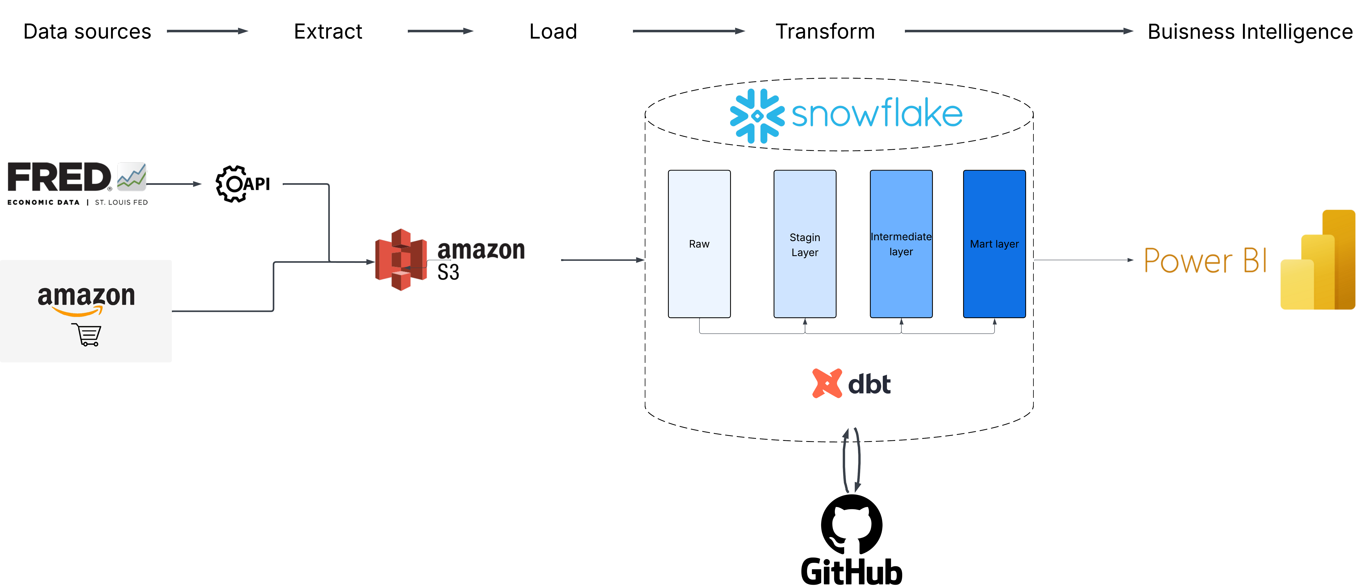
Data pipeline overview

Slide 7

Speaking Impact
Your ability to communicate effectively will leave a lasting impact on your audience
Effectively communicating involves not only delivering a message but also resonating with the experiences, values, and emotions of those listening

Slide 8
Dynamic delivery
METRIC | MEASUREMENT | TARGET | ACTUAL
Audience attendance | # of attendees | 150 | 120
Engagement duration | Minutes | 60 | 75
Q&A interaction | # of questions | 10 | 15
Positive feedback | Percentage (%) | 90 | 95
Rate of information retention | Percentage (%) | 80 | 85
Learn to infuse energy into your delivery to leave a lasting impression
One of the goals of effective communication is to motivate your audience

Slide 9
Final tips & takeaways
Practice makes perfect
Continue improving
Consistent rehearsal
Strengthen your familiarity
Refine delivery style
Pacing, tone, and emphasis
Timing and transitions
Aim for seamless, professional delivery
Practice audience
Enlist colleagues to listen & provide feedback
Seek feedback
Reflect on performance
Explore new techniques
Set personal goals
Iterate and adapt

Slide 10
Speaking engagement metrics
IMPACT FACTOR | MEASUREMENT | TARGET | ACHIEVED
Audience interaction | Percentage (%) | 85 | 88
Knowledge retention | Percentage (%) | 75 | 80
Post-presentation surveys | Average rating | 4.2 | 4.5
Referral rate | Percentage (%) | 10 | 12
Collaboration opportunities | # of opportunities | 8 | 10

Slide 11
THANK YOU

