Slide 1
Salary Prediction from US Job Ads
Phase 1: data collection and preprocessing
Filip Dumitrașcu · IAPD 2026

Slide 2
The Idea
Predict the yearly salary (USD) of a US job ad from the ad itsel
Job ad
Features
Model
$ / year
US pay-transparency laws: ads must state a pay range
the ad gives both the features and the target

Slide 3
Data Collection: Crawl
Official careers sites, read through the public APIs of their hiring platforms
45
17
58,308
companies
hiring platforms
job ads collected
Workday · Greenhouse · Eightfold · SmartRecruiters · iCIMS Jibe · Ashby · Lever · Oracle Cloud · Phenom · Avature · Radancy · own sites (Amazon, Apple, Google, ...)
public listings only · ≤ 4 requests / second

Slide 4
Data Collection: Extract
raw ads
(.jsonl.gz)
rules on the text
(regex)
jobs.csv
31 columns
seniority
role family
years
degree
43 skills
work mode
contract
city · state
salary range
31,901 US ads · 27,020 with a salary

Slide 5
Preprocessing
1
2
3
4
5
6
7
Data types
Measuring
Cleaning
Integration
Transformation
Reduction
Discretization
done
not needed
measure in a notebook · change the data in scripts · train / test split before any learned value

Slide 6
1 · Data Types
Nominal
Binary
company, industry, role family, title, city, state
43 skills (asymmetric)
Ordinal
Numeric
seniority, degree, work mode, contract
years, locations (ratio) · posted date (interval) · salary (ratio, the target)

Slide 7
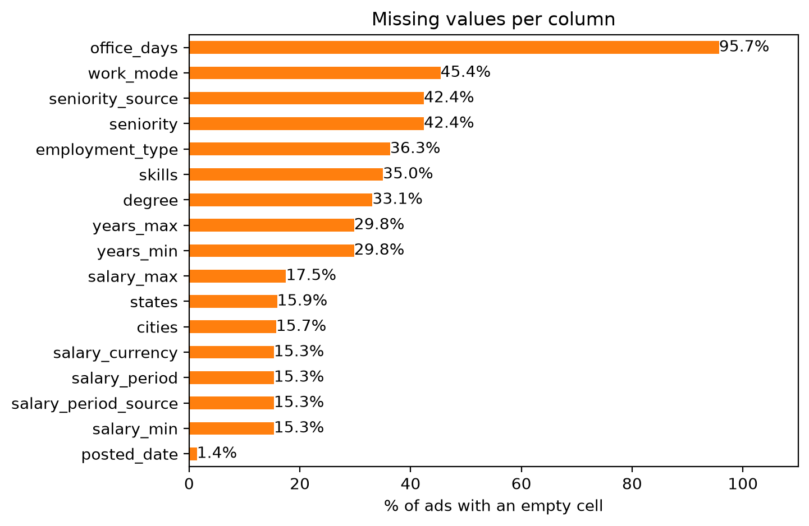
2 · Measuring Data: Missing Values
15.3%
ads without a salary
30-46%
seniority, work mode, degree, years

Slide 8
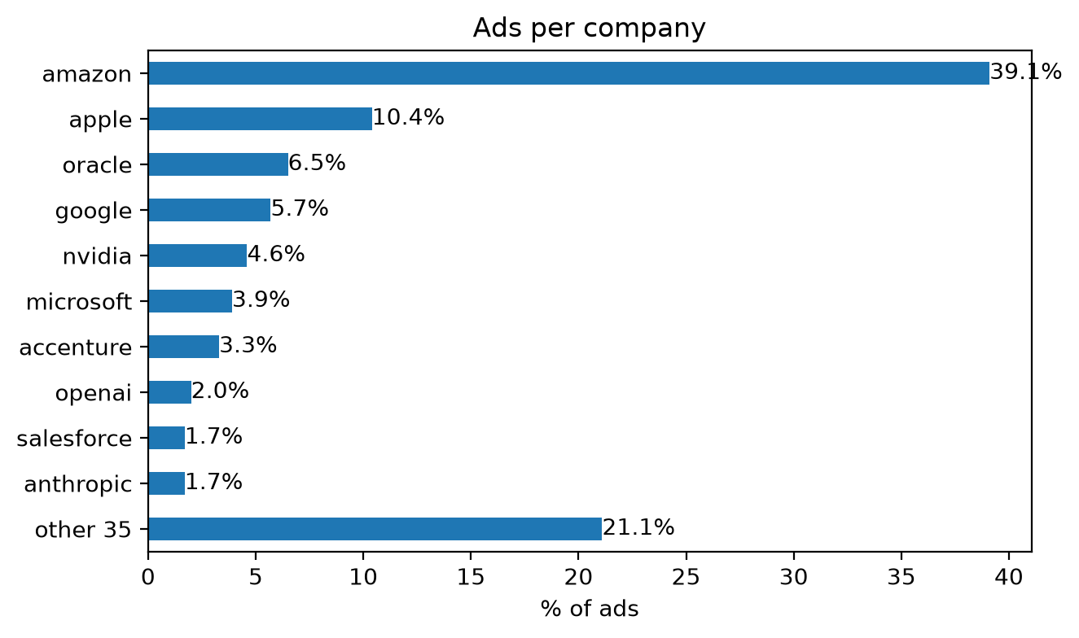
2 · Measuring Data: Companies
39%
of the ads are Amazon
mode, frequency, mean, median, quartiles, IQR, std, skewness, kurtosis, by scale

Slide 9
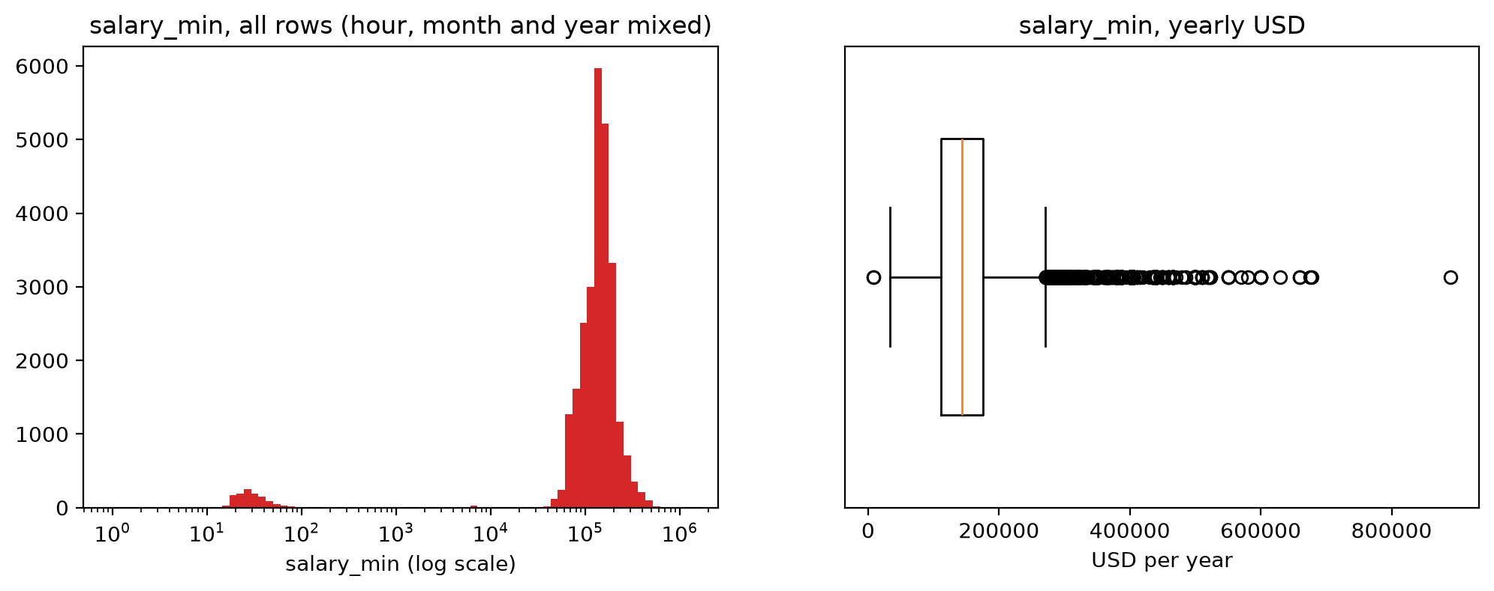
2 · Measuring Data: The Salary
three units mixed: year, hour, month
yearly: median 143,700 USD · skewness 1.9 · kurtosis 7.6

Slide 10
3 · Data Cleaning
Missing values
Noisy data
Outliers
no salary: drop (−4,881)
not stated: "unknown"
numbers: train median
wrong salaries: −49
other currency, not pay, below minimum wage
1.5 IQR: 1,044 yearly
real AI-lab salaries: kept
31,901 → 26,971 ads

Slide 11
4 · Data Integration
Duplicates
Redundancy
Inconsistencies
exact: −150
same job, new id: −1,492
company name, locations, crawl date: dropped
company → industry: Cramér's V = 1
hour × 2,080
month × 12
1,046 salaries → per year
26,971 → 25,329 ads, 45 sources

Slide 12
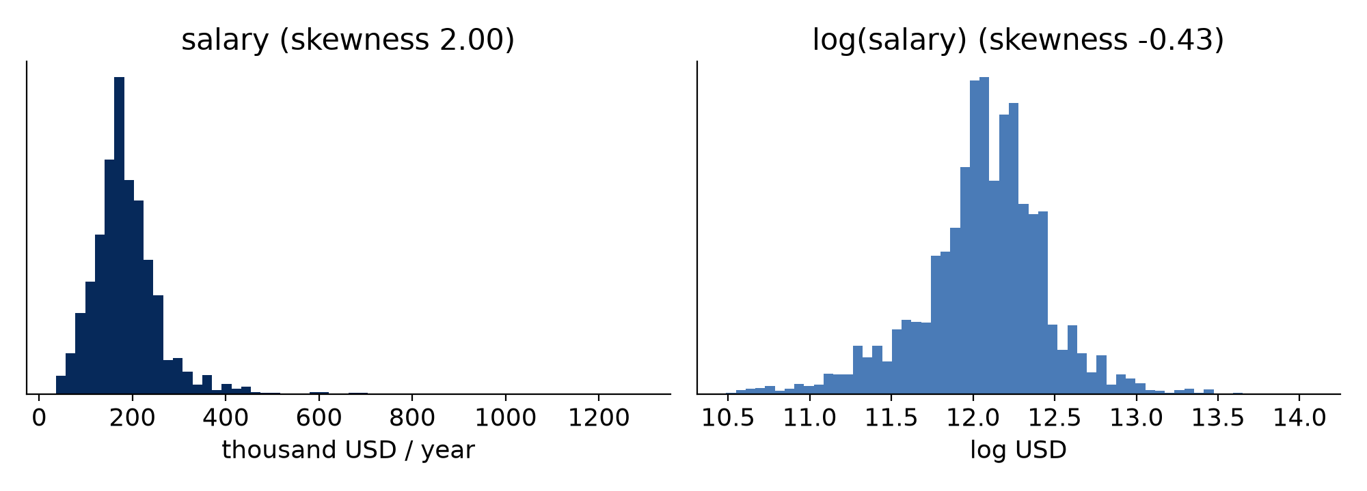
5 · Data Transformation
train / test 80 / 20, first
one-hot, ordinal, multi-hot
z-score, min-max, log
new: days old, number of skills
target: log(salary)
20,263 train · 5,066 test · 199 columns

Slide 13
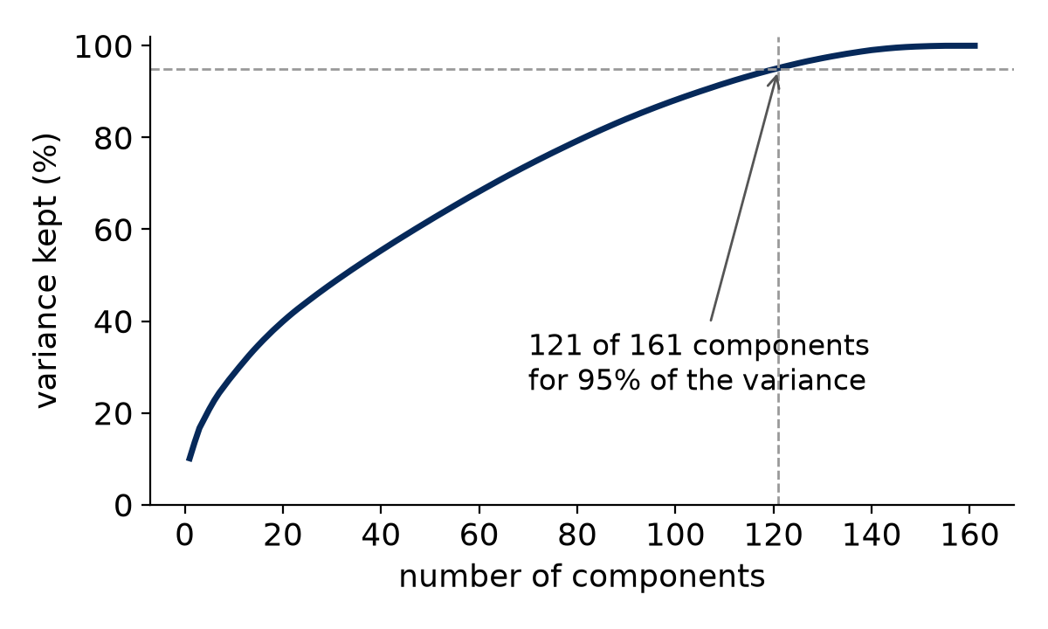
6 · Data Reduction
184 → 161
features
not features (ids, leakage)
low variance (< 20 ads)
redundant (|r| > 0.95)
PCA: not applied, features keep their meaning

Slide 14
7 · Data Discretization
7
Not needed
the target stays a number
trees and boosting choose their own thresholds
linear models, kNN and SVR use the numbers

Slide 15
Models to Run
Linear
Distance & kernel
Trees & ensembles
Linear regression
Ridge
Polynomial
Bayesian linear
k-nearest neighbours
SVR (RBF kernel)
Decision tree
Random forest
AdaBoost
XGBoost
baseline: train median · 5-fold CV on train · MAE · RMSE · R² on test

