Slide 1


Enterprise Data Science Bootcamp
2025
Understanding and predicting
Employee Attrition
Filipe Brandão Carmo | 20240828
João Silva | 20241655
Rita Marques | 20242019
Sara Henriques | 20242070
People are the key to the company’s success.

Slide 2
Agenda
1 | Introduction
2 | Exploratory Data Analysis
3 | Feature Selection
4 | Predictive Model
5 | Insights & Recommendations

Slide 3



1
Introduction
High turnover rates are costly and disruptive
It is fundamental to anticipate which employees are likely to leave
16% of the companies’ employees left
Project Business Goals
Identify key factors influencing attrition
Recommend strategies to retain valuable employees
Predict whether an employee is likely to leave the company

Slide 4




2
Exploratory Data Analysis
Exploratory Data Analysis
31 features categorized for attraction analysis
Demographics
- Age
- Distance from home
- Gender
- Marital Status
Job characteristics
- Department and role
- Frequency of travel
- Rates
- Environment and Job satisfaction
- Work-life balance
Work Experience
- Education
- Number of companies worked
- Total of working years
- Years since the last promotion
Compensation
- Monthly income
- Percent of salary hike
- Performance rating
- Stock Option level
Notes:
31 Features Categorized for Attrition Analysis

Slide 5

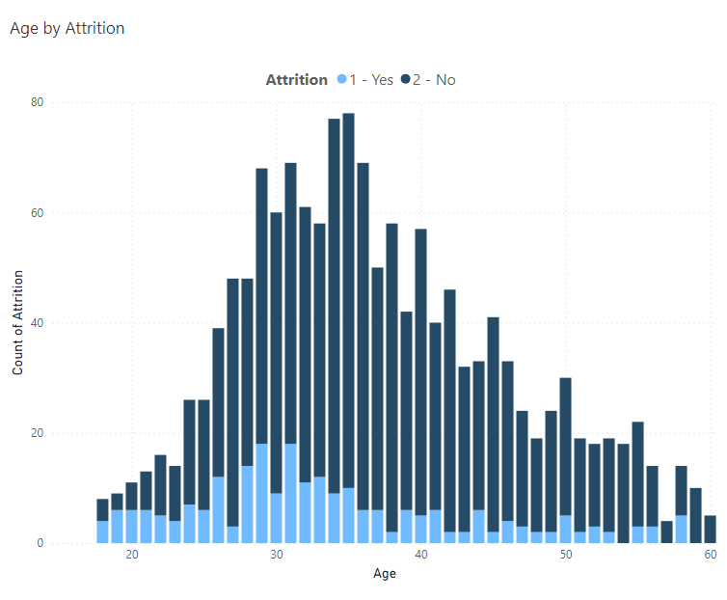
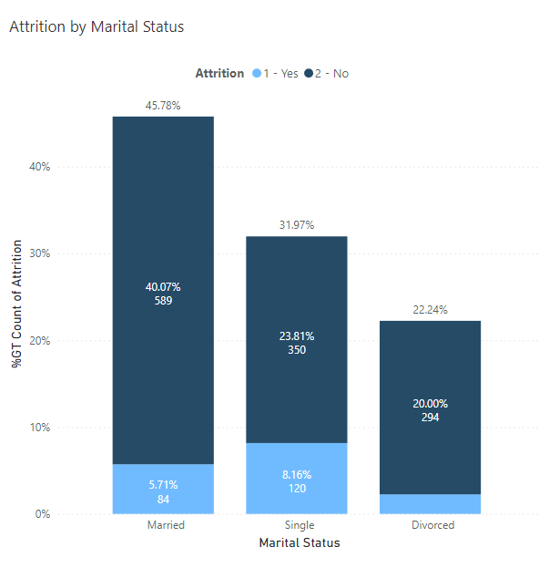
2
Exploratory Data Analysis
Demographics
Younger and single people leave the company more often
Age by Attrition
Attrition By Marital Status
Younger people, between their 20 and 30, are a big part of the work force and are the ones leaving more often in early stages of their career.
In proportion, single people tend to leave more often.
Interative visualization here

Slide 6
2
Exploratory Data Analysis
Job characteristics
Overtime, work life balance and satisfaction as crucial for attrition
Interative visualization here

Slide 7
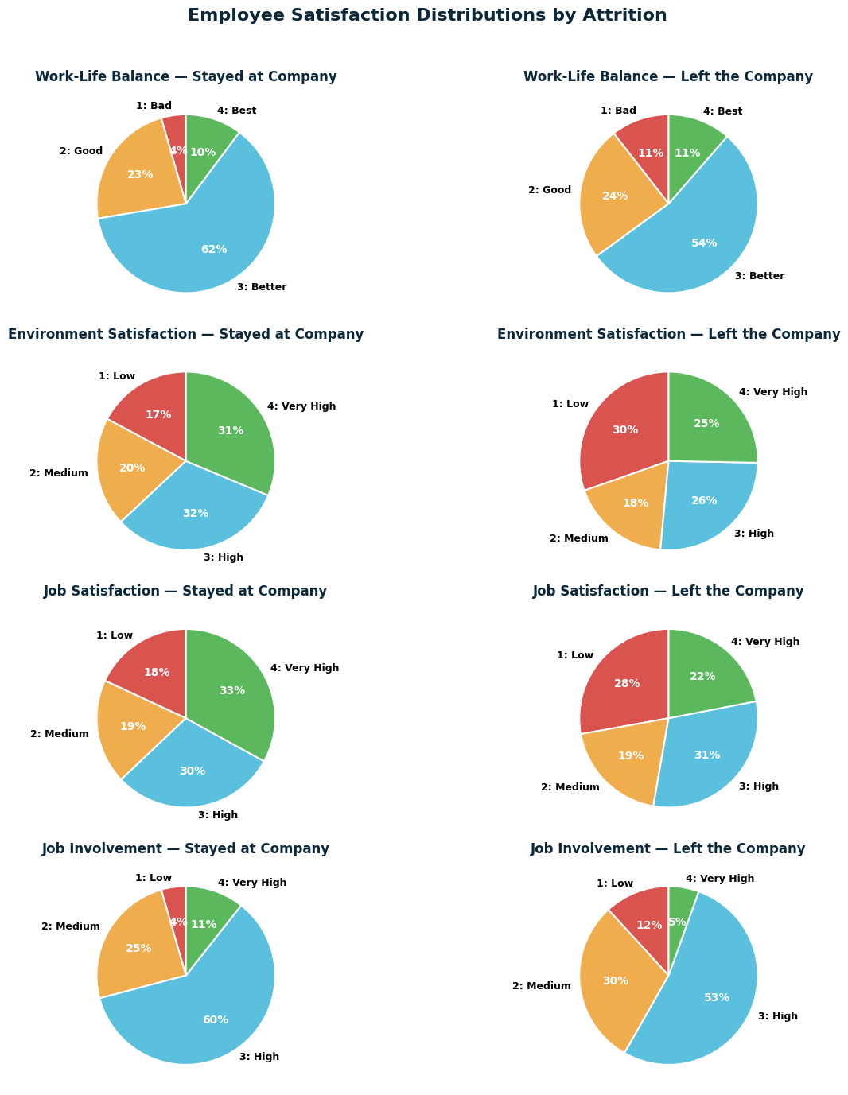
2
Exploratory Data Analysis
Job characteristics
Overtime, work life balance and satisfaction as crucial for attrition
Lower job satisfaction with higher percentage of employees who left
Lower and medium levels of job involvement with higher percentage of employees who left

Slide 8
2
Exploratory Data Analysis
Job characteristics
Overtime, work life balance and satisfaction as crucial for attrition
Bad work life balance with higher percentage of employees who left
Lower and medium environment satisfaction with higher percentage of employees who left

Slide 9
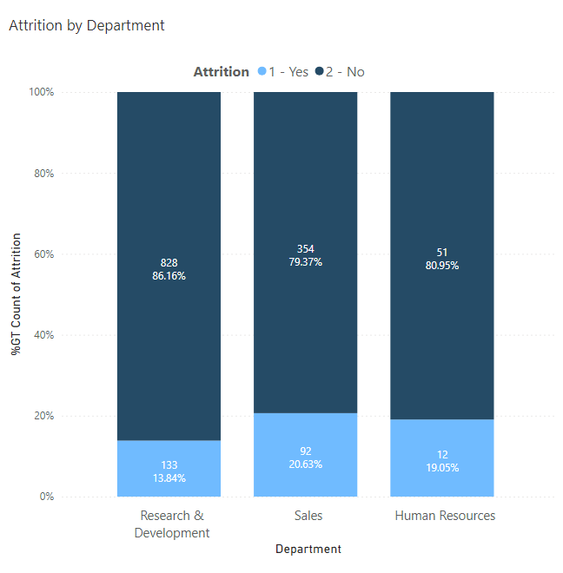
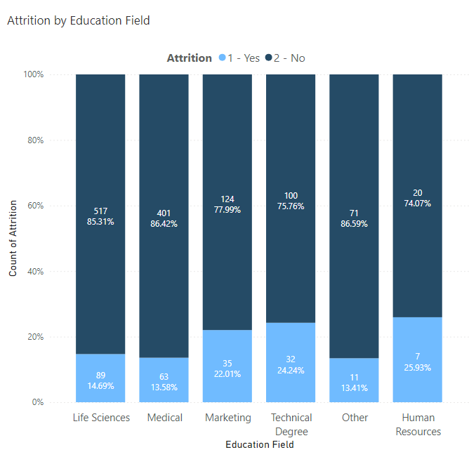
2
Exploratory Data Analysis
Job characteristics and work experience
When the department and education impacts
Attrition by Department
Attrition by Educational Field
Sales and HR departments show increased employee turnover.
Human Resources, Technical Degree, and Marketing graduates have higher turnover rates.
Interative visualization here

Slide 10
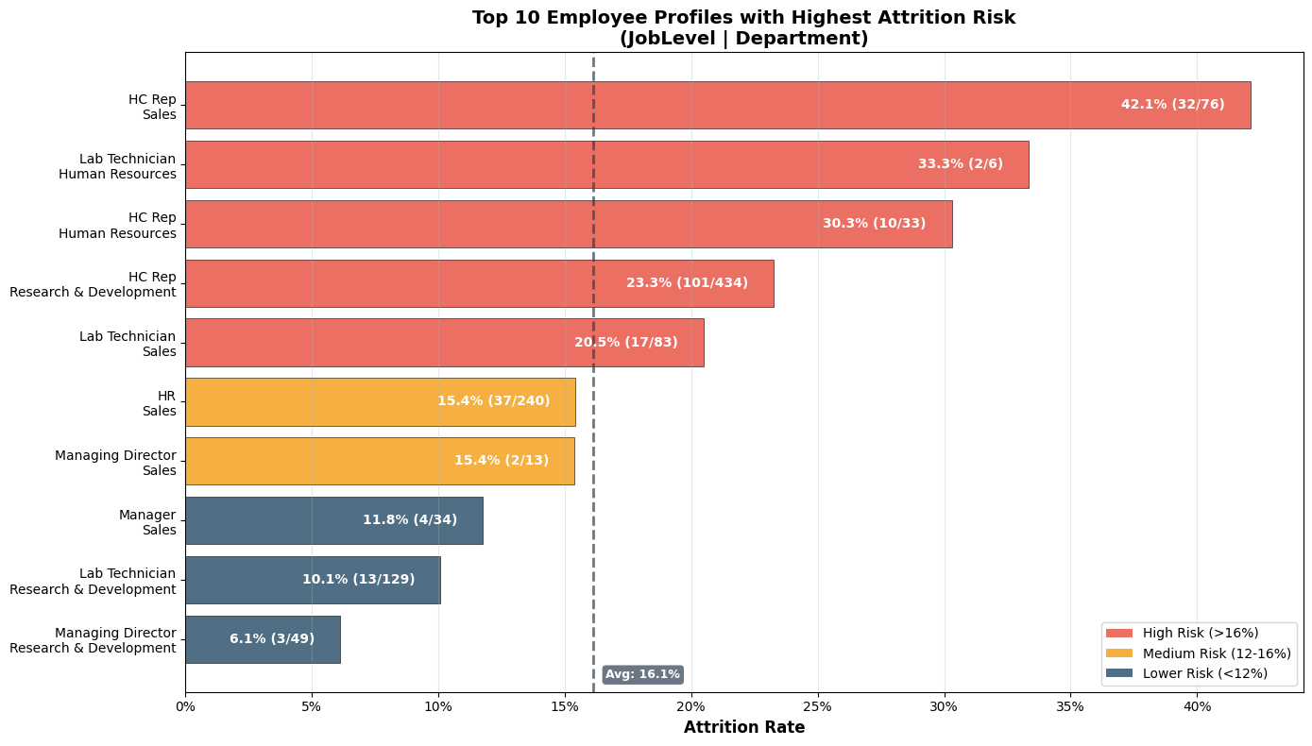

2
Exploratory Data Analysis
Job characteristics and work experience
Top 10 profiles with highest attrition risk, by job level and department
How to read:
32 of 76 employees left the company representing an attrition rate of 42.1%, for this job level and department
Key alert points
HC representatives - lower job roles - with extremely high risk across all departments
Sales department has 5 out of 10 high risk profiles
Lab Technicians – 3rd level role - appear risky in HR (33.3%) and Sales (20.5%)
Notes:
HC Reps are extremely high risk across all departments (42.1% in Sales, 30.3% in HR, 23.3% in R&D)
Sales department has 5 out of 10 high-risk profiles - clear focus area
Lab Technicians also appear risky in HR (33.3%) and Sales (20.5%)
Higher positions (Managing Director, Manager) have lower attrition - career progression helps retention

Slide 11
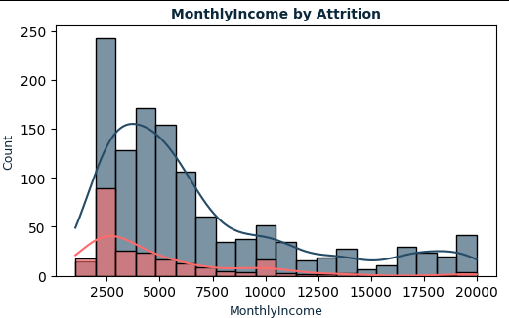
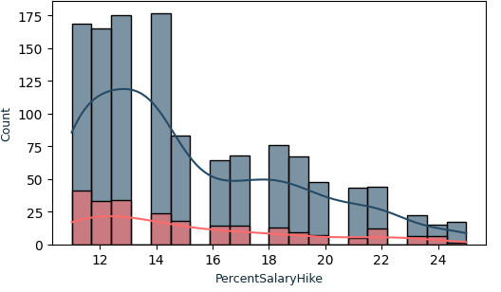
2
Exploratory Data Analysis
Compensation
Rewards incentivize the people to stay
Monthly Income by Attrition
Percent Salary Hike by Attrition
Attrition Yes
Attrition No
Attrition Yes
Attrition No
Lower-salaried employees leave the company more frequently. Usually, these are salaries from younger people.
A lower percentage of salary raises is associated with higher levels of attrition.
Interative visualization here
Notes:
Rita
Nas variáveis relacionadas com compensação, vimos que pessoas com salários mais pequenos saiem mais frequentemente
Da mesma forma, pessoas com Percent Salary Hike menor também saiem mais frequentemente
In the compensation variables, we saw that people with lower salaries tend to leave more often
People with lower salary hikes also leave more often

Slide 12
3
Feature Selection
Feature Selection
Most relevant features for prediction Attrition are mainly in Job characteristics
Despite of the number of features available, after analyzing correlations and applying statistical tests, these were the most relevant for machine learning models.
Curiously, no features from the Compensation category were selected.
Demographics
-
  Married or Single
Job characteristics
Satisfaction
Involvement
Environment satisfaction
Work-life balance
Overtime
Business travel
Department
Roles: Research director; manufacturing director; healthcare representative; manager; R&D department
Work Experience
Years at the company
Total working years
Number of companies worked
Notes:
Rita
Depois fizemos seleção de features de modo a perceber quais as variáveis que previam melhor a Attrition.
Estas variáveis prendiam-se com a satisfação e o envolvimento no trabalho, bem como certos departamentos e cargos.
Pessoas solteiras que iniciaram a sua atividade profissional há pouco tempo ou que já estiveram em várias empresas diferentes surgem como significativamente associadas à Attrition

Slide 13


4
Predictive Model
Predicting employee attrition
Policy option: proactively flag 106 employees to catch 3 out of 4 planned leavers
Logistic Regression Model
Business impact
Predicted
Catches 76.6% of employees planning to leave, requiring intervention with 106 employees (most balanced model).
By choosing a recall‑oriented threshold, we accept more false alarms in exchange for catching more at‑risk employees and reducing unexpected departures.
 | Stay | Leave
Stay | 177 71.7% | 70 28.3%
Leave | 11 23.4% | 36 76.6%
Actual
Model Results
Leavers Caught: 36 out of 47 (76.6%)
Missed Departures: 11 out of 47 (19%)
False Alarms: 70 out of 247 (32%)
Total Flagged: 106 employees
ROC AUC: 0.81
Notes:
Predicting Employee Attrition: Achieving a 76.6% Detection Rate using Logistic Regression
Forecasting and Mitigating Employee Flight Risk: A Logistic Regression Analysis of Attrition

Slide 14
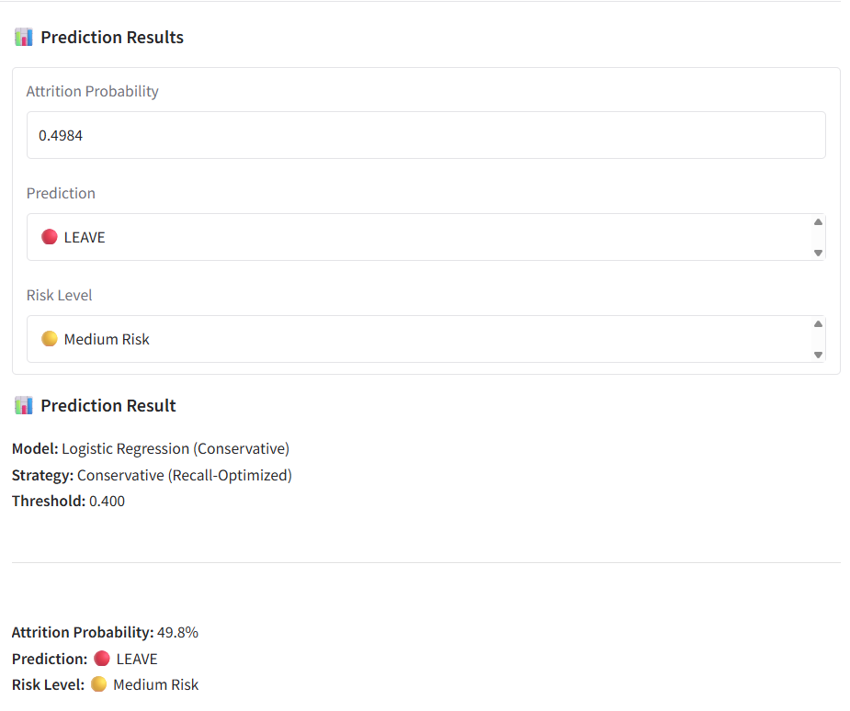
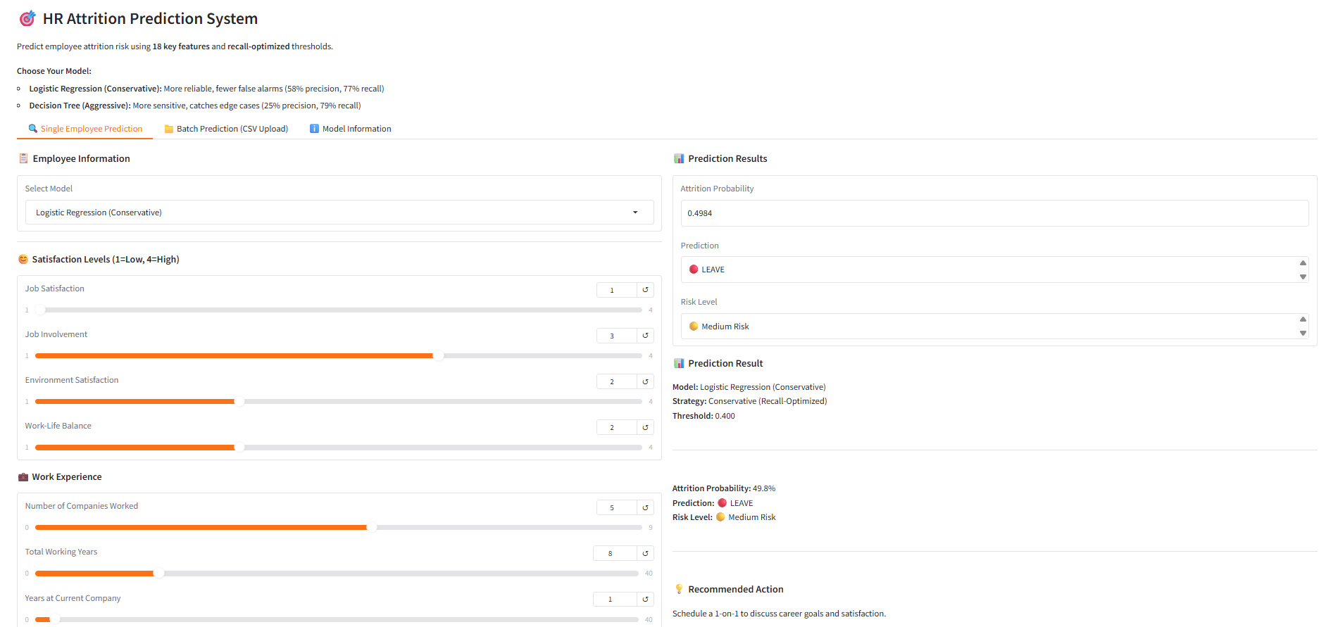
4
Modeling & Evaluation
Model deployment
Placeholder
Hugging Face Spaces
The app takes individual employee features as input, organized by 4 groups: Satisfaction level, Work Experience, Job Details​​.
Models used
Uses saved preprocessing pipeline (scaler + imputer)
Logistic Regression model (more balanced approach) with recall‑optimized threshold 0.40 for predictions.​
Decision Tree (more aggressive approach for high value employees) with recall‑optimized threshold 0.32 for predictions.
App available on Hugging Face Space

Slide 15



5
Insights & Recommendations
Insights & Recommendations
Avoiding attrition requires intervention in overtime, work conditions and business travel
Evaluate the reason behind overtime
Avoid employees working overtime
Provide flexible work schedule
Dimension the team to suppress overtime needs
Turnover in younger and entry-level jobs
Maintain young talent with competitive conditions (work conditions and compensation)
Promote training to accelerate career growth
Review the need for business travel
Avoid frequent travelling
Plan travel in advance (plan per semester)
Notes:
To minimize Attrition, the company should:
Avoid that employees work overtime, provide a flexible schedule
Hire older, more experienced people
Accelerate career growth to retain younger people
Avoid frequent travelling for employees - embrace remote culture
Provide a nice working environment and respect employee’s work-life balance
Cultivate relationships between employees and managers
Immediate Priority Groups:
1. HC Reps in Sales (53.8% attrition)
Suggested Actions:
Career Path Development: Create clear promotion pathways from HC Rep to higher roles
Compensation Review: Sales HC Reps likely have lower base pay - review commission structures and base salary
Mentorship Programs: Pair new HC Reps with experienced sales professionals
Performance Recognition: Implement monthly awards for top performers
Training Investment: Provide sales training, product knowledge, and soft skills development
Work-Life Balance: Review workload and quotas - high attrition suggests burnout
2. HC Reps Across All Departments (40-50% attrition)
Root Cause: HC Rep appears to be an entry-level position with poor retention Suggested Actions:
Onboarding Enhancement: Improve first 90 days experience
Competitive Compensation: Benchmark against market rates
6-Month Review: Implement early performance reviews with growth discussions
Skill Development: Offer certifications and training programs
Internal Mobility: Create fast-track programs for high performers
3. Lab Technicians in Sales (24-33% attrition)
Issue: Possible role mismatch - Lab Technicians in Sales department seems unusual Suggested Actions:
Role Clarity: Ensure job responsibilities match expectations
Department Fit: Consider if these roles should be in R&D instead
Specialized Training: Provide technical sales training
Equipment & Resources: Ensure they have proper tools and support
General Retention Strategies:
For Sales Department (highest overall attrition: 20.6%)
Review sales quotas and commission structure
Reduce administrative burden
Improve sales tools and CRM systems
Team-building activities
Flexible work arrangements
Better work-life balance policies
For Education Levels:
Below College: Offer tuition reimbursement for continuing education
College/Bachelor: Create leadership development programs
Master/Doctor: Provide challenging projects and research opportunities
For All High-Risk Profiles:
Stay Interviews: Conduct quarterly conversations with high-risk employees
Exit Interview Analysis: Understand why people in these roles are leaving
Competitive Analysis: Benchmark compensation and benefits against competitors
Engagement Surveys: Identify specific pain points for each profile
Manager Training: Ensure managers of high-risk teams have strong leadership skills

Slide 16




5
Insights & Recommendations
Insights & Recommendations
Avoiding attrition requires intervention in overtime, work conditions and business travel
Sales and Human Resources department with higher attrition levels in lower job roles
Career path & Development
- Create a transparent career path with achievable metrics and targets for promotion
- Promote specialization to prevent talent generalists from feeling professionally stagnant
Compensation, Recognition & Role Clarity
Quarterly career development 1:1 meeting to discuss long term goals, training needs and internal opportunities – demonstrate investment in their feature
Compensation, Training, Recognition & Role Clarity
Quarterly career development 1:1 meeting to discuss long term goals, training needs and internal opportunities – demonstrate investment in their future
Workload, Wellbeing & Time Management
- Enforce work-life balance to prevent burnout and train managers to recognize the signs and actively manage burnout signals
- Offer easily accessible mental health resources, as the Sales and HR roles deal with constant pressure
Notes:
To minimize Attrition, the company should:
Avoid that employees work overtime, provide a flexible schedule
Hire older, more experienced people
Accelerate career growth to retain younger people
Avoid frequent travelling for employees - embrace remote culture
Provide a nice working environment and respect employee’s work-life balance
Cultivate relationships between employees and managers
Immediate Priority Groups:
1. HC Reps in Sales (53.8% attrition)
Suggested Actions:
Career Path Development: Create clear promotion pathways from HC Rep to higher roles
Compensation Review: Sales HC Reps likely have lower base pay - review commission structures and base salary
Mentorship Programs: Pair new HC Reps with experienced sales professionals
Performance Recognition: Implement monthly awards for top performers
Training Investment: Provide sales training, product knowledge, and soft skills development
Work-Life Balance: Review workload and quotas - high attrition suggests burnout
2. HC Reps Across All Departments (40-50% attrition)
Root Cause: HC Rep appears to be an entry-level position with poor retention Suggested Actions:
Onboarding Enhancement: Improve first 90 days experience
Competitive Compensation: Benchmark against market rates
6-Month Review: Implement early performance reviews with growth discussions
Skill Development: Offer certifications and training programs
Internal Mobility: Create fast-track programs for high performers
3. Lab Technicians in Sales (24-33% attrition)
Issue: Possible role mismatch - Lab Technicians in Sales department seems unusual Suggested Actions:
Role Clarity: Ensure job responsibilities match expectations
Department Fit: Consider if these roles should be in R&D instead
Specialized Training: Provide technical sales training
Equipment & Resources: Ensure they have proper tools and support
General Retention Strategies:
For Sales Department (highest overall attrition: 20.6%)
Review sales quotas and commission structure
Reduce administrative burden
Improve sales tools and CRM systems
Team-building activities
Flexible work arrangements
Better work-life balance policies
For Education Levels:
Below College: Offer tuition reimbursement for continuing education
College/Bachelor: Create leadership development programs
Master/Doctor: Provide challenging projects and research opportunities
For All High-Risk Profiles:
Stay Interviews: Conduct quarterly conversations with high-risk employees
Exit Interview Analysis: Understand why people in these roles are leaving
Competitive Analysis: Benchmark compensation and benefits against competitors
Engagement Surveys: Identify specific pain points for each profile
Manager Training: Ensure managers of high-risk teams have strong leadership skills

Slide 17
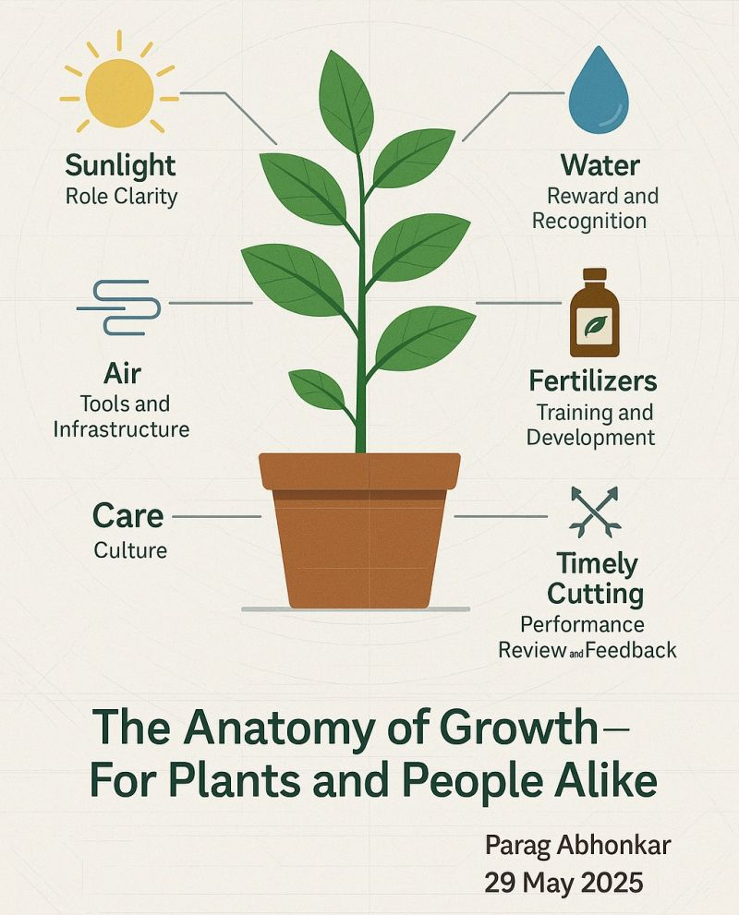
5
Insights & Recommendations
Insights & Recommendations, the final message
People need to be cared for, like plants
Plants stay in the same place during their lifetime.
A well-cared person will do the same.
Source: https://www.linkedin.com/posts/parag-abhonkar-55a3b173_growthmindset-organizationalculture-employeedevelopment-activity-7333572838714462210-c0bP/
Notes:
Rita
No fim de contas, as pessoas e as plantas têm várias coisas em comum.
Ambas precisam de ser bem cuidadas com orientação (luz do sol), água (recompensas), ar (infraestrutura definida), fertilizantes (oportunidades de treino), e também têm de ser podadas frequentemente (com feedback e revisões de trabalho)
Afinal, as plantas ficam no mesmo sítio durante toda a sua vida. Um empregado bem cuidado vai escolher fazer o mesmo.

Slide 18
Thank you!

Slide 19
Appendix
The following slides have more details about the sections presented before. The correspondent chapters are identified in the right upper corner.
The interactive visualizations are available in the Fabric workspace EDSB25_10, though the following link:
https://app.fabric.microsoft.com/links/xDPaVlbiSz?ctid=e4bd69ff-e6f7-4c2e-b247-41b54ba2490e&pbi_source=linkShare
The app for Employee Attrition is available at:
https://huggingface.co/spaces/filipe-carmo/hr-attrition-prediction

Slide 20
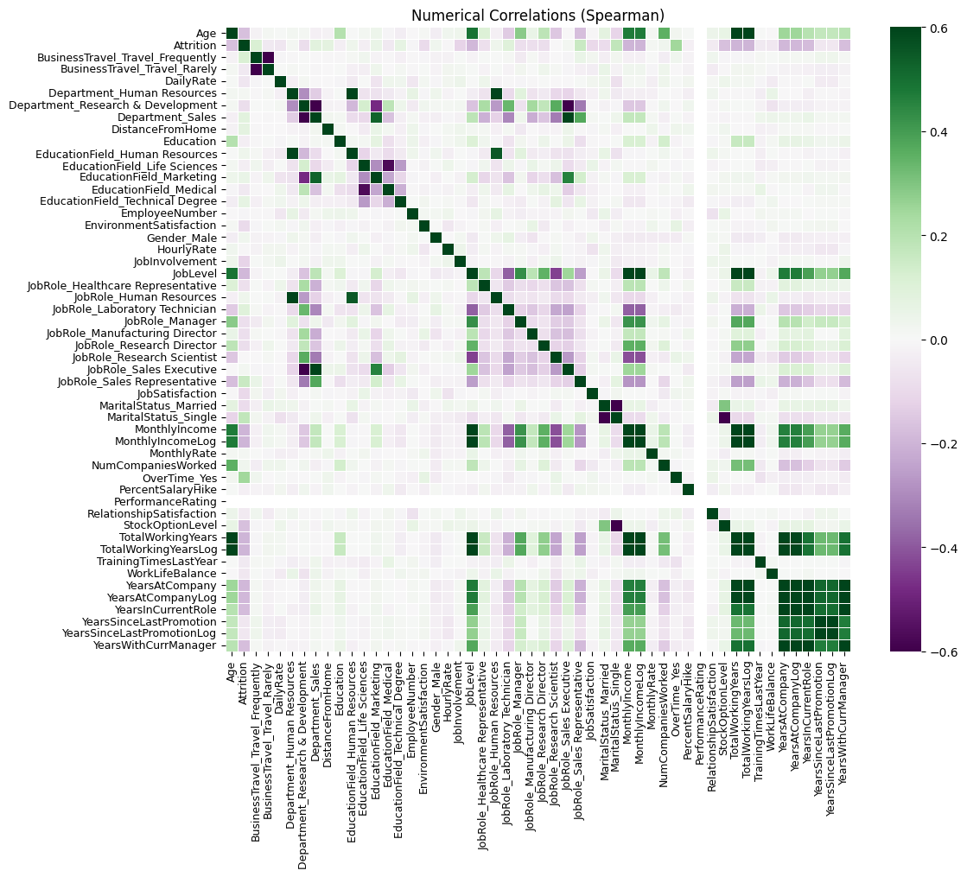
3
Appendix – Feature Selection & Engineering
More details about Feature Selection & Engineering
Redundant features were dropped using Spearman correlation
Features were dropped when correlation > 0.65, keeping the feature with the largest correlation with Attrition
14 Dropped features:
{'MonthlyIncomeLog', 'StockOptionLevel', 'JobLevel', 'YearsSinceLastPromotion', 'MonthlyIncome', 'JobRole_Sales Executive', 'BusinessTravel_Travel_Rarely', 'Age', 'TotalWorkingYears', 'Department_Sales', 'YearsAtCompany', 'YearsWithCurrManager', 'YearsInCurrentRole', 'Department_Human Resources'}
4 Kept:
- TotalWorkingYears
- MaritalStatus
- PercentSalaryHike
- YearsAtCompany

Slide 21
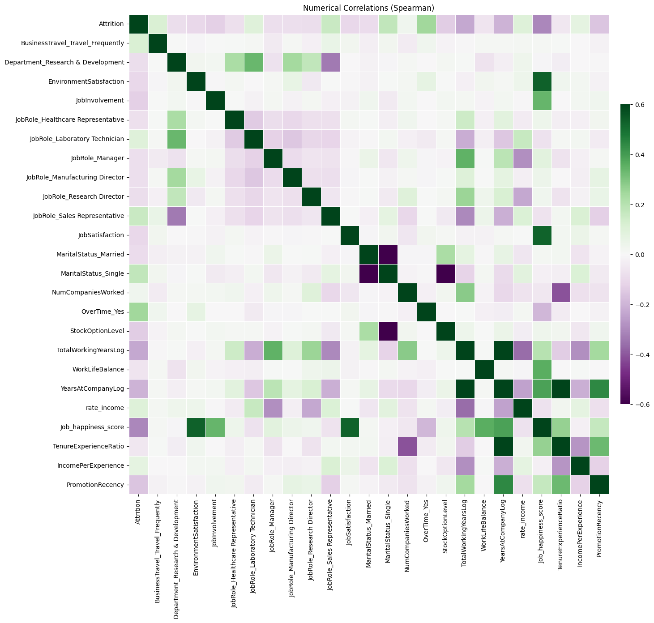
3
Appendix – Feature Selection & Engineering
More details about Feature Selection & Engineering
chi-squared contingency test + Stratified K-Fold
Best predictors (significant in at least 80% of splits):
['BusinessTravel_Travel_Frequently', 'Department_Research & Development', 'EnvironmentSatisfaction', 'JobInvolvement', 'JobRole_Healthcare Representative', 'JobRole_Laboratory Technician', 'JobRole_Manager', 'JobRole_Manufacturing Director', 'JobRole_Research Director', 'JobRole_Sales Representative', 'JobSatisfaction', 'MaritalStatus_Married', 'MaritalStatus_Single',
'NumCompaniesWorked', 'OverTime_Yes', 'TotalWorkingYearsLog', 'WorkLifeBalance', 'YearsAtCompanyLog', ]

Slide 22

3
Appendix – Feature Selection & Engineering
Feature Engineering example
Job happiness is the feature that correlates more with Attrition
Job happiness =
  + Job satisfaction
  + Involvement
  + Environment satisfaction
  + Work-life balance
  + Years at the company
  - Overtime
Achieved -0.33 correlation with Attrition
(more than any other feature)
However, it was not included in the modelling, as it introduced redundant information and flagged more people without much recall gain.
If we had more time, we would repeat all models using "Job happiness" and taking out its related features to assess if it improved any of the models.
Job characteristics
Satisfaction
Involvement
Environment satisfaction
Work-life balance
Overtime
Business travel
Department
Roles: Research director; manufacturing director; healthcare representative; manager; R&D department
Work Experience
Years at the company
Total working years
Number of companies worked

Slide 23
4
Appendix – Modeling & Evaluation
More details about model selection & evaluation
Logistic regression captured better who would be leaving the company
🏆 BEST MODEL: Logistic Regression
├─ Recall: 76.6%
├─ Missed Departures: 11 out of 47
└─ AUC: 0.81
Model | AUC | Recall | Precision | F1 Score | Missed | False Alarms | Accuracy
Logistic Regression | 0.81 | 0.77 | 0.34 | 0.47 | 11 | 70 | 0.72
Decision Tree | 0.72 | 0.79 | 0.25 | 0.38 | 10 | 111 | 0.59
Random Forest | 0.76 | 0.72 | 0.30 | 0.43 | 13 | 78 | 0.69
XGBoost | 0.72 | 0.66 | 0.23 | 0.34 | 16 | 103 | 0.60
Neural Network | 0.73 | 0.70 | 0.32 | 0.44 | 14 | 70 | 0.71

Slide 24
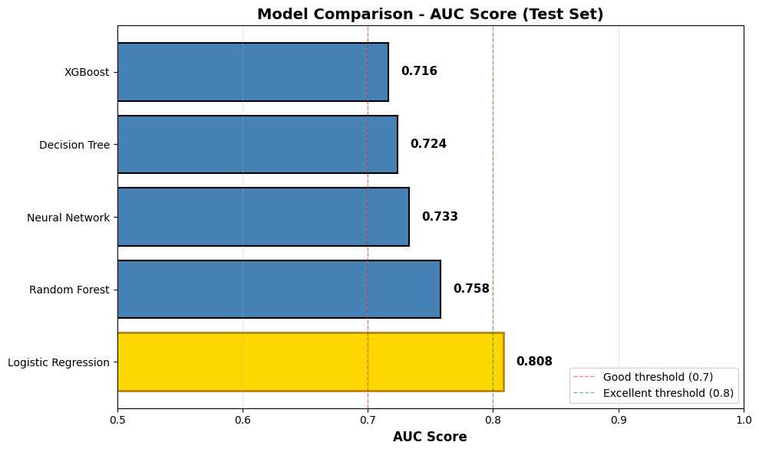
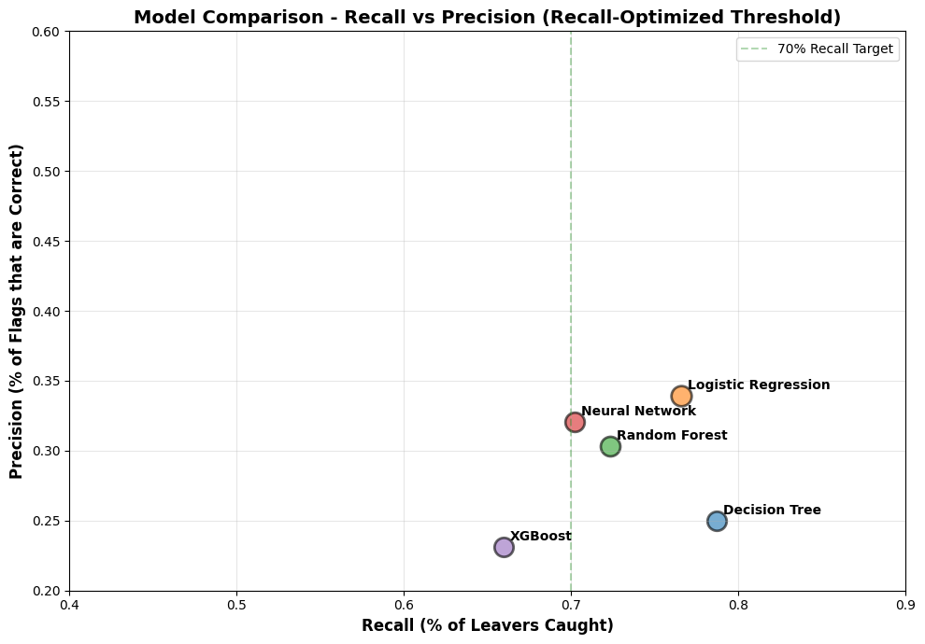
4
Appendix – Modeling & Evaluation
More details about model selection & evaluation
Area under the ROC curve is maximized for Logistic Regression
🏆 BEST MODEL:
Logistic Regression
├─ Recall: 76.6%
├─ Missed Departures: 11 out of 47
└─ AUC: 0.81

Slide 25
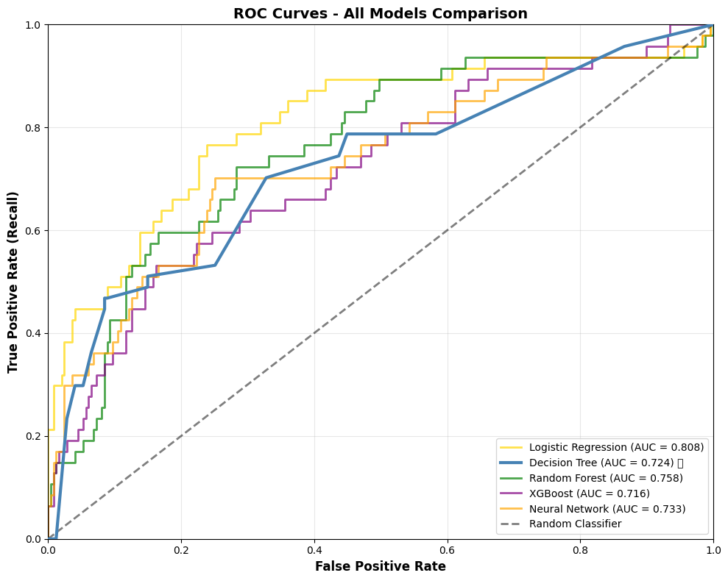
4
Appendix – Modeling & Evaluation
More details about model & evaluation
Area under the ROC curve is maximized for Logistic Regression
Decision Tree:
├─ Leavers Caught: 37/47 (78.7%)
├─ Missed Departures: 10/47
├─ False Alarms: 111/247
├─ Precision: 25.0%
└─ Total Flagged: 148 employees
Logistic Regression:
├─ Leavers Caught: 36/47 (76.6%)
├─ Missed Departures: 11/47
├─ False Alarms: 70/247
├─ Precision: 34.0%
└─ Total Flagged: 106 employees
Random Forest:
├─ Leavers Caught: 34/47 (72.3%)
├─ Missed Departures: 13/47
├─ False Alarms: 78/247
├─ Precision: 30.4%
└─ Total Flagged: 112 employees
Neural Network:
├─ Leavers Caught: 33/47 (70.2%)
├─ Missed Departures: 14/47
├─ False Alarms: 70/247
├─ Precision: 32.0%
└─ Total Flagged: 103 employees
XGBoost:
├─ Leavers Caught: 31/47 (66.0%)
├─ Missed Departures: 16/47
├─ False Alarms: 103/247
├─ Precision: 23.1%
└─ Total Flagged: 134 employees

Slide 26
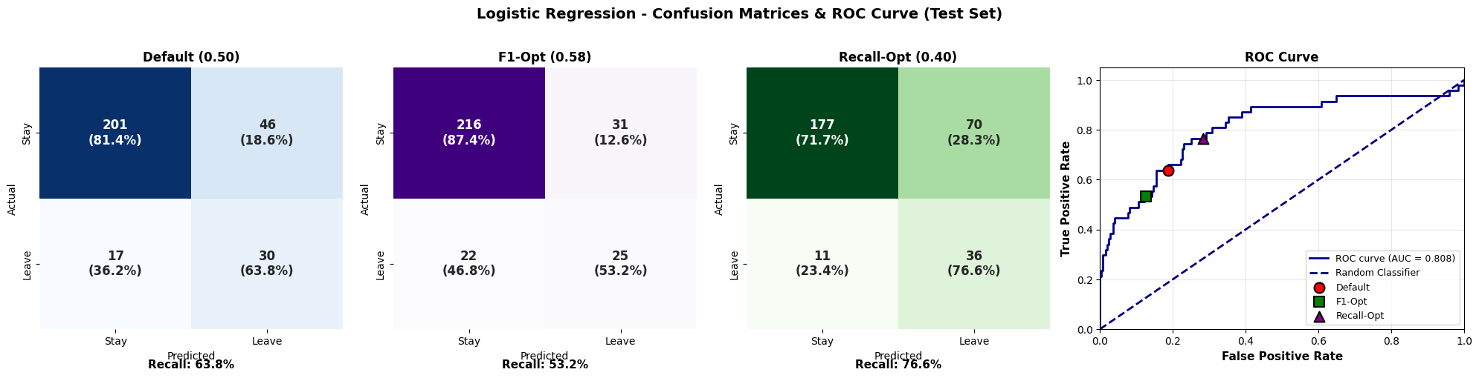
4
Appendix – Modeling & Evaluation
More details about model selection & evaluation
Logistic regression on test set detect 36 of the people who leave, depending on the threshold
Business Impact of recall optimized model:
Catches 76.6% of employees planning to leave
Requires intervention with 106 employees
Minimizes surprise departures for proactive retention

