Slide 1

University of Florida
Sweet corn and potato breeding and genomics lab
Intro 2 Genomic models
Marco Antonio Peixoto
Breeding program simulations
Viçosa, 2024

Slide 2

Genomic selection
Meuwissen 1997, Woollians et al. 2016
1. Identify genetic markers covering most of the genome in the breeding population.
2. Develop prediction models that capture most of the quantitative variation of interest.
3. Use prediction models to select superior genotypes in next cycle.
Genotypic information
Marker
QTL
DNA
University of Florida
Marco Antonio Peixoto

Slide 3
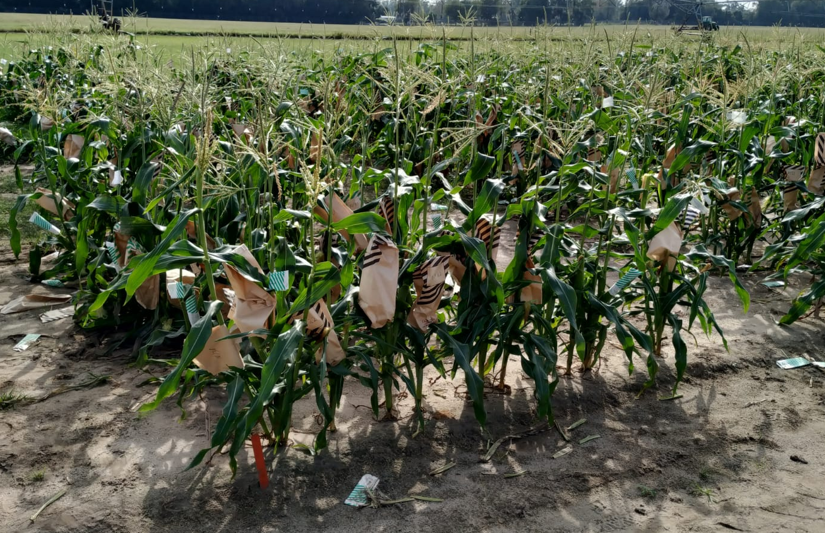
Genomic selection
Quantitative trait information
Genotypic information
Marker
QTL
DNA
Use the model + molecular markers to predict unobserved genotypes.
y = Xβ + Zg + e
University of Florida
Marco Antonio Peixoto
Meuwissen 1997, Woollians et al. 2016

Slide 4






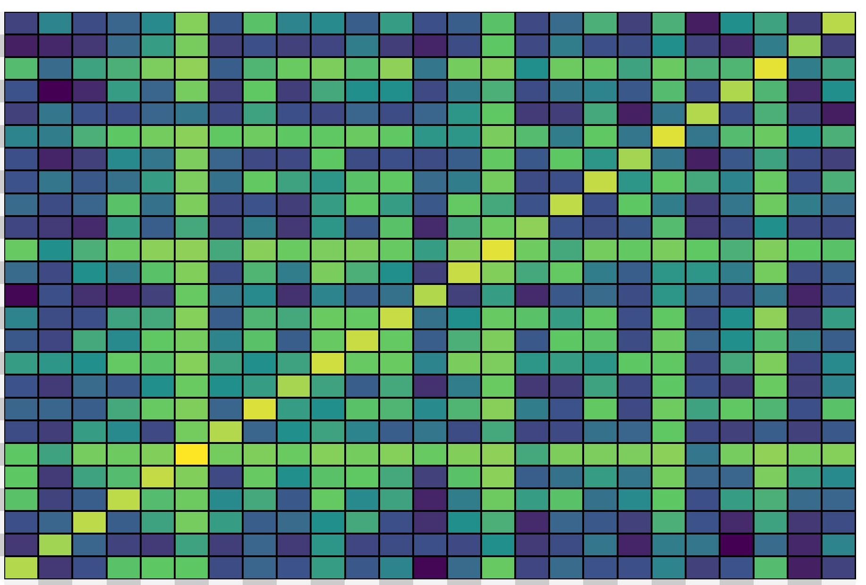



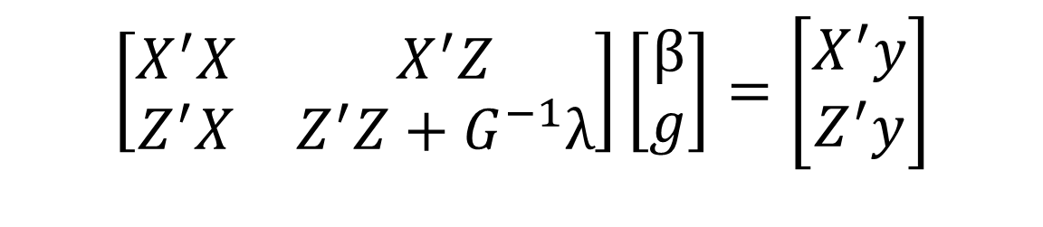


Genomic selection
$$e_{1}$$
$$e_{2}$$
y = Xβ + Zg + e
=
X
+
g
+
$$b$$
Z
$$e_{3}$$
$$e_{4}$$
Henderson (1950) derived the Mixed Model Equations (MME) to obtain the solutions of all effects:
$$\left[\begin{matrix}X^{′}X & X^{′}Z \\ Z^{′}X & Z^{′}Z+G^{−1}λ\end{matrix}\right]\left[\begin{matrix}β \\ g\end{matrix}\right]=\left[\begin{matrix}X^{′}y \\ Z^{′}y\end{matrix}\right]$$
University of Florida
Marco Antonio Peixoto

Slide 5

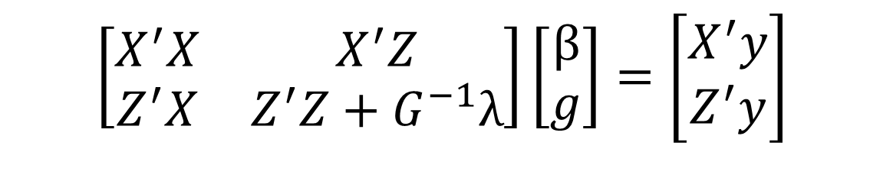
Genomic selection
$$\left[\begin{matrix}X^{′}X & X^{′}Z \\ Z^{′}X & Z^{′}Z+G^{−1}λ\end{matrix}\right]\left[\begin{matrix}β \\ g\end{matrix}\right]=\left[\begin{matrix}X^{′}y \\ Z^{′}y\end{matrix}\right]$$
Relationship matrix: A or G
University of Florida
Marco Antonio Peixoto
VanRaden, (2008)

Slide 6
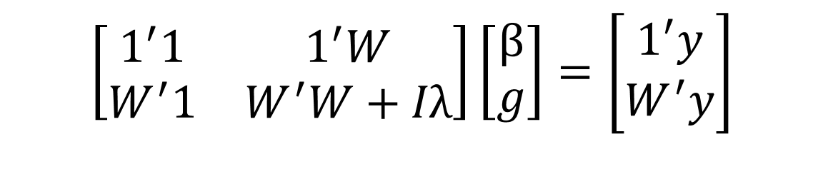
Genomic selection
RRBLUP (BayesB): Markers’ model
$$\left[\begin{matrix}1^{′}1 & 1^{′}W \\ W^{′}1 & W^{′}W+Iλ\end{matrix}\right]\left[\begin{matrix}β \\ g\end{matrix}\right]=\left[\begin{matrix}1^{′}y \\ W^{′}y\end{matrix}\right]$$
University of Florida
Marco Antonio Peixoto

Slide 7

Scan me
Thank you!

