Slide 1
STR
Lab. Work 2 – lesson 2
Operating the storage system
João Rosas (jrosas@uninova.pt), Filipe Moutinho (fcm@uninova.pt)

Slide 2
Agenda
Some function you will need
joystick routine
Storage services routine

Slide 3
Some functions you will need
getBit(value, n_bit)
setBit(variable, bit, value)
move_z_up();
move_z_down();
move_x_right();
move_x_left();
move_y_inside();
move_y_outside();
stop_x(), stop_y(), stop_z()
put_piece();
get_piece();
goto_x(x), goto_y(y), goto_z(z);
goto(X,Z)
Is_at_z(Pos),
is_at_x(pos),
is_at_y(pos)
Is_at_cell(x,z)
goto_up_level()
goto_down_level();
Functions like move_x_right, move_z_down…, moves the axis forever.
Functions like goto_x(int x_pos) moves to the specified x_pos and stops there.
Functions like foto_x uses move_x_right, move_x_left, and stop_x
Function goto_xz, uses goto_x and goto_z
Parts must not move beyond their limits
Move ‘x’ iff cage conveyor is at the ‘center’ sensor.
Move ‘y’ iff cage correctly positioned at a x position .
put_piece() and get_piece() iff correctly positioned at a cell

Slide 4
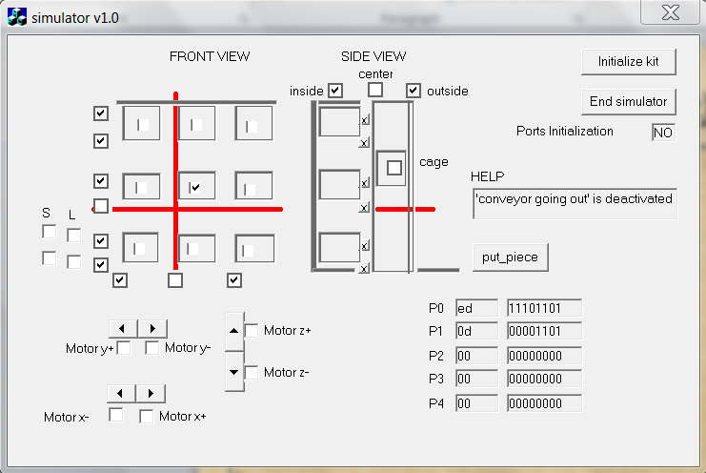
Keyboard control
Z+
o
w
Y+
Z+
X-
X+
a
d
Y+
Y-
Z-
p
z
X+
S – stop all
I – incremental
p – put_pieace
g – get_piece
t – goto_xz(x,z)
… – …
THIS WILL BE YOUR CALLIBRATION ROUTINE.

Slide 5
Routines (3) – get_piece
SIDE VIEW
goto_z and goto_xz - always move the platform to the position of the lowerLevel sensor
void getPiece() // assumed it is already at a cell
{
// it is expected that lift is well positioned at a cell
// it is expected that “center” sensor of the cage is
//activated
gotoLowLevel(); //<- goto_xz already puts at the //lower position
goto_y(3);
gotoUpLevel();
goto_y(2);
gotoLowLevel()
}
Void putPiece() {…// similar to previous one …}
Get
Put

Slide 6
Testing example application
static public void main(String []args)
{
Hardware hard = new Hardware();
hard.create_di(0);
hard.create_di(1);
hard.create_do(2);
//callibration();
//worker_process();
joystick();
hard.write_port(2,1<<7);
System.out.println("Finishing program.“);
}

Slide 7
The joystick function
void joystick()
{
while(true) {
int t = 0;
t = System.in.read(); // be careful, it reads two characters (the character and enter)
switch(t) {
case ‘w’: move_z_up(); break;
case ‘x’: move_z_down(); break;
case ‘a’: move_x_left(); break;
case ‘d’: move_x_right(); break;
case ‘o’: if(is_at_x(1)|| (is_at_x(2)||(is_at_x(3)) // valid x position?
if(!is_at_y(3) ) // isn’t it already inside cell?
move_y_inside(); break;
case ‘p’: if(is_at_x(1)|| (is_at_x(2)||(is_at_x(3)) // valid x position?
if(!is_at_y(1) ) // isn’t it already outside cell?
move_y_outside(); break;
case ‘ ‘ : stop_x(); stop_y(); stop_z(); break;// stop all motors
case ‘c’: if(is_at_x(1)|| (is_at_x(2)||(is_at_x(3)) {
if(is_at_z(1)|| (is_at_z(2)||(is_at_z(3)) put_piece();
else printf(“\n Invalid X position to perform put_piece…”);
} else printf(“\n Invalid Z position to perform put_piece…”);
break;
case ‘v’:/*perform similar checks here ….*/ get_piece(); break;
}
//check limits or kit will be DAMAGED!!!!
if( is_x_at(1) && is_moving_left() ) stop_x();
if( is_x_at(3) && is_moving_rigth() ) stop_x();
if( is_y_at(1) && is_moving_outside() ) stop_y();
if( is_y_at(3) && is_moving_inside() ) stop_y();
if( is_z_at(1) && is_moving_down() ) stop_z();
if( is_z_at(3) && is_moving_up() ) stop_z();
}

Slide 8
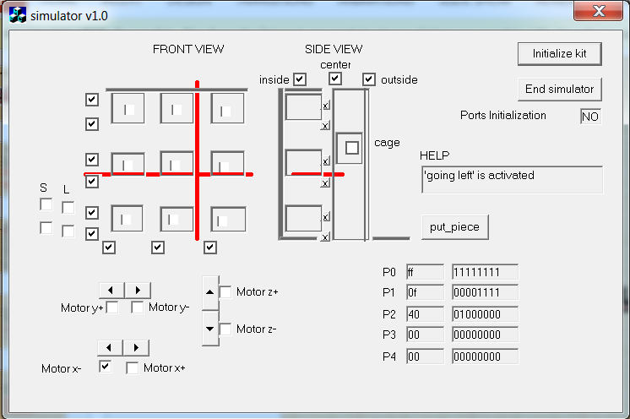
bool is_moving_left() and stop_x()
//We need to check the value of corresponding bit in port 2.
//The move_left bit is port 2, bit 6.
bool is_moving_left()
{
int v = ReadDigitalU8(2);
return getBitValue(v, 6);
}
//In order to stop the xx motor
//we need to set both move_left
//and move_rigth bits to zero value
void stop_x()
{
int v = ReadDigitalU8(2);
v = setBitValue(v,6,0);
v = setBitValue(v,7,0);
WriteDigitalU8(2,v);
}
move_x_left

Slide 9
storage_services pseudocode
void Storage_services_routine()
{
while(true) {
// show the menu(1-> put, 2->get, 3…)
// get selected option from keyboard
// execute selected option
// …
}
}
Good work ☺

