Slide 1
STR
Lab. Work 2 – lesson 3
Operating the storage system
João Rosas (jrosas@uninova.pt), Filipe Moutinho (fcm@uninova.pt)

Slide 2
Agenda
Java real time (annex 3)
Lab work
Storage services UI thread (started in main thread)
goto_x(int x), goto_y(int y) and goto_z(int z) in real time.
Goto_xz(x, z) in realtime
PutInCell, GetFromCell

Slide 3
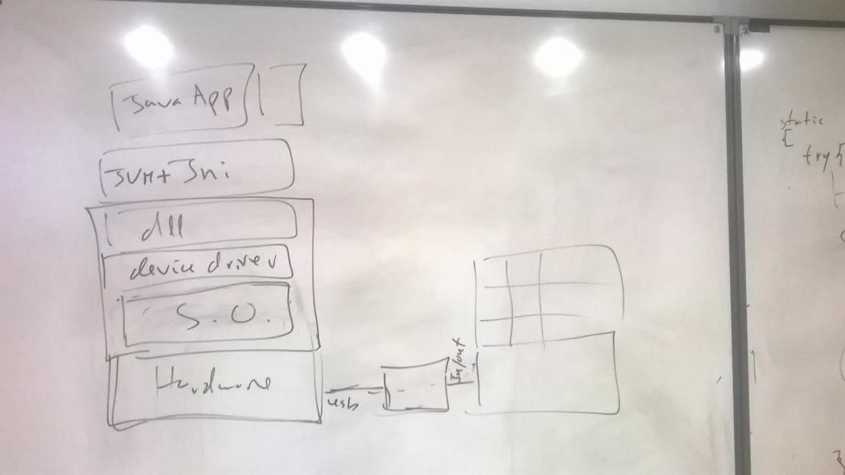
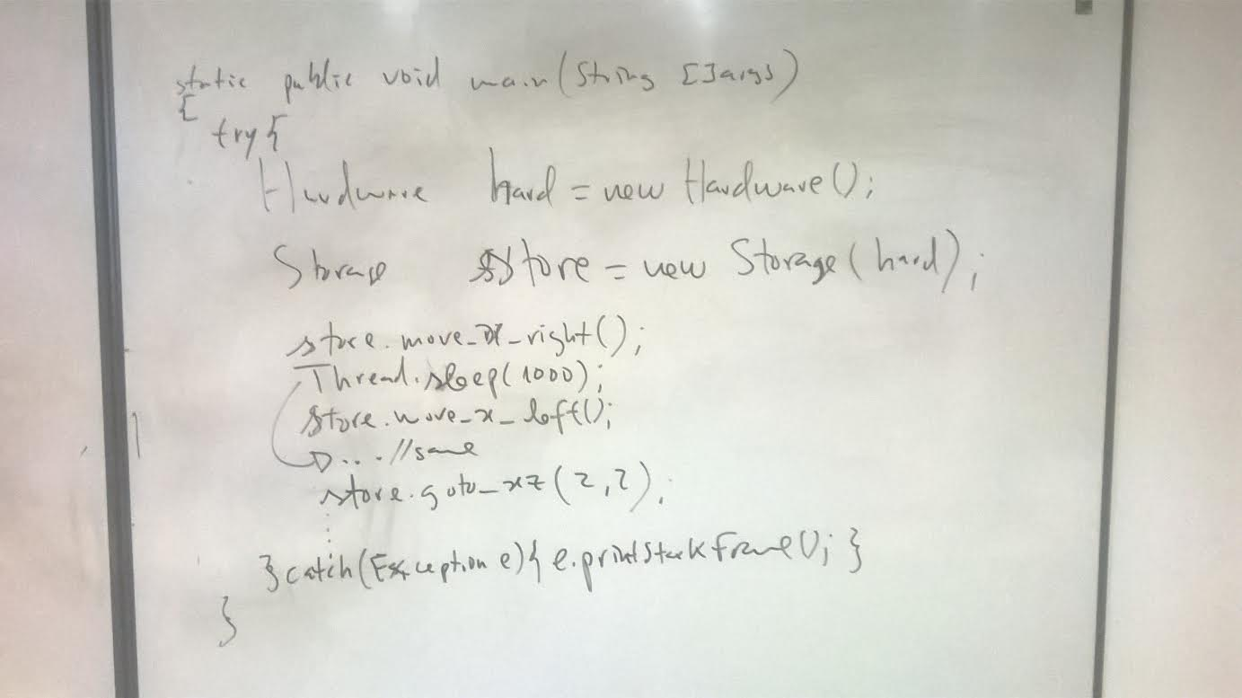
Previous lesson
In the following slides, the mechanism
is the same as the store in this slide.

Slide 4
Hardware.java
import java.util.concurrent.Semaphore;
import java.util.logging.Level;
import java.util.logging.Logger;
public class Hardware {
native public void create_di(int port);
native public void create_do(int port);
native private void write_port(int port, int value);
native private int read_port(int port);
final static private Semaphore SemKit= new Semaphore(1);
public void s_write_port(int port, int value) {
try {
//safe write port
SemKit.acquire();
write_port(port, value);
SemKit.release();
} catch (InterruptedException ex) { ex.printStackTrace(); }
}
public int s_read_port(int port) {
try {
//safe read port
int result;
SemKit.acquire();
result = read_port(port);
SemKit.release();
return result;
} catch (InterruptedException ex) { ex.printStackTrace(); }
return(0); // nunca deve chegar aqui..
}
public int setBitValue(int variable, int bit_n, boolean value)
{
int result;
int mask_on = 1<<bit_n;
int mask_off = ~mask_on; // mask_off =0xff-mask_on;
if(value)
result = variable | mask_on;
else
result = variable & mask_off;
return(result);
}
public boolean getBit(int variable, int bit){
int mask_on = 1<<bit;
int result = variable & mask_on;
if(result!=0)
return(true);
else
return(false);
//return( (variable & (1<<bit))!=0 );
}
static {
System.load("c:\\str\\tttrab2\\Hardware\\x64\\Debug\\Hardware.dll");
}
}

Slide 5
Real time main function
static public void main(String []args)
{
Hardware hard = new Hardware();
Semaphore critical = new Semaphore(1);
Mechanism mech = new Mechanism(hard, critical)
BlockingQueue bq_x = new ArrayBlockingQueue(10);
BlockingQueue bq_z = new ArrayBlockingQueue(10);
java.util.concurrent.BlockingQueue xz_bk = new java.util.concurrent.ArrayBlockingQueue<Request>(10);
// … remaining blocking queues
X_Thread x_thread = new X_Thread(mech, bq_x);
Y_Thread y_thread = new Y_Thread(mech, bq_y);
Z_Thread Z_thread = new Z_Thread(mech, bq_z);
XZ_Thread XZ_thread = new XZ_Thread(mech, bq_xz, bq_x, bq_z);
x_thread.start(); y_thread.start(); z_thread.start(); xz_thread.start();
try {
while(true) {
System.out.print("X="); int x = System.in.read(); System.in.read(); //FILTER ENTER CHARACTER
System.out.print("Z="); int z = System.in.read(); System.in.read();
System.out.println("----------------------");
xz_bk.offer ( new Request(x,z) );
}
}catch(Exception e){ e.printStackFrame();}
}
class Request {
int x,z;
Request(int __x, int __z) {
x = __x;
z = __z;}
}

Slide 6
Mechanism class
public class Mechanism
{
Hardware hard; Semaphore _critical_
public Mechanism(Hardware __hard, Semaphore __critical)
{
hard = __hard;
_critical_ = __critical;
}
private void move_x_left(){…} // calling move_x_left and so on is dangerous in realtime realm
private void move_x_rigth(){…} // So we set these methods as private and set safer ones to be public
private void stop_x(){…}
public void safe_move_x_left()
{
try {
_critical_.acquire();
move_x_left();
_critical_.release();
} catch(Exception e) { e.printStackFrame(); }
}
public void safe_move_x_right() {…}
public void safe_stop_x() {…}
public void safe_move_z_up() {…}
public void safe_move_z_down() {…}
public void safe_stop_z() {…}
// …. / ….
}

