Slide 1
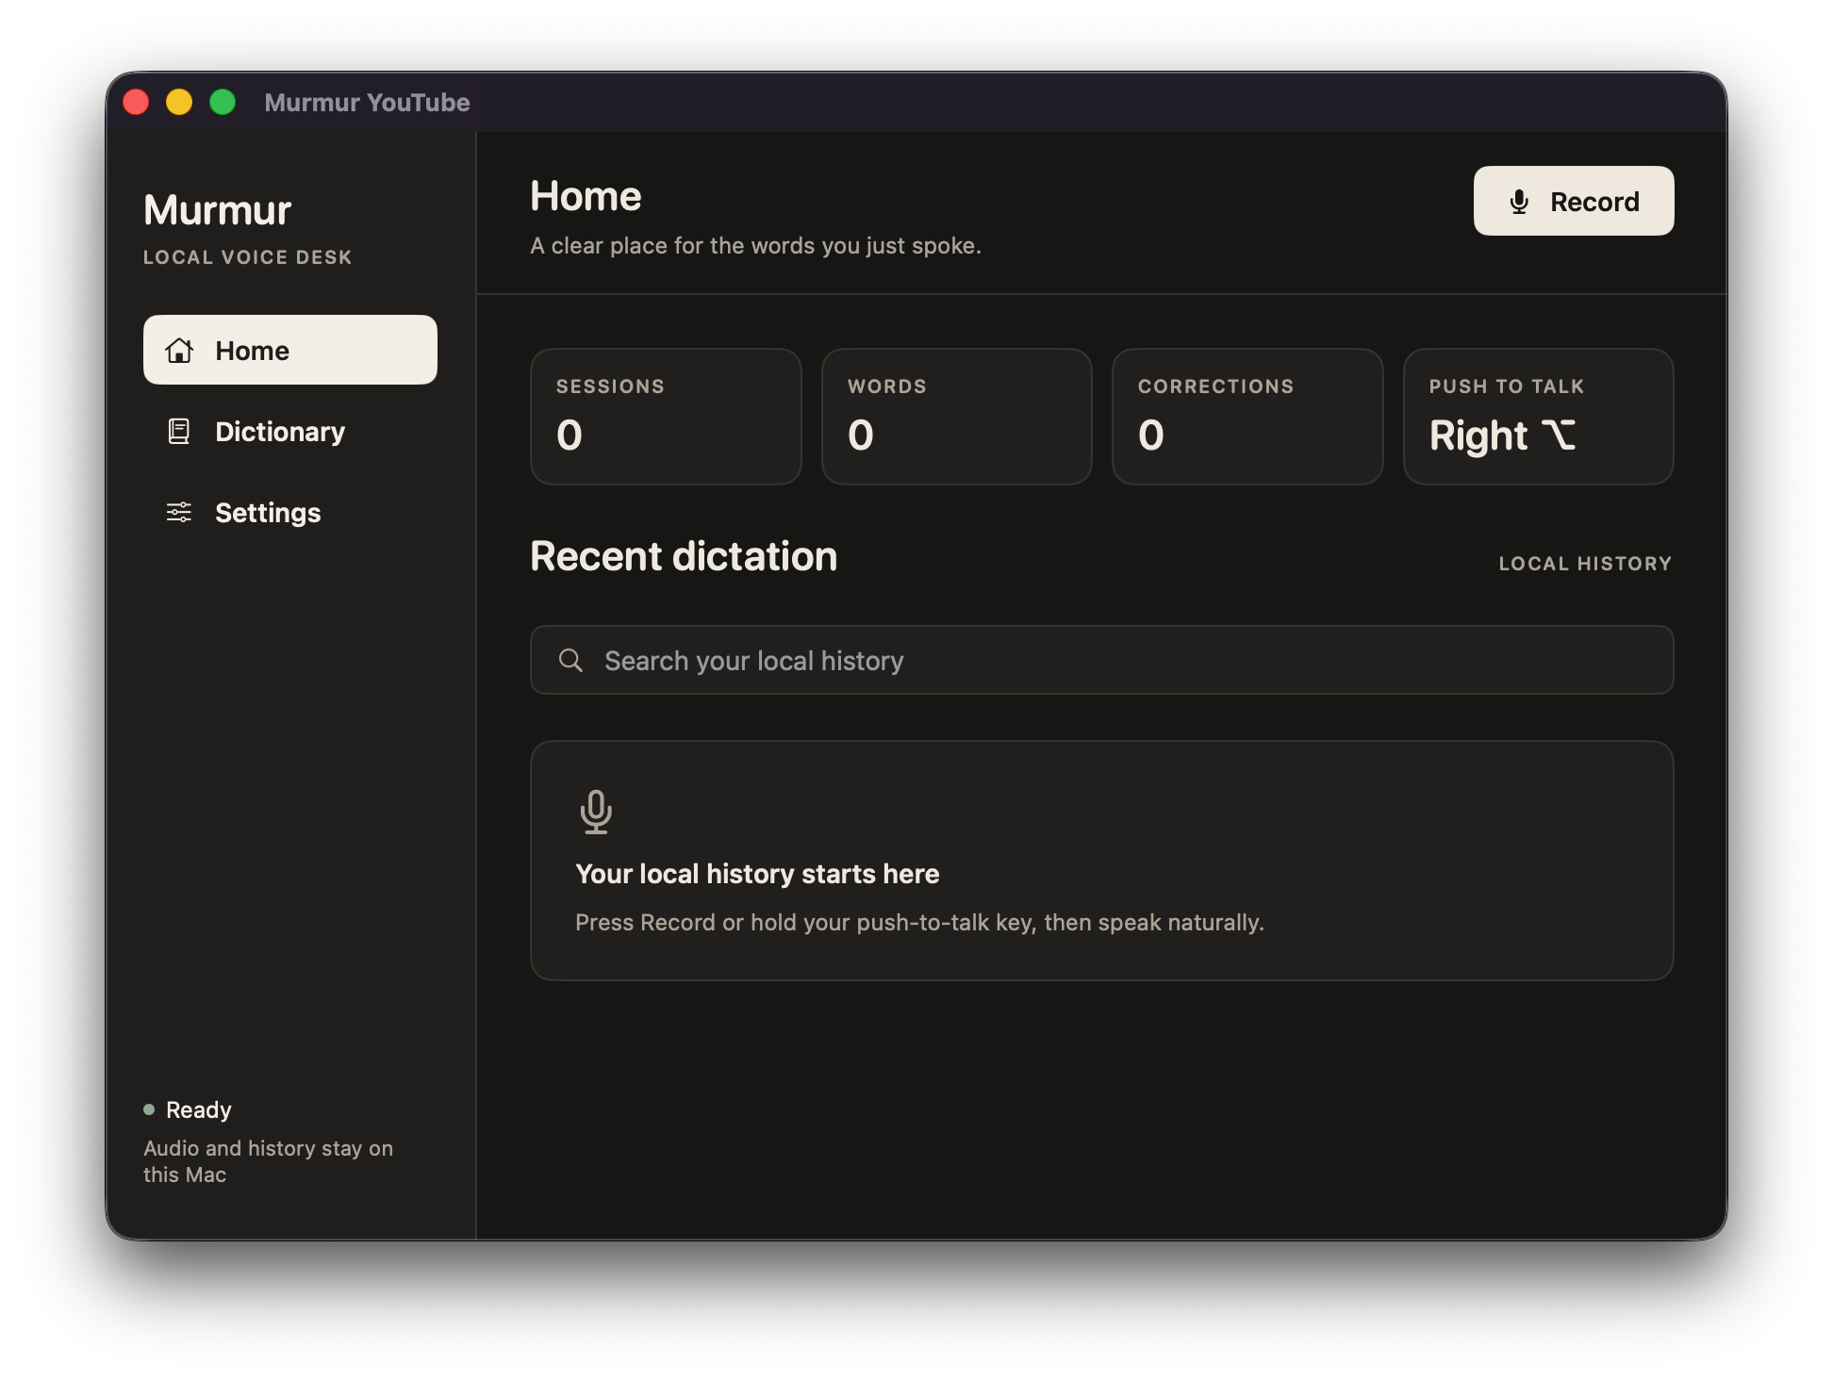
MURMURE
A private voice desk for macOS
Hold. Speak. Release.
Cleaned-up text lands in the field that already has focus.
LOCAL BY DEFAULT
Audio · cleanup · dictionary · history
A practical guide for setup, daily use, and sharing
Notes:
[Sources]
- /Volumes/Extreme Pro/Projects/Clients/StudioInTheBox/Speak to me/README.md
- /Volumes/Extreme Pro/Projects/Clients/StudioInTheBox/Speak to me/PRODUCT.md
- /private/tmp/murmur-installed-window-final.png (local product capture)

Slide 2
01 · THE BASIC LOOP
One gesture takes an idea to the page.
Murmure keeps the interaction deliberately small: the app stays out of the way while you talk.
1
2
3
Hold
→
Speak
→
Release
Press and hold your configured push-to-talk key. The HUD appears without taking focus.
Talk naturally. Apple streams live text; Parakeet resolves the utterance when you release.
Cleanup and dictionary corrections run, then the result is inserted at the existing caret.
FOCUS IS PRESERVED
The recording overlay is non-activating, so the text field you were using remains the destination.
MURMURE · USER GUIDE
02
Notes:
[Sources]
- /Volumes/Extreme Pro/Projects/Clients/StudioInTheBox/Speak to me/Sources/MurmurYouTube/Core/DictationController.swift
- /Volumes/Extreme Pro/Projects/Clients/StudioInTheBox/Speak to me/Sources/MurmurYouTube/Core/HotkeyMonitor.swift
- /Volumes/Extreme Pro/Projects/Clients/StudioInTheBox/Speak to me/Sources/MurmurYouTube/UI/HUDPanel.swift

Slide 3
02 · FIRST LAUNCH
Grant two permissions once. Then just dictate.
macOS protects microphone capture and system-wide keyboard/text insertion separately.
Accessibility
Microphone
System Settings → Privacy & Security → Accessibility
Grant the prompt on first recording, or open the Microphone pane from Settings.
Needed to detect the global key and insert text into the focused app.
Murmure listens only while you hold the push-to-talk key.
Restart Murmure after enabling it so macOS refreshes the trust state.
You must approve these on each Mac; Codex cannot grant TCC permissions for you.
MURMURE · USER GUIDE
03
Notes:
[Sources]
- /Volumes/Extreme Pro/Projects/Clients/StudioInTheBox/Speak to me/Sources/MurmurYouTube/UI/SettingsWindow.swift
- /Volumes/Extreme Pro/Projects/Clients/StudioInTheBox/Speak to me/Sources/MurmurYouTube/Support/Permissions.swift
- /Volumes/Extreme Pro/Projects/Clients/StudioInTheBox/Speak to me/README.md

Slide 4
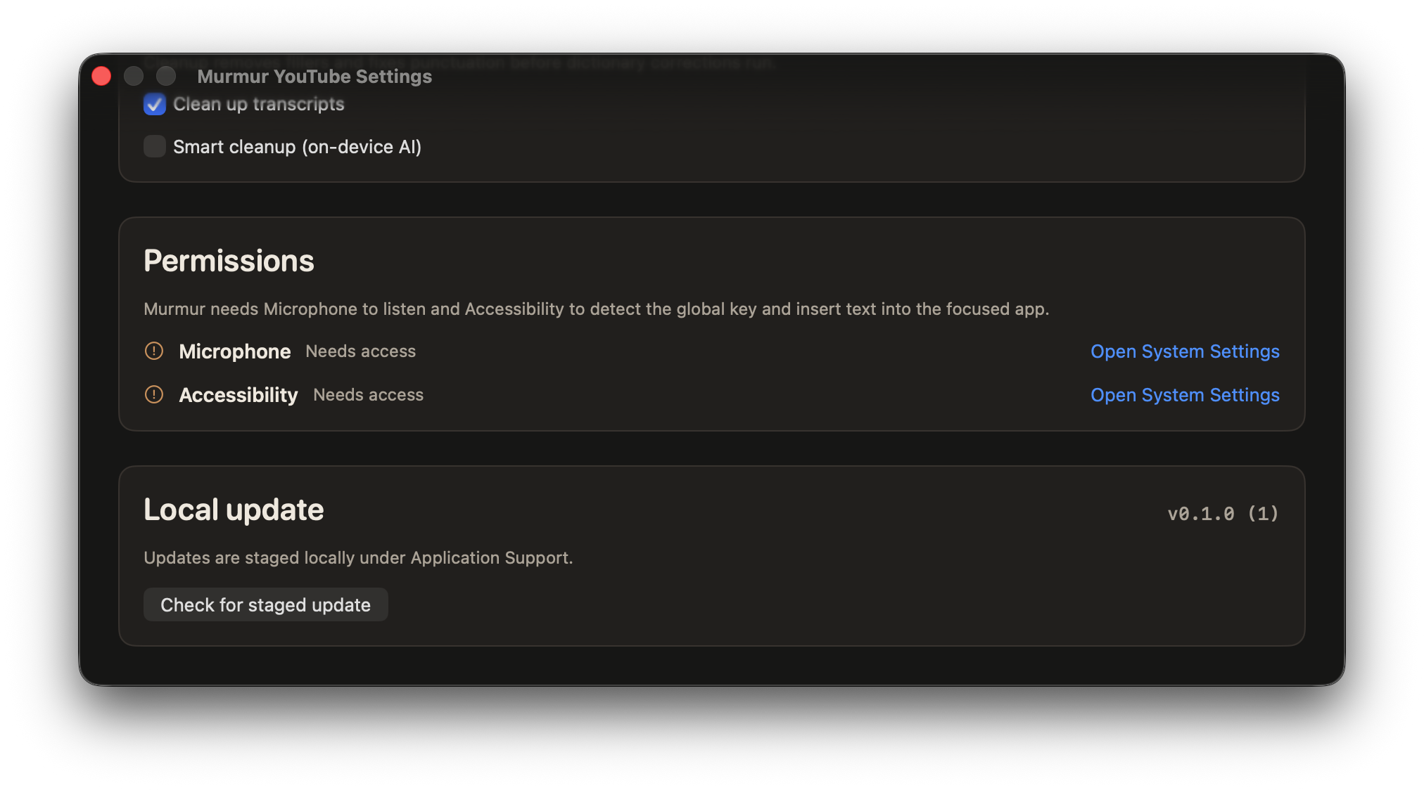
03 · SETTINGS
Choose how it hears, then choose how it edits.
The speech engine decides the words. Cleanup makes those words easier to use.
Apple · streaming
The default. Text appears while you speak, with no bundled model download.
Parakeet · batch
A local alternative to test when English recognition is the priority. It resolves on release.
Smart cleanup · on-device AI
Apple's local language model edits the transcript after recognition. It can remove fillers, repair punctuation, format lists, and apply spoken self-corrections. It does not listen again.
MURMURE · USER GUIDE
04
Notes:
[Sources]
- /Volumes/Extreme Pro/Projects/Clients/StudioInTheBox/Speak to me/Sources/MurmurYouTube/Transcription/AppleSpeechEngine.swift
- /Volumes/Extreme Pro/Projects/Clients/StudioInTheBox/Speak to me/Sources/MurmurYouTube/Transcription/ParakeetEngine.swift
- /Volumes/Extreme Pro/Projects/Clients/StudioInTheBox/Speak to me/Sources/MurmurYouTube/Formatting/FoundationModelFormatter.swift
- /Volumes/Extreme Pro/Projects/Clients/StudioInTheBox/Speak to me/Sources/MurmurYouTube/UI/SettingsWindow.swift
- /private/tmp/murmur-installed-settings-final.png (local product capture)

Slide 5
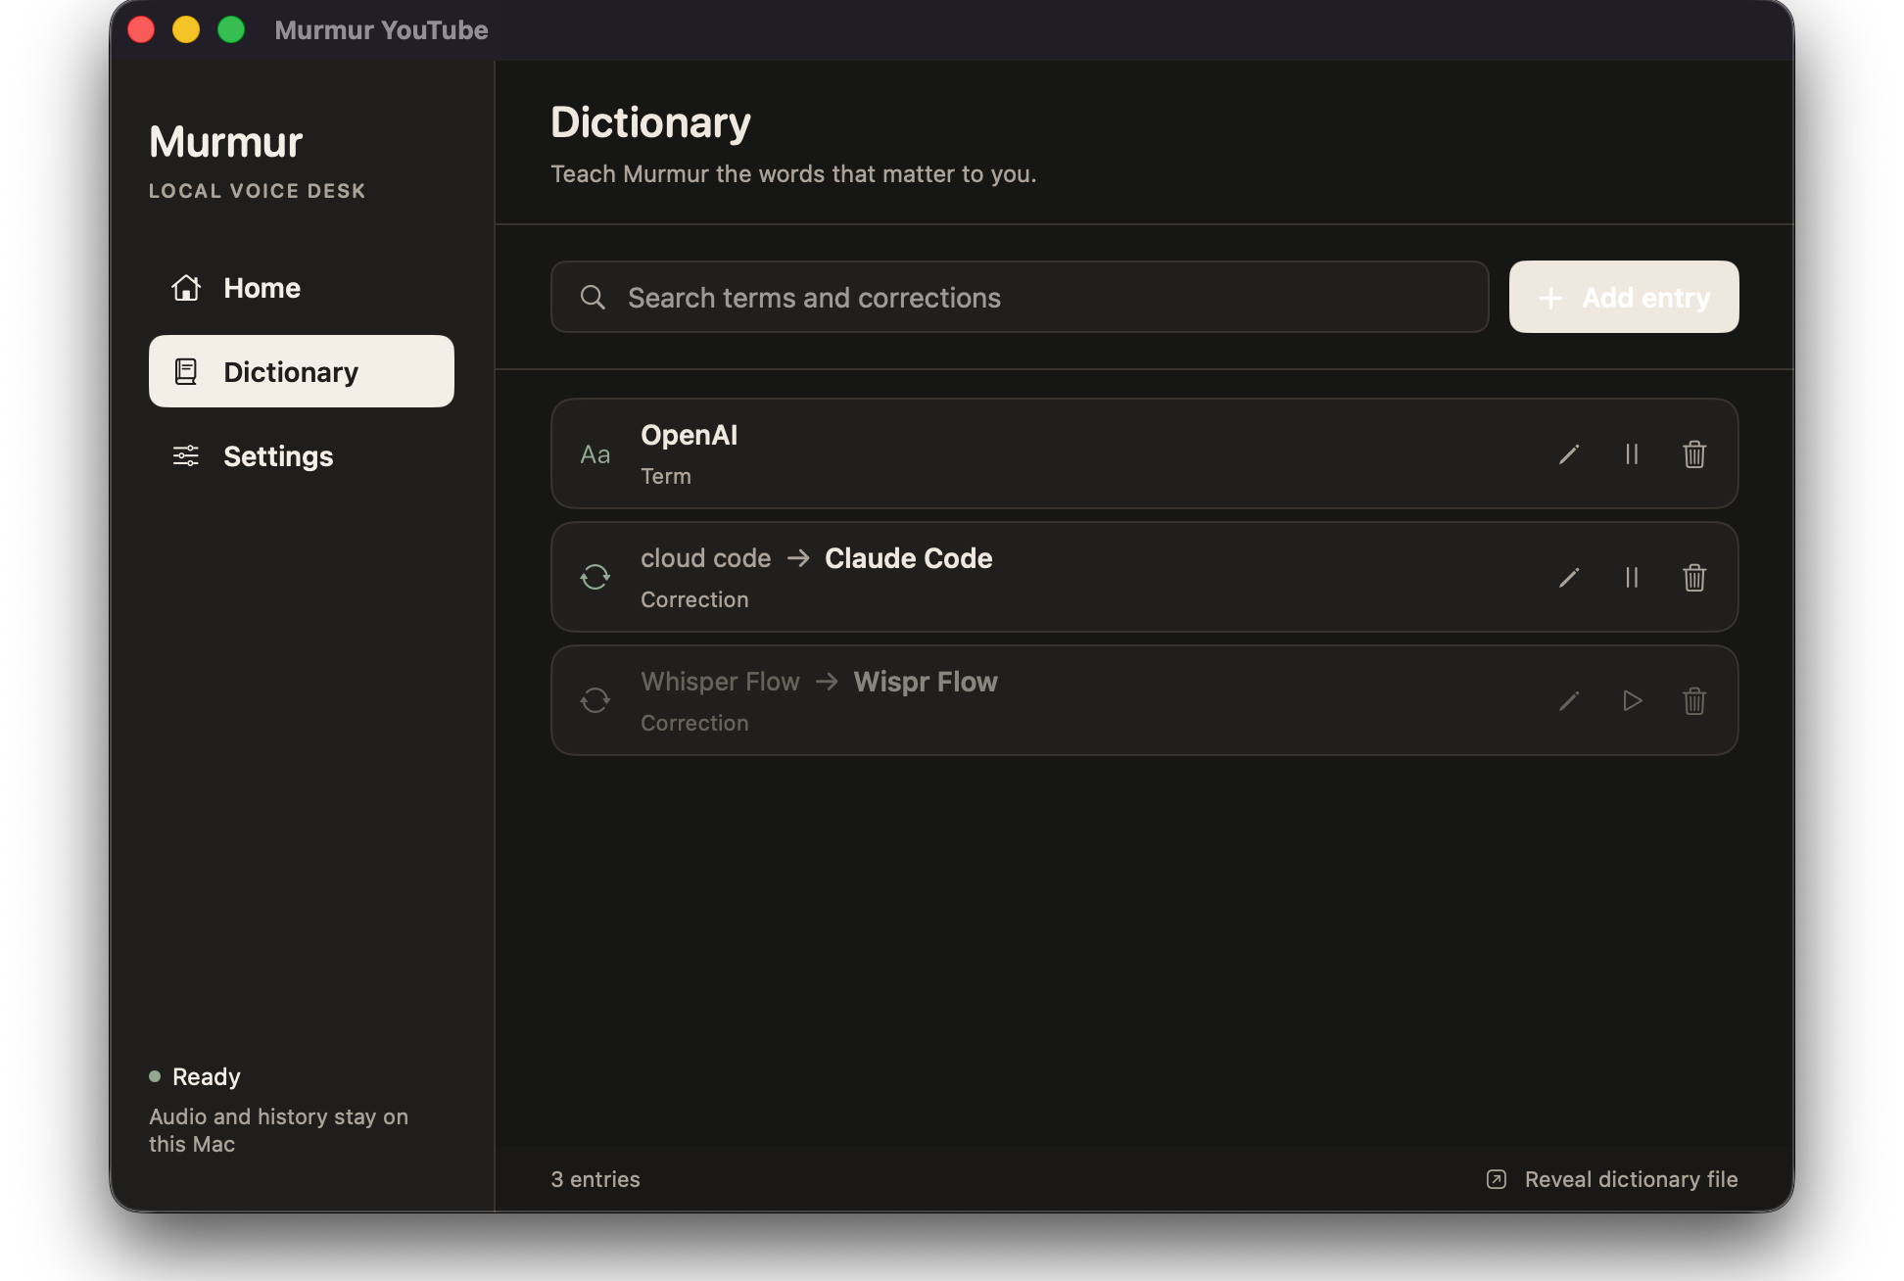
04 · PERSONAL VOCABULARY
Teach the dictionary the words that matter.
A dictionary entry is both a nudge before recognition and a guaranteed correction after it.
A correction remembers the mapping
When you hear
write
banana
→
Marina
Use a Term for a name or product the engine should know. Use a Correction for a repeated mishearing.
Entries live in dictionary.txt on the Murmure data folder and survive app updates.
MURMURE · USER GUIDE
05
Notes:
[Sources]
- /Volumes/Extreme Pro/Projects/Clients/StudioInTheBox/Speak to me/Sources/MurmurYouTube/Dictionary/DictionaryStore.swift
- /Volumes/Extreme Pro/Projects/Clients/StudioInTheBox/Speak to me/Sources/MurmurDictionary/DictionaryEntry.swift
- /Volumes/Extreme Pro/Projects/Clients/StudioInTheBox/Speak to me/Sources/MurmurYouTube/Transcription/AppleSpeechEngine.swift
- /private/tmp/murmur-installed-dictionary-final.png (local product capture)

Slide 6
05 · YOUR DATA
Keep recordings and history where you own them.
The default workflow has no hosted account and no remote API dependency.
NORMAL LOCATION
/Volumes/Extreme Pro/Murmure Data
The folder is created for Murmure; unrelated drive files are not removed or overwritten.
Inside the folder
If the drive is not present
runs.jsonl
dictionary.txt
settings.json
dashboard.html
Recordings/*.caf
Murmure falls back to a local Application Support folder and shows that status in Settings. Reconnect the drive before recording if external storage is required.
MURMURE · USER GUIDE
06
Notes:
[Sources]
- /Volumes/Extreme Pro/Projects/Clients/StudioInTheBox/Speak to me/Sources/MurmurYouTube/Support/MurmurDataStore.swift
- /Volumes/Extreme Pro/Projects/Clients/StudioInTheBox/Speak to me/Sources/MurmurYouTube/Support/RunLog.swift
- /Volumes/Extreme Pro/Projects/Clients/StudioInTheBox/Speak to me/Sources/MurmurYouTube/UI/SettingsWindow.swift
- /Volumes/Extreme Pro/Projects/Clients/StudioInTheBox/Speak to me/PRODUCT.md

Slide 7
06 · UPDATES
Updates are a button, not a permission reset.
The installed app can replace itself with a validated bundle staged on the same Mac.
Build
→
Stage
→
Check
→
Install
make stage-update
Local update inbox
Settings → Local update
Install and relaunch
SHARING NOTE
The button handles a locally staged update. A newer GitHub archive still needs to be downloaded and replaced, unless a bundle has been staged first.
MURMURE · USER GUIDE
07
Notes:
[Sources]
- /Volumes/Extreme Pro/Projects/Clients/StudioInTheBox/Speak to me/Sources/MurmurYouTube/Support/AppUpdateCoordinator.swift
- /Volumes/Extreme Pro/Projects/Clients/StudioInTheBox/Speak to me/Sources/MurmurUpdateCore/UpdateCore.swift
- /Volumes/Extreme Pro/Projects/Clients/StudioInTheBox/Speak to me/Makefile
- /Volumes/Extreme Pro/Projects/Clients/StudioInTheBox/Speak to me/README.md

Slide 8
07 · SHARING
Give friends a download path and a build path.
Everyone gets their own local history and permissions. Do not share your data folder or signing material.
A · Download the archive
B · Ask Codex to install
1 Download dist/Murmure.app.zip
2 Unzip and drag Murmure.app to /Applications
3 Control-click → Open if Gatekeeper asks
4 Grant Microphone + Accessibility
5 Hold the key and dictate
Clone https://github.com/filipego/murmure.git
Read README.md and AGENTS.md.
Use make install, not bare swift build.
Ask before writing to /Applications.
Do not touch unrelated external files.
Explain the two permission steps.
Fastest for a friend. The shared archive is signed but not notarized.
Codex may request command approval; the friend still grants macOS permissions.
MURMURE · USER GUIDE
08
Notes:
[Sources]
- /Volumes/Extreme Pro/Projects/Clients/StudioInTheBox/Speak to me/README.md
- /Volumes/Extreme Pro/Projects/Clients/StudioInTheBox/Speak to me/Makefile
- /Volumes/Extreme Pro/Projects/Clients/StudioInTheBox/Speak to me/AGENTS.md
- /Volumes/Extreme Pro/Projects/Clients/StudioInTheBox/Speak to me/dist/INSTALL.md

Slide 9
08 · START HERE
Your first minute with Murmure.
Install
Download the archive or clone the repo.
HOLD
Authorize
Grant Microphone and Accessibility; restart once.
SPEAK
Choose
Pick a push-to-talk key, engine, and cleanup level.
RELEASE
Teach
Add names and repeated mishearings to Dictionary.
Talk
Focus a text field, hold, speak, release.
Read the full install and sharing notes in README.md.
MURMURE · USER GUIDE
09
Notes:
[Sources]
- /Volumes/Extreme Pro/Projects/Clients/StudioInTheBox/Speak to me/README.md
- /Volumes/Extreme Pro/Projects/Clients/StudioInTheBox/Speak to me/PRODUCT.md

