Slide 1
JIRA Slides

Slide 2
Proportion of each Virus type out of all currently in progress

Slide 3
Total in progress per virus
Virus | in progress
Influenza | 2976
Respiratory syncytial virus | 366
Parainfluenza virus | 332
Coronavirus | 165
Rotavirus | 153
Metapneumovirus | 130
Other | 232
Total | 4354

Slide 4
Proportion of viral types out of all published samples

Slide 5
Proportion of influenza out of all published samples

Slide 6
Proportion of viral types, not including Influenza out of all published samples

Slide 7
Published Per Virus with split-out

Slide 8
Total published per virus
Virus | Total Published
Influenza | 11977
Rotavirus | 547
Coronavirus | 190
Norovirus | 190
Metapneumovirus | 41
Other | 26
Total | 12971

Slide 9
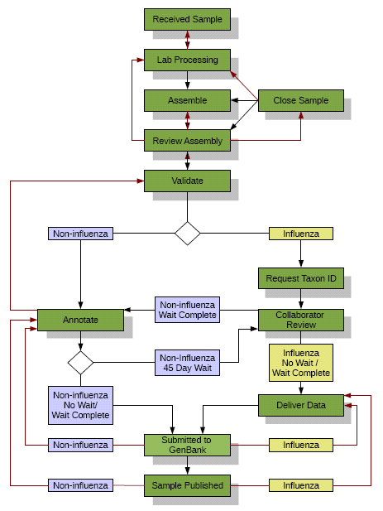
Workflow all viruses including Influenza

Slide 10
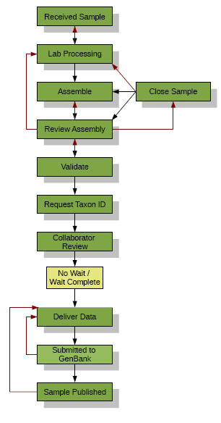
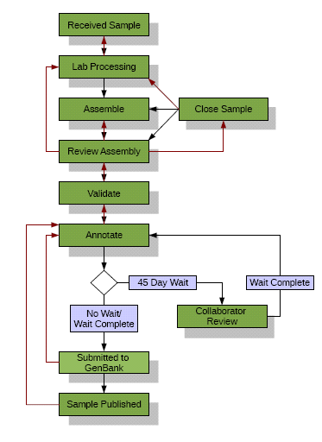
Workflow split in two
Influenza
Other Viruses

Slide 11
JIRA Sample Tracking
JCVI track thousands of Samples from arrival to publication. To keep track of all of this information a customized version of Atlassian’s JIRA is used. JIRA was originally created for software support but contains a wide array of customization options and interfaces.
The JIRA Sample Tracking System mirrors the Viral pipelines combination of high throughput and high flexibility. Large groups of samples can be updated as a single operation; through JIRA’s GUI or via command line scripts. Each sample can also be treated individually when special processing is required and then return to being bulk updated.
A sample’s status is only part of its meta-data. The sample tracking system is integrated with the ‘Viral Genome Database’. Gathering information from the system and synchronizing changes to its status.
Reporting is key to using the information gathered by the system. It has been integrated into several highly tailored status reports and the JCVI website.

Slide 12
Alt version: JIRA Sample Tracking
JIRA is a project tracker produced by Atlassian. It was originally created for use in software support. It has been customized for JCVIs use in a number of ways. These have included:
Configuring the system to store information about each samples journey from its arrival at JCVI to its publication on GenBank.
Adding custom data loaders and plug-ins to integrate it with the main Viral meta-data store.
Creating scripts and new search tools to allow the use of existing identifiers.
Integrating status information from the system into existing automated reports.

