Slide 1

Group F: Library Database (code name bookstore)
Team Members:
Edna Pires
Joseph Abueh
Abner Barros
Filipe de Paiva

Slide 2
Our Objective:
To design and implement a windows form application, a simple but yet powerful library database to be used by a librarian.

Slide 3
Requirements Document
Implement a class called Patron where each patron has a name, contact information, credit card information, and maximum number of books allowed
Implement a class called Book where each book has a title, author, ISBN, number of copies and price
The Librarian will be able to edit the book inventory and the patrons

Slide 4
Continued…
The patrons are able to renew the books in advance and the maximum number of renewals is one
Use the DateTime class to keep track of the days and due dates
As soon as the patron lands the book, the due date is going to be two weeks after that. If he/she decides to renew, the due date is going to be two weeks after the day he/she renewed

Slide 5
Test Cases
Display the library policy
Display search results for the search box
Display all the books and the patrons information
Addition, deletion and edition of a book or a Patron from the database
Historical display of all books borrowed by a Patron and all Patrons that borrowed a particular book
A book Check-In, Check-Out and renewable transaction process
Display Patrons with overdue books and those books that are overdue

Slide 6
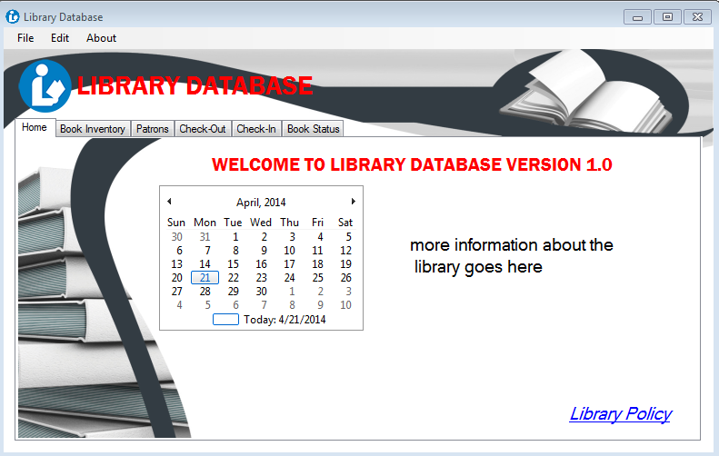
User Interface
Tab1 - Home

Slide 7
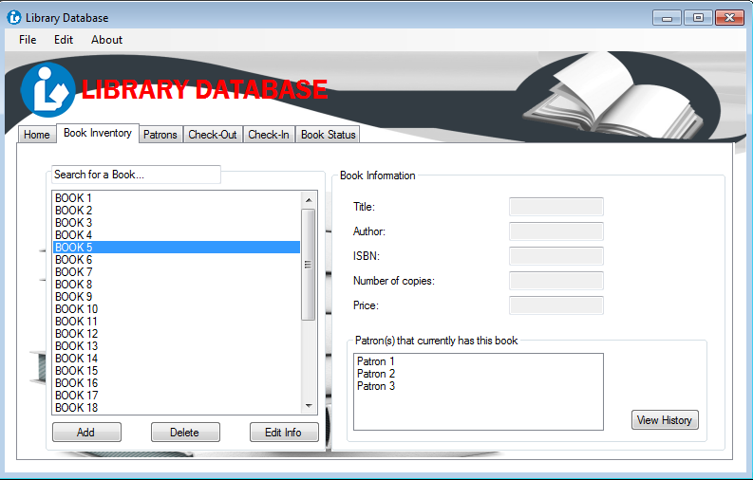
User Interface
Tab2 – Book Inventory

Slide 8
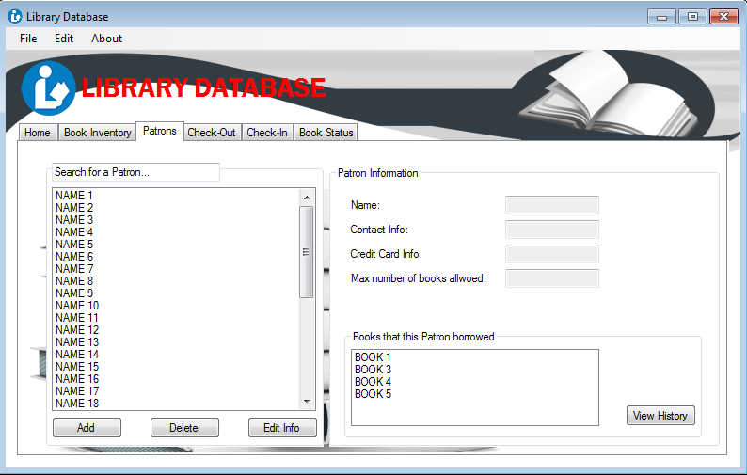
User Interface
Tab3 - Patrons

Slide 9
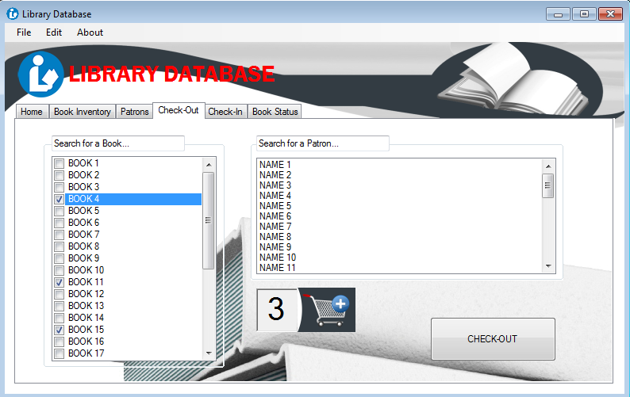
User Interface
Tab4 – Check-Out

Slide 10
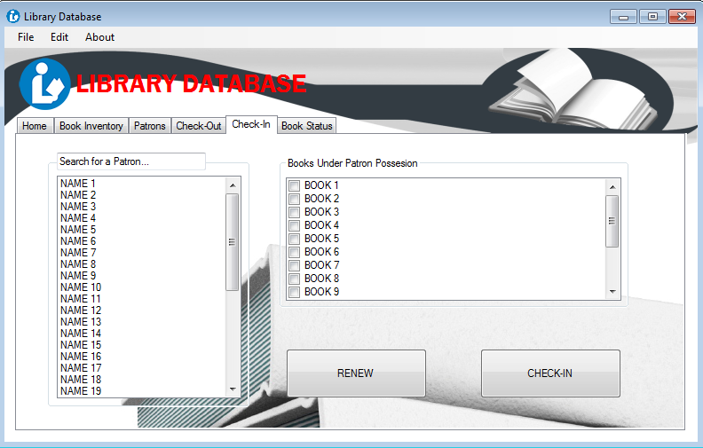
User Interface
Tab5 – Check-In

Slide 11
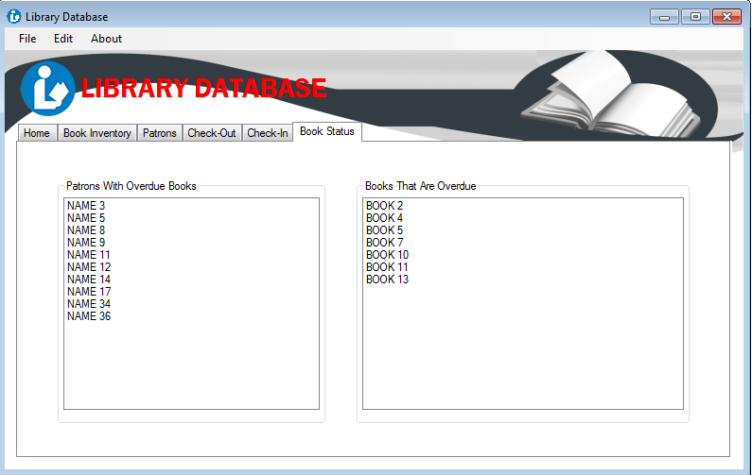
User Interface
Tab6 – Book Status

