Slide 1

Python Project Escape Room
Keren Vasconcelos
Filipe Morgado
Álvaro Gonzalez

Slide 2
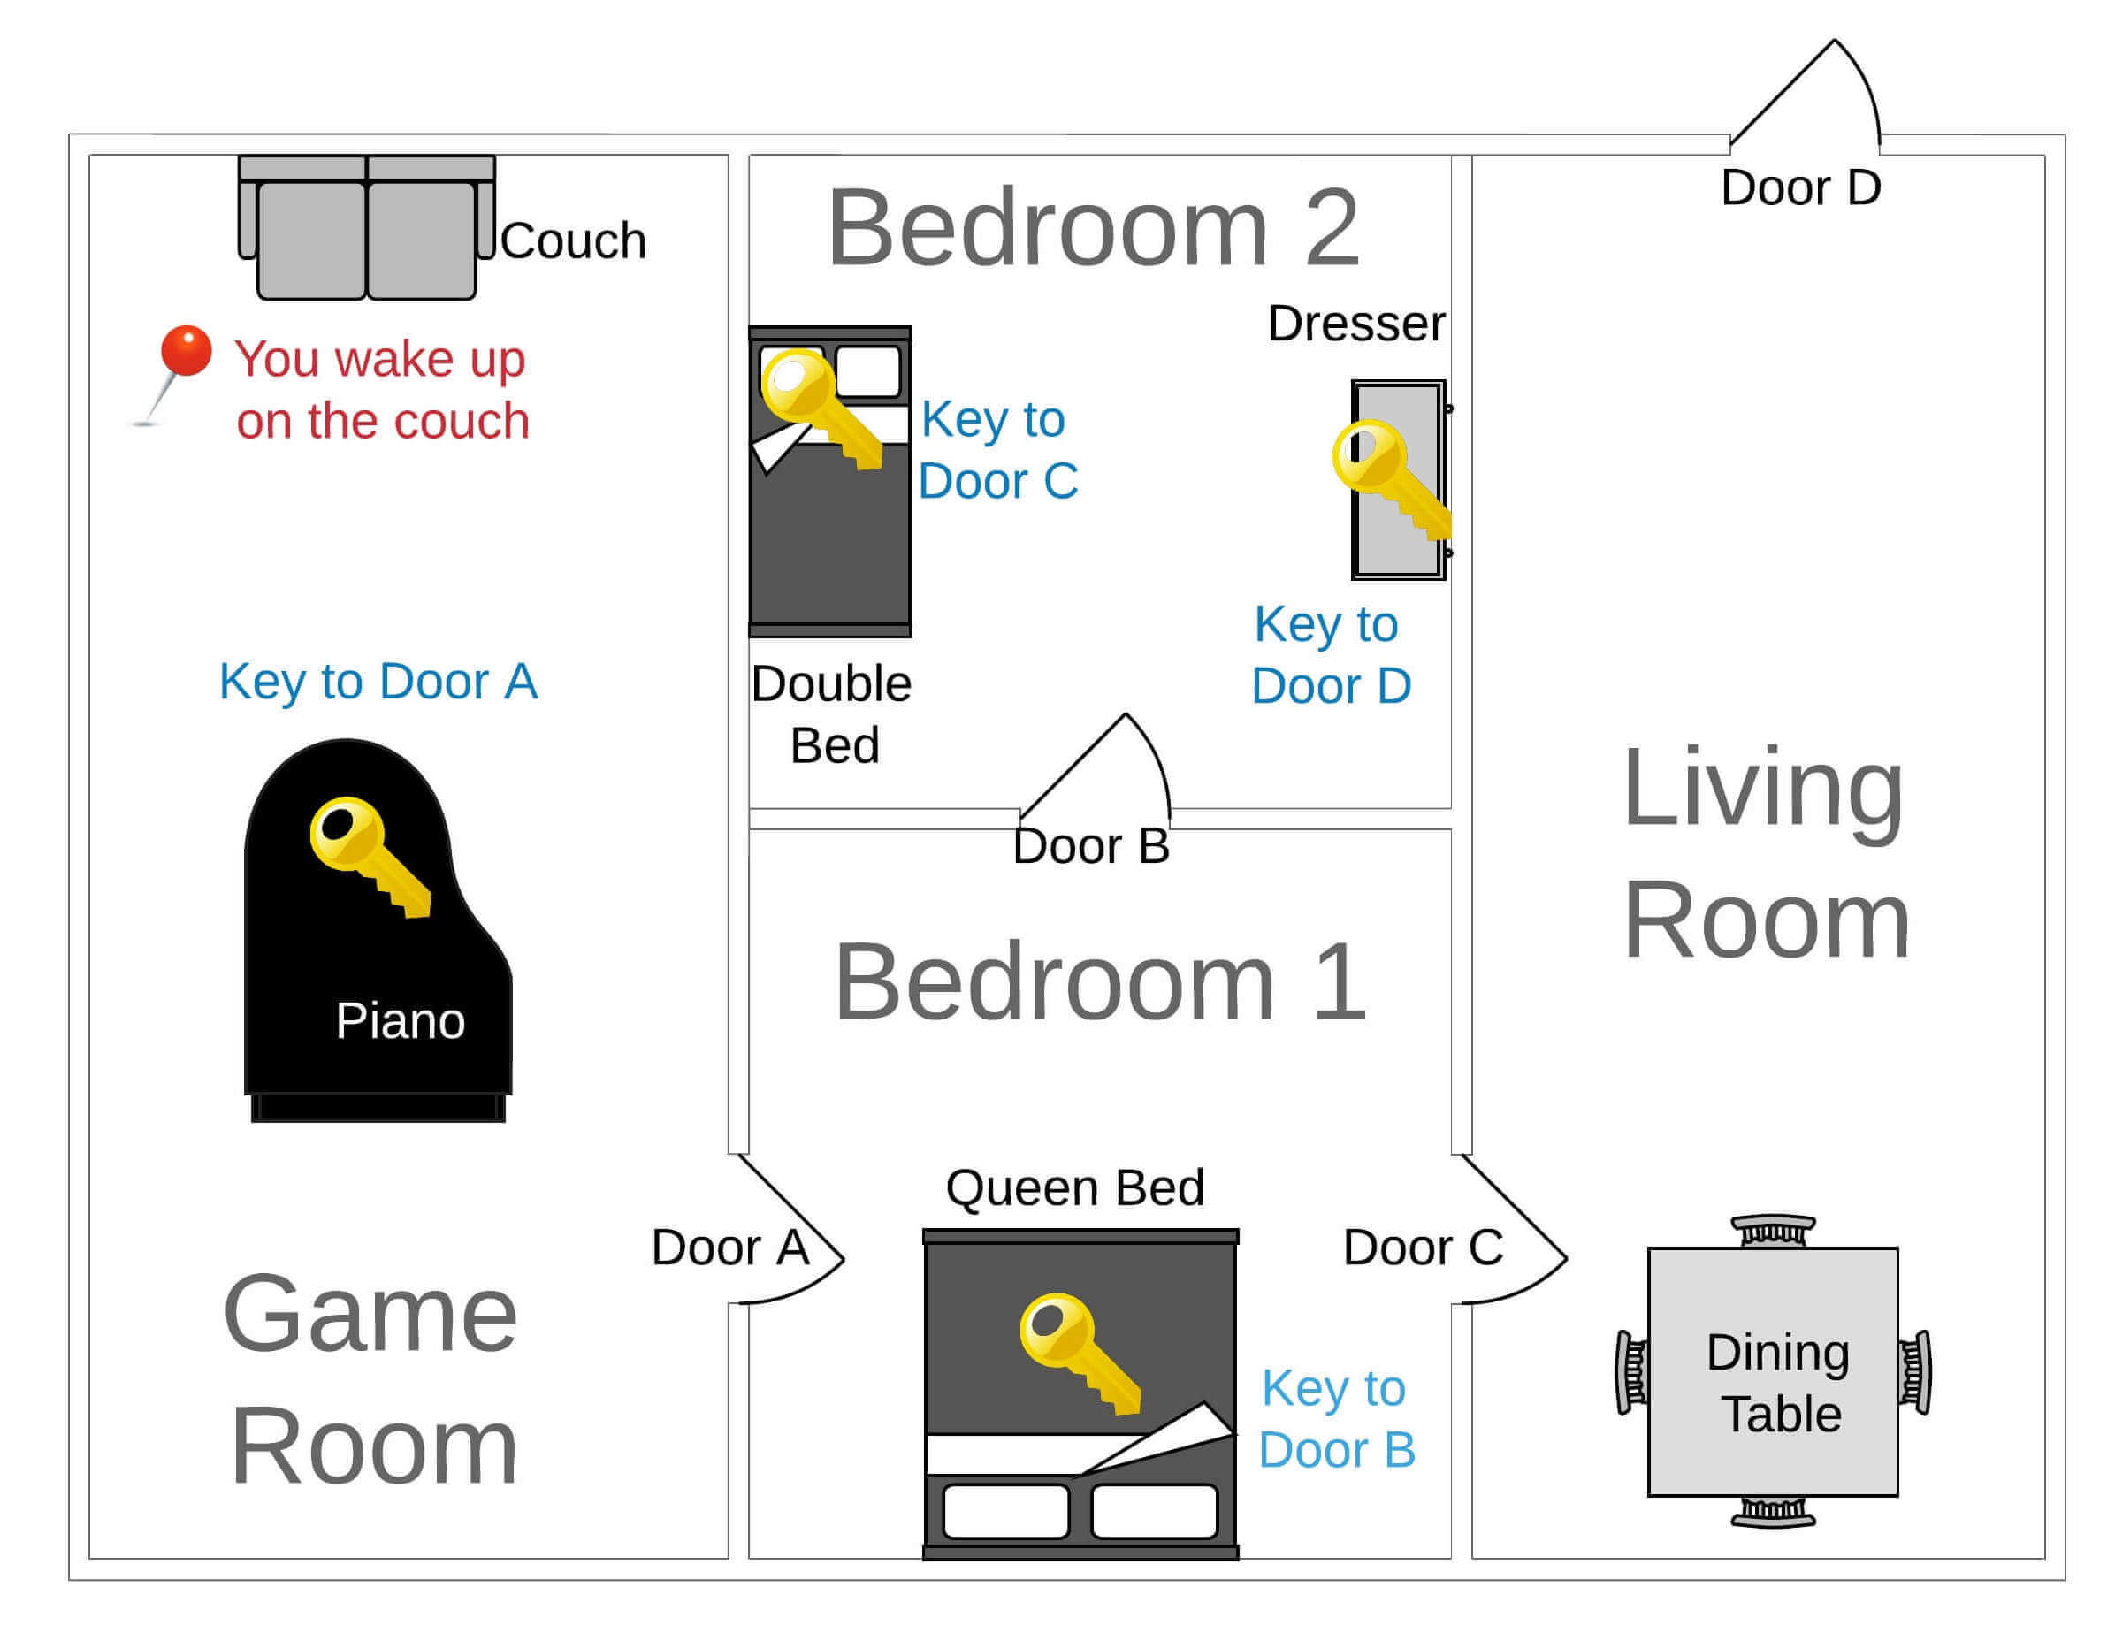


Escape Room
1. Updated items and relations.
3. Improved Usability
4. Created new features

Slide 3
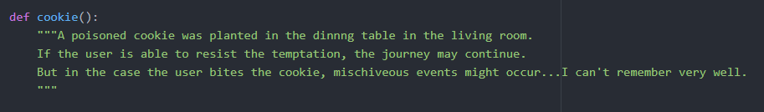
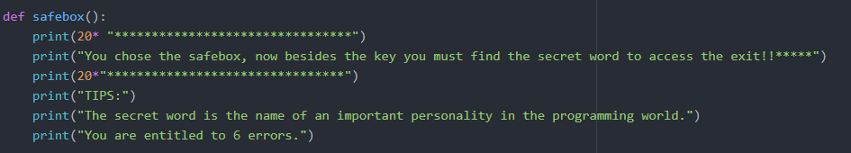
New Features

Slide 4
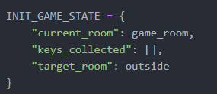
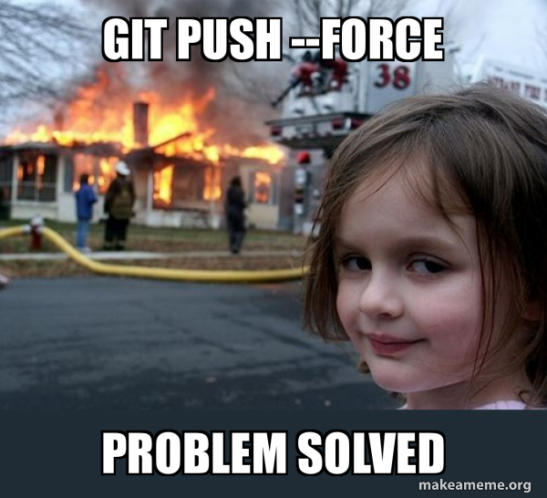

Challenges

