Slide 1
Quantum Autoencoders for Efficient Image Compression
Presented by Filip Igic
Supervised by Dr Richard Jiang

Slide 2
Introduction
Quantum Computing has a bright future
Quantum Image Representation is a popular topic:
NEQR
FRQI
Currently, Quantum Computers are very limited in resources and are prone to errors
It would be beneficial to represent high-quality images within those limitations
Notes:
So, why quantum computing?
Quantum computing is becoming increasingly popular, and is making regular advancements both practically and theoretically.
One of the topics that is particularly popular is QIR with proposals such as Novel Enhanced Quantum Representation and Flexible Representation of Quantum Images which I will expand on in the next slides.
Currently, Quantum Computers are very limited in resources in the amount of qubits and quantum volume, as well as being prone to errors such as quantum decoherence.
In the next slides, I would like to give you some background information before I move onto the objective.

Slide 3
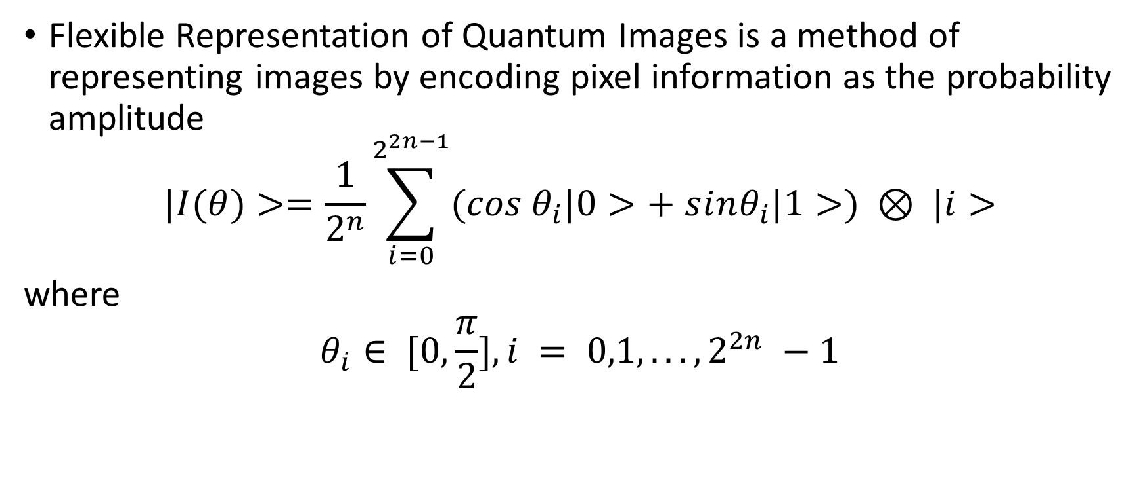
FRQI (Le, P.Q., Dong, F. & Hirota, K.)
Flexible Representation of Quantum Images is a method of representing images by encoding pixel information as the probability amplitude
$$|I(θ)>=\frac{1}{2^{n}}\sum_{i=0}^{2^{2n−1}}{(cos θ_{i}|0>+ sⅈnθ_{i}|1>) ⊗ |ⅈ>}$$
where
$$θ_{i}∈ [0,\frac{π}{2}],ⅈ = 0,1,...,2^{2n} −1$$
Notes:
Read definition.
To create the state you would sum up all the pixels with the encoded pixel information by using the angle theta to encode the colours onto the pixel position |i> and then put them in superposition.

Slide 4
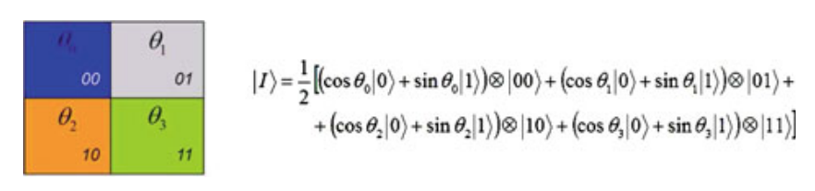
FRQI (Le, P.Q., Dong, F. & Hirota, K.)(Cont.)

Slide 5
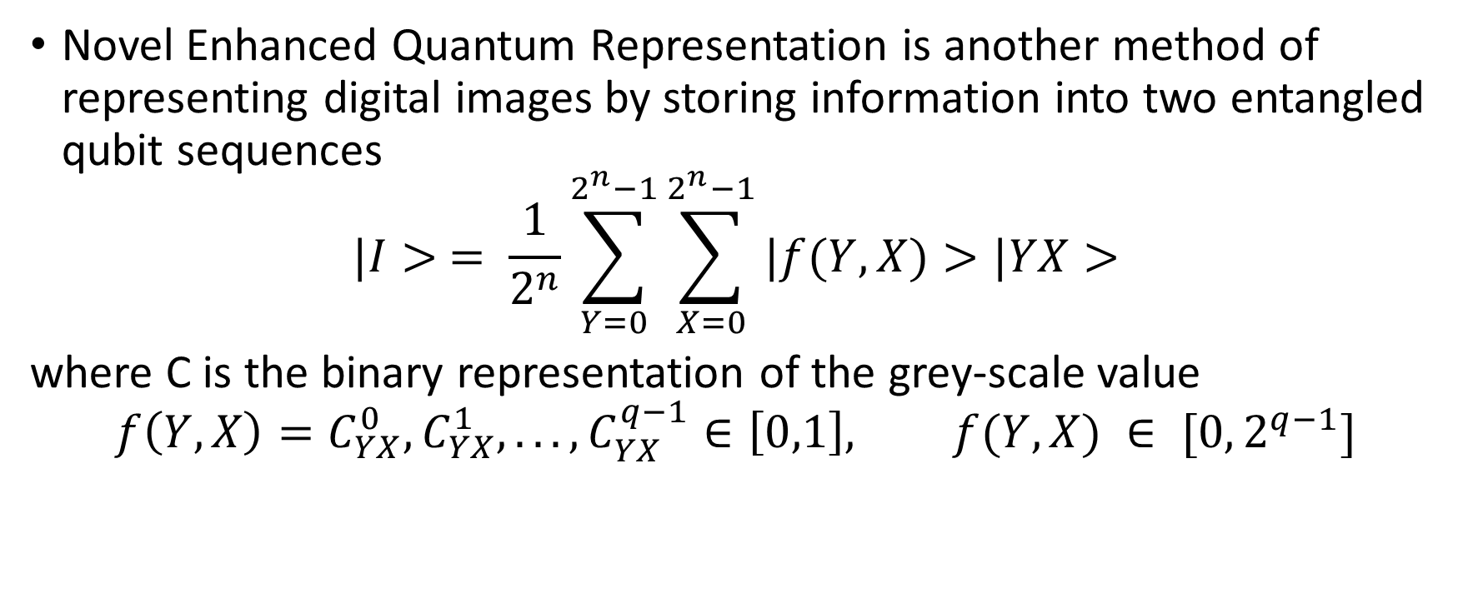
NEQR (Zhang, Y., Lu, K., Gao, Y. et al.)
Novel Enhanced Quantum Representation is another method of representing digital images by storing information into two entangled qubit sequences
$$|I> = \frac{1}{2^{n}}\sum_{Y=0}^{2^{n}−1}{\sum_{X=0}^{2^{n}−1}{|f(Y,X)>|YX>}}$$
where C is the binary representation of the grey-scale value
$$f\left(Y,X\right)=C_{YX}^{0},C_{YX}^{1},...,C_{YX}^{q−1}∈\left[0,1\right], f(Y,X) ∈ [0,2^{q−1}]$$
Notes:
Read definition + and has been proposed to be an improvement on FRQI.
To create this state you would run through all possible pixel positions and entangle them with the function of Y and X which will return a binary representation of the grey-scale value but it could also be any colour depending on how you choose to interprate the data.

Slide 6
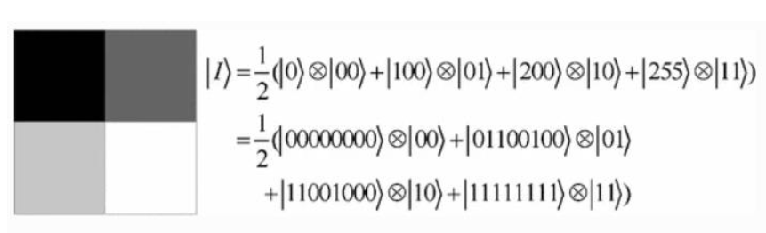
NEQR (Zhang, Y., Lu, K., Gao, Y. et al.)(Cont.)
Notes:
Here is an example of that with pixel values ranging up to 255 which based on the expression on the last slide would take 10 qubits, 8 being for the pixel intensity and 2 being for the pixel position.

Slide 7
Quantum Autoencoder (Romero et al.)
Quantum Autoencoders consist of two unitary programmable quantum circuits:
Encoder: Takes in a vector of angles and attempts to preserve maximum quantum information from the input to the set output
Decoder: Is the conjugate transpose of the encoder and attempts to reconstruct the initial state with the given qubits
The work of Romero et al. demonstrated how autoencoders can be used to compress quantum data such as ground states of the Hubbard model and molecular Hamiltonians

Slide 8
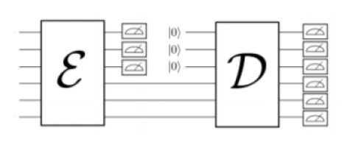


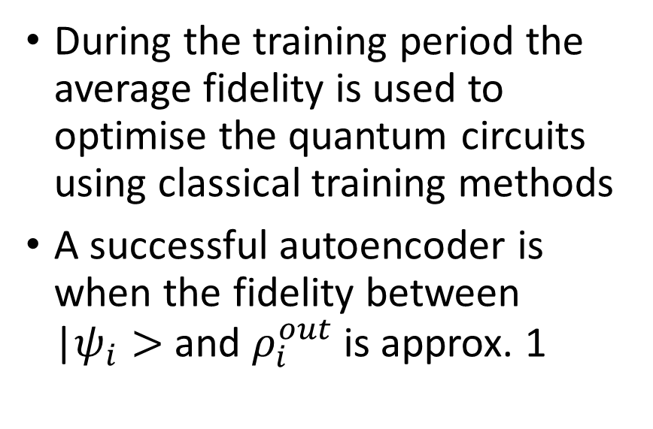
Quantum Autoencoder (Romero et al.)(Cont.)
During the training period the average fidelity is used to optimise the quantum circuits using classical training methods
A successful autoencoder is when the fidelity between |$ψ_{i}>$ and $ρ_{i}^{out}$ is approx. 1
|$ψ_{i}>$
$$ρ_{i}^{out}$$
Notes:
Classical training methods such as basin hopping.

Slide 9
Objective
NEQR and FRQI both propose depth compression techniques such as minimising the Boolean expressions
However, they do not propose compressing the circuit width beyond storing the image in a superposition of qubits
The objective was to reduce the width of a quantum circuit containing image information using a Quantum Autoencoder
Notes:
NEQR and FRQI both propose depth compression techniques such as minimising the Boolean expressions
However, they do not propose compressing the circuit width beyond their proposal of storing the image in a superposition of qubits
So, the objective was to reduce the width of a quantum circuit containing image information using a Quantum Autoencoder

Slide 10
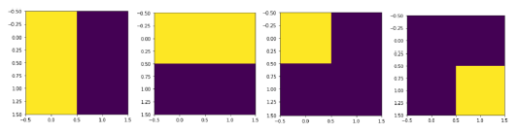
Implementation – Tools & Dataset
Tools:
Python
Qiskit
SciPy
JupyterLab
Dataset:
2x2 images
Notes:
Python: Used as the programming language for this project
Qiskit: IBM’s Python framework for Quantum Simulation
SciPy: Used internally in Qiskit as well as for classical training methods which I will discuss more later on.
JupyterLab: was the IDE used for testing and analysing.
Due to the computational complexity of large quantum images I had to keep the dataset small for testing within my given time frame.
There are no simple solutions above a Toffoli gate so if I were to expand to e.g. a 3x3 image the circuit complexity would be significantly larger.
From a programmers perspective, I have found that Qiskit offers some solutions in their api by introducing multi-control toffoli operation but again from a simulation aspect it would take too long to simulate.

Slide 11
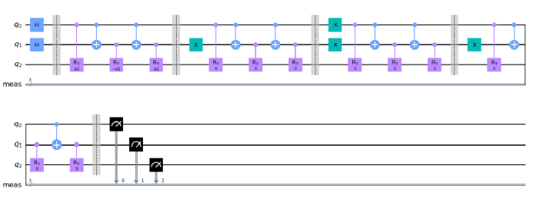
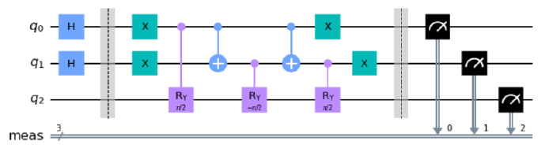
Implementation – FRQI Model
Create a circuit that prepares the FRQI state
Compress the depth of the circuit with the Boolean minimisation method
Create the inverse of the circuit for training
Notes:
When creating the FRQI Model I started by creating the state preparation circuits before moving onto the autoencoder.
Read bullet points.

Slide 12
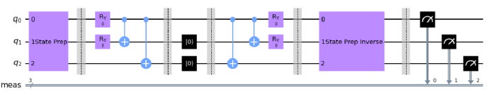
Implementation – FRQI Model (Cont.)
3-1-3 Autoencoder
Encoder:
Two single-qubit rotational gates
Two control-nots
Decoder is the inverse
Expected result is “000”
Negate the probability of measuring “000” and cast it as a minimisation problem and optimise with COBYLA. Sim et al.
Notes:
As the dataset consisted of 2x2 images, 3 qubits were all that was needed so in that case I built a 3-1-3 autoencoder to attempt to compress the image into a 1 qubit latent space.
There are many ways to construct the encoder but to keep it simple it consisted of two single-qubit rotational gates and two control-nots.
I then reset two qubits and inversed the encoder to create the decoder.
As I added the inverse of the FRQI state prep circuit at the end, the obvious measurement result would be “000” as the inverse would cancel out the state after the decoder because the image should theoretically be the same as in the input.
After I obtain the measurements I simply negate the probability of getting “000” and optimise the parameters using the Constrained Optimization by Linear Approximation algorithm.

Slide 13
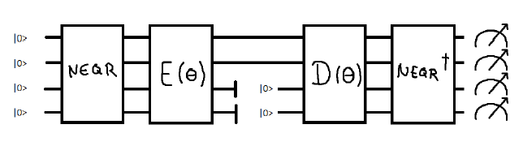
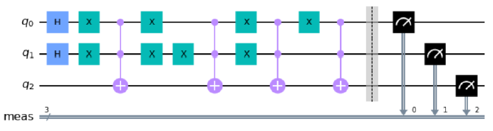
Implementation – NEQR Model
Consists of:
NEQR State Prep Circuit
Encoder
Decoder
Inverse NEQR State Prep Circuit
Same training optimisation method
Notes:
The NEQR model works in the same fashion but has a different state preparation circuit as seen in the slide.

Slide 14
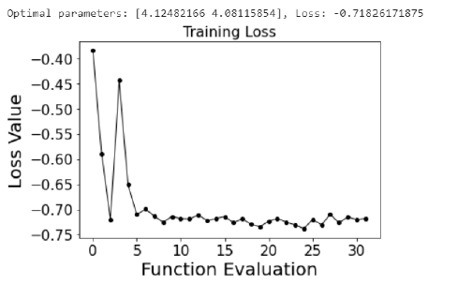
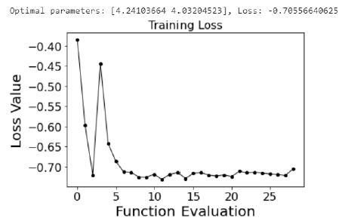
Results – Case 1
FRQI Model
NEQR Model
Notes:
As for the results, in case 1 I trained and tested and image with a single pixel turned on in the top left corner.
As you can see the results were fairly similar both achieving around 70% retention of information.

Slide 15
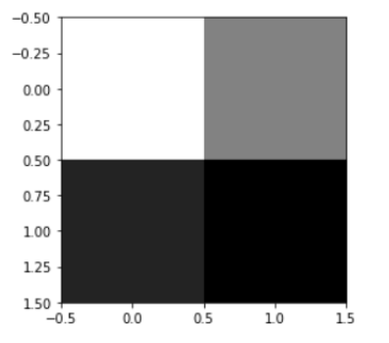
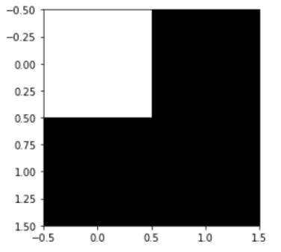
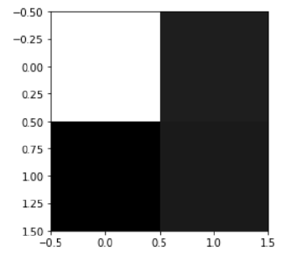
Results – Case 1 (Cont.)
FRQI Model
NEQR Model
Notes:
Although the FRQI results seemed good, the way that the image is retrieved from the measurements makes the result almost trivial especially compared to the NEQR results.
However adding an additional single-qubit rotational gate improves the image drastically although still shows signs of error.

Slide 16
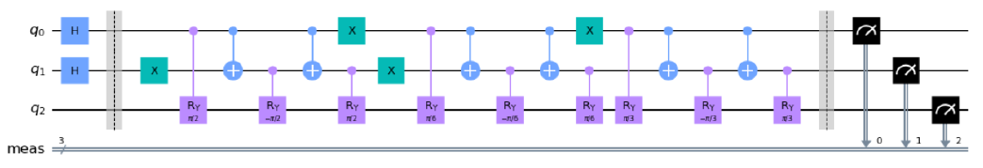
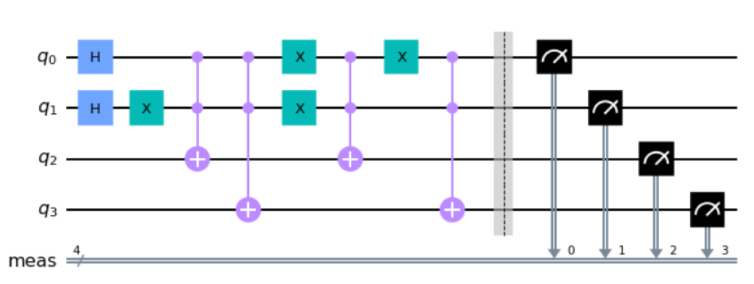
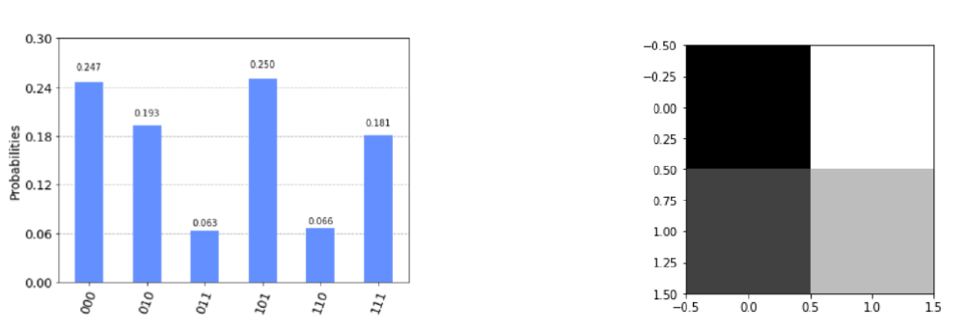
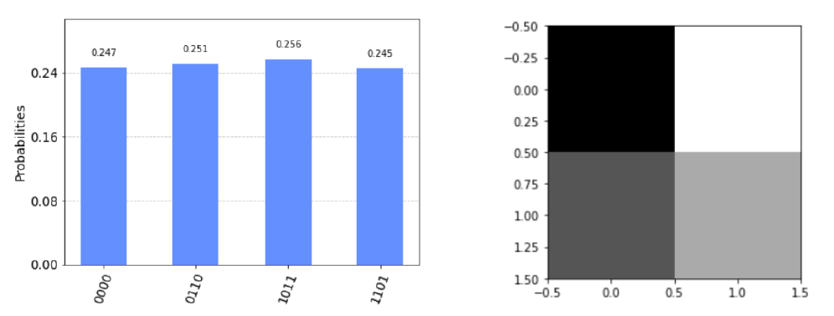
Results – Case 2
FRQI Model
NEQR Model
Notes:
In case 2 I attempted to introduce a larger pixel intensity range from only being 0 and 1 to being in a range of 0-3.
After attempting to train and test, the results were very poor. I couldn’t get an image back from the FRQI model and the NEQR model gave me a 24% retention rate.
Clearly the sensitivity and preciseness required from the FRQI state was too much for encoding and decoding whereas the NEQR despite needing an additional qubit to process information gives more promising results which should be looked into more.

Slide 17
Results Conclusion
FRQI Model
NEQR Model
Showed promising results with some images, but due to the way images are retrieved after measurement, made these results trivial
Smaller circuit width to produce the same image as NEQR
Performed much better, showing good results without the need of adding onto the autoencoder circuit
Image retrieval method allows room for loss error
Notes:
The FRQI model showed promising results with some images, but due to the way images are retrieved after measurement, made these results trivial.
However one pro was the ability to expand the pixel intensity range with one qubit rather than introducing more as was needed with the NEQR model.
Performed much better, showing good results without the need of adding onto the autoencoder circuit
Image retrieval method allows room for loss error

Slide 18
Contribution
Demonstrated how Quantum Autoencoders can be used to compress images using Qiskit
Can be expanded to larger images
Could be used to:
Denoise images
Compress images for transporting qubits
Amplify certain characteristics of images
Notes:
As my contribution I Demonstrated how Quantum Autoencoders can be used to compress images using Qiskit.
This work can be expanded onto larger images and has the potential to denoise images, compress images and amplify certain characteristics depeneding on how you train the autoencoder.

Slide 19
Overall Conclusion
Demonstrated that the general quantum autoencoder can be used on quantum image representations
Compared the results and came to the conclusion that NEQR is the better option
Expand onto larger images
Use quantum autoencoders to amplify FRQI probability amplitudes for better results
Notes:
I have demonstrated that the general quantum autoencoder can be used on quantum image representations, but could we get a lot more out of the quantum images if we were to optimise the autoencoder specifically for images rather than general use?
I’ve shown the pros and cons of both models and concluded that NEQR has more potential with and without autoencoders.
For future work I would like to expand on larger images as well as look into other image representations that aren’t just confined to square images.
I would also like to see if autoencoder could amplify FRQI states to make them just as good to use as NEQR images.

Slide 20
Thank you for your time

