Slide 1


Project Overtime
By Felix Jopkiewicz
Filip Josipovic
Dejan Sunaric
Fabio Boran
Eldi Neziri

Slide 2






Agenda
Our Team
Background/Idea/Reason
Planning (Gantt-Chart and goals)
Technical details
Prototype

Slide 3
Our Team
Felix Jopkiewicz
Filip Josipovic
Dejan Sunaric
Fabio Boran
Eldi Neziri
Project leader, Co. Website Developer, Paperwork
Co. Backend Developer, Leading Simulation Developer
Leading Website Developer, Design
Leading Backend Developer, Co. Simulation Developer
Assistant

Slide 4

Background/Idea/Reason
Students wanted to stay longer after their regular classes
The housekeeper is responsible for these students
Housekeeper lacks the information about students in the building
Solution: Website for people with authority to have an insight over the locations of students in school after their regular classes

Slide 5
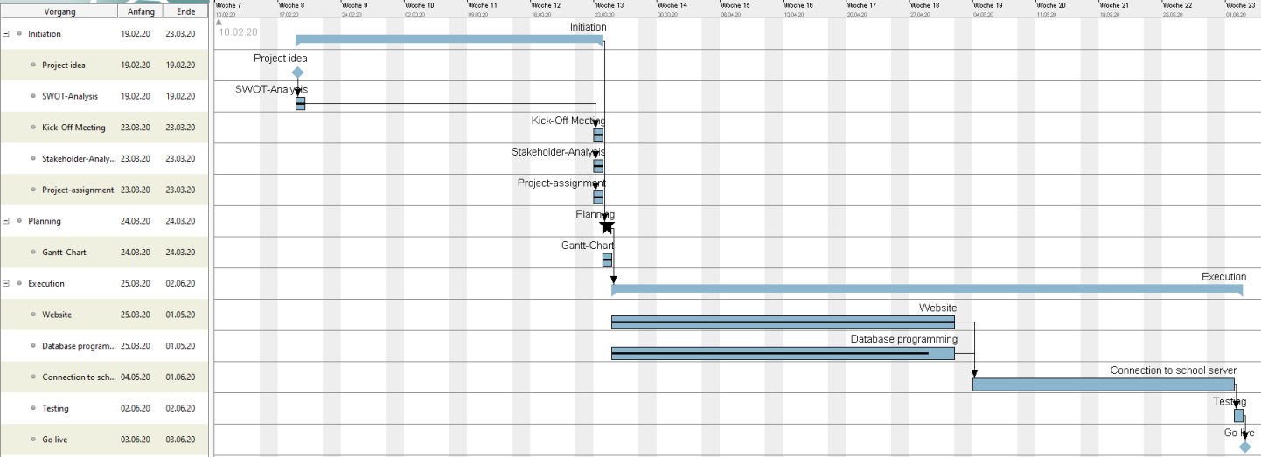

Planning
http://localhost:5000/

Slide 6







Technical details
Tools for development
Tools for Communication
Mongo DB
Visual Studio 2017
HTML 5
CSS 3
Node.Js
Discord
WhatsApp

Slide 7
Implementation
Unable to host our database on the school server due to quarantine
Prototype had to be hosted via localhost
Simulation of prototype in WPF
Came across MongoDB to implement our database

Slide 8



Resume
Incomplete team
Problems with database and hosting
Managed to finish prototype in time

Slide 9

Thank you for your attention!
Team
Overtime
3EHIF
HTL- Donaustadt

