Slide 1
FILIP · THE DAY JOB
I've made Apify's videos for two years.
THE ROLE
Video content producer at Apify. Videos for the company, every day.
THE WORK
A lot of it is motion graphics and animation. Also every day.
THE CATCH
I like doing it. In Premiere and After Effects. That's what makes this a strange talk.

Slide 2
FILIP · THE PROBLEM
I love motion design. It just takes all day.
DESIGN
Make the design — or wait for the design team to make one.
CONVERT
Figma out, Adobe in. Every single time.
ANIMATE
Layer by layer. And there are a lot of layers.
That's fine for a launch video. It's impossible at YouTube cadence.

Slide 3
HOW IT WORKS · 1
Then I met Remotion.
ASK
Your scene asks one question: what frame are we on? Remotion says 47.
ANSWER
You return what frame 47 looks like. That's the whole API.
EXPORT
Headless Chrome screenshots every frame. ffmpeg stitches them.
No Figma export. No layers. A video is a text file — and models are exceptionally good at writing React.

Slide 4
HOW IT WORKS · 2
Great engine. Terrible taste.
THE PROBLEM
Remotion could animate anything — and the style was all over the place. So I taught it our house style.
TOKENS
Our palette, ported out of the design system. Every scene imports it; a raw hex code is a rule violation.
COMPONENTS
29 scenes built from our real marketing. It opens the actual source file before it copies one.
REFERENCES
Real frames from real Apify videos, as images. It sees the house style instead of reading the word “clean”.
LIMITS
The banned moves are a seven-value enum. No entrance blur, no fade from black, no slide-wipe — unsayable, not forbidden.

Slide 5
HOW IT WORKS · 3
Then I put it all in one place.
PROMPT
Describe a scene. It animates it.
TEMPLATES
Or drop in a branded block that's already made.
EDIT
Give it footage: it cuts the dead air on its own.
COMPOSE
Or builds the finished video — footage and animation together.
SVG
Hand it a logo or a diagram and it animates the file itself.
It turned out far more powerful than I thought it would be.

Slide 6
SPARE · IF THERE'S TIME
It looks at its own work.
01
02
03
04
Write
Render
Look
Fix
It writes the scene, renders real frames, looks at them, and fixes what it got wrong — before I ever see it.

Slide 7
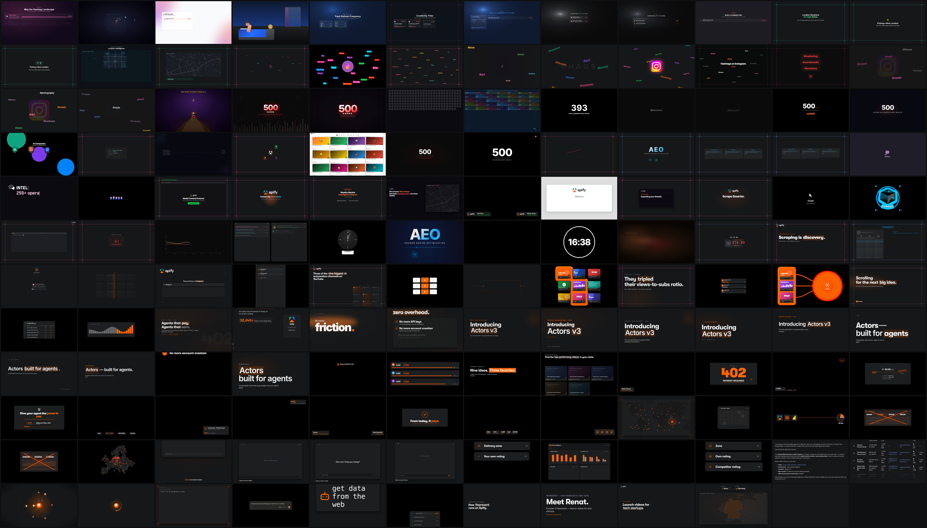
313 projects. Six months.
Chronological. The top rows are March — rainbow, before I taught it anything. The bottom rows are last week. You can watch it learn the house style.
EVERY PROJECT, IN ORDER

