Slide 1



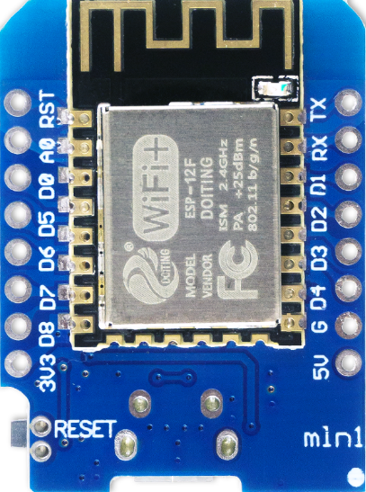

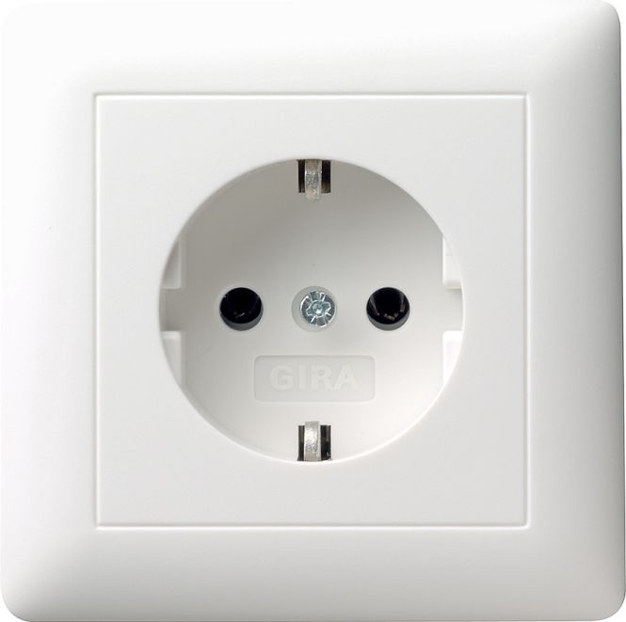


SMOKE-DETECTOR-ALERT
How it works ...
Potential-free relay contact
NO (normaly open) > D5 = HIGH
Alarm (closed) > D5 connected to GND = LOW
Arduino D1 Mini
connects to Mosquitto
MQTT broker by
WiFi and send „on/off“
on alert-topic
D5 (GPIO 14) + internal pullup resistor enabled = HIGH
Node-RED Flow connects
to Mosquitto broker,
waits for signal and
process alert-message
Telegram-Bot
connects the API and send
alert-message to
notification group
Supplies the Arduino with 5 Volt voltage

