Slide 1
PERFORMANCE DRIVEN STOCK EXCHANGE ARCHITECTURE AND IMPLEMENTATION
Jakub Filipovský,
Ing. Jan Horáček

Slide 2
MOTIVATION
Exchanges power the global economy
Interesting technical and architectural challenge
Electronic trading demands sub-millisecond latency
Millions of messages per second
My passion for markets, performance

Slide 3
GOALS
Capture functional & non-functional requirements
Define measurable performance targets
Compare architectural styles and technologies
Benchmark and select key system components
Implement and validate the optimized exchange

Slide 4
KEY TERMS (1/2)
Stock Exchange
A marketplace that matches buy/sell orders for equities & securities
Ensures fair, transparent price discovery
Order Types
Limit Order - buy or sell at a specified price
Market Order - buy or sell immediately at the best available price

Slide 5
KEY TERMS (2/2)
Limit order book
Data structure holding all active limit orders, sorted by price & time
Bids on one side (buy), asks on the other (sell)

Slide 6
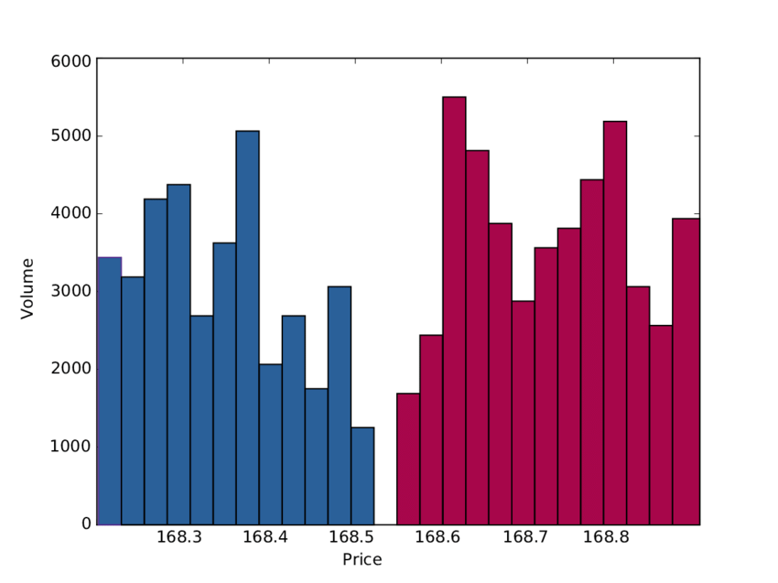

Slide 7
REQUIREMENTS
Users can submit limit, market, and cancel orders
Users receive order-status notifications
Real-time order-book updates are broadcast to all clients
End-to-end latency: sub-millisecond on LAN
Throughput target: ≥ 100 000 orders per second

Slide 8
BENCHMARKING
Core Engine Languages: C++, Java, Python
Persistence Methods: PostgreSQL, KDB+, File-based logging
Communication Protocols: REST, TCP, Kafka
Market-Data Dissemination: UDP multicast

Slide 9
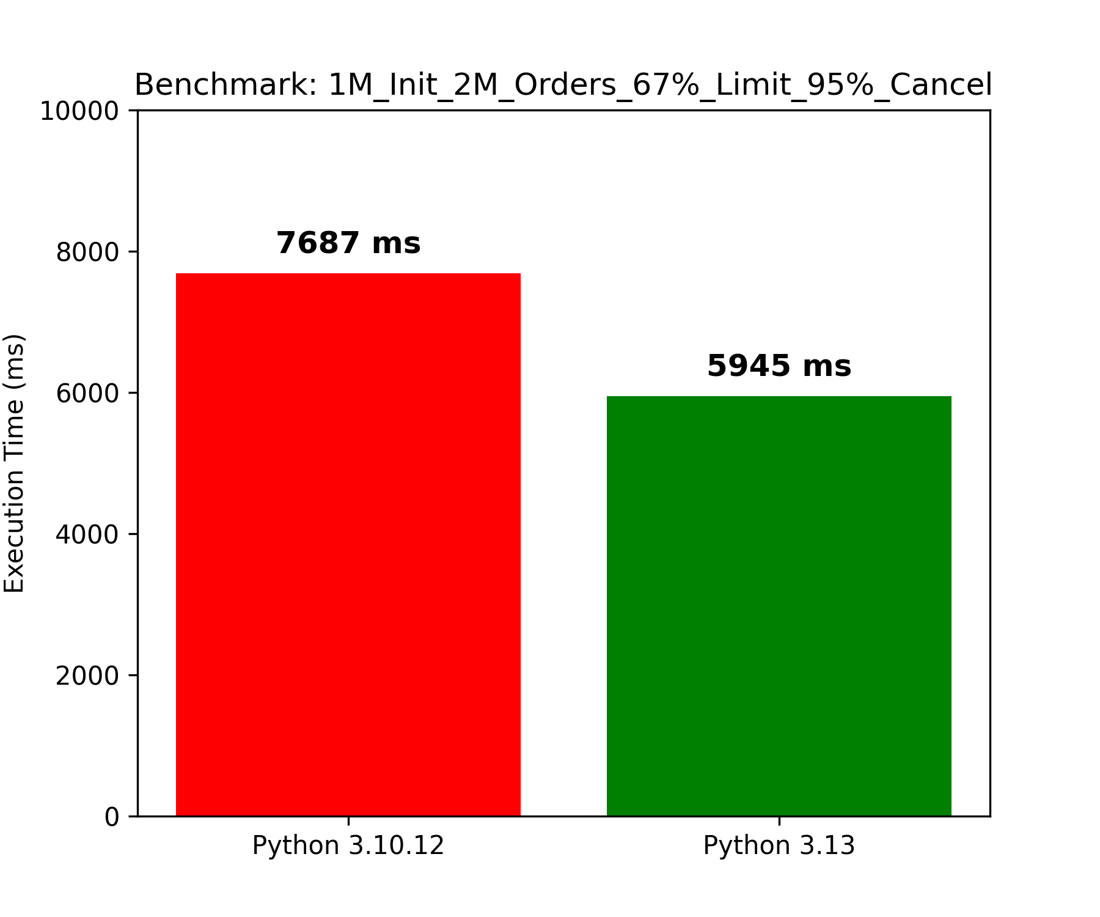

Slide 10
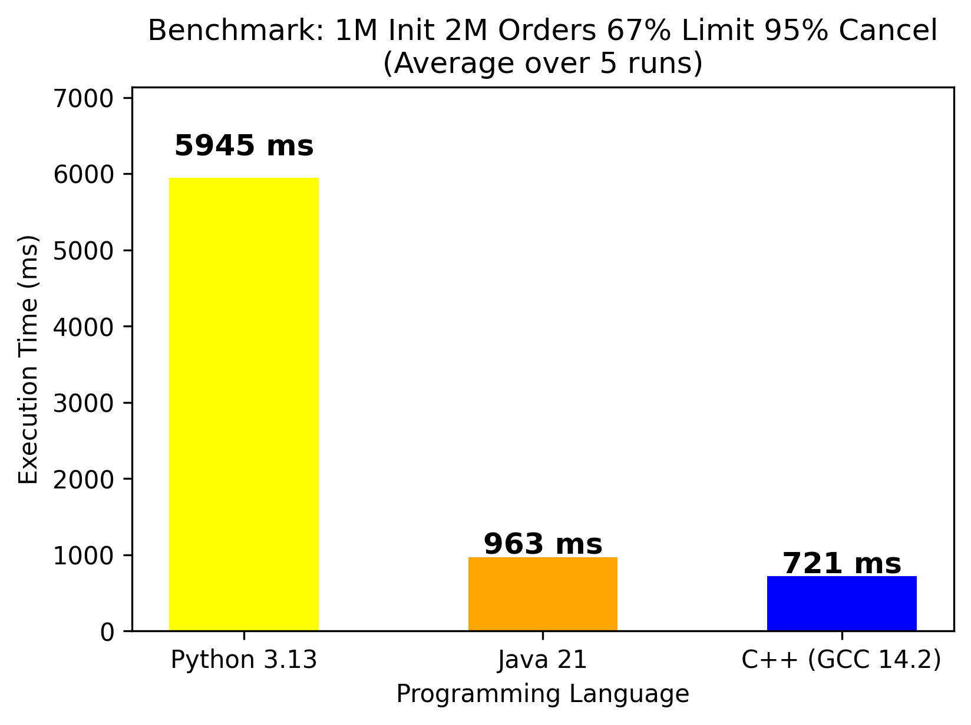

Slide 11
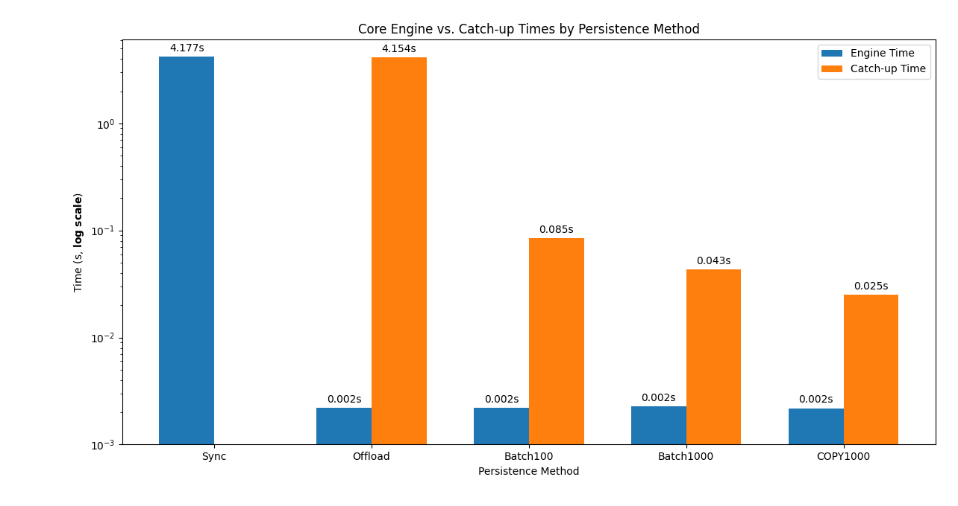

Slide 12
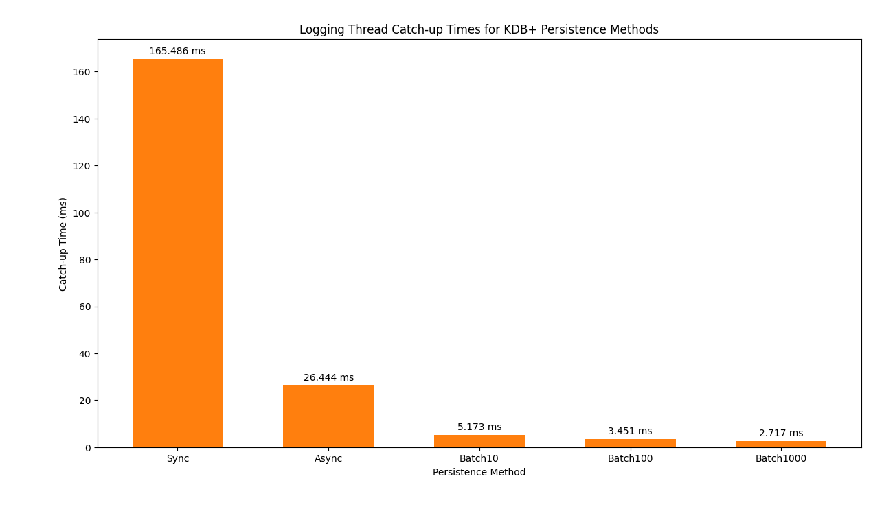

Slide 13
Persistance Method | Core Engine Time | Logger Thread Catch up Time | Total Time
PostgreSQL | 129 ms | 1 s 157 ms | 1 s 286 ms
KDB+ | 167 ms | 346 ms | 513 ms
File logger | 226 ms | 28 ms | 254 ms
Python Flask Server | C++ Crow server
3,200 requests/s | 15,900 request/s

Slide 14
Single Persistent TCP Connection | New Connection per Order
77,400 requests/s | 14,300 requests/s
Kafka Producer | Consumer (no access) | Consumer (store to vector) | Consumer (parse and print)
3,439,000 messages/s | 478,000 messages/s | 239,000 messages/s | 123,000 messages/s
UDP Multicast | UDP Multicast (IGMP Snooping)
101,000 updates/s | 2,710,000 updates/s

Slide 15
FINAL ARCHITECURE
REST/TCP gateways publish to Kafka
C++ engine: match, log, multicast
Notifier service: WebSockets
Independent horizontal scaling

Slide 16
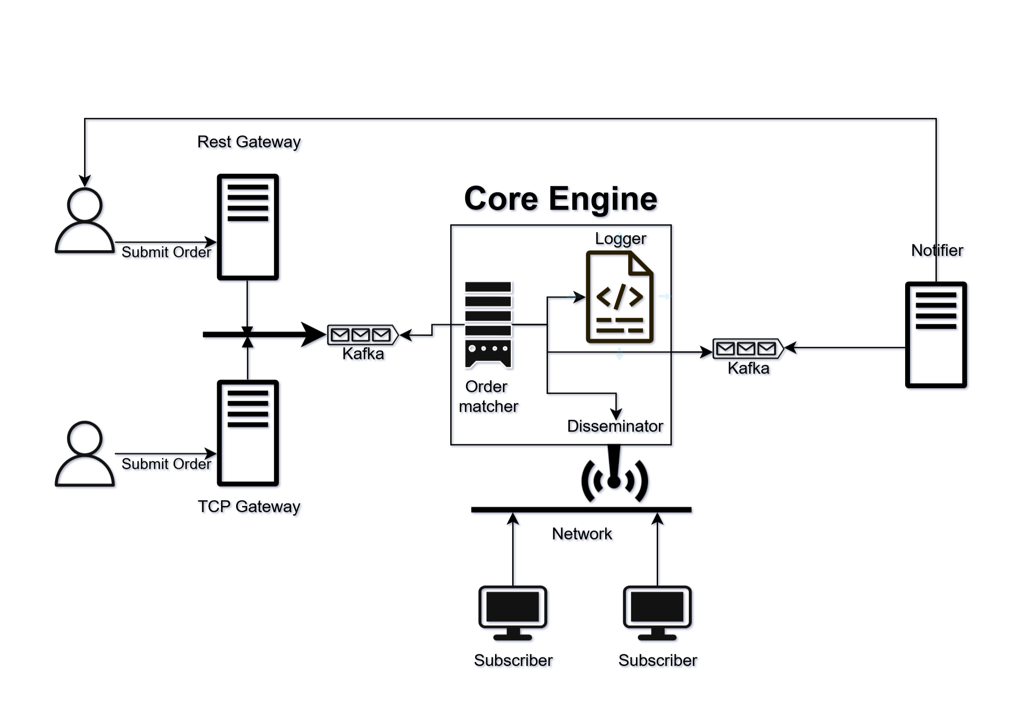

Slide 17
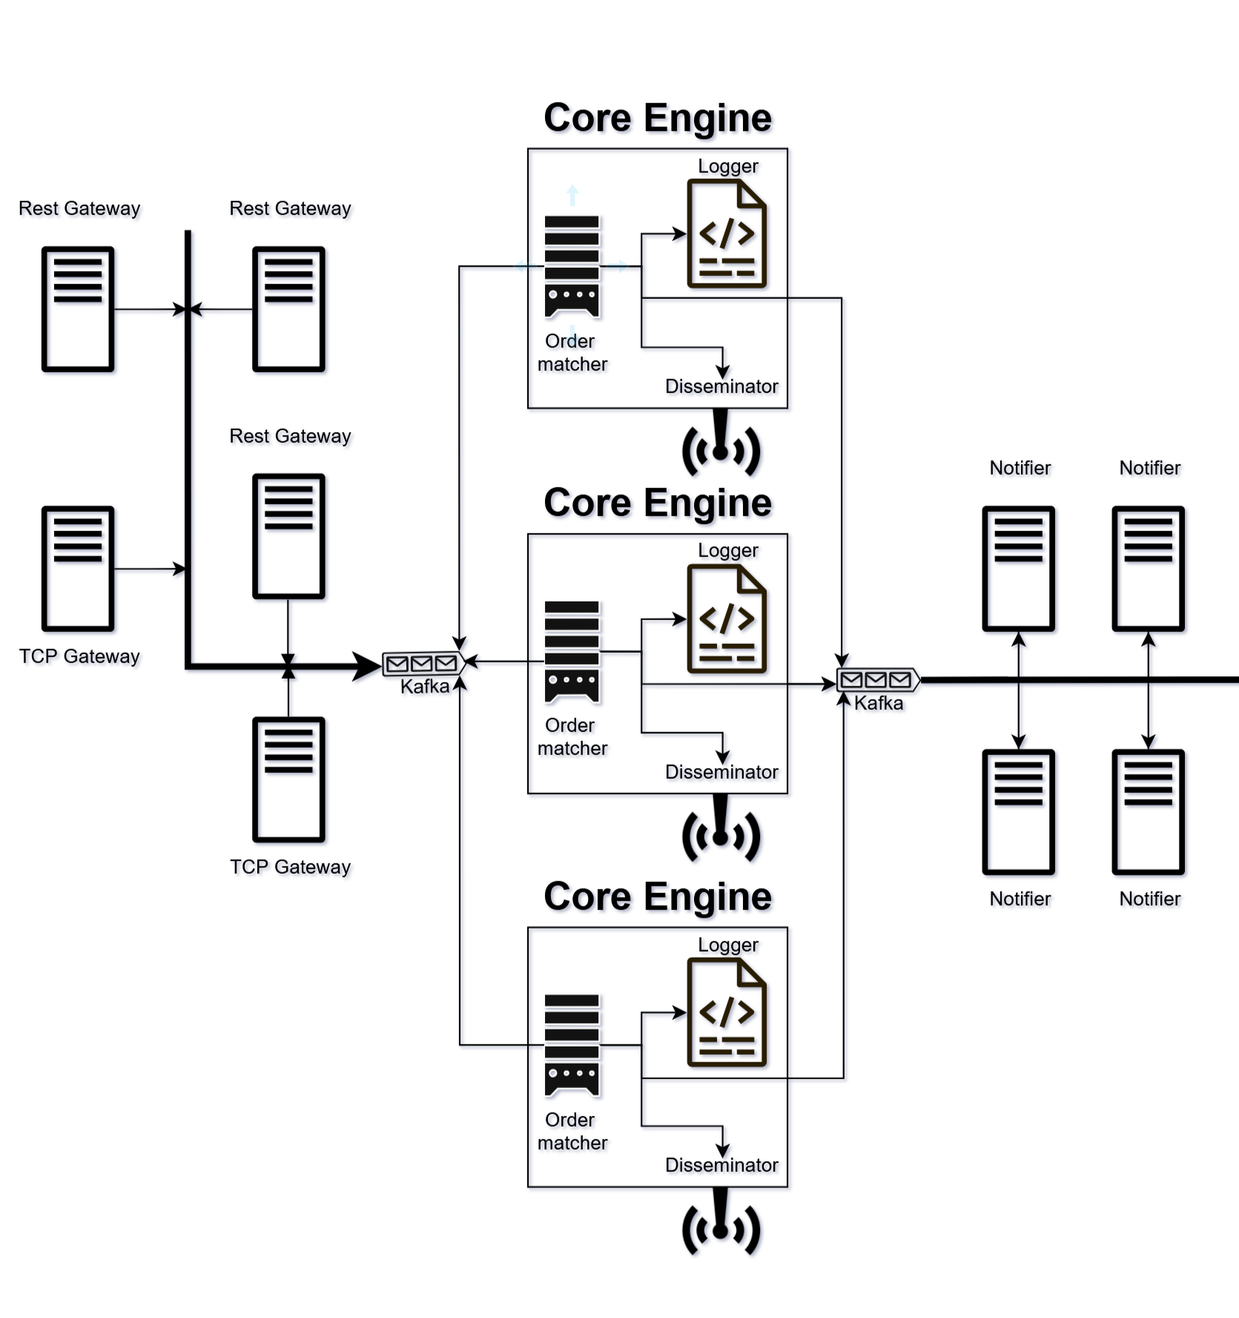

Slide 18
IMPLEMENTATION RESULTS
Crow REST (multithreaded): ~25 k orders/s
TCP gateway (multithreaded): ~120 k orders/s
Market-data multicast latency: ~ 1 ms
WebSocket notification latency: ~ 5–6 ms

Slide 19
CONCLUSION
Optimizations Learned
Batching
Offloading to a different thread
Limitations
All tests ran on one 8-core PC
No multi-node or real network deployment yet

Slide 20
DISCUSSION

Slide 21
THANKS FOR YOUR ATTENTION

