Slide 1
Real-Time Electricity Demand for Ontario
Team 2131: Filipp, Shan, Gaurav & Elder

Slide 2
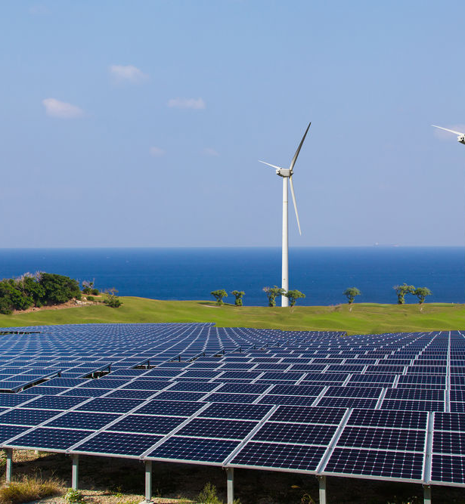
Agenda
Using real-time electricity data
Step 1
Collect data
Step 2
Format data
Step 3
Visualize
Analyze data
Draw conclusions

Slide 3
Problem
Collecting data from multiple sources
Processing it into a redable format
Accommodate for the timing differences and the different variety of information from online sources
Emphasis on the actual energy demand at the provincial level

Slide 4
Approach / Solutions
Pick Ontario to collect real-time data
Deregulated – data was easily available
Demonstrate proof of concept using the largest province
Scalable to other provinces

Slide 5
Results
See webpage

Slide 6
Conclusion
Able to collect real-time data for Ontario through parsing
Visualize data through an interactive graph Java Script
Used HTML to structure the data on the webpage
This method can be used to draw conclusions for decision-making
Can be applied to other jurisdictions for analyzing data

Slide 7


Questions
Thanks to CanDev for organizing this event!
Filipp Gorodkov Shan Thind
Gaurav Dewan Elder Gomes Pereira

