Slide 1
2days_reset
- Episode of two days. - Reset of the FMU for each episode.

Slide 2
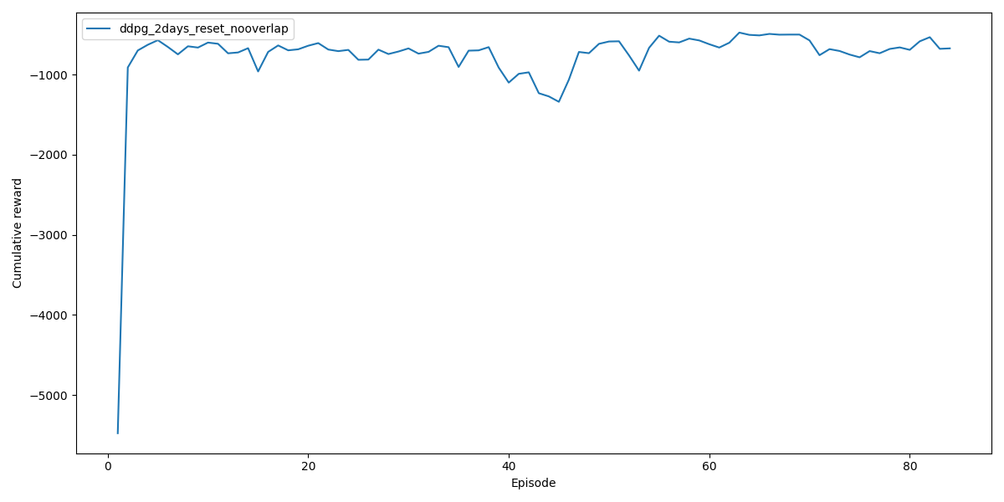
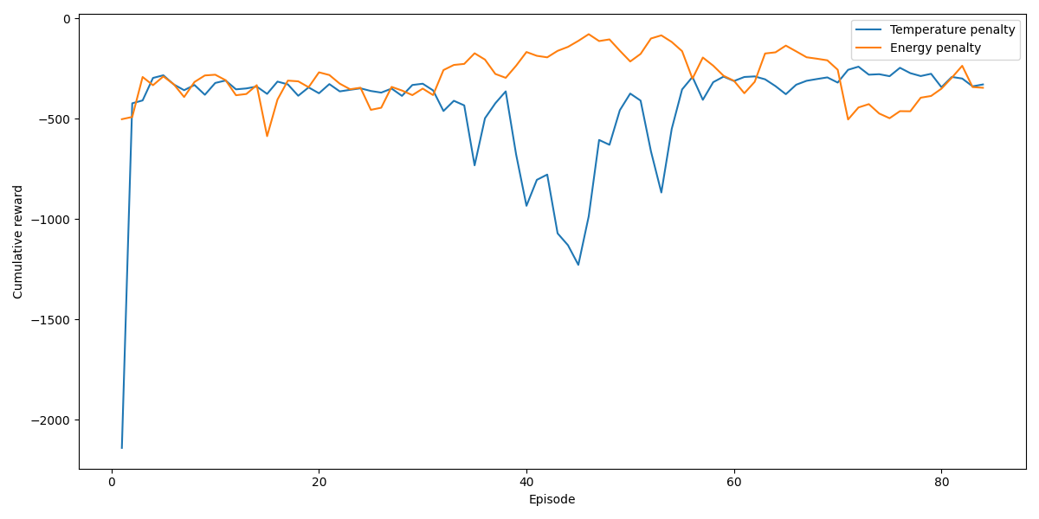
⬅Reward convergence
Reward convergence splitted ➔

Slide 3
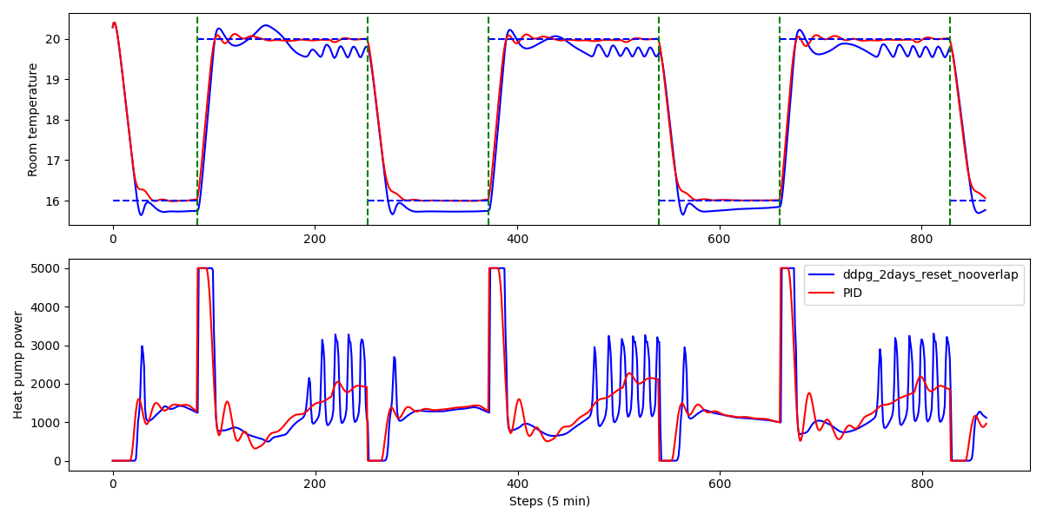
TEST OVER 3 DAYS
Average HeatPump power: 1346.964
Average temperature error: 0.568

Slide 4
2days_reset_overlapped
- Episode of two days. - The second day of one episode corresponds to the first day of the next episode. - Reset of the FMU for each episode.

Slide 5
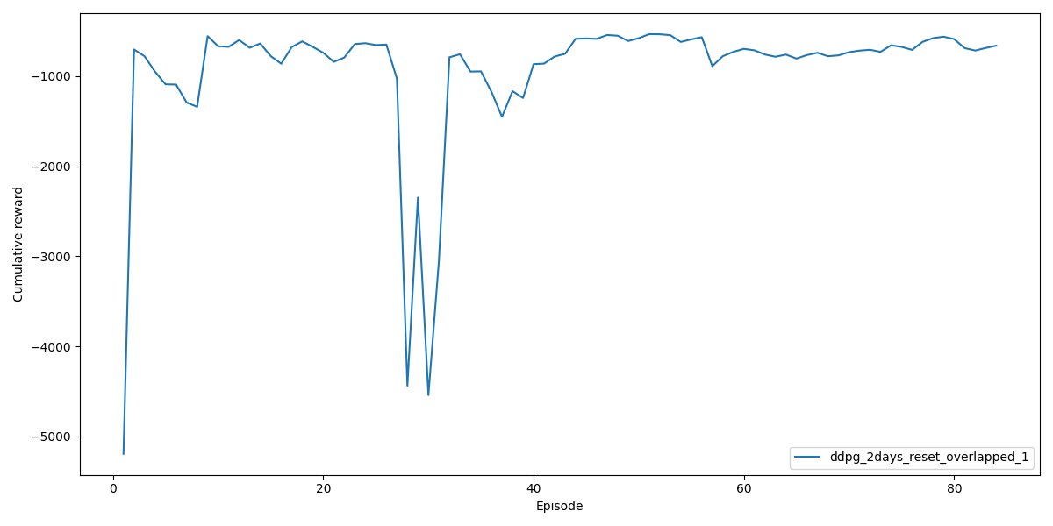
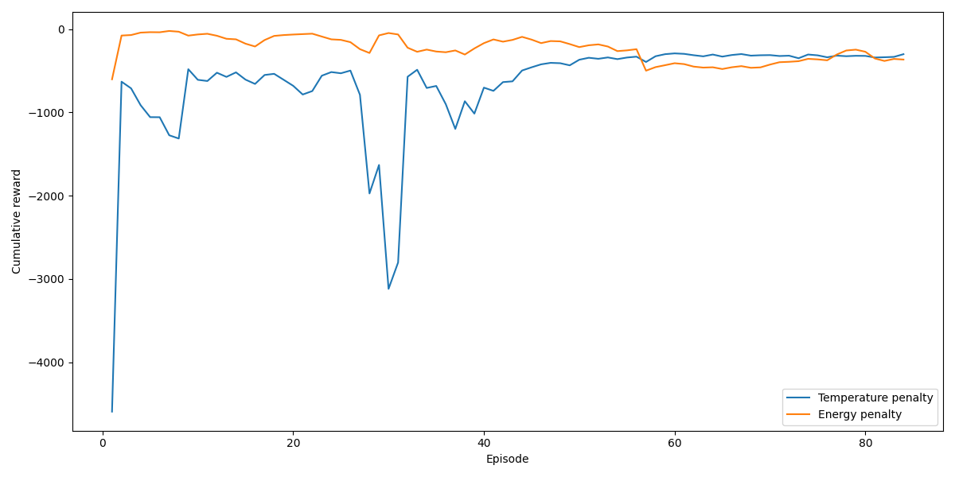
⬅Reward convergence
Reward convergence splitted ➔

Slide 6
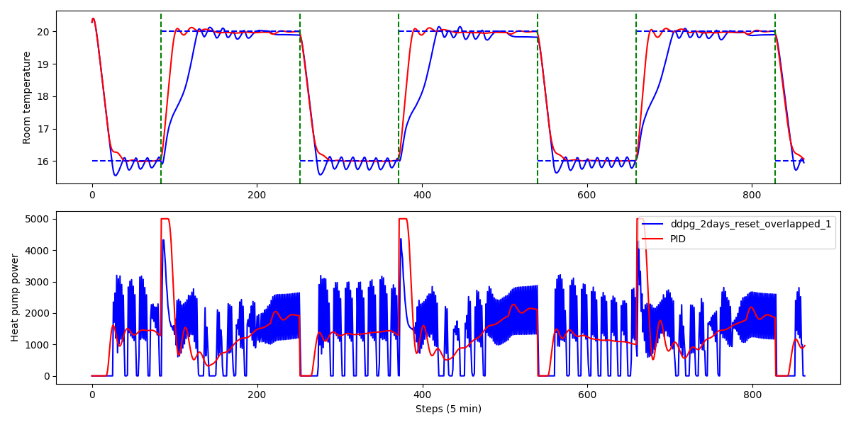
TEST OVER 3 DAYS
Average HeatPump power: 1338.355
Average temperature error: 0.642

Slide 7
No_FMU_reset
- Episode of two days. - Reset the FMU at the end of an heating season.

Slide 8
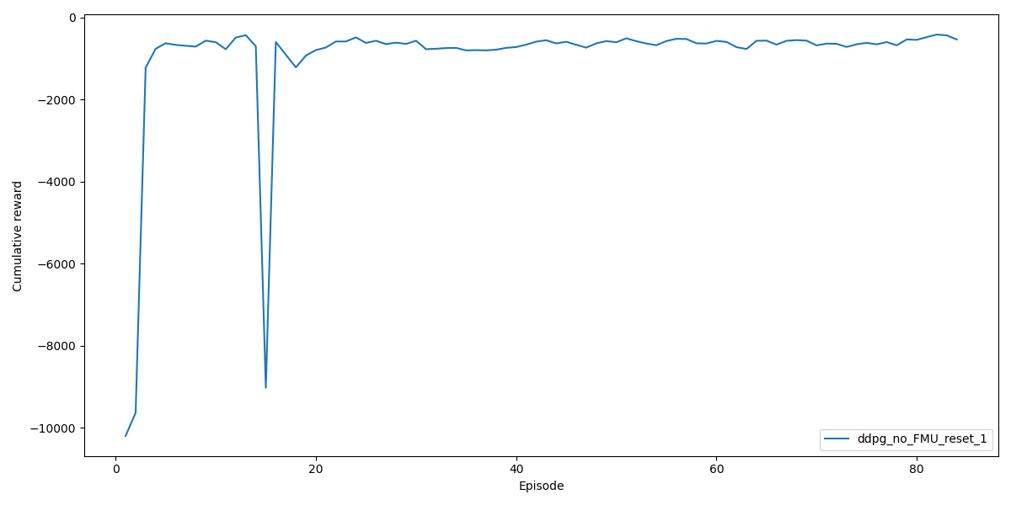
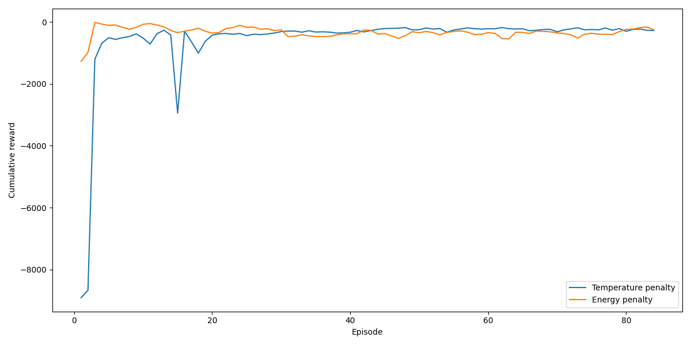
⬅Reward convergence
Reward convergence splitted ➔

Slide 9
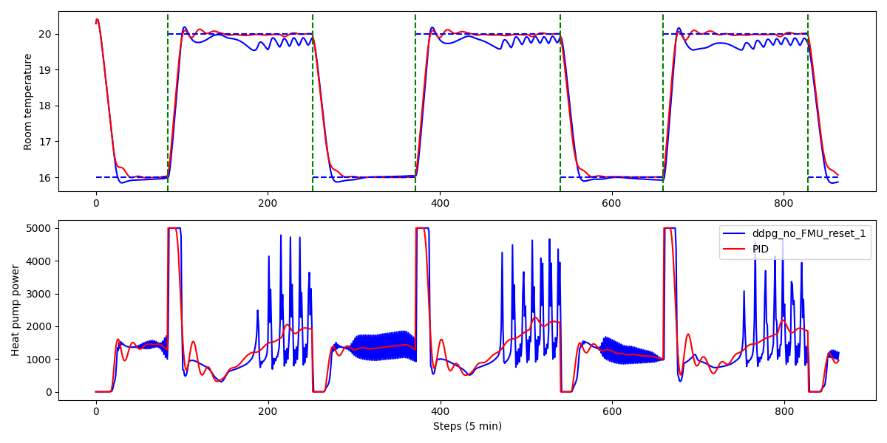
TEST OVER 3 DAYS
Average HeatPump power: 1355.811
Average temperature error: 0.500

Slide 10
