Slide 1
New weather files
NASA POWER: https://power.larc.nasa.gov/data-access-viewer/
Location: Aosta
4 weather file for training: 2020-2023
1 weather file for testing: 2019

Slide 2
Online (2 seasons training)
Avg HP power: 1761.101
Offline as is (PID dataset of 4 seasons)
Avg HP power: 1547.482
Offline trained (2 months online training – update_interval = 4)
Avg HP power: 1721.101
Avg temp error: 0.611
Saving: 0.293%
Avg reward: -1.677
Avg temp error: 1.480
Saving: 12.388%
Avg reward: -3.738
Avg temp error: 0.590
Saving: 2.515%
Avg reward: -1.624
PID
Avg HP power: 1766.284
Avg temp error: 0.356

Slide 3
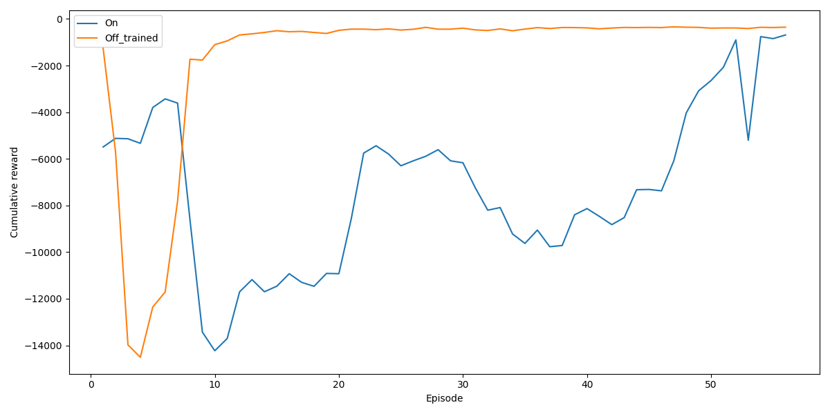
Reward convergence – 2 months

Slide 4
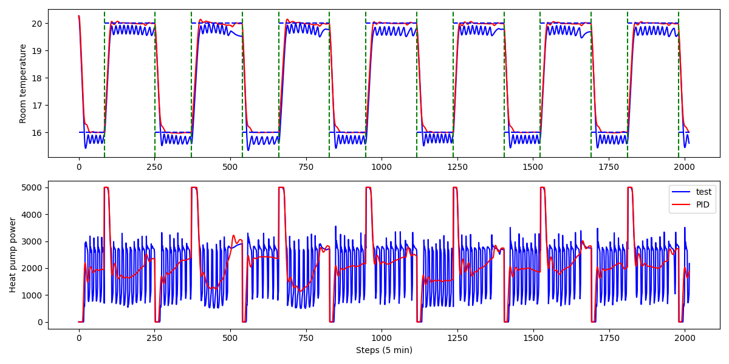
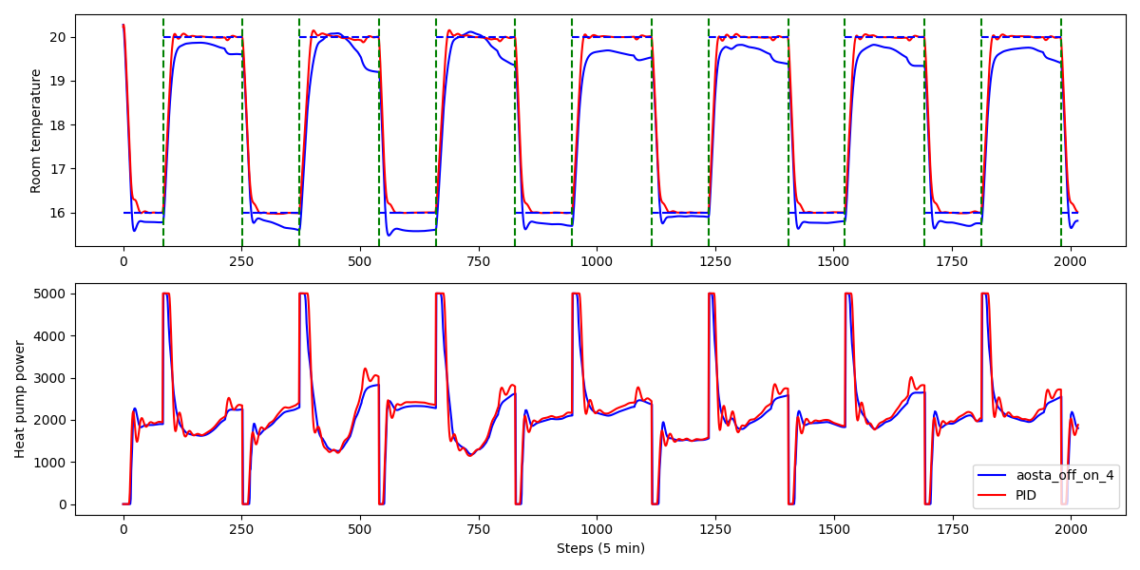
Only online update_interval = 4
2 month online training
Offline and online update_interval = 4 ➔ 2 months online training

Slide 5
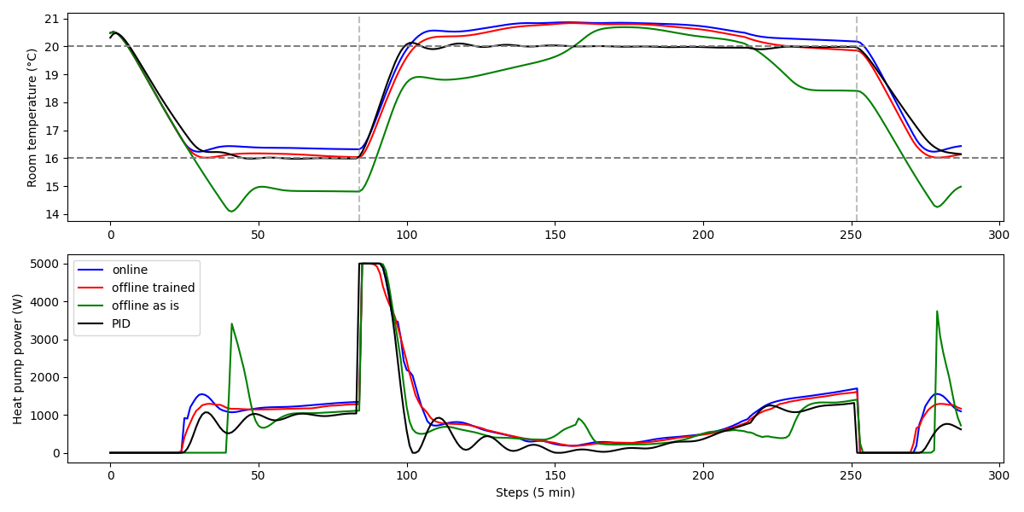
10 Oct

Slide 6
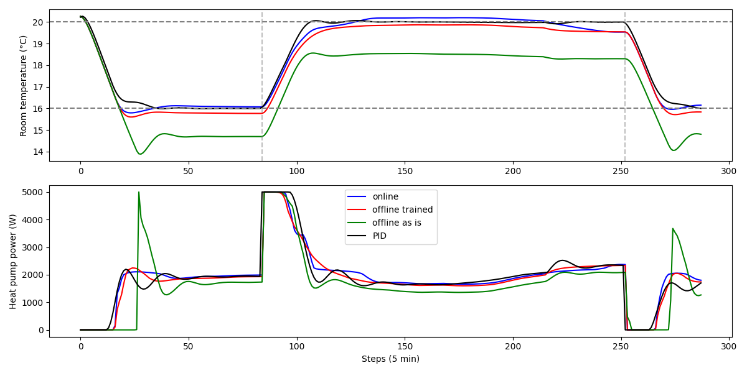
10 Nov

Slide 7
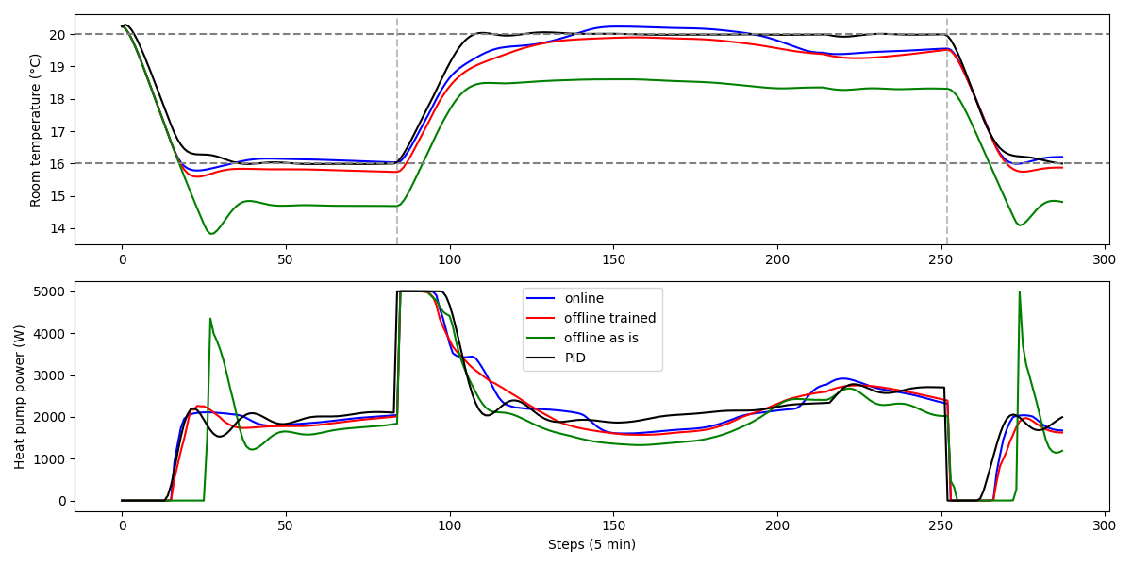
10 Dec

Slide 8
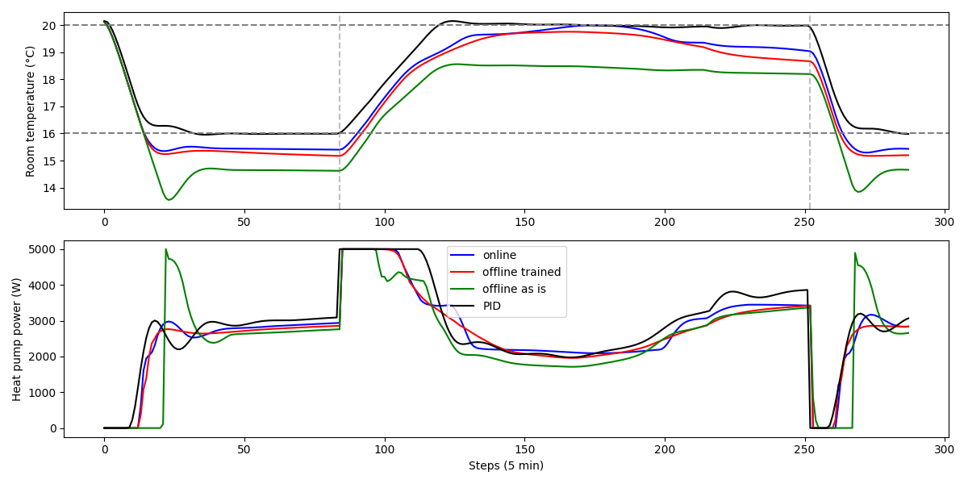
10 Jan

Slide 9
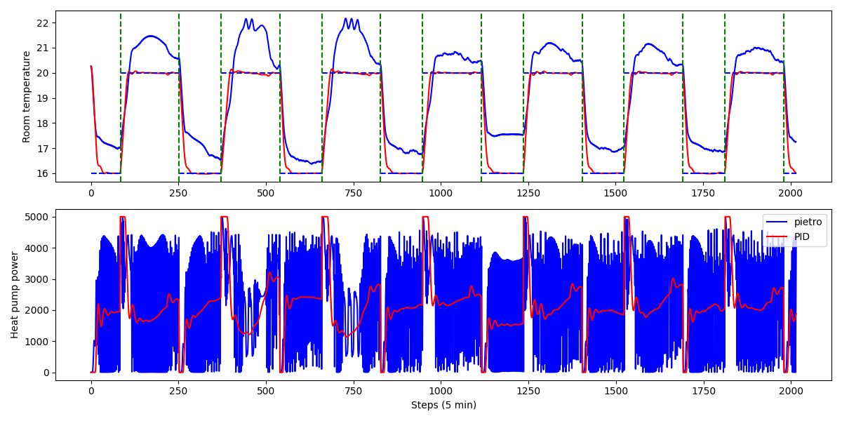
Temp_error = 0 during the night schedule

