Slide 1
Reward function weights optimization
270 trials
Eval value = -(normalize(avg_error, 0, 0.55) + normalize(avg_power, 0, 1100.0))
avg_error and avg_power calculated over an heating season (6 months)
0.55 and 1100.0 are the PID values
Hyperparameters = slow_conv_parameters

Slide 2
First 200 trials:
Random weights between -5 and 0 with step=0.1
Results: Temperature weight = -2.4 Energy weight = -0.6
Then 70 trials:
- Random temperature weight between -2.7 and -2.2 with step=0.05
Random energy weight between -0.8 and -0.4 with step=0.05
No better result

Slide 3
Heating season test
DDPG
Average HeatPump power: 1058.511
Average temperature error: 0.594
PID
Average HeatPump power: 1098.900
Average temperature error: 0.406
Saving: 3.675%

Slide 4
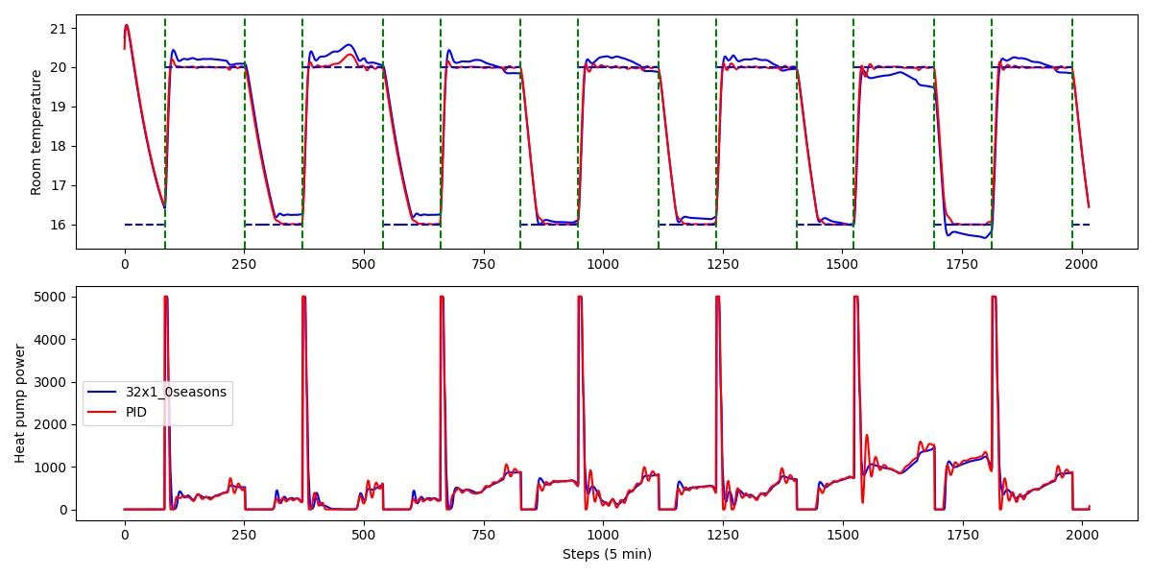
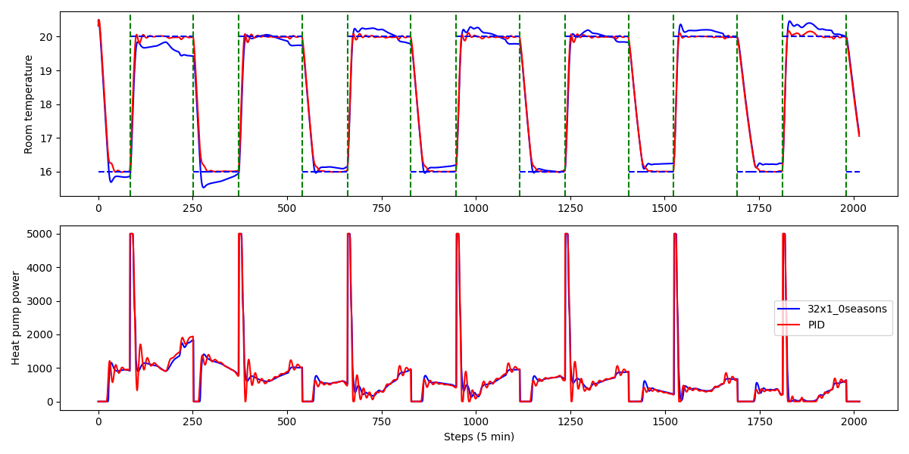
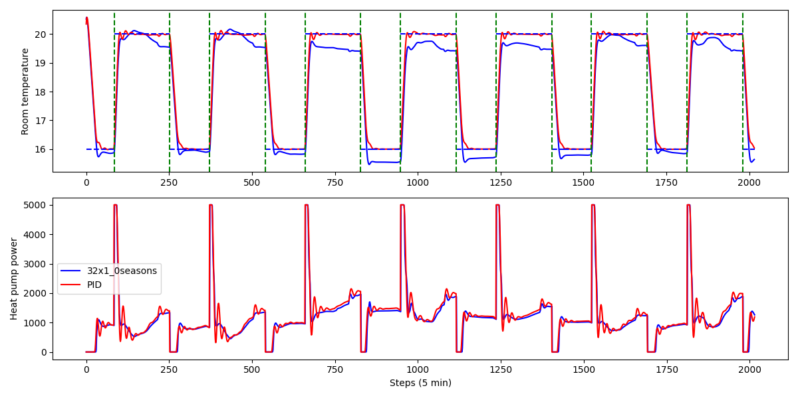
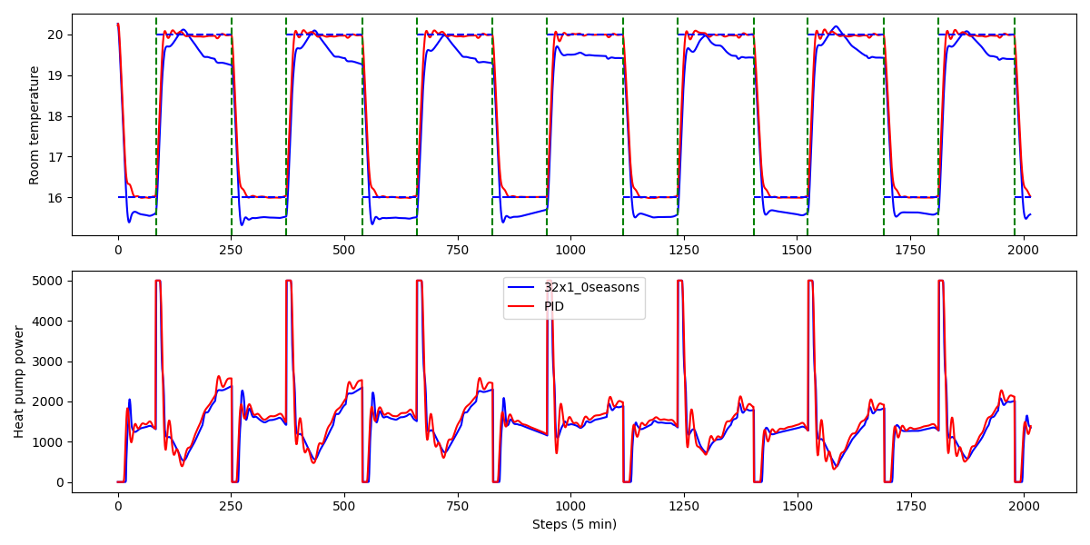
10-17 Oct: saving = 0.473% error = 0.662
10-17 Nov: saving = 1.250% error = 0.535
10-17 Dec: saving = 4.908% error = 0.657
10-17 Jan: saving = 4.147% error = 0.572

Slide 5
Offline training optimization
Parameters optimized:
actor_lr = loguniform(1e-5, 1e-3)
critic_lr = loguniform(1e-5, 1e-3)
batch_size = [128, 256, 512]
tau = [0.001, 0.005, 0.01, 0.02, 0.05, 0.08]
n_steps = [50000, 100000, 200000, 300000, 400000, 500000, 1000000]
n_steps_per_epoch = [5000, 10000, 20000, 40000, 50000, 100000]

Slide 6
Trials evaluated on the average reward during an entire heating season after the training.
Best params after 115 trials:
actor_lr = 0.00009
critic_lr = 0.0009
batch_size = 256
tau = 0.05
n_steps = 400000
n_steps_per_epoch = 50000

Slide 7
Heating season test
DDPG
Average HeatPump power: 993.339
Average temperature error: 0.986
PID
Average HeatPump power: 1098.900
Average temperature error: 0.406
Saving: 9.606%

Slide 8
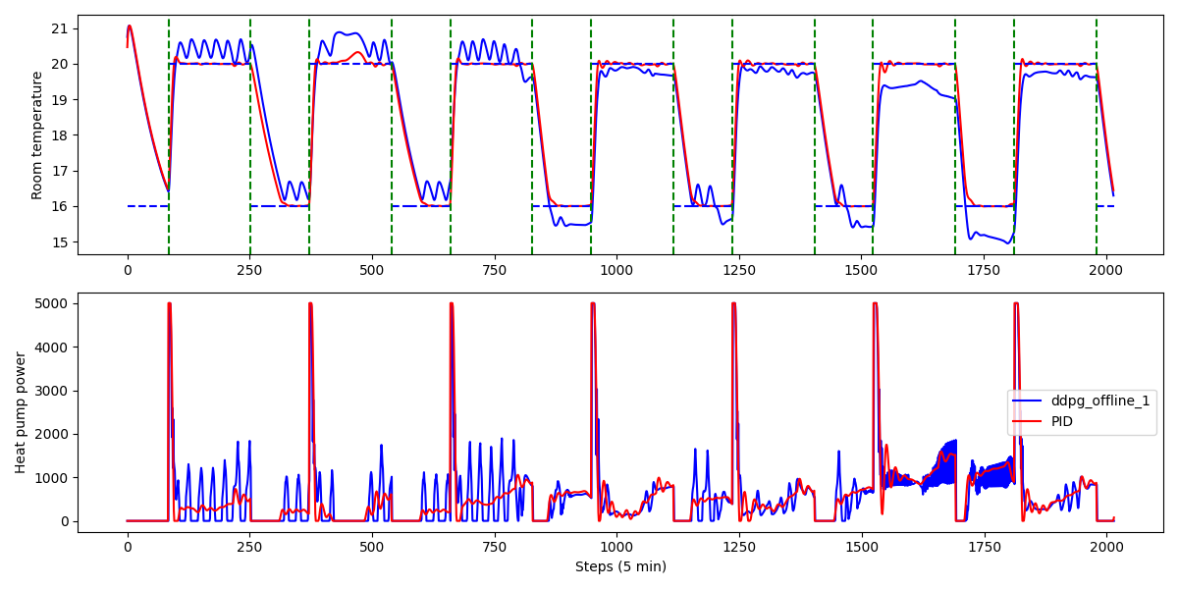
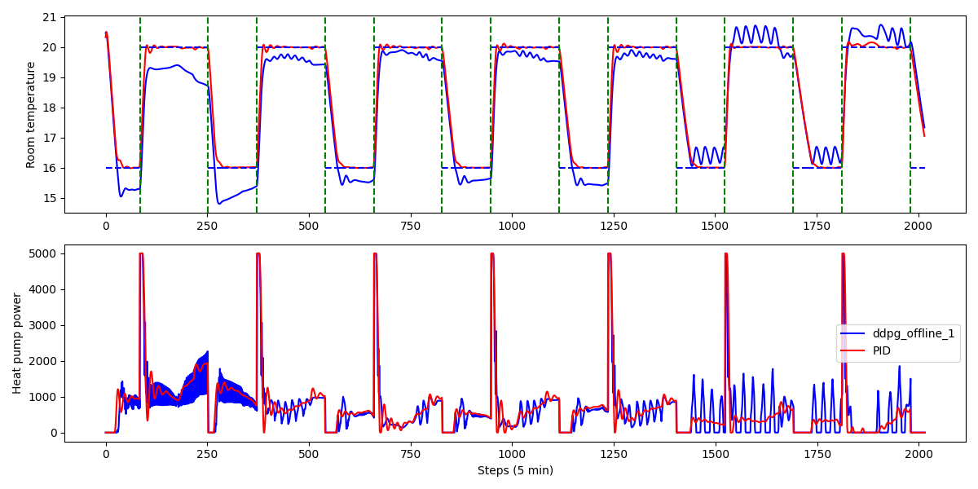
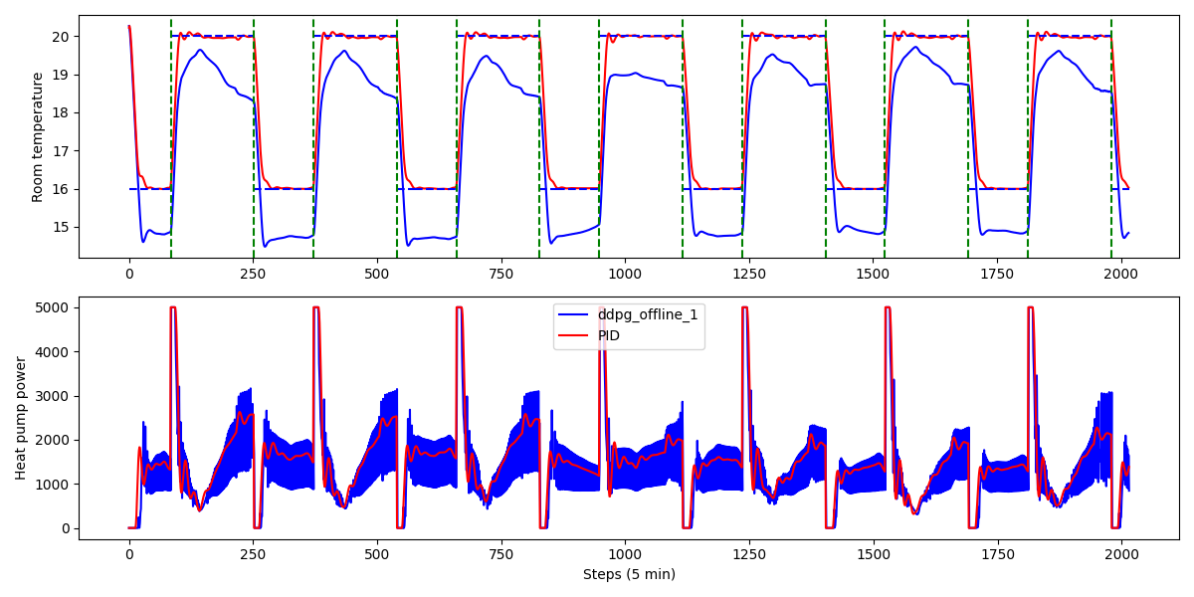
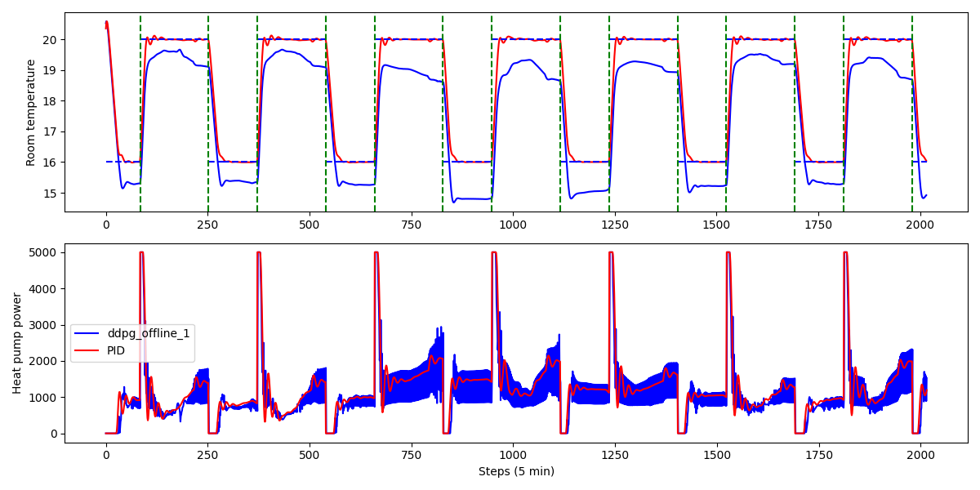
10-17 Oct: saving = 2.772% error = 0.854
10-17 Nov: saving = 5.223% error = 0.767
10-17 Dec: saving = 11.792% error = 1.227
10-17 Jan: saving = 10.508% error = 1.020

Slide 9
4 weather files 2020-2024 stessa location
Epw to mos
Provare Temp error = 0 durante notte
Online vs off as is vs off trained vs pid
Diversi algoritmi

