Slide 1
Fast convergence optimization
- 1 heating season x trial
- Trial evaluation based on the average reward of the entire training OPTIMIZED PARAMETERS
gamma: 0.99
actor_learning_rate: 0,00004
critic_learning_rate: 0.0003
batch_size: 256
buffer_size: 100000
tau: 0.05
episode_lenght: WEEK
update_interval: 1
n_updates: 2

Slide 2
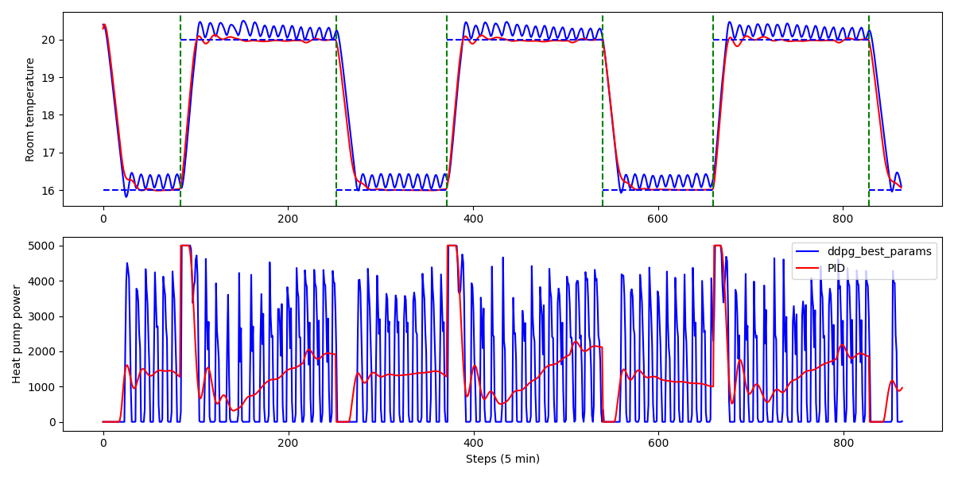
TEST OVER 3 DAYS
Average HeatPump power: 1539.162
Average temperature error: 0.560

Slide 3
Slow convergence optimization
- 2 heating season x trial
- Trial evaluation based on the average reward of the last month of training OPTIMIZED PARAMETERS
gamma: 0.95
actor_learning_rate: 0,0007
critic_learning_rate: 0.0002
batch_size: 2048
buffer_size: 50000
tau: 0.05
episode_lenght: DAY
update_interval: 2
n_updates: 3

Slide 4
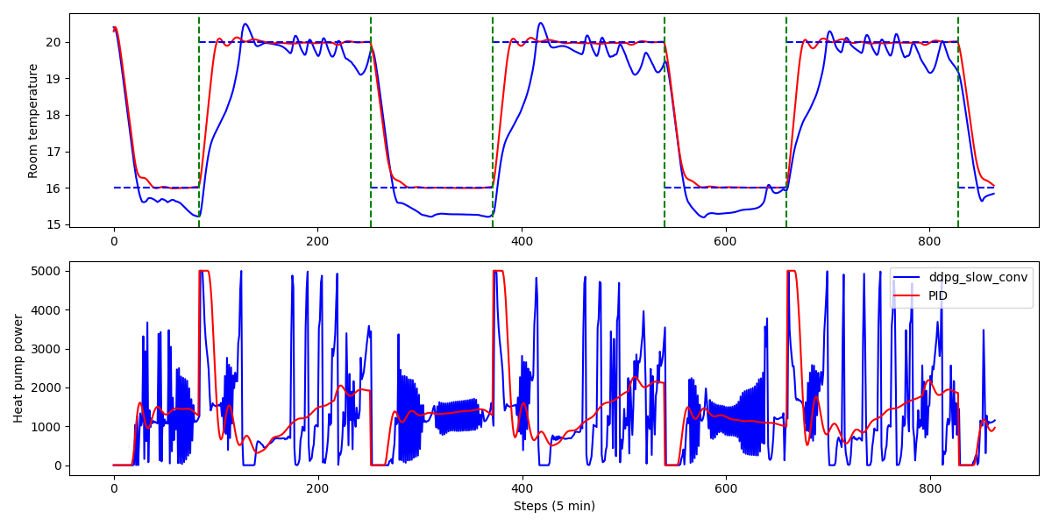
TEST OVER 3 DAYS
Average HeatPump power: 1315.236
Average temperature error: 0.834

