Slide 1
DDPG VS TD3 VS SAC

Slide 2
Online (2 seasons training)
DDPG
Avg HP power: 1761.101
TD3
Avg HP power: 1717.660
SAC
Avg HP power: 1734.256
Avg temp error: 0.611
Saving: 0.293%
Avg reward: -1.677
Avg temp error: 0.617
Saving: 2.753%
Avg reward: -1.686
Avg temp error: 0.628
Saving: 1.813%
Avg reward: -1.716
PID
Avg HP power: 1766.284
Avg temp error: 0.356

Slide 3
Offline as is (PID dataset of 4 seasons)
DDPG
Avg HP power: 1547.482
TD3
Avg HP power: 1980.956
SAC
Avg HP power: 1833.540
Avg temp error: 1.220
Saving: -12.154%
Avg reward: -3.165
Avg temp error: 0.781
Saving: -3.808%
Avg reward: -2.095
PID
Avg HP power: 1766.284
Avg temp error: 0.356
Avg temp error: 1.480
Saving: 12.388%
Avg reward: -3.738

Slide 4
Offline trained online (2 months online)
DDPG
Avg HP power: 1721.865
TD3
Avg HP power: 1754.176
SAC
Avg HP power: 1725.457
Avg temp error: 0.590
Saving: 2.515%
Avg reward: -1.624
Avg temp error: 0.489
Saving: 0.685%
Avg reward: -1.385
Avg temp error: 0.535
Saving: 2.311%
Avg reward: -1.492
PID
Avg HP power: 1766.284
Avg temp error: 0.356

Slide 5
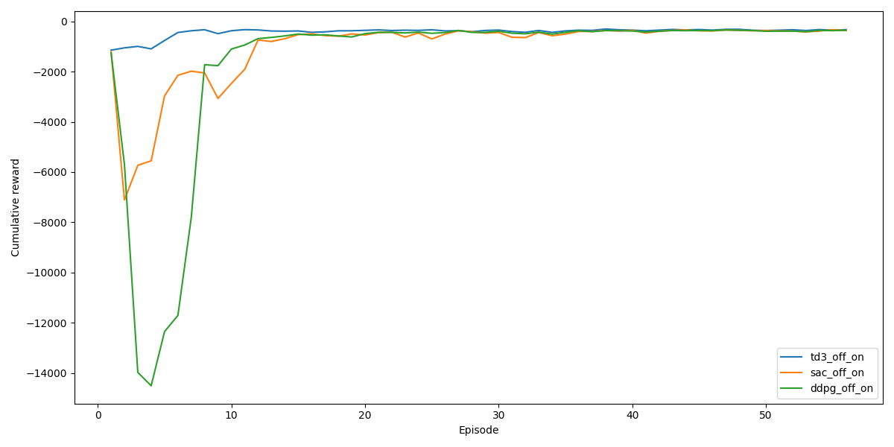
Off_On - Reward convergence 2 months online training

Slide 6
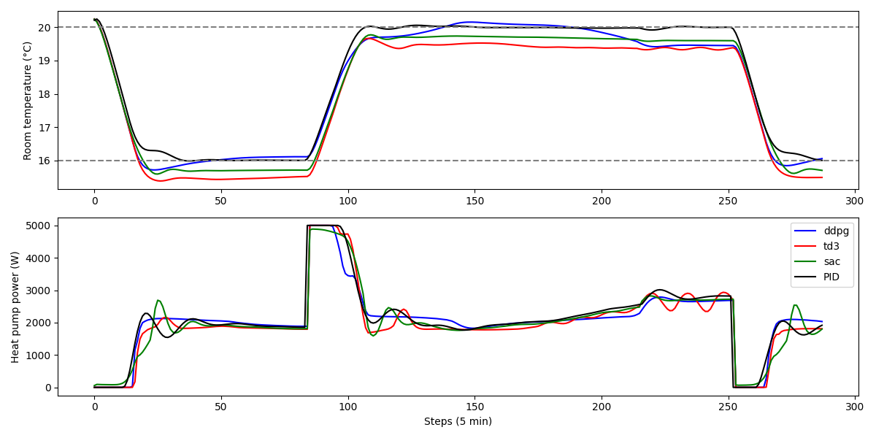
15 Nov – On

Slide 7
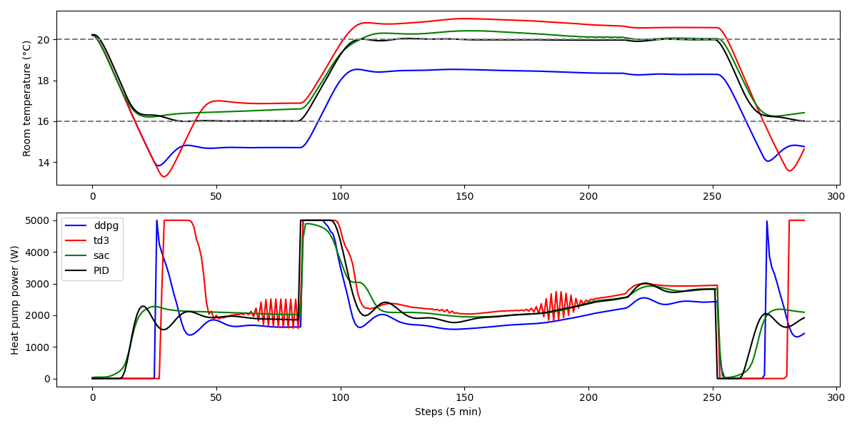
15 Nov – Off

Slide 8
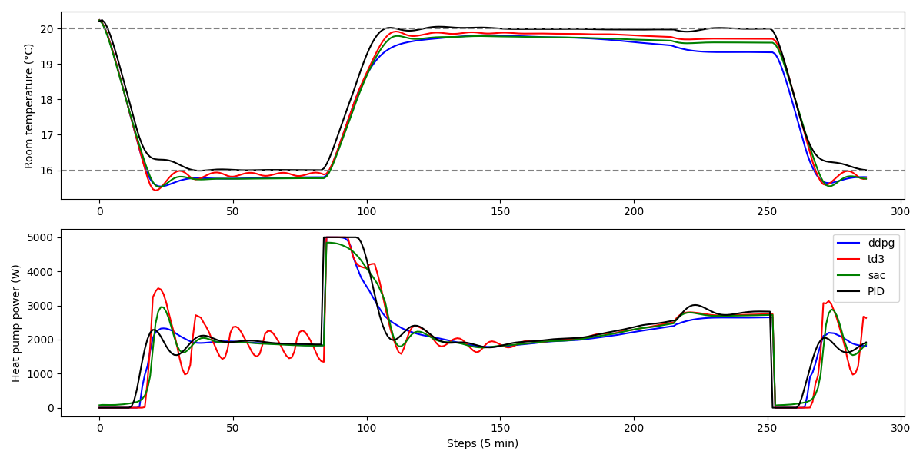
15 Nov – Off_On

Slide 9
Bc o alternative in offline learning
Bc vs others
Bc + online
Diverse dimensioni dataset offline 1m 2m 6m 1y 2y
Training online lenght

