Slide 1
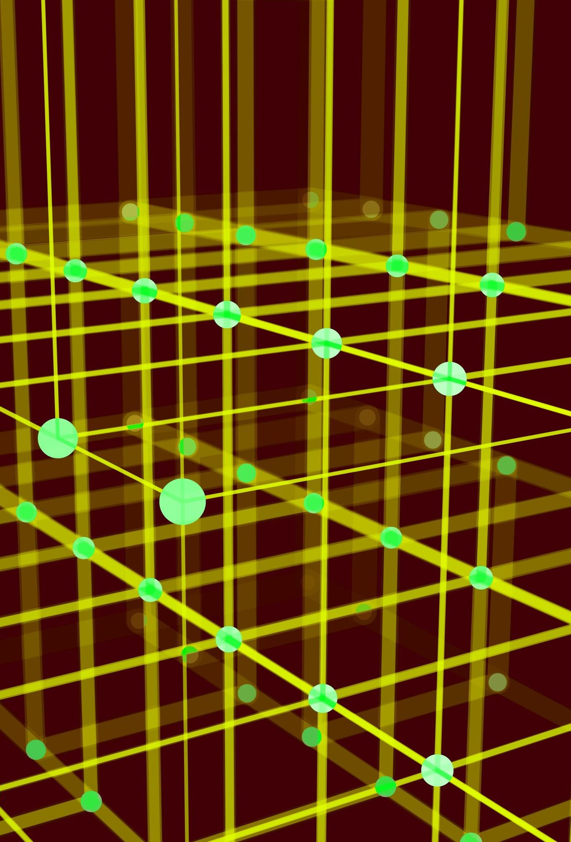
Reinforcement Learning

Slide 2
Thorndike’s Law Of Effect
"responses that produce a satisfying effect in a particular situation become more likely to occur again in that situation, and responses that produce a discomforting effect become less likely to occur again in that situation."

Slide 3
Environment
Reward
Agent
Reinforcement
Learning
State/
Observation
Action

Slide 4
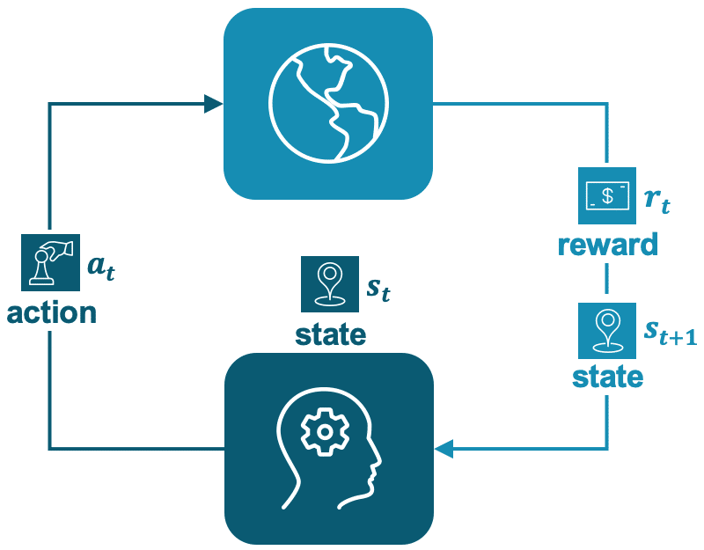

Slide 5
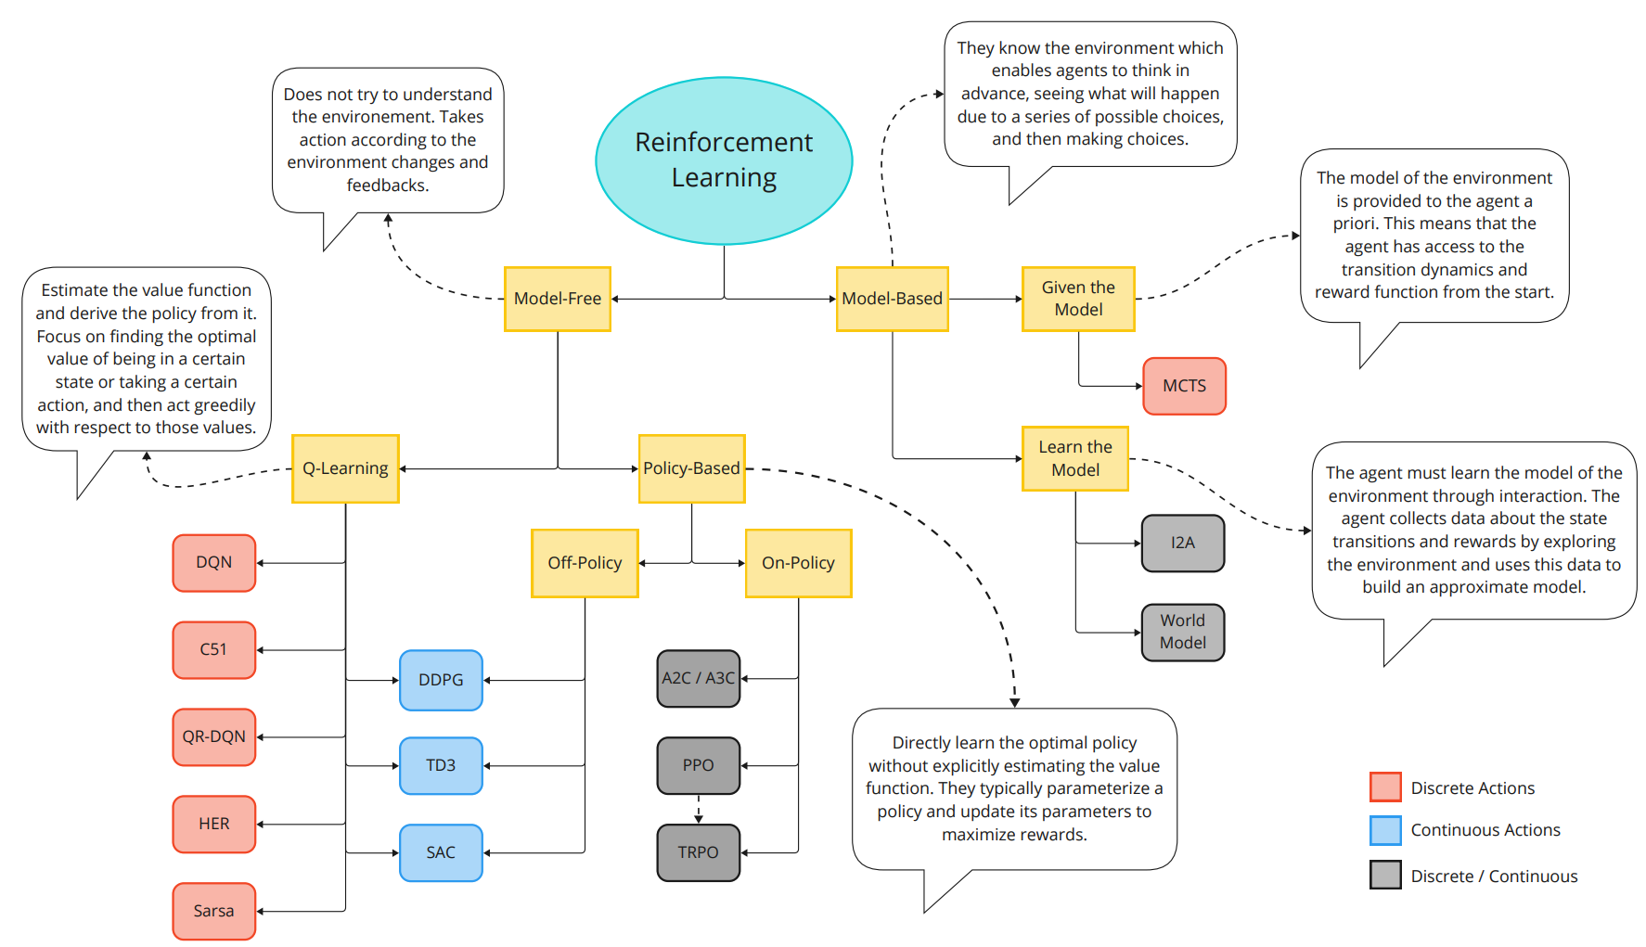

Slide 6


