Slide 1

WP8: Showcases Development and Overall Performance Evaluation
Cloud4SOA project
Athens meeting
Gerd Woetzel (FIT)
09-10 December 2010

Slide 2
WP8
T8.1 Use-Cases As-Is Analysis and Showcases Definition
M3 -> M15 (FIT)
M12: D8.1.1 Cloud4SOA Use Cases As-Is Analysis – Draft
M15: D8.1.2 Cloud4SOA Use Cases As-Is Analysis - Preliminary Document
M24: D8.1.3 Cloud4SOA Use Cases As-Is Analysis
T8.2 Evaluation Strategy Definition and Validation
M10 -> M18 (FIT)
T8.3 Cloud4SOA Showcases Development
M13 -> M32 (SingularLogic)
M32: D8.2 Business Intelligence Showcase (PTIN)
M32: D8.3 Business Cooperation Showcase (FIT)
M32: D8.4 Network Monitoring Showcase (RomTelecom)

Slide 3
WP8 (final work)
T8.4 Showcases Operation, Maintenance and Governance
M31 –> M36 (cloudControl)
T8.5 Performance Evaluation and Lessons Learnt
M31 -> M36 (FIT)
M36: D8.5 Performance Evaluation and Lessons Learnt

Slide 4
D8.1 Use Cases As-Is Analysis
Description of current deployment
Usage
Architecture
Infrastructure
Resources
Bottlenecks / Scalability problems
Analysis
Communication Requirements
Processing Requirements
Storage Requirements
Scalability Requirements
Cloud deployment strategy (<which>aaS )
Expected Benefits / Costs
Identification of Interoperability Needs

Slide 5
D8.1 Use Cases As-Is Analysis Draft (deadline M12)
Business Cooperation Showcase
Description of current deployment (FIT, M6 / ASAP)
Analysis (FIT, M9)
FIT needs input:
Business Intelligence Showcase (PTIN)
Description of current deployment
Analysis
Network Monitoring Showcase (RomTelecom)
Description of current deployment
Analysis
Final Editing (FIT)
Start M9
Want to finish before T8.2 starts (M10) ...

Slide 6
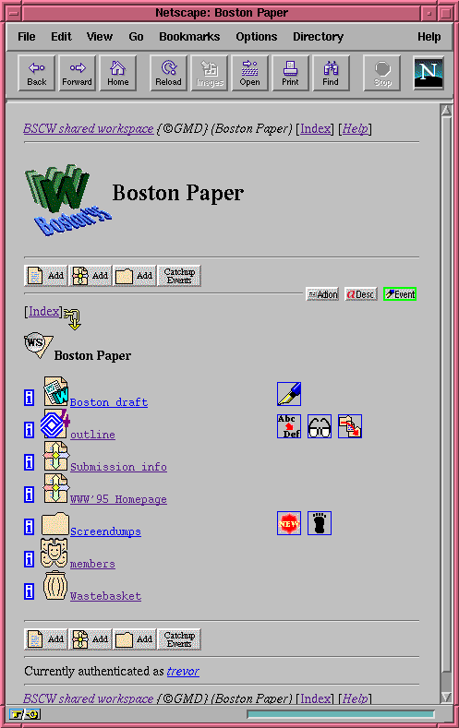
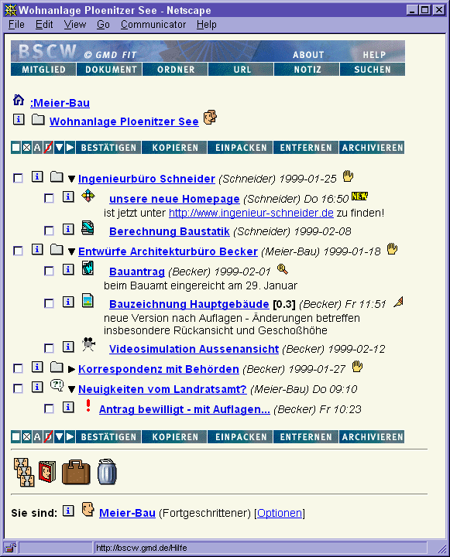
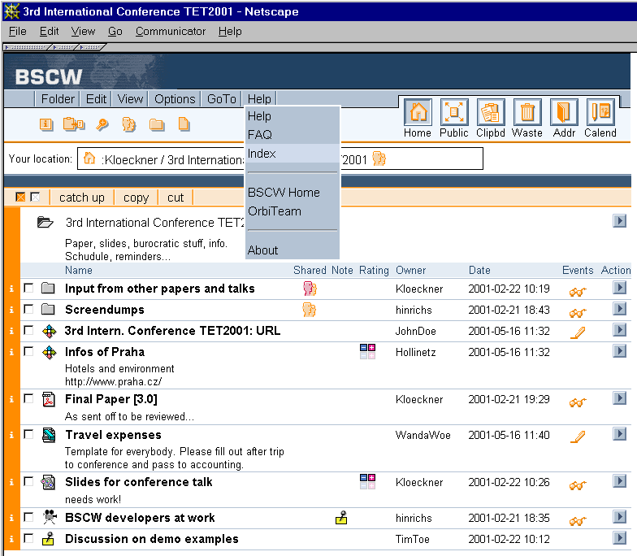
Business Collaboration Showcase

Slide 7
D8.1 Business Collaboration Patterns of BSCW Usage
Description of current deployment
Usage
Project management
Organisation and department management
Ad hoc group information exchanges
Communities
Individual storage

Slide 8
D8.1 Business Collaboration Current Architecture (basic)
CGI
CGI
CGI
Database
Process
Metadata
Content

Slide 9
D8.1 Business Collaboration Shortcomings
Descrition of current deployment
Scalability problems
Single server approach
Distribution only on NFS level
Deployment/Configuration Problems

Slide 10


D8.1 Business Collaboration New Architecture
CGI
CGI
CGI
Database
Process
Metadata
Amazon S3 ->
WP6 SOA Layer

Slide 11
D8.1 Business Collaboration Is that possible?
CGI
CGI
CGI
Amazon EC2
Database
Process
Metadata
Content

Slide 12
D8.1 Business Collaboration Showcase Analysis
N-Tier Architecture of BSCW
Presentation + Logic (CGI + BSCW API)
Analysis
Cloud Deployment Strategy: Amazon EC2 –> Cloud4SOA ?
File/Document Store
Cloud Deployment Strategy: Amaon S3 -> Cloud4SOA ?
CloudFront (?)
Object Store (+Metadata +Events +Preferences)
Cloud Deployment Strategy: Amazon EBS -> Cloud4SOA ?
Session Store
Alarm Service
Notification Service
Indexer
Access Graph Service (seaching)

Slide 13
D8.1 Business Collaboration Object Store
CGI
CGI
CGI
Cache
Cache
RPC
RPC
Random Access
Read only
Database
Process
Object
Store
Multiple Readers
Sigle Writer
Not allowed by EBS
Append only

Slide 14
D8.1 Identification of Interoperabilty needs
API (Aplication)
Storage Models (EBS / S3 / CloudFront)
Network configuration Models
Platform / Infrastructure Deployment Models
Language Bindings (PaaS?)
API (Deployment)
SLA Models
Scalability
Security
Billing Models
But how can we find out what we need?

Slide 15
Experimental BSCW Deployment on AWS
Design problems (N-Tier separation)
Implementation problems
Python API: boto, Mitch Garnaat, Eucalyptus Systems
EBS probably doesn‘t work (LBFS, DRBD, search for a DNBD)
Deployment problems
SLA / Billing problems
Security problems (VPN, Data Encryption)
Scaling problems (predictions?)
Measurements
Execution time (experienced by the User)
Resource consumption (as defined by AWS)
Costs
Other Ineffiencies?

Slide 16
Future Extensions
(End- / BSCW-) User interface to the cloud ?
BSCW Clouded Server Inteoperability ?

Slide 17
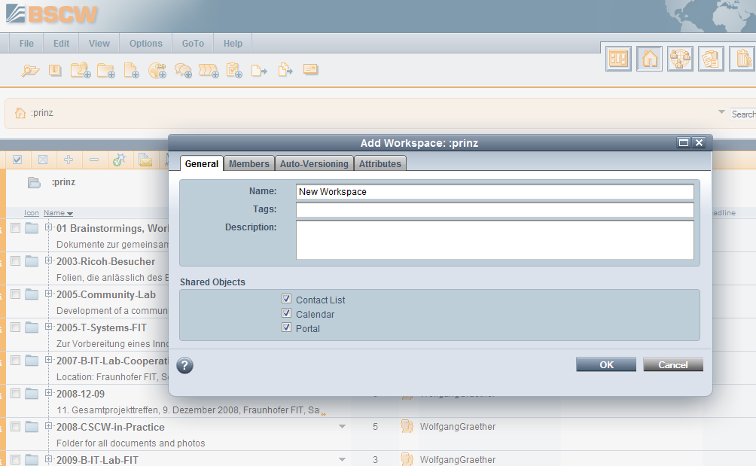
Semantics
Location (national, international)
Speed, Performance
Encryption
BackUp
Reliability
Mobility
Clustering
By workspace
By folder
By document
By user
By process / scenario

Slide 18
CLOUD
Location (national, international)
Speed, Performance
Encryption
BackUp
Reliability
Mobility

Slide 19
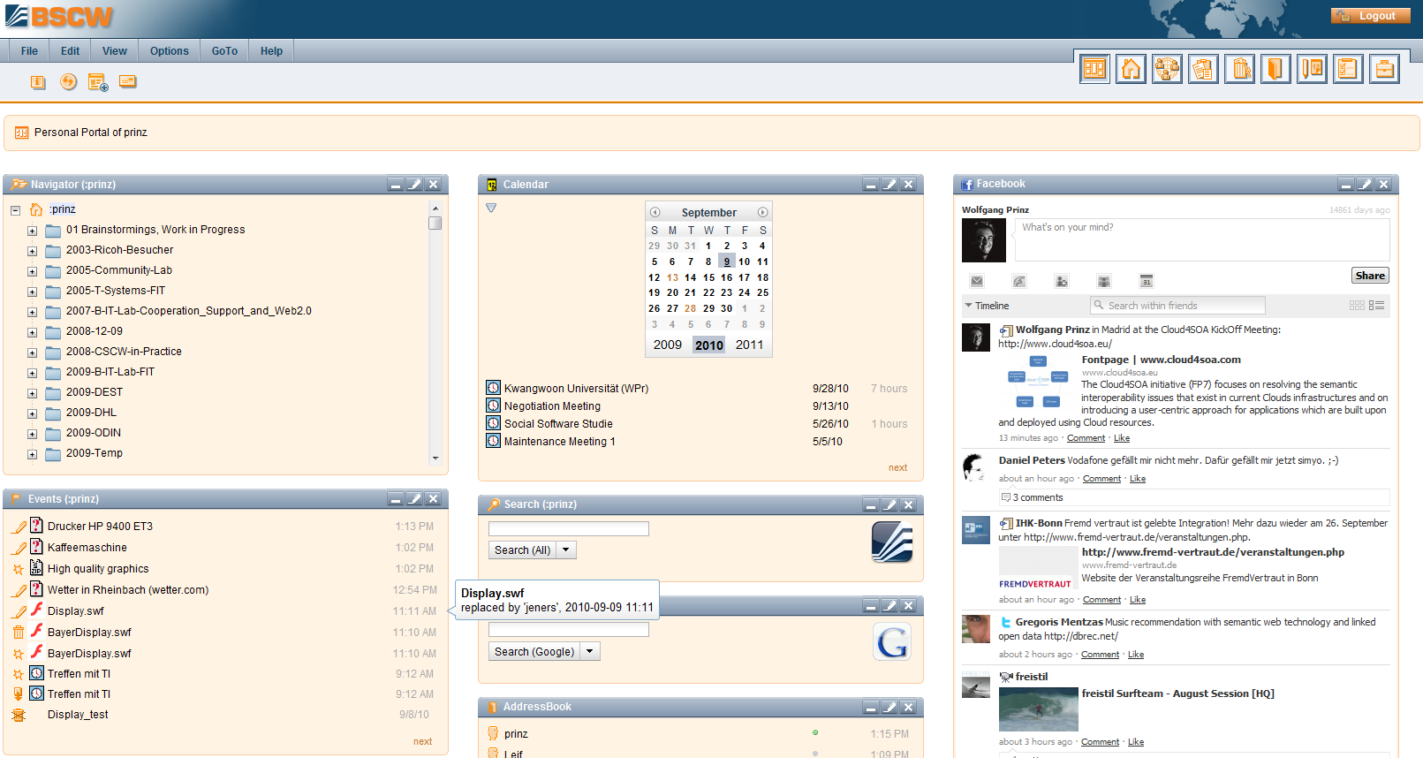
BSCW User Portal
Integration of Cloud4SOA Widgets for:
Semantic Management of clouded workspaces?
Reorganisation of clouded workspaces?
…

Slide 20
Challenging Issues
Cross Server use of cloud content
Cross Plattform use of cloud content
Cross Plattform interoperability by cloud interoperability

