Slide 1

Integrated ADC
Filippo Carastro

Slide 2
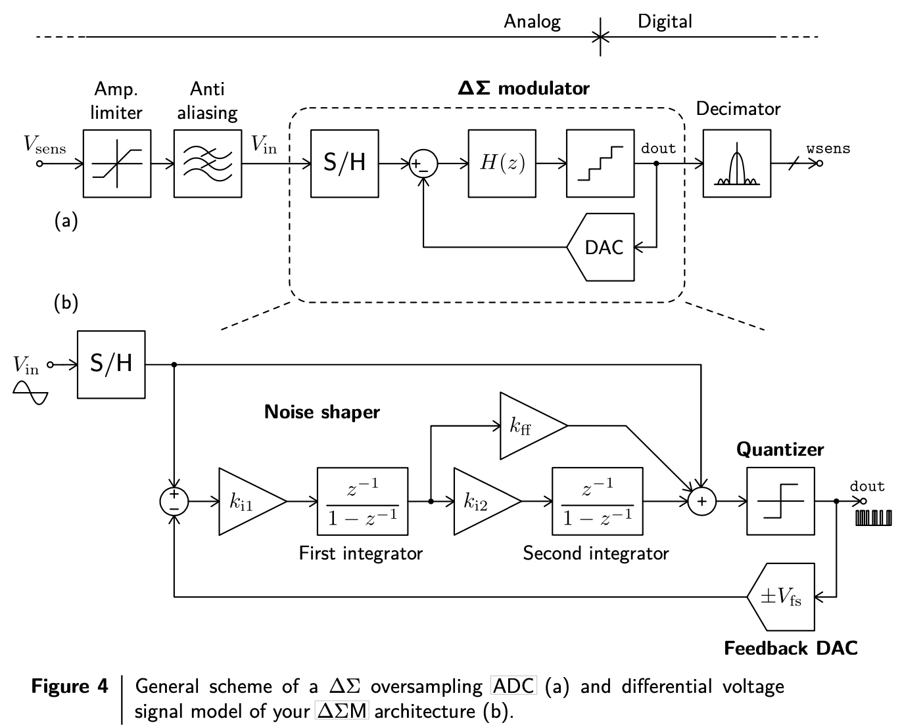

$ΣΔ$ modulator analog-to-digital converter

Slide 3
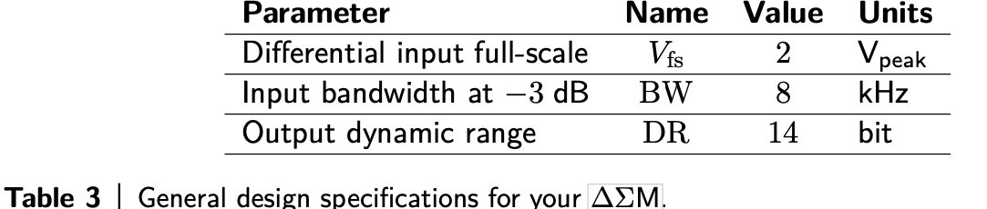
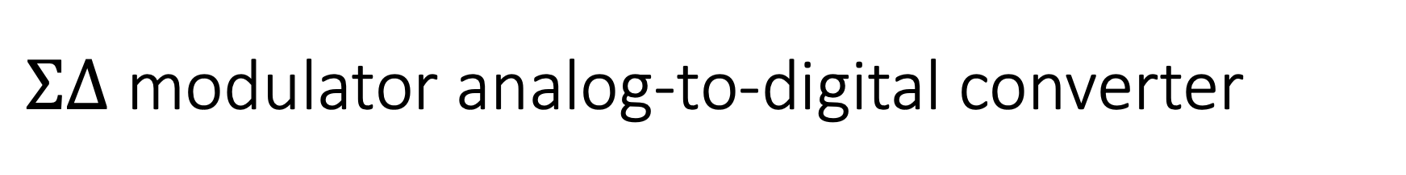
$ΣΔ$ modulator analog-to-digital converter
This project is focused on the ∆ΣM stage and its circuit implementation using switched- capacitor (SC) design techniques. In particular, the architecture chosen for your ∆ΣM is the single-loop discrete-time topology of Fig. 4(b), where Vin and dout are the analog differential voltage input signal and the ∆Σ modulated output bit stream, respectively, while Vfs stands for the differential input full scale. A second-order single-bit solution is selected here in order to avoid both, the stability problems of noise shapers with higher order transfer functions H(z), as well as the typical distortion issues due to mismatching of the feedback digital-to-analog converter (DAC) in multi-bit architectures. As shown in the equivalent differential voltage signal model of Fig. 4(b), this noise shaper topology introduces nested feedforward loops to optimize signal full scale and distortion at the cost of adding an extra summer at the input of the quantizer.
The overall design specifications for your ∆ΣM are listed in Table 3 in terms of differential input signal full scale (FS) and bandwidth (BW), and output digital dynamic range (DR).

Slide 4
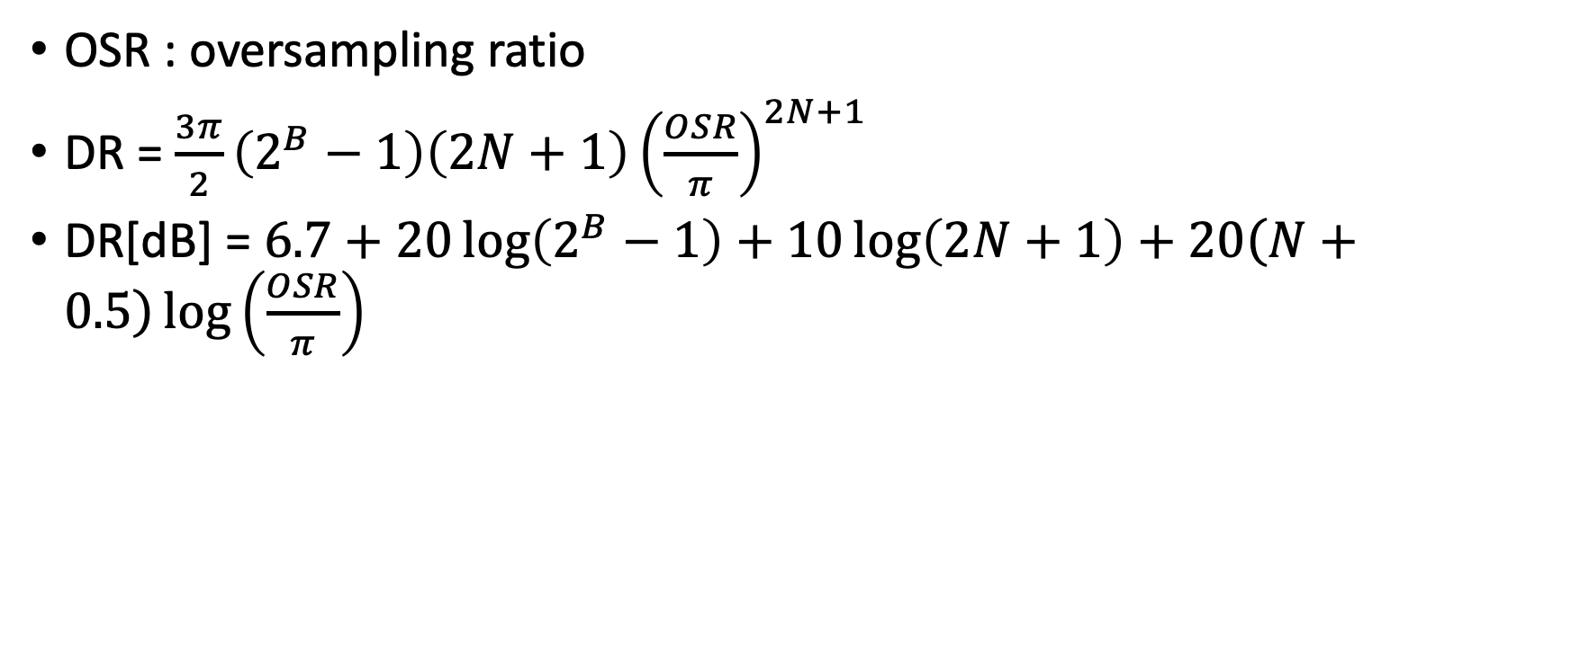
Sampling frequency
OSR : oversampling ratio
DR = $\frac{3π}{2}\left(2^{B}−1\right)\left(2N+1\right){\left(\frac{OSR}{π}\right)}^{2N+1}$
DR[dB] = $6.7+20\log\left(2^{B}−1\right)+10\log\left(2N+1\right)+20\left(N+0.5\right)\log\left(\frac{OSR}{π}\right)$

Slide 5

Sampler capacitance
DR[dB] = $20{\log\left(\frac{V_{fs}}{v_{neq}}\right)}_{rms}$
$v_{neq}^{2}=\frac{2}{OSR}\frac{kT}{C_{s}}$
T and k are absolute temperature and Boltzmann constant

Slide 6
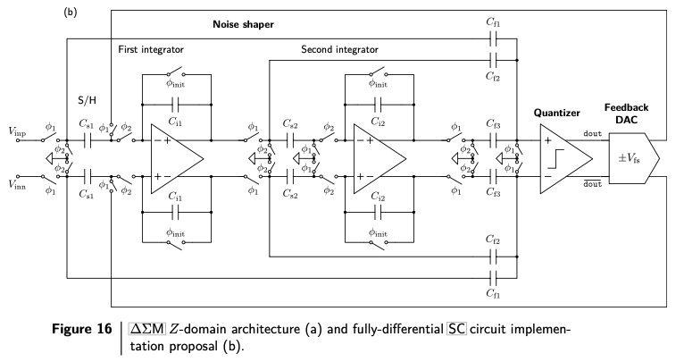
Architecture

Slide 7
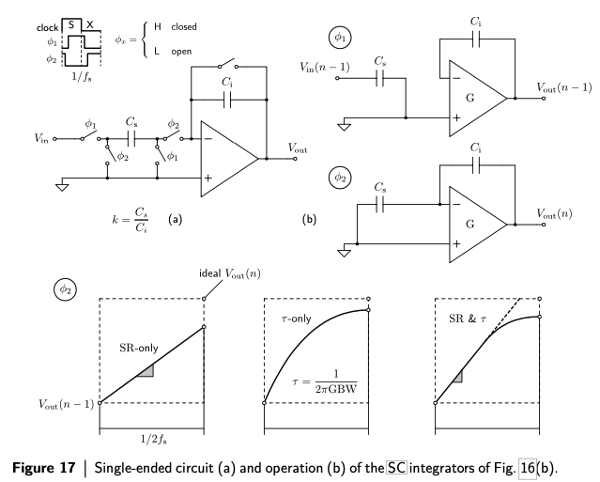
Circuit implementation

Slide 8
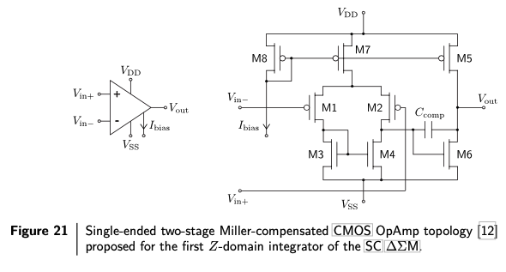
Single ended Op-Amp stage

Slide 9
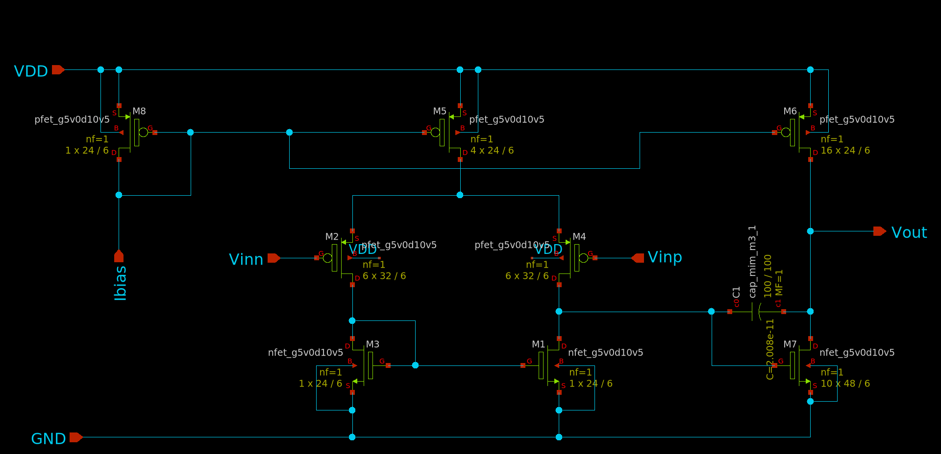
Schematic

Slide 10
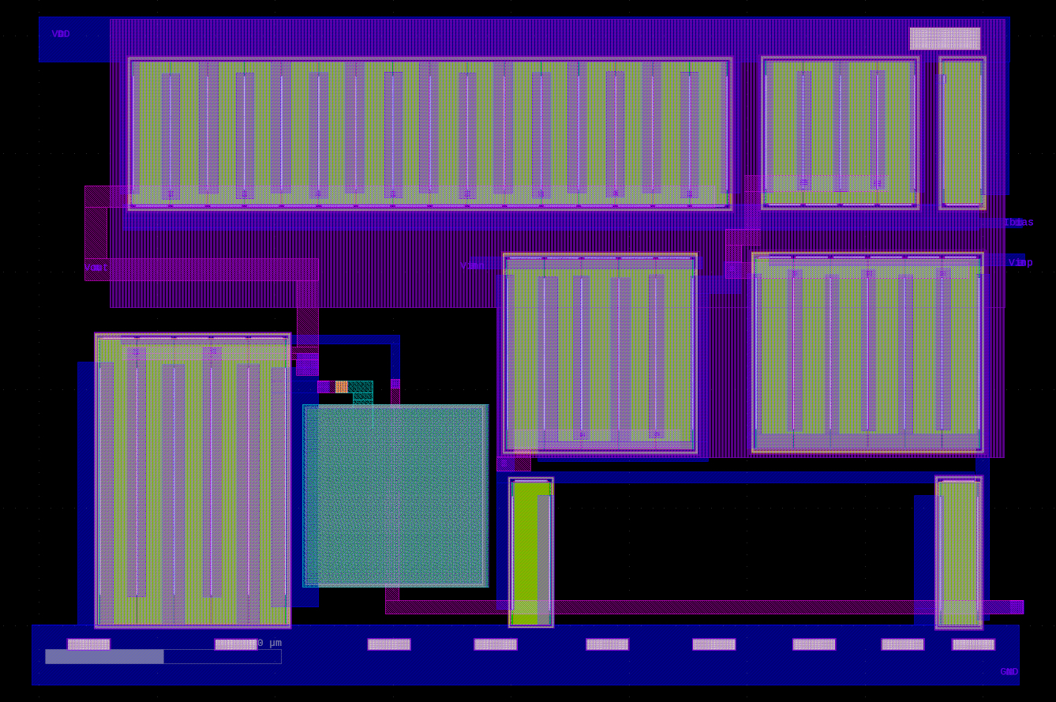
Layout

